Slide 1
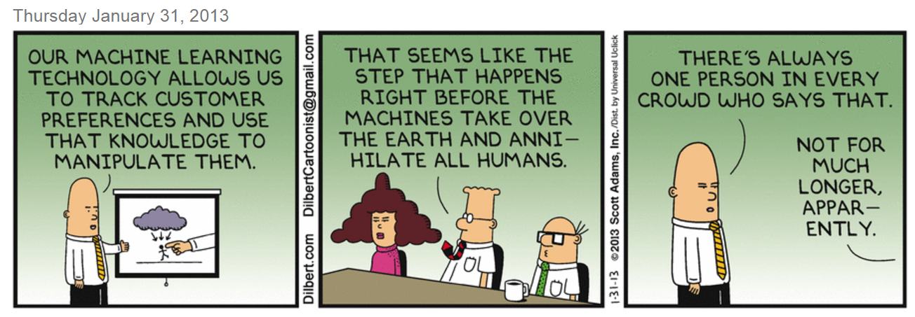
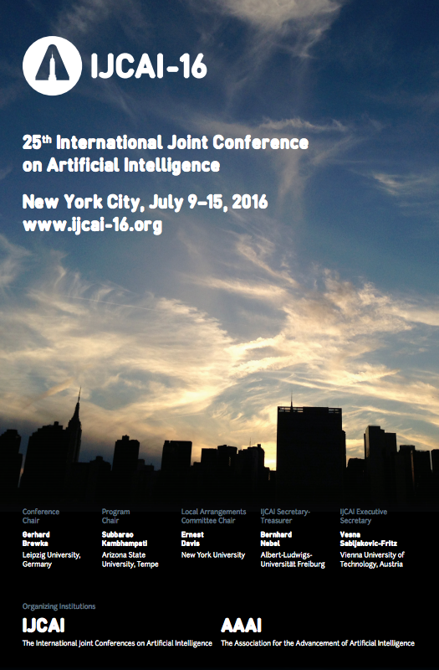
Existential Risk, moi ?
Subbarao Kambhampati
Waiting in the wings for my turn to save the world
from the impending robot armageddon..
Association for the
Advancement of
Artificial Intelligence
Notes:
I am also the incoming president of the main professional organization for Artificial Intelligence. Although I am not representing AAAI here, but rather myself and many researchers who share my views.

Slide 2
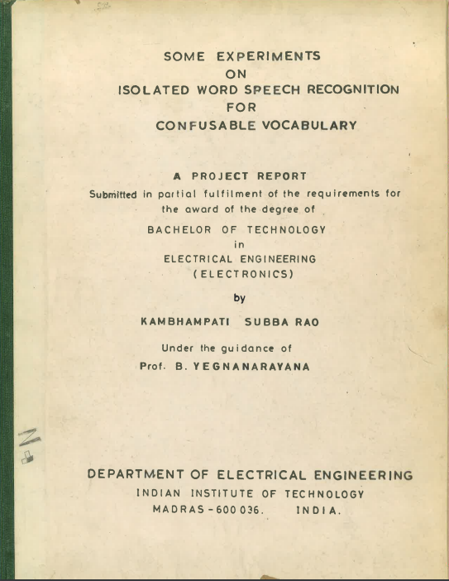
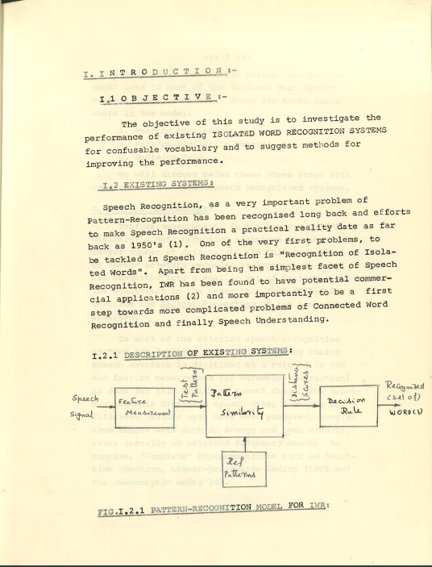
1983 Bachelors thesis ☺

Slide 3
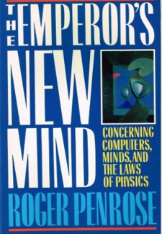
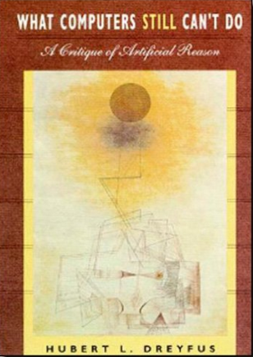
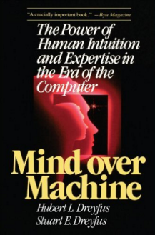
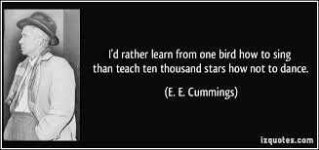

Slide 4
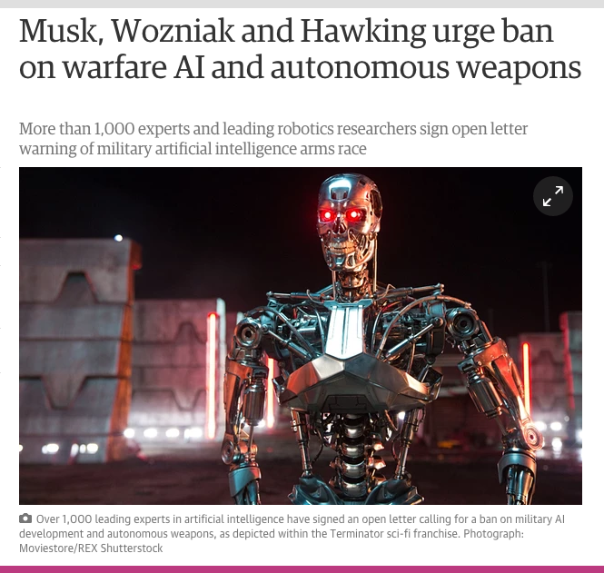
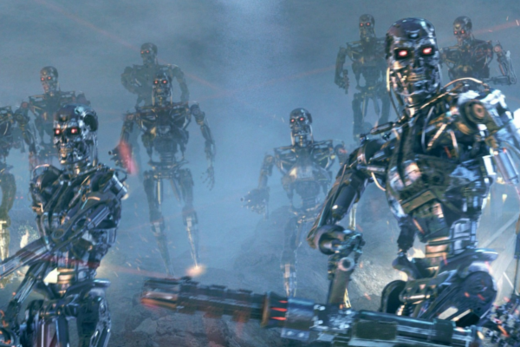
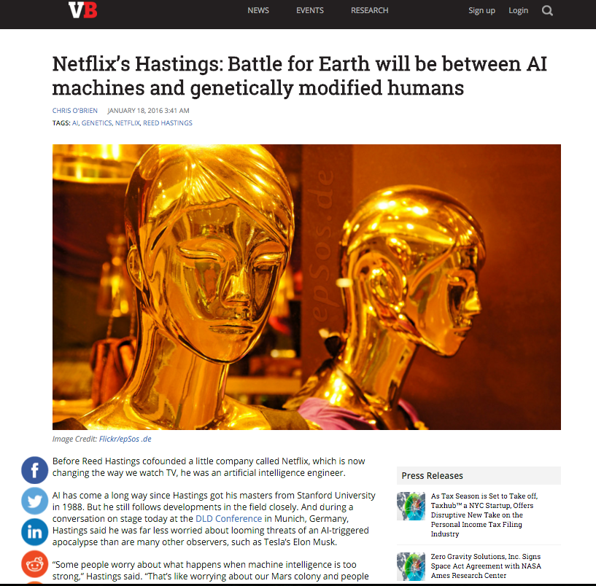
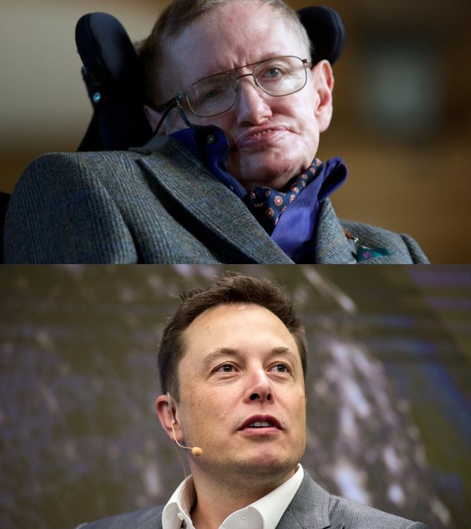
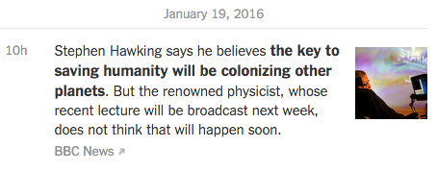
AI is the only technology that is going
from disappointment to deadly
without touching beneficial.. (?)
Notes:
Those of course were the halcyon days of AI—where things were just getting noticed. Things are different now.. For one thing, some pretty famous thinkers mentioned about their worries about AI, and the media has reported it all in a very balanced way.. I am not sure how we went from disappointment to a world-take-over technology, but apparently we did.

Slide 5
Why we don’t need to over-worry…
We already have autonomous systems; making them intelligent can’t be bad!
We get to design AI—we don’t need to imbue them with the same survival instincts
The way to handle possible problems with AI are to allow multiple AIs
Technological unemployment is a big concern..
..but even here, the opinion is divided
“biased advantages” vs. “rising tide lifts all boats”

Slide 6
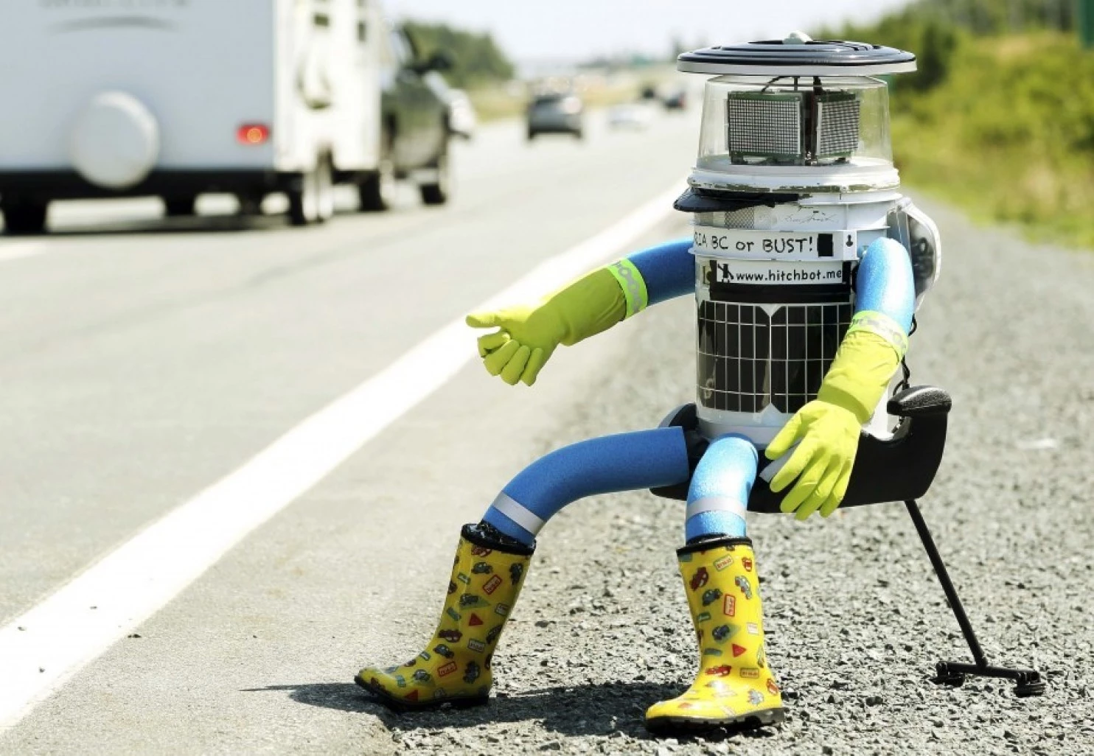
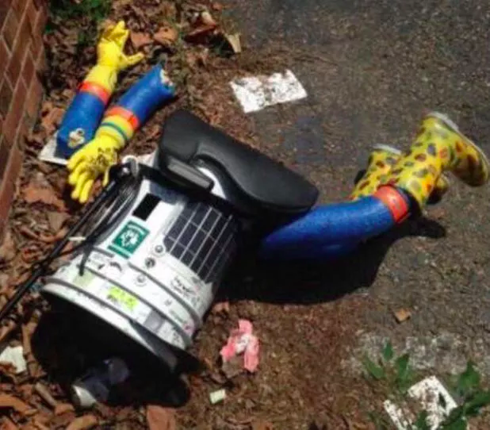
Captain America to the Rescue?
Notes:
We will organize Posseys and take ‘em robots down—one at a time!

Slide 7
Why many AI researchers are skeptical about the “existential Risk” of AI..
There are many open problems that we still don’t have much of a clue on how to solve…

Slide 8
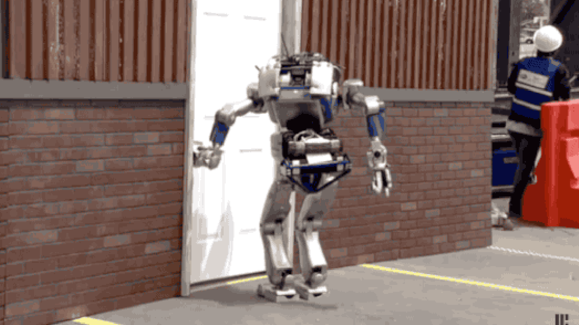
AI Thresholds (aka You have come a long way, Robbie! But boy do you have a long ways still to go…)
The explorer Magellan went
around the world three times.
On one of his trips he died.
Which trips did he die in?
Subbarao Kambhampati
Arizona State University

Slide 9
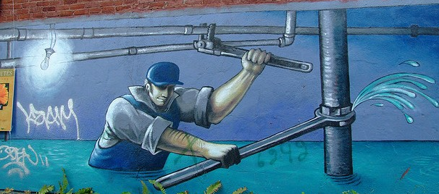
AI’s progress towards Intelligence
80’s --- Expert systems
Rule-based systems for many businesses
Lisp Machines—the GPUs of 80’s!
90’s -- Reasoning systems
Dethroned Kasparov
00’s: Perceptual tasks
Speech recognition common place!
Image recognition has improved significantly
Current: Connecting reasoning and perception..
Lee Sedol joins Kasparov, thanks to AlphaGo
Notice the contrast.. Human
babies master perception
before they get good at
reasoning tasks!
In other words, AI will be (is?)
replacing lawyers before it
replaces plumbers ☺
Plumbing: We survived outsourcing
and we might yet survive the Robots!
Notes:
Good thing all you lawyers are banding up to regulate AI ;-)

Slide 10
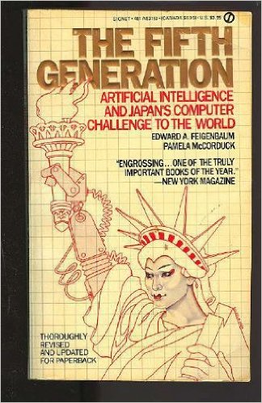
…and are we there yet?
If you give me a lever, and a place to
stand, I can move the world
Google DeepMind calls the self-guided method reinforced (sic) learning, but it’s really just another word for “deep learning,” the current AI buzzword.
-IEEE Spectrum (!!) 1/27/16
Give me a big enough GPU,
large enough data set, and deep enough
Network, I will create you super intelligence..

Slide 11
Still Elusive Commonsense
Our systems are, by and large, still idiot savants..
Giving them common sense remains a big threshold
CYC/Lucid & Video Watching notwithstanding…
The world is full of obvious things
that nobody by any chance
ever observes
--Christopher in the “Curious
incident of the dog in the
night time”
(Inadvertently channeling
Sherlock Holmes/
Sir Arthur Conon Doyle)

Slide 12
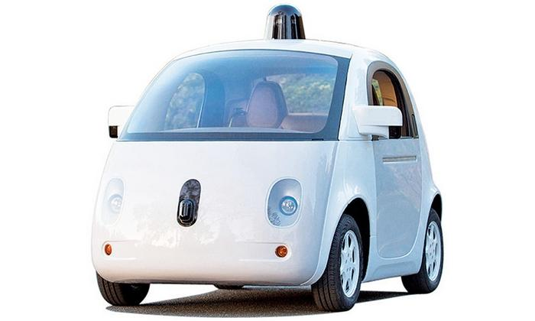
“Commonsense” elaborates partial specifications of facts, observations, norms, goals….
Which trip did Magellan Die?

Slide 13
You can cause more destruction with ignorance without any malice..
Much of the knowledge of the agents is going to be incomplete
Both the world dynamics and objectives

Slide 14
(Knowledge-based) Learning from fewer examples..
Learning? Hand-coded input?
No. The still elusive “Advice Taker” that McCarthy wanted to build
Operationalize the advice in the context of existing knowledge.

Slide 15
What we should worry about…
Let’s worry about “stupid” software, not the “intelligent” one..
We already have autonomous systems; making them intelligent can’t be bad!
Legal/Regulatory issues of autonomous systems
Verification of agent software with autonomous behavior
The grocery bag as flying deer situation..
How to ensure that AI systems are not hijacked by humans
From “cyber security” to “AI security”
AI systems monitoring other AI systems (being manipulated by humans
Technological unemployment is a big concern..
..but even here, the opinion is divided
“biased advantages” vs. “rising tide lifts all boats”
Notes:
Stereotyping by AI software?

Slide 16
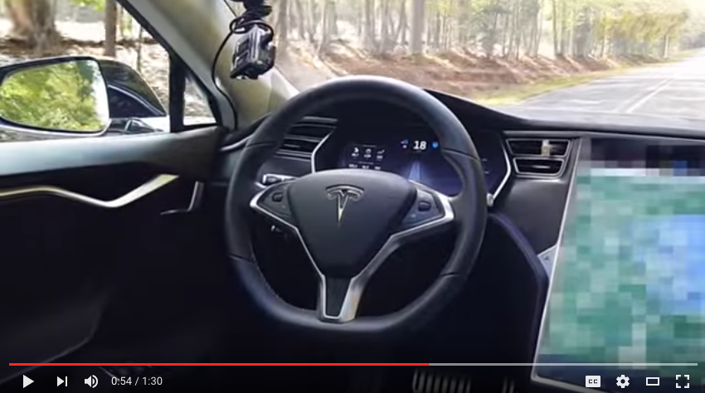
Summary
Existential threat of AI is overblown..
And a focus on it distracts us from the more pressing issues of security/safety/regulatory issues of autonomous systems
Intelligence is not part of the problem, it is a big part of the solution!
The irony of pondering about
SuperIntelligence
Control while our
Teslas’ get driverless auto updates!
Notes:
After all, as of this morning, we know that the worth of a human life is 572K ;-)

Slide 18
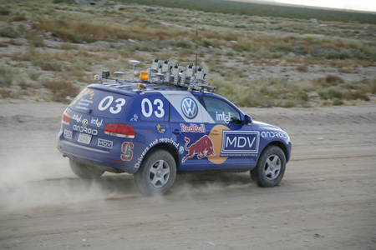
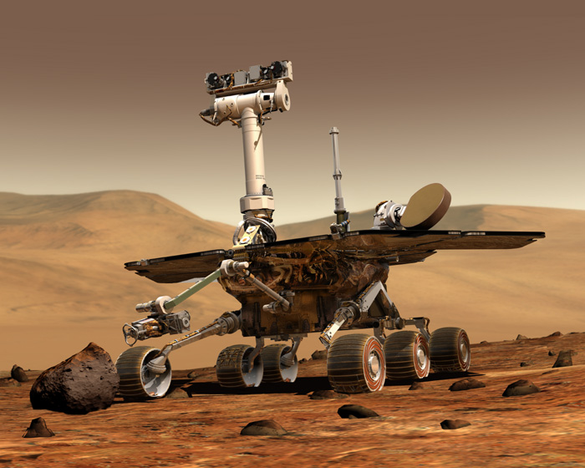
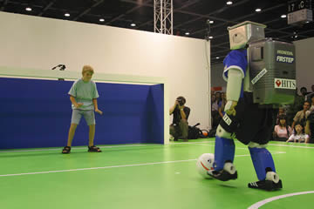
AI’s Curious Ambivalence to humans..
Our systems seem happiest
either far away from humans
or in an adversarial stance with humans
You want to help humanity, it is the people that you just can’t stand…
Notes:
I said AI has had a curious ambivalence to humans; and automated planning/decision making are no exceptions

Slide 19
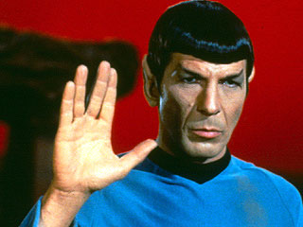
Spock or Kirk?
By dubbing “acting rational” as the definition of AI, we carefully separated the AI enterprise from “psychology”, “cognitive science” etc.
But pursuit of HAAI pushes us right back into these disciplines (and more)
Making an interface that improves interaction with humans requires understanding of human psychology..
E.g. studies showing how programs that have even a rudimentary understanding of human emotions fare much better in interactions with humans

Slide 20
