Slide 1
Trust and Profit Sensitive Ranking for Web Databases and On-line Advertisements
Raju Balakrishnan
rajub@asu.edu
(PhD Dissertation Defense)
Committee: Subbarao Kambhampati (chair)
Yi Chen
AnHai Doan
Huan Liu.
Notes:
I am raju balakrishnan. I am a PhD candidate in ASU. Thank you all for inviting me to department of computer science and engineering at Wright State University;

Slide 2
Agenda
Part 1: Ranking the Deep Web
  SourceRank: Ranking Sources.
  Extensions: collusion detection, topical source ranking & result ranking.
  Evaluations & Results.
Part 2: Ad-Ranking sensitive to Mutual Influences.
Part 3: Industrial significance and Publications.

Slide 3
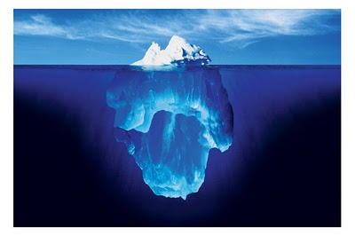



Searchable Web is Big, Deep Web is Bigger
Searchable Web
Deep Web
(millions of sources)
Notes:
HTML pages are only a fraction of data in the web. Rest of the data is stored in millions of relational databases searchable through web forms. This relational data is wrapped in HTML and delivered to you when you search. Examples are Amazon or Craiglist. This huge collection is called the deep web. According to the most estimates, deep web is many times larger than the HTML web. Google or Bing searches the HTML pages; or some times called the surface web.

Slide 4
Deep Web Integration Scenario
“Honda Civic 2008 Tempe”
Mediator
←query
←answer tuples
query→
answer tuples→
←answer tuples
answer tuples→
answer tuples→
←query
query→
←query
Web DB
Web DB
Web DB
Web DB
Web DB
Deep Web
Notes:
Civic 2010 in Dayton OH. Explain the process.
4

Slide 5
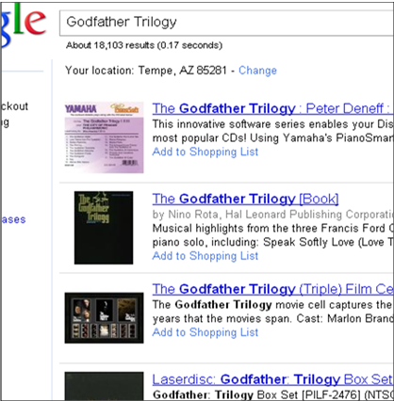
Why Another Ranking?
Rankings are oblivious to result Importance & Trustworthiness
Example Query: “Godfather Trilogy” on Google Base
Importance: Searching for titles matching with the query. None of the results are the classic Godfather
Trustworthiness (bait and switch)
The titles and cover image match exactly.
Prices are low. Amazing deal!
But when you proceed towards check out you realize that the product is a different one! (or when you open the mail package, if you are really unlucky)
Notes:
The most important problem in deep web search---in that matter any search---presenting relevant top-k results.
Why cant we reuse existing rankings?
Here is a search results for the query “Godfather Trilogy” in Google Product Search.
These results are ranked high due to keywords are contained in the title.
Then slide content.
…. Bait and Switch is frequently used.
5

Slide 6
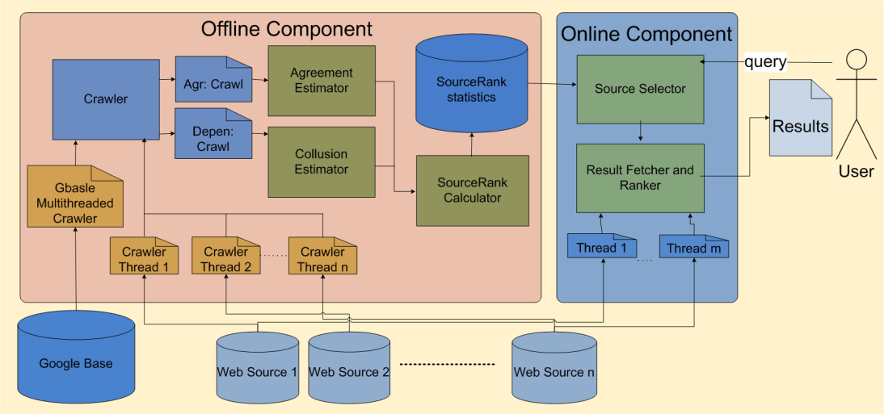
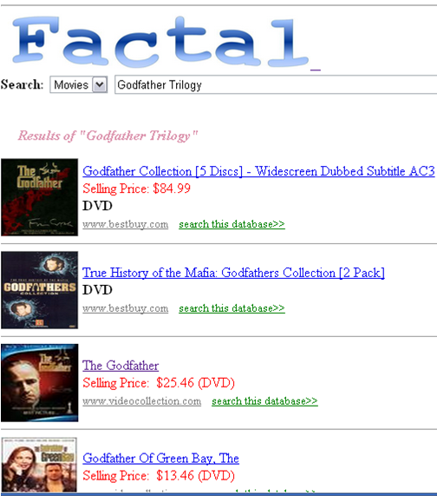
Factal: Search based on SourceRank
”I personally ran a handful of test queries this way and got
much better results [than Google Products] using Factal” --- Anonymous WWW’11 Reviewer.
http://factal.eas.asu.edu
Notes:
1. Offline Component.
6

Slide 7
Source Selection in the Deep Web
Problem: Given a user query, select a subset of sources to provide important and trustworthy answers.
Surface web search combines link analysis with Query-Relevance to consider trustworthiness and relevance of the results.
Deep web records do not have hyper-links.
Certification based approaches will not work since the deep web is uncontrolled.
Notes:
Given these motivational example, let us formally state the problem of sources ranking.
The trust and importance problems are crucial for all open-uncontrolled collections.
7

Slide 8






Source Agreement
Observations
Many sources return answers to the same query.
Comparison of semantics of the answers is facilitated by structure of the tuples.
Idea: Compute importance and trustworthiness of sources based on the agreement of answers returned by the different sources.
Notes:
Two observations relevant to formulating a method of solution are….
For the time being think of agreement as the semantic similarity between the answers to the same query by two sources. We will describe the details of agreement computation below.
8

Slide 9
Agreement Implies Trust & Importance
Important results are likely to be returned by a large number of sources.
  e.g. Hundreds of sources return the classic “The Godfather” while a few sources return the little known movie “Little Godfather”.
Two independent sources are not likely to agree upon corrupt/untrustworthy answers.
  e.g. The wrong author of the book (e.g. Godfather author as “Nino Rota”) would not be agreed by other sources.
Notes:
An intuitive explanation of Why Agreement will imply trustworthy and relevant sources.
9

Slide 10
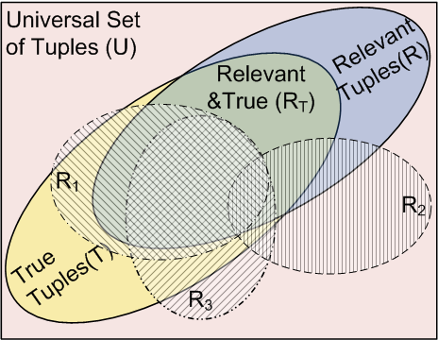
Agreement Implies Trust & Relevance
Probability of agreement of two independently selected irrelevant/false tuples is
Probability of agreement or two independently picked relevant and true tuples is
Notes:
To give a more formal explanation, Given “Godfather trilogy” example. 3 =>Godfather 1 2 & 3 against 100000 (all movies, trustworthy and non-trustworthy) or so.
10

Slide 11
Method: Sampling based Agreement
where induces the smoothing links to account for the unseen samples. R₁, R₂ are the result sets of S₁, S₂.
Agreement is computed using key word queries.
Partial titles of movies/books are used as queries.
Mean agreement over all the queries are used as the final agreement.
Link of weight w from S_{i} to S_{j} means that S_{i} acknowledges w fraction of tuples in S_{j}. Since weight is the fraction, links are directed.
Notes:
Sampling, Key word based, Send 200 movie/books title and computed the agreement on the returned answers.
The agreements are modeled as an agreement graph.
Weighted and Directed. Why unsymmatric.
11

Slide 12
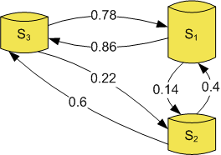
Method: Calculating SourceRank
How can I use the agreement graph for improved search?
Source graph is viewed as a markov chain, with edges as the transition probabilities between the sources.
The prestige of sources is computed by a markov random walk.
SourceRank is equal to this stationary visit probability of the random walk on the database vertex.
SourceRank is computed offline and may be combined with a query-specific source-relevance measure for the final ranking.
Notes:
1. How can we use this static agreement graph to improve the search?
2. In general, sources with high in-degree will get higher ranks.
12

Slide 13
Computing Agreement is Hard
Computing semantic agreement between two records is the record linkage problem, and is known to be hard.
Godfather, The: The Coppola Restoration | James Caan / Marlon Brando more | $9.99
Example “Godfather” tuples from two web sources. Note that titles and castings are denoted differently.
Marlon Brando, Al Pacino | 13.99 USD | The Godfather - The Coppola Restoration Giftset [Blu-ray]
Semantically same entities may be represented syntactically differently by two databases (non-common domains).
Notes:
These are real Tuples
13

Slide 14
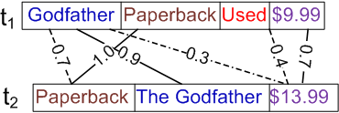
Method: Computing Agreement
Agreement Computation has Three levels.
Comparing Attribute-Value
  Soft-TFIDF with Jaro-Winkler as the similarity measure is used.
Comparing Records.
  We do not assume predefined schema matching.
  Instance of a bipartite
  matching problem.
  Optimal matching is .
  Greedy matching is used. Values are greedily matched
  against most similar value in the other record.
  The attribute importance are weighted by IDF. (e.g. same titles (Godfather) is more important than same format (paperback))
Comparing result sets.
  Using the record similarity computed above, result set similarities are computed using the same greedy approach.
Notes:
1.Comparing Attribute values. Comparing Records. Comparing entire answer sets.
Soft-TFIDF is similar to the normal TFIDF, but counts the similar tokens in two vectors compared, instead of just exact matches in TFIDF. Secondary similarity is used which is jaro-winkler. Proved to be performing well for named entity matching.
2. Few things to be noted. No schema mapping assumed. Greedy matching is used. Attribute matches are weighted.
3. Third level is mapping between the result sets.
14

Slide 15
Agenda
Part 1: Ranking the Deep Web
  SourceRank: Ranking Sources.
  Extensions: collusion detection, topical source ranking & result ranking.
  Evaluations & Results.
Part 2: Ad-Ranking sensitive to Mutual Influences.
Future research, Industrial significance and Funding.
Notes:
Three extensions.

Slide 16
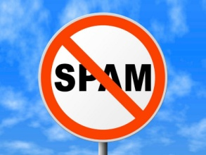
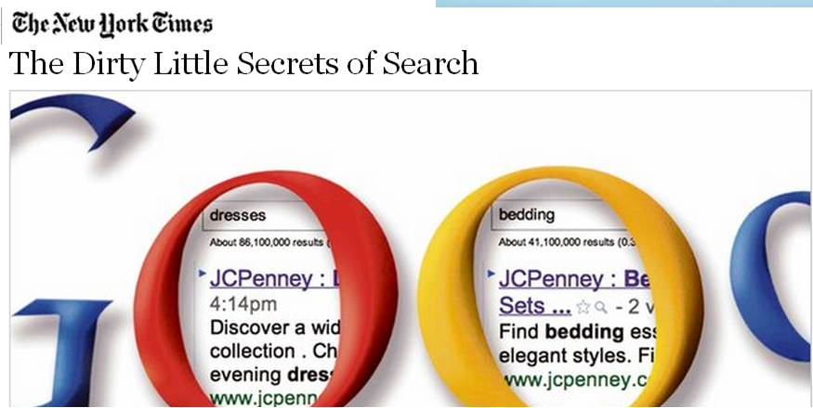
Detecting Source Collusion
The sources may copy data from each other, or make mirrors, boosting SourceRank of the group.
Basic Solution: If two sources return same top-k answers to the queries with large number of answers (e.g. queries like “the” or “DVD”) they are likely to be colluding.
Notes:
Like surface web---link spam---the sources may collude each other to improve their SourceRank. This was the news in NYTimes a week back on JCPenny boosting its ranks by paid links.
We compute and adjust for collusion while computing agreement.
16

Slide 17
Topic Specific SourceRank: TSR
`
Movies
Deep Web
Web DB
Web DB
Web DB
Music
Web DB
Web DB
Web DB
Web DB
Camera
Books
Topic Specific SourceRank (TSR) computes the importance and trustworthiness of a sources primarily based on the endorsement of the sources in the same domain (joint MS thesis work with M Jha).
Notes:
The next extension is Topical SourceRank work. Here we refine the Deep Web model slightly as containing multiple topics/domains.
The premise for the TSR is that the endorsement from sources in the same domain may be more indicative of the source quality than endorsement from sources in other domains.
17

Slide 18



TupleRank: Ranking Results
After retrieving tuples from the selected sources, these tuples have to be ranked to present to the user.
Similar to the SourceRank, an agreement graph is built between the result tuples at the query time.
Tuples are ranked based on the second order agreement.
  second order agreement considers the common friends of two tuples.
Godfather, The | James Caan | $9.99
0.6
0.7
0.5
Brando | $13.9 | Godfather
0.8
0.3
0.2
Marlon Brando | 14.9 | The Godfather
Notes:
The vertices are the tuples and agreement is computed the same way as described before.

Slide 19
Agenda
Part 1: Ranking the Deep Web
  SourceRank: Ranking Sources.
  Extensions: collusion detection, topical source ranking & result ranking.
  Evaluations & Results.
Part 2: Ad-Ranking sensitive to Mutual Influences.
Future research, Industrial significance and Funding.
Notes:
I will go over some sample results in next few slides.

Slide 20
Evaluation
Precision and DCG are compared with the following baseline methods
CORI: Adapted from text database selection. Union of sample documents from sources are indexed and sources with highest number term hits are selected [Callan et al. 1995].
Coverage: Adapted from relational databases. Mean relevance of the top-5 results to the sampling queries [Nie et al. 2004].
Google Products: Products Search that is used over Google Base
All experiments distinguish the SourceRank from baseline methods with 0.95 confidence levels.
Notes:
Two Domains, Two data sets,
Two sets of experiments: Relevance and Trust.
CORI is the most known method used for the text databases.
Coverage is the most known method used for the relational databases.
20

Slide 21
Google Base Top-5 Precision-Books
675 Google Base sources responding to a set of book queries are used as the book domain sources.
GBase-Domain is the Google Base searching only on these 675 domain sources.
Source Selection by SourceRank (coverage) followed by ranking by Google Base.
675 Sources
24%
Notes:
NDCG is not computed since all rankings are by Google Base.

Slide 22
Trustworthiness of Source Selection
Corrupted the results in sample crawl by replacing attribute vales not specified in the queries with random strings (since partial titles are the queries, we corrupted attributes except titles).
If the source selection is sensitive to corruption, the ranks should decrease with the corruption levels.
Google Base Movies
Every relevance measure based on query-similarity are oblivious to the corruption of attributes unspecified in queries.
Notes:
2. Coverage and CORI is oblivious to corruption. This is a general rule, any query similarity based method will be oblivious to corruption in unspecified attributes. Note that X axis denotes the decrease in Rank.
Google Base can not be used here since it can not be made to search on the corrupt collections.

Slide 23
TSR: Precision for the Topics
Evaluated on a 1440 sources from four domains
TSR(0.1) is TSR x 0.1 + query similarity x 0.9.
TSR(0.1) outperforms other measures for all topics.
Notes:
Topic Speific SourceRank is compared with the Google Base and CORI, TSR outperforms the competitors.
TSR- Topic Sensitive Source Rank
We found that combining TSR with the query sensitive CORI improves accuracy.

Slide 24
TupleRank: Precision Comparison
Sources are selected using SourceRank and returned tuples are ranked.
The top-5 precision and NDCG of TupleRank and baseline methods.
Query Sim: is the TF-IDF similarity between the tuple and the query.
Notes:
Evaluation of the result ranking. NDCG and precision of the tuple rank is compared with that of the Google Base and the TF-IDF based query similarity.

Slide 25
Agenda
Part 1: Ranking for the Deep Web
Part 2: Ad-Ranking sensitive to Mutual Influences.
  Optimal Ranking and Generalizations.
  Auction Mechanism and Analysis.
Part 3: Industrial significance and Publications.

Slide 26
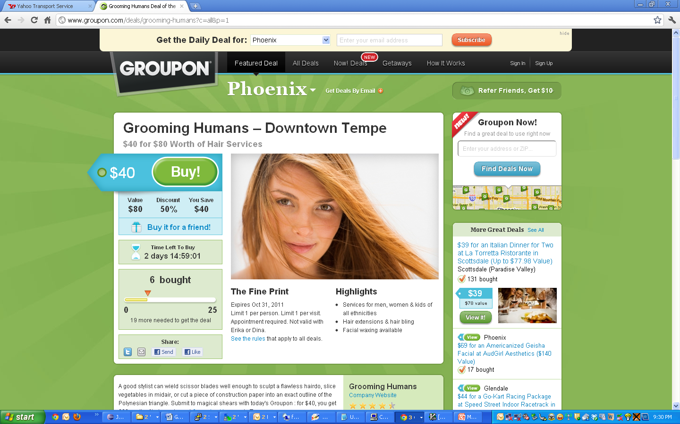



Agenda
Part 1: Ranking for the Deep Web
Part 2:Ranking and Pricing
of Ads.
A different
aspect of
ranking
Notes:
Ranking for the computational ads ad one more dimension of profits to the problem.

Slide 27

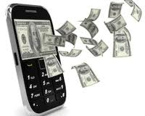




Web Ecosystem Survives on Ads
$
$
$
Notes:
Multi-Billion.
Survivability in web critically depends on profitability by ads.
Ranking for the computational ads ad one more dimension of profits to the problem.
Everything from mom and pap stores to Google and social media depends on ads.

Slide 28

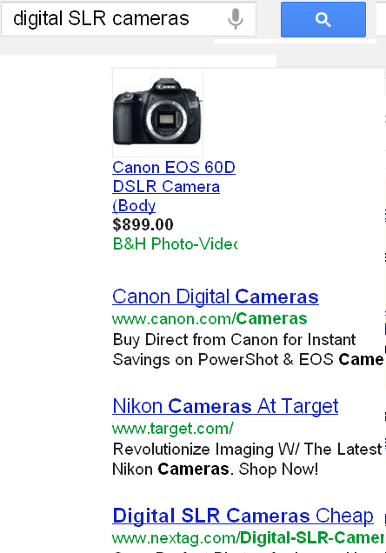


Ad Ranking Explained
Bids
Ranking
Raked
Clicks
Pricing
Information
Revenue
Clicks
User
Notes:
To explain the mechanism of ad auctions, the search engine is the auctioneer here. The advertisers places bid for the keywords, which says what is the maximum amount they are ready to pay for a click. Depending on the bid amounts and relevance of the ads to the user, the search engine decides the ranking and pricing. Pricing decides how much the advertiser has to pay for each click, this may be different from the bid amount. For example, in second price auction the pricing may be equal to the next highest bid. Users browse through ads, click and visit the advertiser site.

Slide 29
Dissertation Structure
Ranking is ordering of entities to maximize the expected utility.
Utility=Relevance
Utility=$
Part 1:
Data Ranking in the Deep Web.
Part 2:
Ad-Ranking.
Notes:
The Unifying theme in my dissertation in ranking.

Slide 30
Agenda
Part 1: Ranking for the Deep Web
Part 2: Ad-Ranking sensitive to mutual influences.
  Optimal Ranking and Generalizations.
  Auction Mechanism and Analysis.
Part3: industrial significance and Publications.

Slide 31


Popular Ad Rankings
(Overture, changed later)
Sort by
Bid Amount x Relevance
Sort by
Bid Amount
Ads are Considered in Isolation, as both ignore Mutual influences.
We consider ads as a set, and ranking is based on user’s browsing model
Notes:
To explain the context of the problem
Yahoo changed the strategy
Optimal for the user model.

Slide 32





User’s Cascade Browsing Model
User browses down staring at the first ad
At every ad he May
Click the ad with relevance probability
Abandon browsing with probability
Goes down to the next ad with probability
Process repeats for the ads below with a reduced probability
Notes:
We uses a general browsing model of the user, same model is empirically validated and used by other ad placement research also.

Slide 33
Mutual Influences
Three Manifestations of Mutual Influences on an ad are:
  Similar ads placed above
    Reduces user’s residual relevance of
  Relevance of other ads placed above
    User may click on above ads may not view
  Abandonment probability of other ads placed above
    User may abandon search and may not view
Notes:
Ten eBay ads
Arbitrary relevance measure.
Highly relevant, less profitable ad above, user will click on the ad and goes away.
High bid amount but not interesting to user ads. Abandonment as user leaving browsing the search results.

Slide 34
Optimal Ranking
Rank ads in the descending order of:
The physical meaning RF is the profit generated for unit consumed view probability of ads
Higher ads have more view probability. Placing ads producing more profit for unit consumed view probability higher up is intuitive.
Notes:
34
Proof is by induction.
Consider adding the NP-Hard slide before.

Slide 35
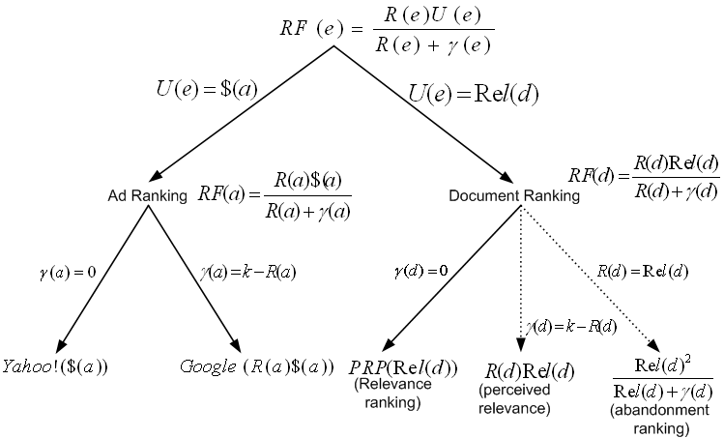
Generality of the Proposed Ranking
The generalized ranking based on utilities.
For documents utility=relevance
For ads utility=bid amount
First part of the dissertation deals with the document ranking…
Second part of the dissertation deals with the ad ranking...
Popular relevance ranking
Notes:
An interesting observation is that the users follow the same browsing model for the search results. A hierarchy of optimal ranking functions under different assumptions can be derived.
Replacing the relevance with utility.
Left tree– the commonly used PRP (Gordon and Lenk) can be directly derived. Dotted lines indicates new ranking functions.

Slide 36
Quantifying Expected Profit
Abandonment probability
Uniform Random as
Bid amount only strategy becomes optimal at
Relevance
Uniform random as
Difference in profit between RF and competing strategy can be significant
Number of Clicks
Zipf random with exponent 1.5
Proposed strategy gives maximum profit for the entire range
Bid Amounts
Uniform random
Notes:
36
Parameter Sweep on abandonment probability.
Multi Billion dollar, small improvements are very significant.
Actual user models and probabilities will be noisy and profits will be less.

Slide 37
Agenda
Part 1: Ranking for the Deep Web
Part 2: Ad-Ranking sensitive to Mutual Influences.
  Optimal Ranking and Generalizations.
  Auction Mechanism and Analysis.
Industrial significance.

Slide 38
Extending to an Auction Mechanism
Auction mechanism needs a ranking and a pricing.
Nash equilibrium: Advertisers are likely to keep changing bids their bids until the bids reach a state in which profits can not be increased by unilateral changes in bids.
  Propose a pricing.
  Establish existence of a Nash equilibrium.
  Compare to the celebrated VCG auction.
Notes:
38
In ad placement, the net profits of ranking to the search engine can only be analyzed in association with a pricing mechanism. To this end,
we introduce a pricing to be used with the CE designing a full auction mechanism.
Our three contributions are
Skip next three slides if run out of time.

Slide 39

Auction Mechanism: Pricing.
Let,
In the order of ads by , let us denote the i^{th} ad in this order as . Also let
Pricing for the i^{th} ad:
Payment never exceeds bid (individual rationality).
Payment by and advertiser increases monotonically with his position in any equilibrium.
Notes:
39
For notational convenience, let us denote weight of an ad w(a) as wi
The pricing schema is.
This pricing obeys two interesting properties

Slide 40
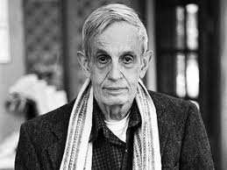
Auction Mechanism Properties:
Nash Equilibrium
Assume that the advertisers are ordered in the increasing order of where is the private value of the i^{th} advertiser. The advertisers are in an pure strategy Nash Equilibrium if
This equilibrium is socially optimal as well as optimal for search engines for the given cost per click.
Notes:
40
Private value of the advertiser is the expected revenue per click for the advertises.
Socially optimal means sum of the revenues for all the advertisers is a maximum.

Slide 41
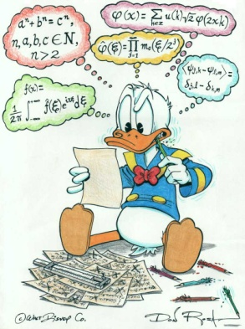
Auction Mechanism Properties: VCG Comparison
Search Engine Revenue Dominance: For the same bid values for all the advertisers, the revenue of search engine by the proposed mechanism is greater or equal to the revenue by VCG.
Equilibrium Revenue Equivalence: At the proposed equilibrium, the revenue of search engine is equal to the revenue of the truthful dominant strategy equilibrium of VCG.
Notes:
41
We compare the revenues of the proposed mechanism with the revenues of the celebrated VCG mechanism.
Both search engine.

Slide 42
Agenda
Part 1: Ranking for the Deep Web
Part 2: Ad-Ranking sensitive to mutual Influences.
Part3: Industrial significance and Publications.

Slide 43

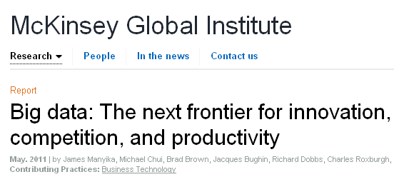
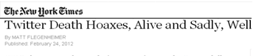
Industrial Significance.
Online Shift in Retail: Walmart is entering to integrating product search, similar to Amazon Marketplace.
Big-Data Analytics: Highly strategic area in Information Management.
Data trustworthiness of open collections is getting more important
  We need new approaches for data trustworthiness of open uncontrolled data.
Notes:
Related to the twitter trustworthiness researcy.
43

Slide 44
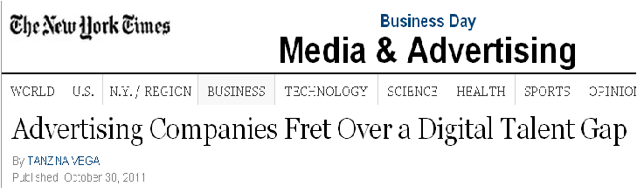
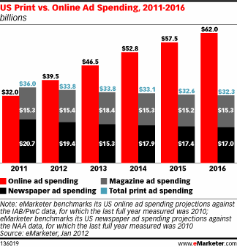
Industrial Significance
“mathematical, quantitative and technical skills”
Jobs
  Skills in computational advertisement are highly sought after.
Revenue Growth
  Expenditure on online ads are increasing in rapidly USA as well as world wide.
Social ads is an infant with a high growth potential.
  2011 Revenue of Facebook is only 3.5 Billion, 10% of Google revenue.
Notes:
Highly sought after skill in industry. Very few departments offer a course in computational advertisement.
44

Slide 45
Deep Web: Publications and Impact
SourceRank: Relevance and Trust Assessment for Deep Web Sources Based on Inter-Source Agreement. R Balakrishnan, S Kambhampati.
WWW 2011 (Full Paper).
Factal: Integrating Deep Web Based on Trust and Relevance. R Balakrishnan, S Kambhampati.
WWW 2011 (Demonstration).
SourceRank: Relevance and Trust Assessment for Deep Web Sources Based on Inter-Source Agreement . R Balakrishnan, S Kambhampati.
WWW 2010 (Best Poster Award).
Agreement Based Source Selection for the Multi-Domain Deep Web Integration. M Jha, R Balakrishnan, S Kabhmpati. COMAD 2011.
Assessing Relevance and Trust of the Deep Web Sources and Results Based on Inter-Source Agreement. R Balakrishnan, S Kambhampati, M Jha. (Accepted in ACM TWEB with minor revisions).
Ranking Tweets Considering Trust and Relevance. S Ravikumar, R Balakrishnan, S Kambhampati. IIWeb 2012.
Google Research Funding 2010. Mention in Official Google Research Blog.
Notes:
Notice that Certificate is attached in case you are a skeptic like most scientists ☺.
45

Slide 46
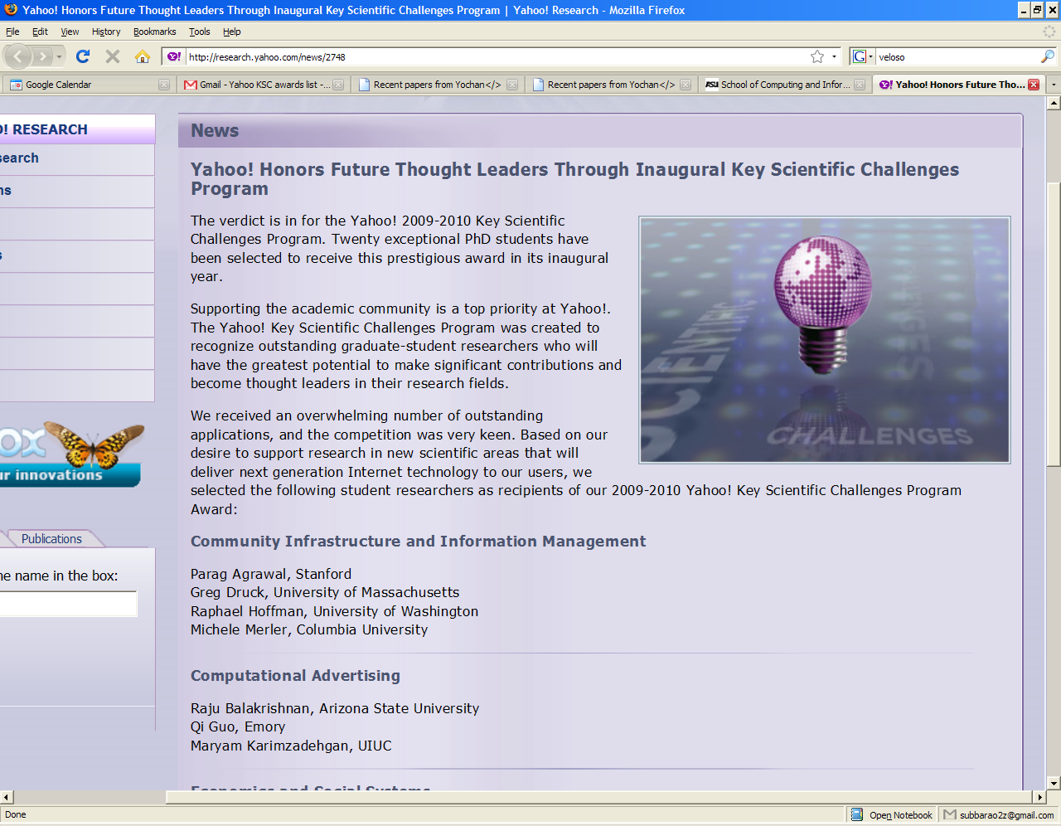
Online Ads: Publications and Impact
Real-Time Profit Maximization of Guaranteed Deals. R Balakrishnan, R P Bhatt. (CIKM’12, Patent Pending)
Optimal Ad-Ranking for Profit Maximization. R Balakrishnan, S Kambhampati. WebDB 2008.
Click Efficiency: A Unified Optimal Ranking for Online Ads and Documents. R Balakrishnan, S Kambhampati. (ArXiv, To be Submitted I TWEB).
Yahoo! Research Key scientific Challenge award for Computation advertising, 2009-10
Notes:
Yahoo! research recognized this work with Key Scientific Challenge award in computational advertisement for the year 2009. It is under review for 8 months, like most theory journals.

Slide 47
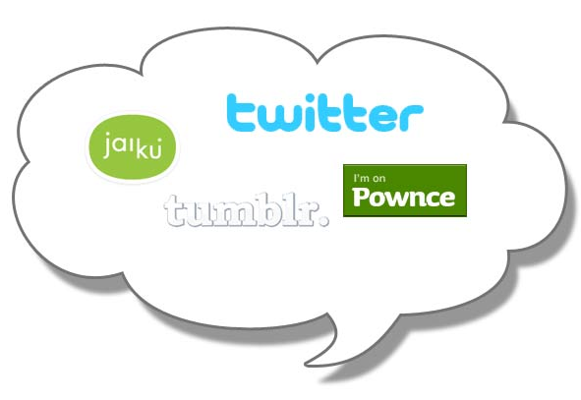
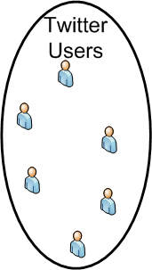
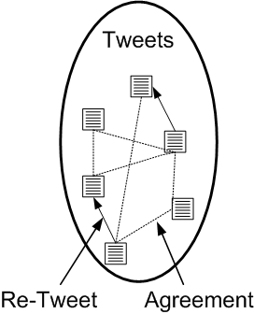
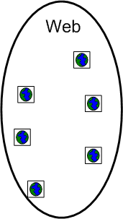

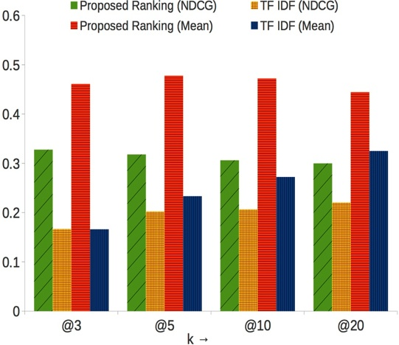
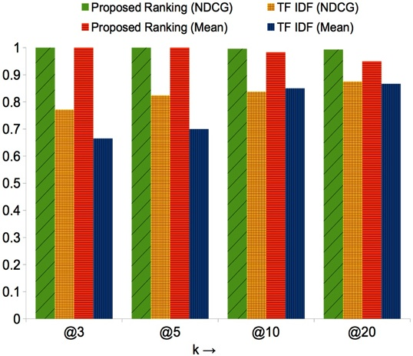
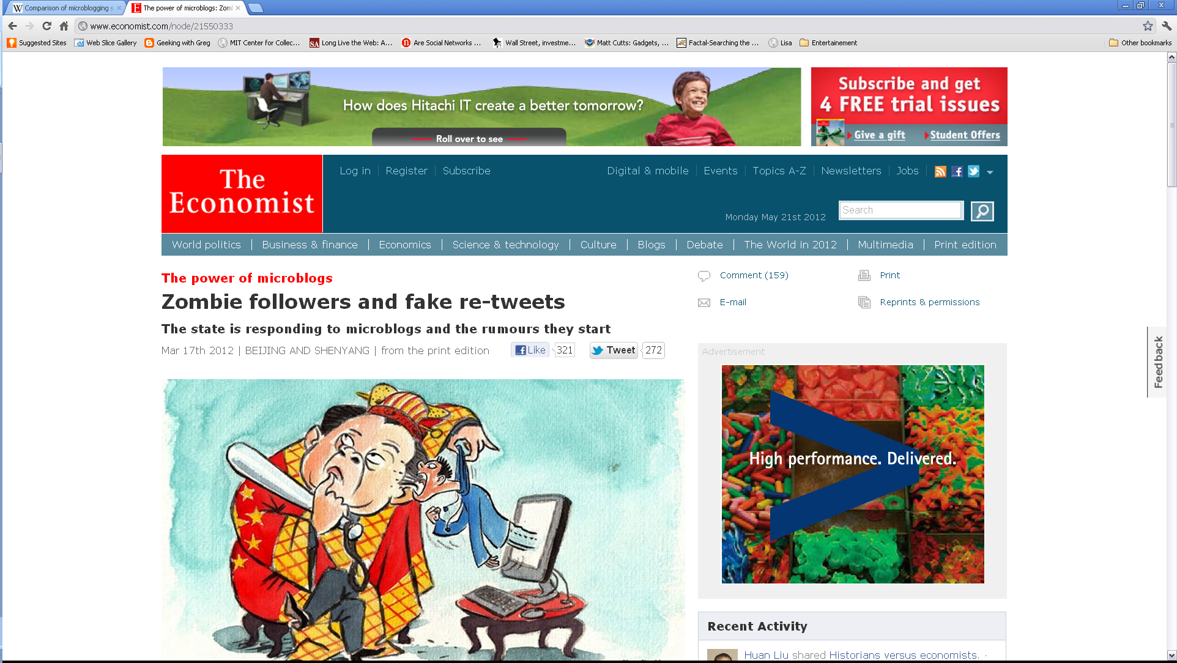
Ranking Tweets Considering Trust and Relevance
Spread of false information reduces the usability of Microblogs.
We Model the Tweet eco-system as a tri-layer graph.
Query Results: Britney Spears
Twitter Results | TweetRank Results
(Oops?!) Britney Spears is Engaged... Again! - its britney: http://t.co/1E9LsaH7 | In entertainment: Britney Spears engaged to marry her longtime boyfriend and former agent Jason Trawick.
Future Work
Completed Work
Future Work
Tweeted By
Tweeted URL
Top-k Relevance Comparison
How do we rank tweets considering trustworthiness and relevance?
Surface web uses hyperlink analysis between the pages.
Twitter consider retweets as “links” between the tweets for ranking.
Followers
Hyperlinks
Build Implicit links between the tweets containing the same fact, and analyze the link-structure.
Retweets are sparse, and often planted or passively retweeted.
Top-k Trust Comparison
Agreement-edge weights between the tweets are computed using the Soft TF-IDF.
Ranking-score is equal to sum of the edge weights.
Notes:
False tweets are a severe problems in twitter as the recent news articles illustrate.
We modeled tweets are a three layer graph, with tweet layer, user layer and web page layer.
47

Slide 48
Real-Time Profit Maximization for Guaranteed Deals
Many emerging ad types require stringent Quality of Service guarantees---like minimum number of clicks, conversions or impressions.
Fixed time horizon
Minimum number of Conversions
Instead of content owner displaying guaranteed ads directly, impressions may be bought in spot market.
Notes:
Optimal Real time bidding strategies for Guaranteed Deals. Work I did in Yahoo! Labs Bangalore in the summer. Not going into the details
Skip this slide also if run out of time.

Slide 49
Events After Thesis Proposal: Data Ranking
1. Ranking the Deep Web Results [ACM TWEB accepted with minor revisions]
  Computing and combining query-similarity.
  Large Scale Evaluation of Result Ranking.
  Enhancing prototype with result ranking.
2. Extended SourceRank to Topic Sensitive SourceRank (TSR) [COMAD’11, ASU best masters thesis’12, ACM TWEB].
3. Ranking Tweets Considering Trust and Relevance [IIWEB’12].

Slide 50
Events After Thesis Proposal : Ads
Ad-Auction based on the proposed ranking
Formulating an envy free equilibrium.
Analysis of advertiser’s profit and comparison with the existing mechanisms.
2. Optimal Bidding of Guaranteed Deals [CIKM’12, Patent Pending].
Accepted the offer as a Data Scientist (Operational Research) at Groupon.

Slide 51
Ranking is the life-blood of the Web: content ranking makes it accessible, ad ranking finances it.
Ranking the Deep Web
SourceRank considering trust and relevance.
Collusion detection.
Topic specific SourceRank.
Ranking results.
Ranking Ads
Optimal ranking & generalizations.
Auction mechanism and equilibrium analysis.
Comparison with VCG.
Thank You!
Notes:
I am summarizing contributions and impact of my research in both ranking the deep web, and ranking the ads. Thank you all for finding time to attend my talk.

