Slide 1
Human Factors Analysis of Automated Planning Technologies for Human-Robot Teaming
Vignesh Narayanan
Master of Science – Thesis Defense
Graduate Supervisory Committee
Dr. Subbarao Kambhampati, Co-Chair
Dr. Yu Zhang, Co-Chair
Dr. Nancy Cooke
Dr. Georgios Fainekos

Slide 2
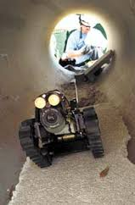
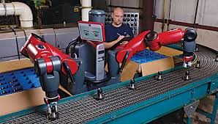
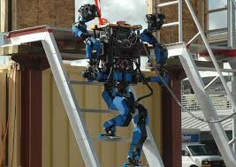
Current state of Human-Robot Teams (HRT)
The robotic capabilities in many domains are still insufficient to execute several tasks robustly and efficiently.
Mostly remotely controlled
In restricted settings (manufacturing)
And programmed for specific assistance
Robots can still accomplish those tasks as a team with human assistance.
Notes:
The vision of humans and robots working together to accomplish complex team tasks is driving much of the current research in the area of autonomous teamwork. As robots become more capable they can handle increasingly complex tasks and highly uncertain environments, but the current robotic capabilities in many domains are still insufficient to execute these tasks robustly and efficiently. In these scenarios, robots can still accomplish the tasks with human assistance as human capabilities are often better suited for some tasks and they complement robot capabilities in many situations. Thus, for robots to become an integral part of society, human-robot teams must be effective in a variety of settings.

Slide 3
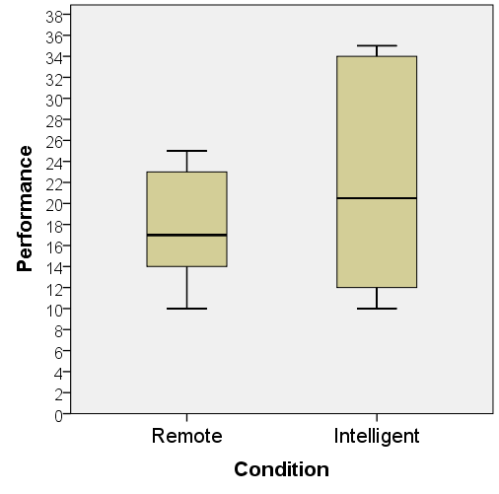
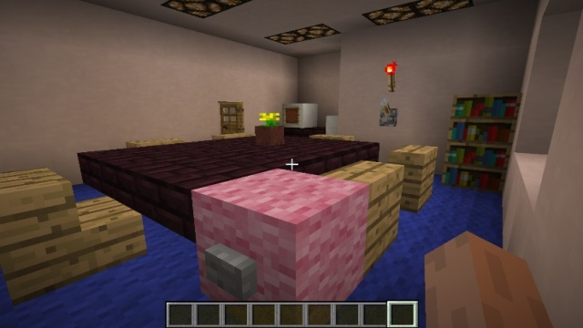
Lessons from Human-Human Teams *
Connections to Automated Planning Technologies
Planning - Agents mostly plan for themselves
Proactive Support – Often no need to specifically ask for help
Higher teaming performance
* “Communication Between Teammates in Urban Search and Rescue”, Cade Earl Bartlett, Nancy Cooke

Slide 4
Automated Planning Technologies in Human-Robot Teams
To move closer to human-human teams we need automated planning technologies.
Automated planning system:
Enables autonomy
Allows the robot agent to reason directly about goal (like human counterparts)
Supports high level (task or sub-task) decision making beyond low level motion commands.
However
Planning - Agents mostly plan for themselves
Proactive Support – Often no need to specifically ask for help
? Higher teaming performance
Apart from positive effects, automation can have negative influence on human performance too:
Trust factor
Loss of Situation Awareness

Slide 5
Overview of my Thesis
STUDY 1 *
Is automated planning for robot preferred in Human-Robot teams?
STUDY 2 **
Is proactive support from robot preferred in Human-Robot teams?
* “Automated Planning for Peer-to-peer Teaming and its Evaluation in Remote Human-Robot Interaction ” Vignesh Narayanan, Yu Zhang, Nathaniel Mendoza and Subbarao Kambhampati. 10th ACM/IEEE Intl. Conf on Human Robot Interaction (HRI), 2015.
** “A Human Factors Analysis of Proactive Assistance in Human-robot Teaming” Yu (Tony) Zhang, Vignesh Narayanan, Tathagata Chakraborty & Subbarao Kambhampati. IROS 2015.

Slide 6
Types of Human-Robot Teams
Human Robot Teaming
Based on physical distance between Human and Robot
Remote
Proximal

Slide 7
STUDY 1 *
Is automated planning for robot preferred in Human-Robot teams?
* “Automated Planning for Peer-to-peer Teaming and its Evaluation in Remote Human-Robot Interaction ” Vignesh Narayanan, Yu Zhang, Nathaniel Mendoza and Subbarao Kambhampati. 10th ACM/IEEE Intl. Conf on Human Robot Interaction (HRI), 2015.

Slide 8
Supervised Vs. Peer-to-Peer(P2P) HRT
In supervised human-robot interaction the human creates the plan for the robot to achieve the global goal.
In peer-to-peer(P2P) human-robot interaction, general planning capability is incorporated into the robot.
Notes:
Human then either directly provides motion commands or breaks the plan into sub-plans (or sub-goals) for the robot to handle.
During plan execution, the human can interact with the robot using a low level motion controller, or a high level task and plan manager.
The human and robot share the same global goal and collaborate to achieve it.
An autonomous robot here can achieve the global goal alone when the task information is completely specified.

Slide 9
Is automated planning for robot preferred in Human-Robot teams?

Slide 10
Why not?
Can Automated Planning reduce effectiveness of HRTs?
The trust factor –
Are humans comfortable with robots having a planning ability ?
Information asymmetry –
Can task information be fully specified a priori ?
Is the knowledge always synchronized between human and robot ?
Notes:
Task information often cannot be completely specified in real-world applications.
Is it always bad ?
Dynamic environmental influences
Practicality issues
Certain task updates require manual processing, which is prone to interpretation delay (e.g., environment changes that can only be perceived and interpreted by humans)
The knowledge cannot be easily incorporated into the planning model (e.g., inferencing and image processing capabilities of humans)
NO! (e.g., the human does not need to know how many rooms the robot travels through to move to a specified location).

Slide 11
Human factors analysis to validate effectiveness of Automated Planning in human-robot teams.

Slide 12
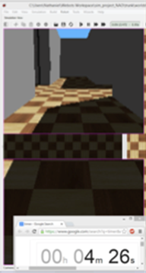
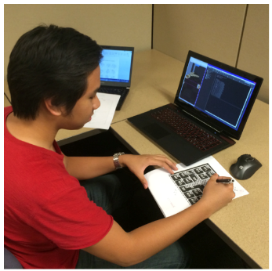
Urban Search And Rescue (USAR) Scenario Setup
Notes:
Remote human-robot interaction
Incomplete task information – environmental changes due to disasters
Deployed during early phases of emergency response
To explore disaster scene
To provide real-time information
Situation assessment to aid emergency management
Apart from human robot interaction, human also need to collaborate with other operators and related personnel.

Slide 13
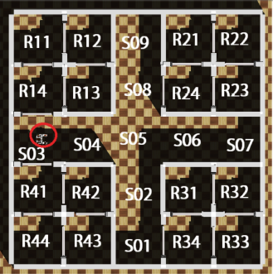
The Setup
USAR task details
Team goal – Report the number of casualties in as many rooms as possible, given a certain amount of time.
Incomplete task information
Blocked doors (Information provided to subjects but not modelled by the robot inside the environment)
The subjects must also process and analyze information from the robot teammate and other sources
Simulated by making the subjects solve puzzle problems

Slide 14
The Setup
Interaction Interface

Slide 15
Automated Planner Component
An automated planner [1] allows an automated agent to reason directly about the global goal (with the limitation coming only from the completeness assumption).
A task can be compiled into a problem instance (specified using PDDL) for an automated planner.
The planner creates a plan by connecting initial state to the goal state using the agent actions.
[1] Talamadupula, K.; Benton, J.; Kambhampati, S.; Schermerhorn, P.; and Scheutz, M. 2010. Planning for human-robot teaming in open worlds. ACM Transactions on Intelligent Systems and Technology (TIST) 1(2):14.
Notes:
Various types of incompleteness like
Partial satisfaction of the goal
Incomplete initial state
Incomplete action models
Incomplete preference of the human teammate
can also be considered in an automated planner.

Slide 16
Evaluation Criterion
Hypothesis for effectiveness of Automated Planning in HRTs
Robot with and without planning ability.
– Hypothesis 1 –
Robot with a planning capability reduces human teammate's mental workload; on the other hand, it also reduces situation awareness.
– Hypothesis 2 –
Robot with a planning capability enables more effective teaming (e.g. Gradually reduced interaction)

Slide 17
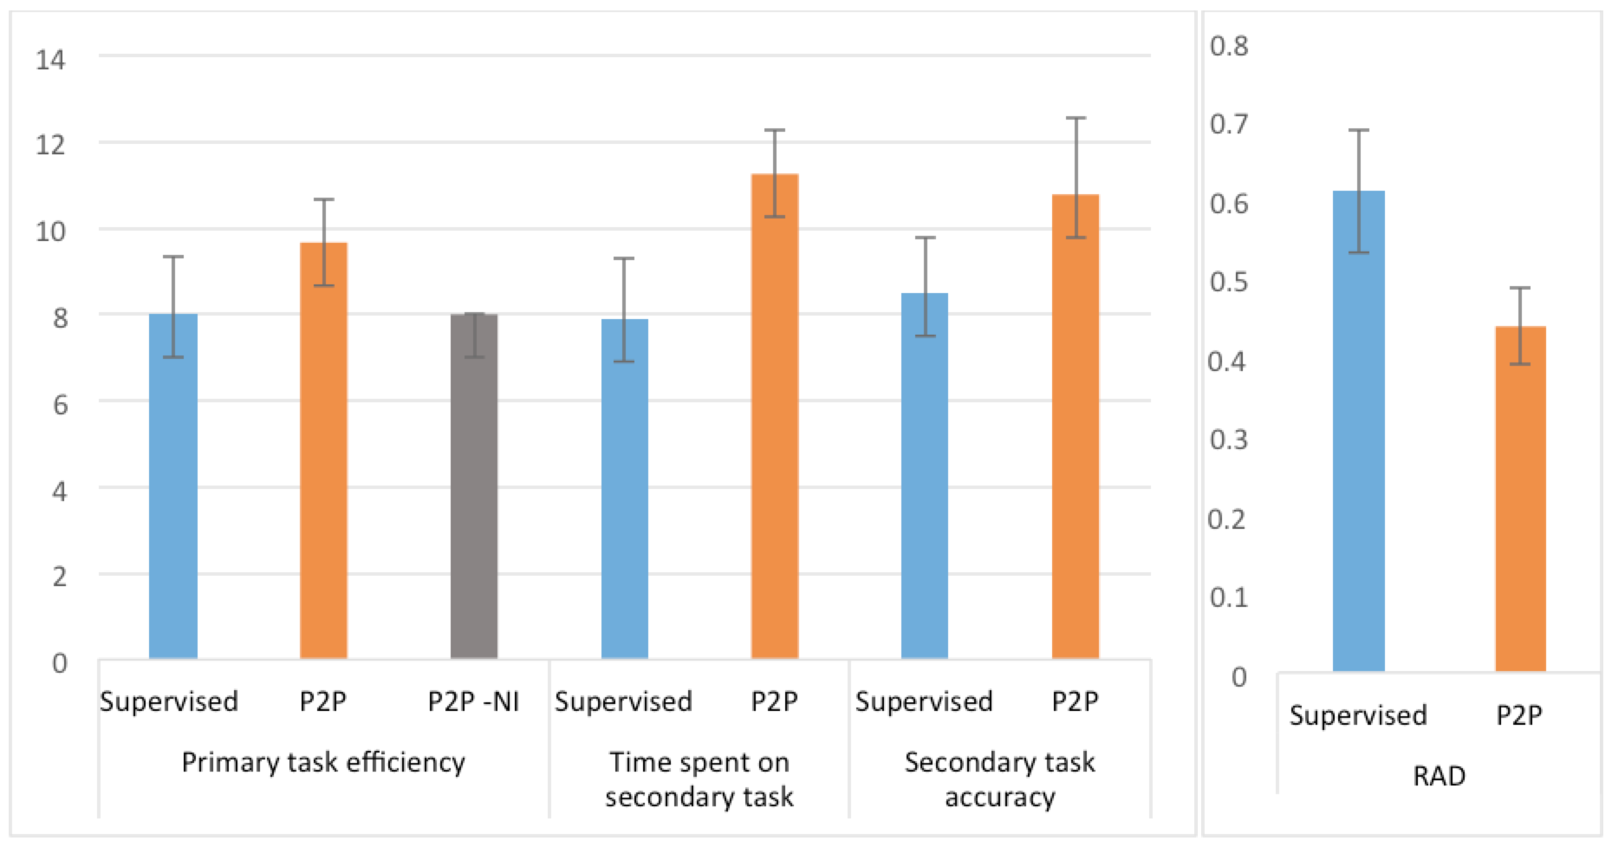
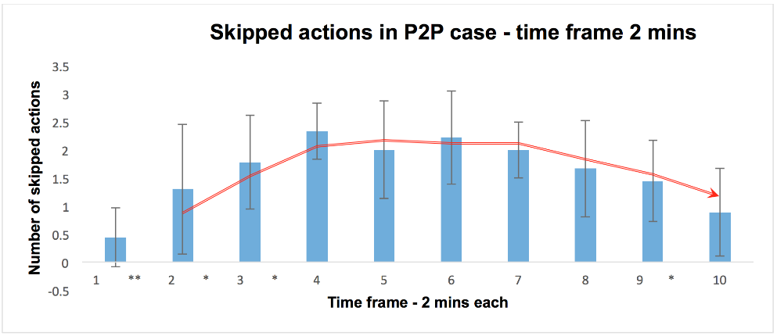
Humans interacted more as time ran out to improve performance
Objective Performance
Primary Task Performance
Secondary Task Performance
RAD & Fan-out
Skipped actions
Max #robots a human can simultaneously interact with
Time Spent
Secondary Task accuracy
Percentage of participants time dedicated to Human-robot interaction
We use P2P-NI as a baseline
#rooms reported in 20 mins
Mental Workload indicator

Slide 20
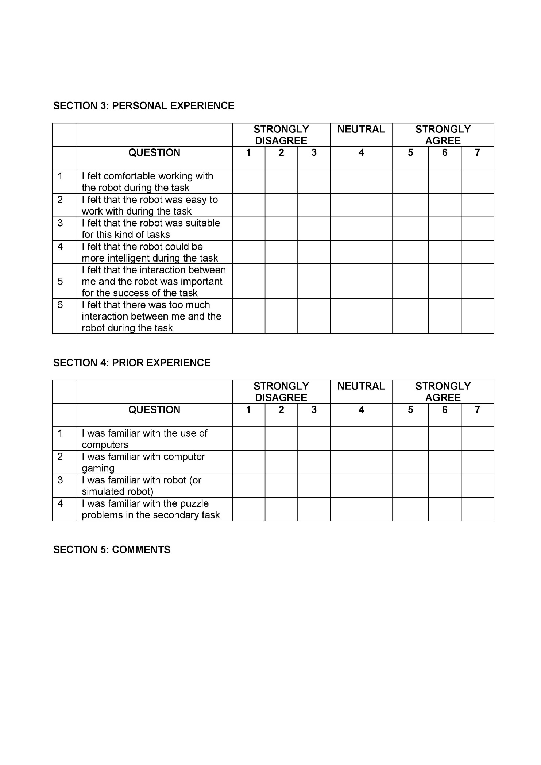
Subjective Likert Scale Questionnaire

Slide 21
Subjective Performance
INCONSISTENT WITH H1
INCONSISTENT WITH H1
CONSISTENT WITH H2
Mental Workload
Situation Awareness
Complacency
Ease of working with robot
Awareness of robot’s position
Comfort and ease of teaming
Participants workload to interact with the robot
Understanding of robot actions during the task

Slide 22
Improvability
How much the robot could be improved ?
Subjective Performance
CONSISTENT WITH H2
Immediacy
Effectiveness
Likability
Trust
How useful the participant felt about interaction
Ease and comfort
How much the participant felt like working in a real team
How useful the participant felt about robot as a teammate
Interaction between participant and robot was effective ?
Perceived effectiveness
Robot took initiatives to achieve the common goal ?
Robot sometimes performed unexpectedly ?

Slide 24
Summary of Study 1 *
Generally positive attitude towards peer-to-peer team
Results are partially consistent with the hypotheses.
Subjects seemed to prefer to engage in peer-to-peer teaming.
Task performance was higher in peer-to-peer teaming than supervised teaming.
Peer-to-peer teaming may not reduce mental workload in short-term tasks.
Situational awareness is not reduced significantly in peer-to-peer teaming
* “Automated Planning for Peer-to-peer Teaming and its Evaluation in Remote Human-Robot Interaction ” Vignesh Narayanan, Yu Zhang, Nathaniel Mendoza and Subbarao Kambhampati. 10th ACM/IEEE Intl. Conf on Human Robot Interaction (HRI), 2015.
Notes:
Working with a proactive teammate may require more interactions at the beginning and once a mutual understanding is established, the mental workload may be reduced.
This suggests that providing “recommended actions" may also be used as a way to reduce the negative influence of automation.

Slide 25
STUDY 2 *
Is proactive support from robot preferred in Human-Robot teams?
* “A Human Factors Analysis of Proactive Assistance in Human-robot Teaming” Yu (Tony) Zhang, Vignesh Narayanan, Tathagata Chakraborty & Subbarao Kambhampati. IROS 2015.

Slide 26
Active vs. Proactive support
Humans + Robots sharing workspace
Active support – Robots can provide specific assistance when the human needs/asks for it.
Proactive support (PS) – Assistive robots can infer the goals and intents of the humans, and take proactive actions to help them achieve their goals.

Slide 27
Is proactive support from robot preferred in Human-Robot teams?

Slide 28
Why not?
Can Proactive Support reduce effectiveness of HRTs?
The trust factor –
Are humans are comfortable with robots having a goal and intent recognition (GIR) ability ?
Being on the same page –
Misinterpretations, delays, redundancy?
Cognitive overload –
The human needs to replan constantly with proactive support.

Slide 29
Human factors analysis to validate effectiveness of Proactive Support in human-robot teams.

Slide 30
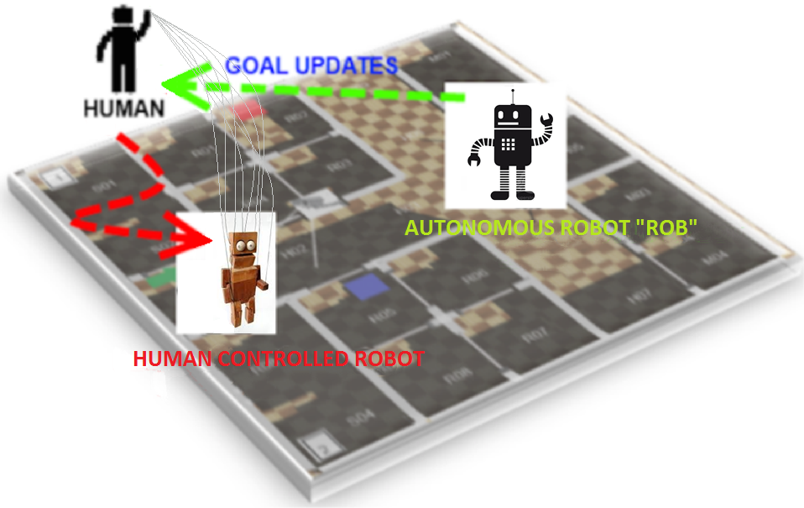
The Setup
Urban Search and Rescue (USAR)

Slide 31
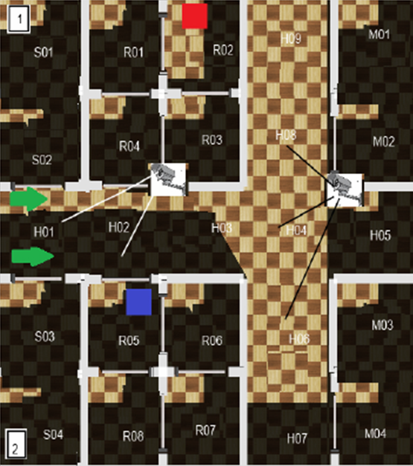
The Setup
Human’s point of view

Slide 32
The Setup
USAR environment details
Casualty (critically injured)
Medical kits
Casualty (lightly injured)
Fetch medical kits from storage rooms (S)
Search for casualties in rooms (R)
CCTV cameras
Treat casualties in medical rooms (M)

Slide 33
The Setup
USAR task details
Team goal – Find and treat all casualties
Critically injured casualties must be treated first
Human/Robot can carry one medkit/casualty at a time
The triage can only be performed by the human
Simulated by making the subjects solve puzzle problems
A medical room can only accommodate one casualty and each medical kit can be used towards one casualty.

Slide 34
Action Selection (Human)
Modes of interaction between human and robot
Goal
Goal/Action updates
Inform
Inform current goal
Request
Stop current plan
Conduct Triage
Undo current plan
Open Door
Grab/Drop Medkit
Move
Lift/Lay down Casualty

Slide 35
Action Selection (Robot)
Without PS (no GIR component)
Environment
Candidate
Goal Set
Human
Goal
Robot
Grab/Drop Medkit
update
Actions
Move
Team Utility
Assign goal to self to maximize team utility
Open Door
Actions
Automated Planning Component
Carry/Lay Down Casualty
Plan

Slide 36
Action Selection (Robot)
Components of Proactive Support
Environment
Candidate Goal Distribution
update
Human
Goal
Robot
Grab/Drop Medkit
Goal/Intent Recognition (GIR) Component
Actions
Move
observations
Most probable goal of human
Team Utility
Open Door
Actions
Assign goal to self to maximize team utility
Carry/Lay Down Casualty
Automated Planning Component
Plan

Slide 37
Components of Proactive Support
Automated Planning and Intent Recognition
Automated Planning Component^{[1]}
Computes a plan i.e. a sequence of actions that transforms the current world state to the goal state
Intent/Goal Recognition Component^{[2]}
Computes a probability distribution over a set of goals depending on their likelihood given some observations
Off-the-shelf software for both modules
[1] Talamadupula, K.; Benton, J.; Kambhampati, S.; Schermerhorn, P.; and Scheutz, M. 2010. Planning for human-robot teaming in open worlds. ACM Transactions on Intelligent Systems and Technology (TIST) 1(2):14.
[2] Miquel Ramirez and Hector Geffner. “Probabilistic plan recognition using off-the-shelf classical planners”. In Proceedings of the Twenty- Fourth AAAI Conference on Artificial Intelligence, AAAI 2010, Atlanta, Georgia, USA, July 11-15, 2010, 2010.

Slide 38
Use Case
How the robot provides proactive assistance
The human has found the critically injured casualty.
His current goal is to bring the critically injured casualty to the medical room.
The robot doesn’t know this. It is searching for casualties in the other region.

Slide 39
Use Case
How the robot provides proactive assistance
When the human enters into the field of view of the cameras, his actions are detected.
The robot recognizes that the critically injured casualty has been found and removes this goal from the goal set.
The robot realizes that bringing the medical kit to the human would achieve a better utility for the team.

Slide 40
Use Case
How the robot provides proactive assistance
The robot recognizes that the critically injured casualty has been found and removes this goal from the goal set.
If the human chose to inform the robot about his goal, it could have done this directly (active support).
The robot realizes that bringing the medical kit to the human would achieve a better utility for the team.

Slide 41
Use Case
How the robot provides proactive assistance
If the lightly injured casualty was found instead, the robot would have decided to continue its search
The robot realizes that bringing the medical kit to the human would achieve a better utility for the team.

Slide 42
Use Case
How the robot provides proactive assistance
If the lightly injured casualty was found but the critically injured casualty has already been treated, the robot would still help the human fetch the medical kit.
The robot realizes that bringing the medical kit to the human would achieve a better utility for the team.

Slide 43
Use Case
How the robot provides proactive assistance
Having computed its current goal, the robot generates a plan to achieve it using its automated planning component.

Slide 44
Evaluation Criterion
Hypothesis for effectiveness of Proactive Support
Robot with and without proactive support ability.
– Hypothesis 1 –
Robot with PS enables more effective teaming (e.g., less communication and more efficiency).
– Hypothesis 2 –
Robot with PS increases human mental workload

Slide 45
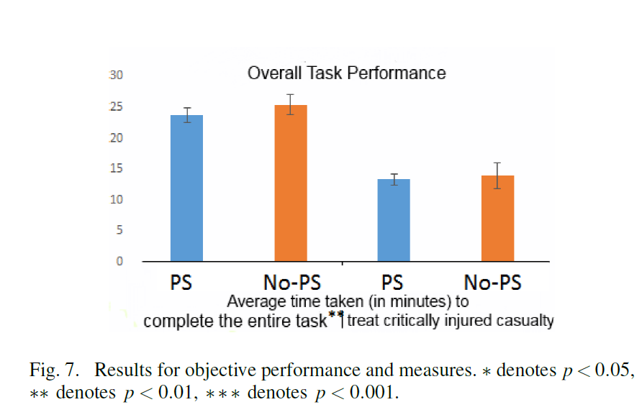
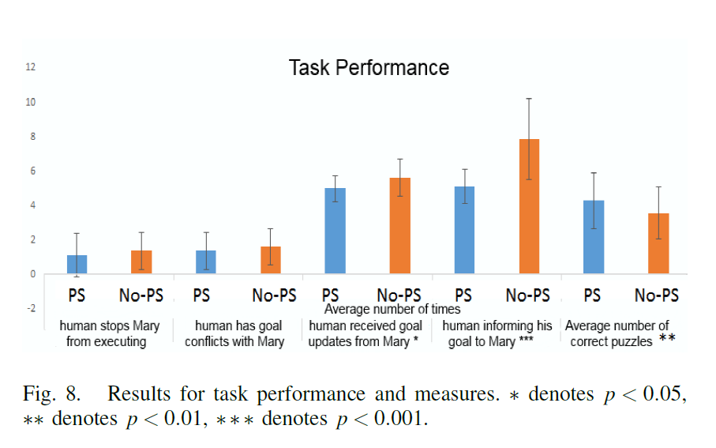
Objective Performance
Overall Task Performance
Cognitive Load
Total time taken for the team to find and treat the critically injured casualty
# Human stopped ROB from executing its current goal
Inconsistent with H2
SIGNIFICANTLY
DIFFERENT
# Correct puzzles
Total time taken for the team to finish the entire task
# Subject had goal conflicts with ROB
# Subject informing his goal to ROB
# Human received goal updates from ROB

Slide 48
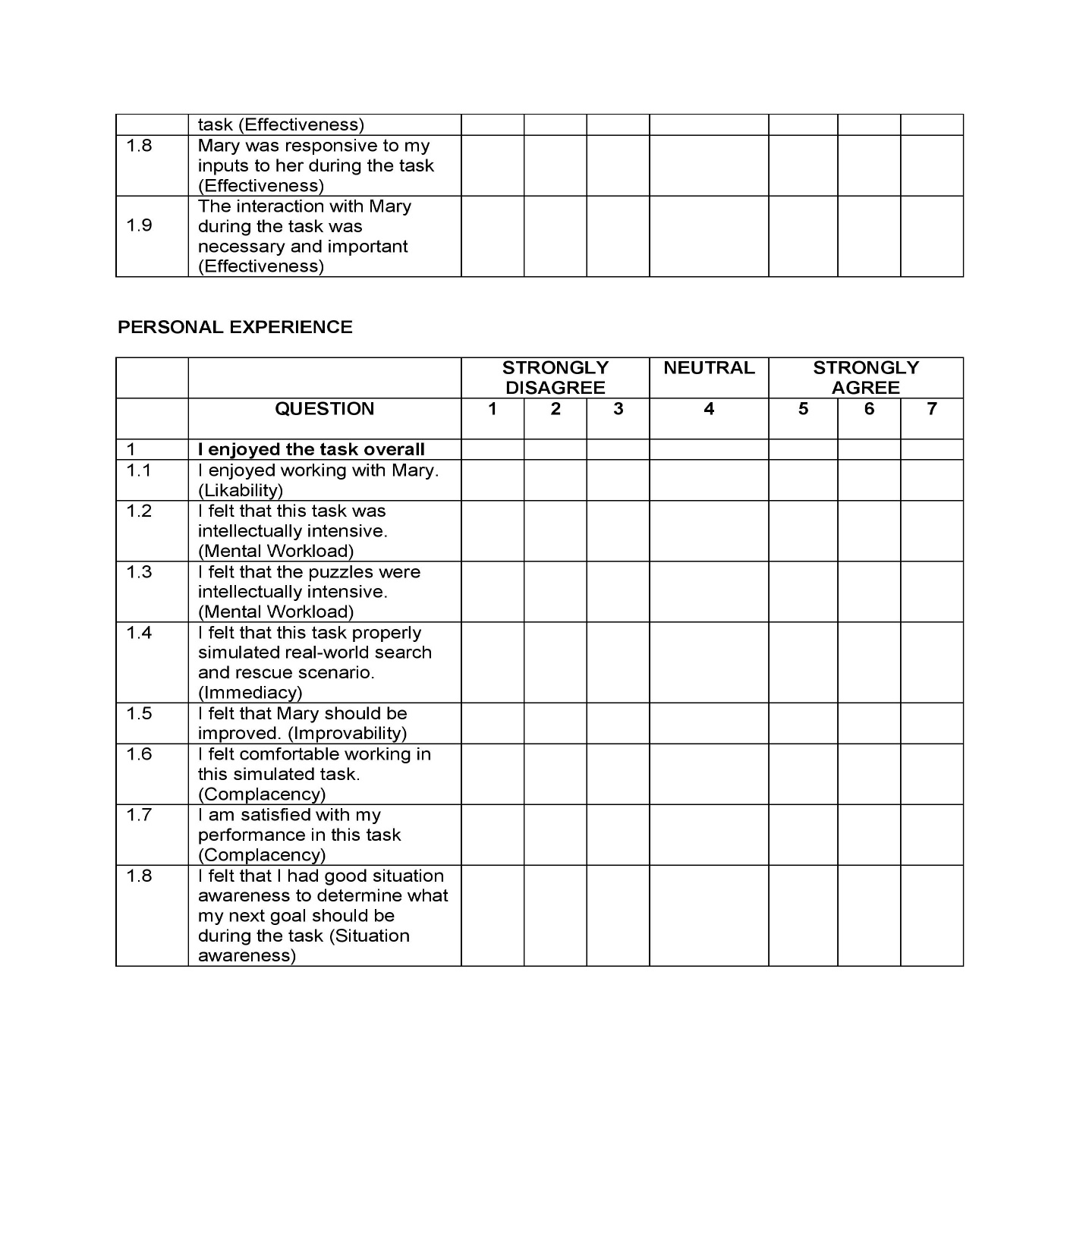
Subjective Likert Scale Questionnaire

Slide 49
Subjective Performance
Consistent with objective measures
Consistent with H2
PS does not reduce SA much
Mental Workload
Situation Awareness
Complacency
Ease of working with ROB
How subject felt about their performance in the task
Participants workload to interact with ROB
Whether the subject felt that he/she had enough information to determine what the next goal should be
Comfort and ease of teaming
Notes:
Updated

Slide 50
Improvability
Subjective Performance
How much ROB could be improved ?
Consistent with H1
Immediacy
Effectiveness
Likability
Trust
How much the subject considered the simulated task as a realistic USAR task
ROB’s trustworthiness with the assignments
How useful the participant felt about ROB as a teammate
Balanced workload?
Perceived effectiveness
ROB’s trustworthiness with the updates during the task
Ease and comfort
ROB sometimes performed unexpectedly?
Interaction between participant and ROB was effective?
Notes:
Updated

Slide 52
Summary of Study 2 *
Generally positive attitude towards Proactive Support
Results are mostly consistent with the hypotheses.
Subjects had positive feelings towards PS capabilities
Seems to suggest that intelligent robots with a PS ability may be used and accepted in various settings
The increased mental workload does not overwhelm the humans.
More investigations need to be conducted in scenarios with information asymmetry and human cognitive load.
* “A Human Factors Analysis of Proactive Assistance in Human-robot Teaming” Yu (Tony) Zhang, Vignesh Narayanan, Tathagata Chakraborty & Subbarao Kambhampati. IROS 2015.

Slide 53
Conclusions
Results of both the studies are mostly consistent with the hypotheses.
Subjects had positive feelings towards peer-to-peer (P2P) team* and proactive support (PS)** capabilities in general.
No significant increase in mental workload (for both P2P and PS team).
No significant decrease in situation awareness (for both P2P and PS team).
* “Automated Planning for Peer-to-peer Teaming and its Evaluation in Remote Human-Robot Interaction ” Vignesh Narayanan, Yu Zhang, Nathaniel Mendoza and Subbarao Kambhampati. 10th ACM/IEEE Intl. Conf on Human Robot Interaction (HRI), 2015.
** “A Human Factors Analysis of Proactive Assistance in Human-robot Teaming” Yu (Tony) Zhang, Vignesh Narayanan, Tathagata Chakraborty & Subbarao Kambhampati. IROS 2015.

Slide 54
Thank you ☺

