Slide 1

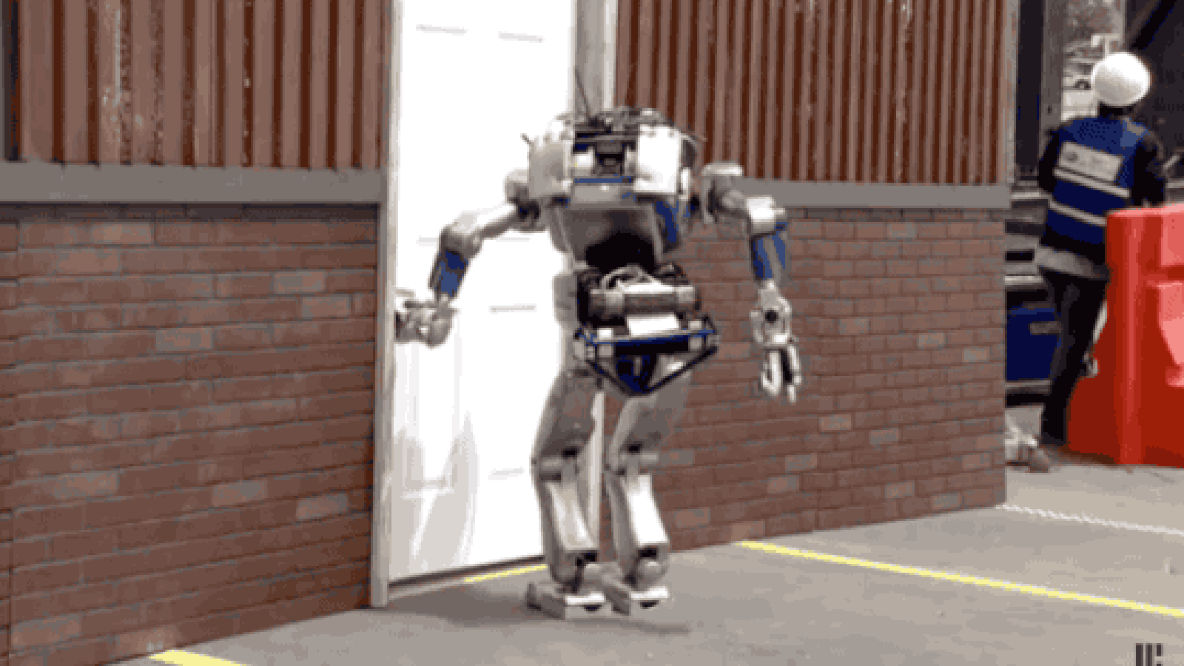

AI Thresholds
(aka You have come a long way, Robbie!
But boy do you have a long ways still to go…)
The explorer Magellan went
around the world three times.
On one of his trips he died.
Which trips did he die in?
Subbarao Kambhampati
Arizona State University

Slide 2

All I need to know about life, I learned in
Kindergarten?
First few hours of life?
Pre-conception…?
Notes:
A brief recap of some of our achievements yesterday, especially for those of you who found a rather large bourbon bottle

Slide 3
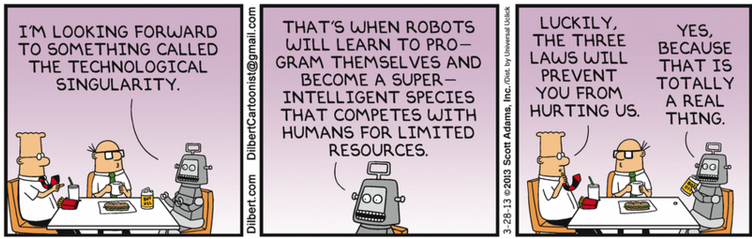
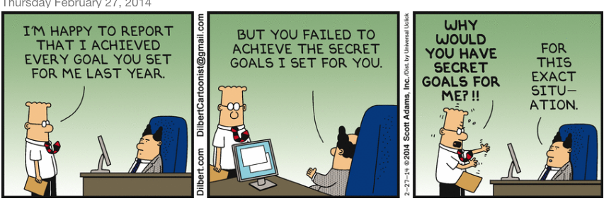
All I need to know about the Super Intelligence Control problem, I learned from…

Slide 4
The way to control machines is to continually make them feel inadequate!

Slide 5
AI Thresholds
The explorer Magellan went
around the world three times.
On one of his trips he died.
Which trips did he die in?
Subbarao Kambhampati
Arizona State University

Slide 6
AI Thresholds
(aka You have come a looong way, baby, but boy do you have a long ways to go still…)
The explorer Magellan went
around the world three times.
On one of his trips he died.
Which trips did he die in?
Subbarao Kambhampati
Arizona State University

Slide 7
Thresholds
Thresholds for what?
  To reach “super-intelligence” (whatever that may be)
  To reach “human-like” or “human-level” intelligence

Slide 8
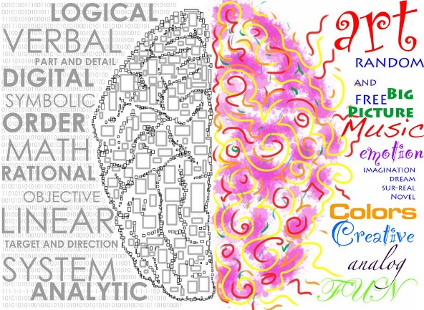
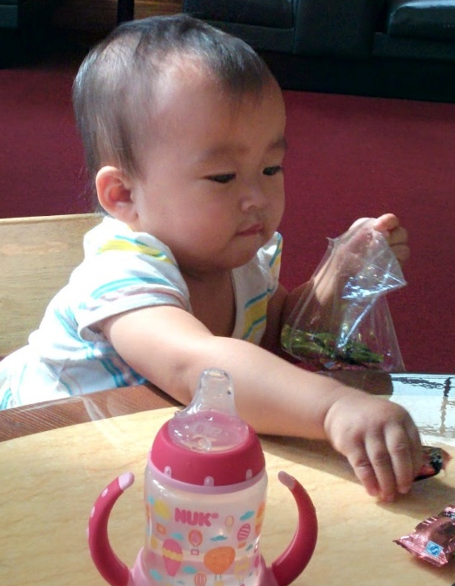
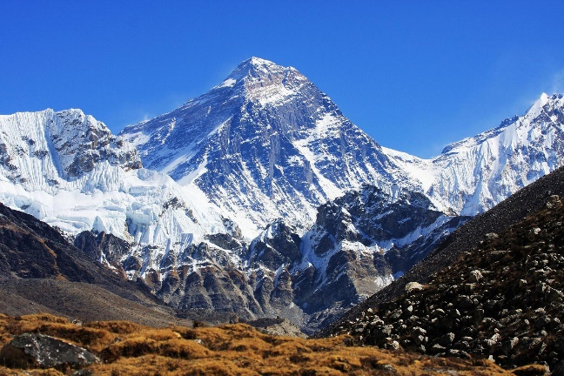

Many
Intelligences..
Perceptual & Manipulation intelligence that seem to come naturally to us
  Form the basis for the Captchas..
    But rarely form the basis for our own judgements about each other’s intelligence
Emotional Intelligence
Social Intelligence..
Cognitive/reasoning tasks
  That seem to be what we get tested in in SAT etc.
Notes:
We take what all of us have for granted…

Slide 9
AI’s progress towards intelligence
80’s --- Expert systems
  Rule-based systems for many businesses
    Lisp Machines—the GPUs of 80’s!
90’s -- Reasoning systems
  Dethroned Kasparov
00’s: Perceptual tasks
  Speech recognition common place!
  Image recognition has improved significantly
Current: Connecting reasoning and perception?
Notice the contrast.. Human
babies master perception
before they get good at
reasoning tasks!

Slide 10
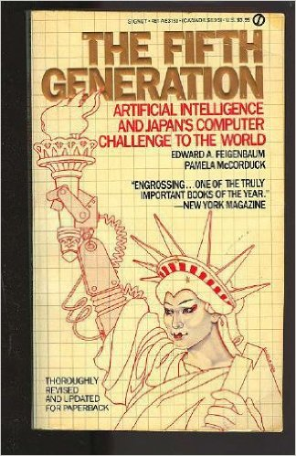
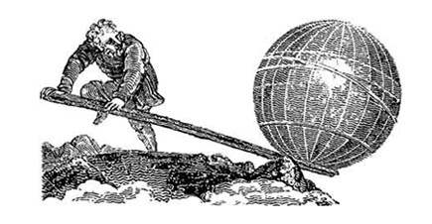
…and are we there yet?
If you give me a lever, and a place to
stand, I can move the world
Google DeepMind calls the self-guided method reinforced (sic) learning, but it’s really just another word for “deep learning,” the current AI buzzword.
-IEEE Spectrum (!!) 1/27/16
Give me a big enough GPU,
large enough data set, and deep enough
Network, I will create you super intelligence..

Slide 11
Still Elusive Commonsense
Our systems are, by and large, still idiot savants..
Giving them common sense remains a big threshold
  CYC/Lucid & Video Watching notwithstanding…
The world is full of obvious things
that nobody by any chance
ever observes
--Christopher in the “Curious
incident of the dog in the
night time”
(Inadvertently channeling
Sherlock Holmes/
Sir Arthur Conon Doyle)

Slide 12
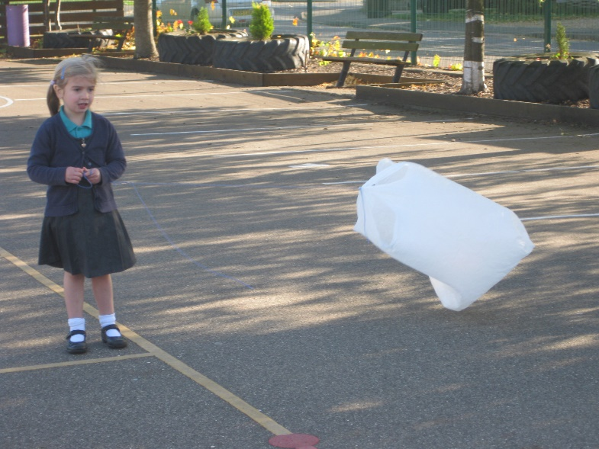
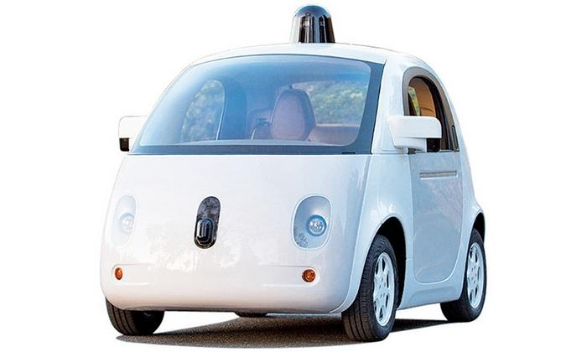

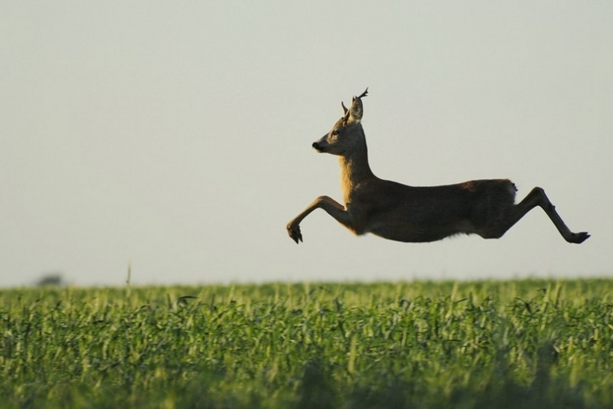
“Commonsense” elaborates partial specifications of facts, observations, norms, goals….
Which trip did Magellan Die?

Slide 13
Robust Decision Making (Planning) with Incomplete Models
Incomplete world models
Incomplete objectives
How to generate robust plans/make robust decisions
    “Risk-aware exploitation”
  Computationally much harder than generating plans in known models.
    In essence you are generating plans over a huge number of possible models.
Notes:
(Risk-Aware exploitation )

Slide 14
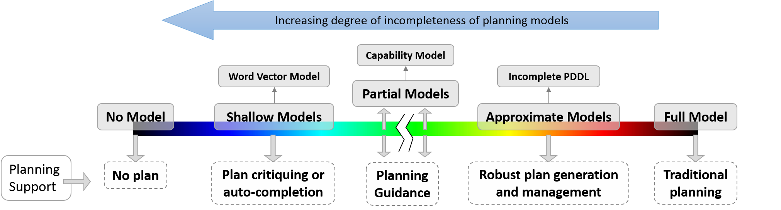
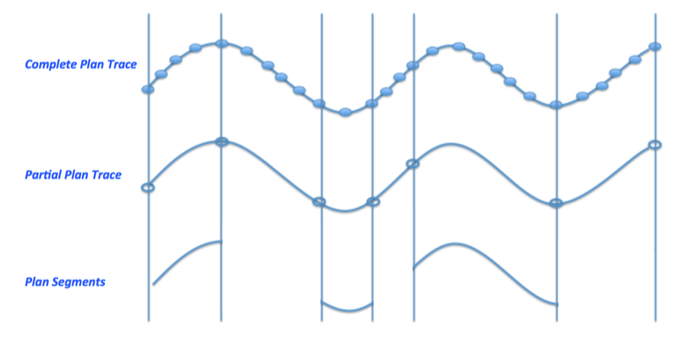
Spectrum of Domain Models
Ease of learning/acquiring the models
Notes:
In this talk I will focus on our work on capability models

Slide 15
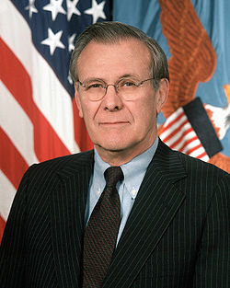
There are known knowns; there are things we know that we know. There are known unknowns; that is to say, there are things that we now know we don’t know. But there are also unknown unknowns; there are things we do not know we don’t know.
Don Rumsfeld; Part time Defense
Secretary; Full time Philosopher
Notes:
Also Missy Cummings—a lot of unknown unknowns. How do we know that the car will settle back to safe recovery when they find an unknown condition.

Slide 16
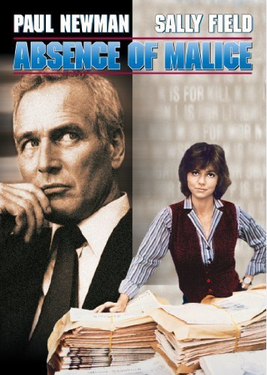
You can cause more destruction with ignorance without any malice..
Much of the knowledge of the agents is going to be incomplete
  Both the world dynamics and objectives

Slide 17
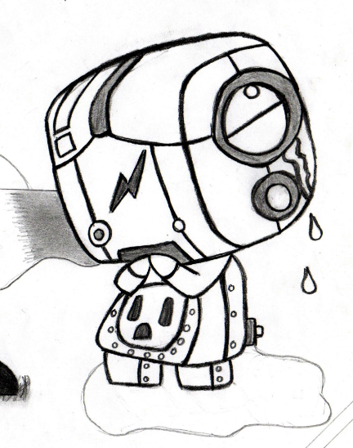

Will super intelligent AI have to be super-social and super-emotional?

Slide 18
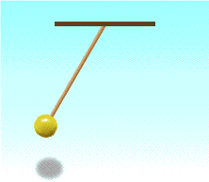
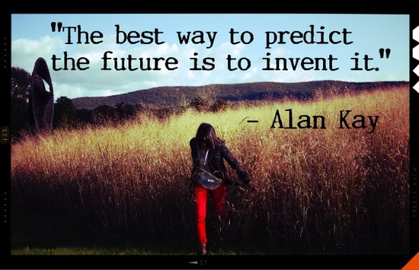
Replace←→Augment
Why intentionally design a dystopian future and spend time being paranoid about it?

Slide 19
The incompleteness extends to the robot’s model of other agents..
Maintaining the model of other agents’ beliefs, desires, intentions
  And “manipulating” them appropriately..

Slide 20
Explanation/Justification/Trust
If we are considering teaming between humans and machines, we need to consider
  How to make them trustworthy for human team-mates
  Need Explanations
    Explanations, like teaching, are ABOUT THE OTHER AGENT’s MODEL

Slide 21
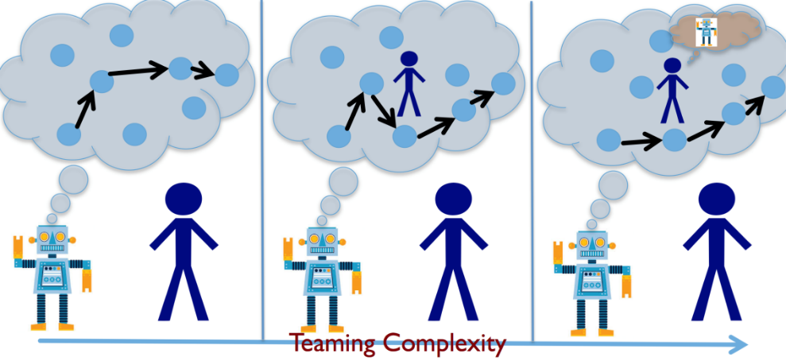
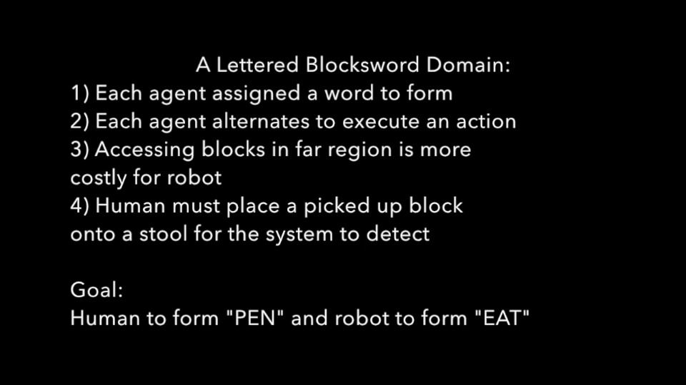
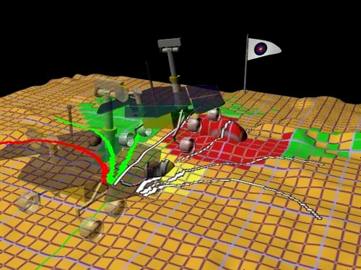
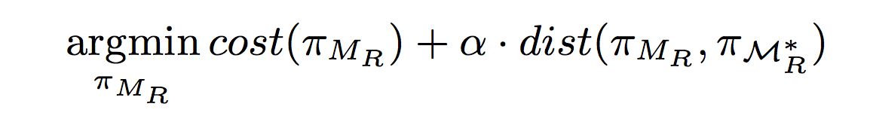
When is a plan “Explainable” to the human in the loop?
The robot generates its plan of action using its model M_{R}
The human “interprets” this plan in light of her understanding of the Robot’s model M*_{R}
M_{R} and M*_{R} can be quite different..
Differences can be a result of:
  Different capabilities (e.g., possible actions)
  Different knowledge (e.g., level of modeling)
  Different interpretation of behaviors (e.g., plans) interacting with the world -- more than just trajectory planning!
But, alas, M*_{R} is not known!

Slide 22

Kilimanjaro group..
Discussion
Dimensions of trust
  Confidence in capabilities vs. confidence in beneficence
    Related to Tool vs. partner view
  Mental states affect trust
Dispositional vs. situational trust
  Prior vs. Likelihood
  Trust scale/calibration
Action implementation vs. Decision Making
Does knowing the capabilities of the agent increase trust?
  YES!! NO!!
    Yes because knowing the capability increases the transparency of interactions
    No(?) because in the extreme case, if you know everything about the agent, trust is “redundant” (in this view, trust needs some leaf of faith)
  Transparencey only pushes trust to the next level
    Is the agent telling the truth
  Self-disclosure—especially of vulnerabilities – seems to improve trust
How do we trust agents that evolve?
  Do we need to trust their learning ability?
Action items for research
Need richer understanding of Trust
  “we are depressingly simplistic and unidimensional on how we view trust”
Agents should try to get the humans get a better model of their capabilities
  Trust vs. Verification
Trust evolution over time
  Is loss of trust swifter than gain?

Slide 23
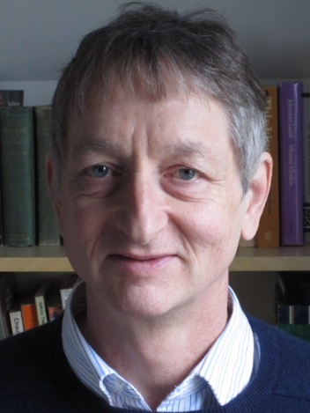
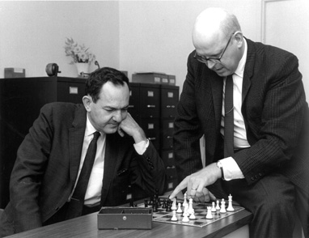
Symbols or Neurons?
(and other Civil Wars & Skirmishes)
Symbols are Luminiferous Aether of AI
    —Geoff Hinton
"A physical symbol system has the necessary and sufficient means for general intelligent action.
--Allen Newell &
Herbert Simon
Notes:
All your introductory AI courses will still teach you about symbolic manipulation.. So much so that I was surprised at Jieping..

Slide 24
Interpretable AI…
(Symbols/Neurons Redux)
We humans may be made of neurons, but we seem to care a “lot” about comprehensibility and “explanations”
If we want AI systems to work with us, they better handle this
  This is an important challenge for the neural architectures
    What do those middle layers represent?
      Hinton says that (eventually?) we can just connect them to language generator networks and in effect “ask them”..

Slide 25
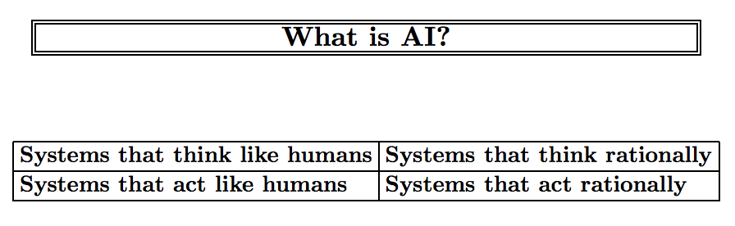

Slide 26
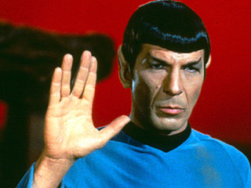
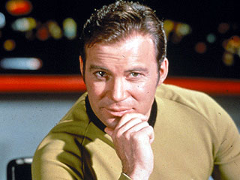
Spock or Kirk?: Should AI have emotions?
By dubbing “acting rational” as the definition of AI, we carefully separated the AI enterprise from “psychology”, “cognitive science” etc.
But pursuit of HAAI pushes us right back into these disciplines (and more)
  Making an interface that improves interaction with humans requires understanding of human psychology..
    E.g. studies showing how programs that have even a rudimentary understanding of human emotions fare much better in interactions with humans

Slide 27
(Knowledge-based) Learning from fewer examples..
Learning? Hand-coded input?
  No. The still elusive “Advice Taker” that McCarthy wanted to build
    Operationalize the advice in the context of existing knowledge.

Slide 28
Thresholds: Summary
Commonsense
Incompleteness
Interaction (with humans)
Learning by being told

Slide 29
Odds and ends...
I don’t completely buy the urgency of “the control problem”
  But at the same time, if I did, I would find the kinds of solutions being proposed somewhat premature..
We need to understand safety of autonomy before fixating on the safety of Superintelligence..
Safety problem is a “maintenance” goal rather than a goal of achievement
  The idea of “safety supplements” for all your projects..?

