Slide 1


Partial Satisfaction Planning:
Representations and Solving Methods
J. Benton
j.benton@asu.edu
Dissertation Defense
Committee:
Subbarao Kambhampati
Chitta Baral
Minh B. Do
David E. Smith
Pat Langley

Slide 2
Classical vs. Partial Satisfaction Planning (PSP)
Classical Planning
  Initial state
  Set of goals
  Actions
Find a plan that achieves all goals
(prefer plans with fewer actions)

Slide 3
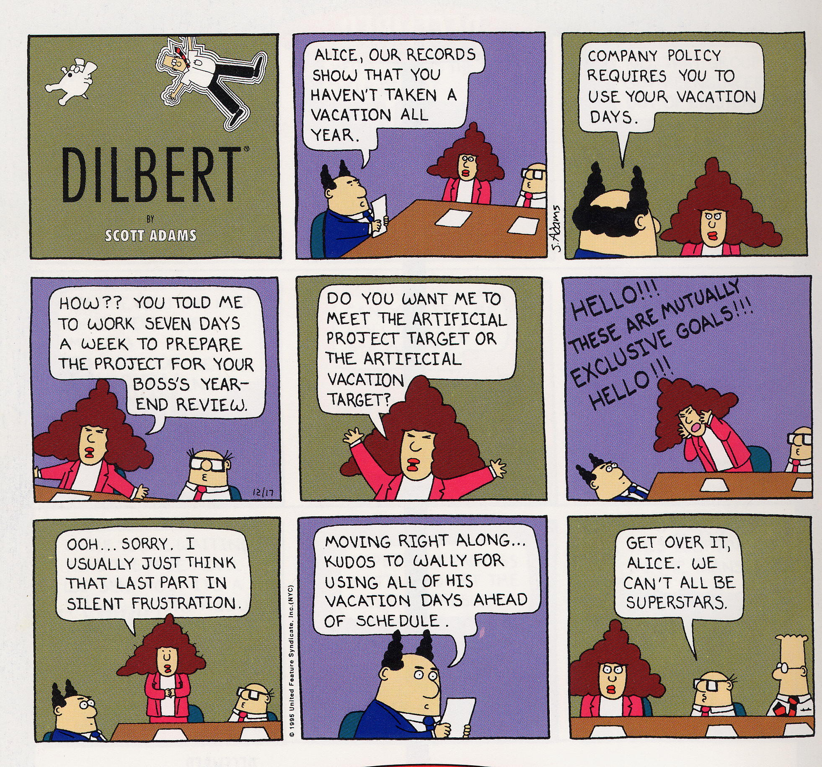

Slide 4
Classical vs. Partial Satisfaction Planning (PSP)
Classical Planning
  Initial state
  Set of goals
  Actions
Find a plan that achieves all goals
(prefer plans with fewer actions)
Partial Satisfaction Planning
  Initial state
  Goals with differing utilities
    Goals have utility / cost interactions
    Utilities may be deadline dependent
  Actions with differing costs
Find a plan with highest net benefit
  (cumulative utility – cumulative cost)
(best plan may not achieve all the goals)

Slide 5
Partial Satisfaction/Over-Subscription Planning
Traditional planning problems
  Find the shortest (lowest cost) plan that satisfies all the given goals
PSP Planning
  Find the highest utility plan given the resource constraints
    Goals have utilities and actions have costs
…arises naturally in many real world planning scenarios
  MARS rovers attempting to maximize scientific return, given resource constraints
  UAVs attempting to maximize reconnaissance returns, given fuel etc constraints
  Logistics problems resource constraints
… due to a variety of reasons
  Constraints on agent’s resources
  Conflicting goals
    With complex inter-dependencies between goal utilities
  Deadlines
[IJCAI 2005; IJCAI 2007; ICAPS 2007; AIJ 2009; IROS 2009; ICAPS 2012]

Slide 6
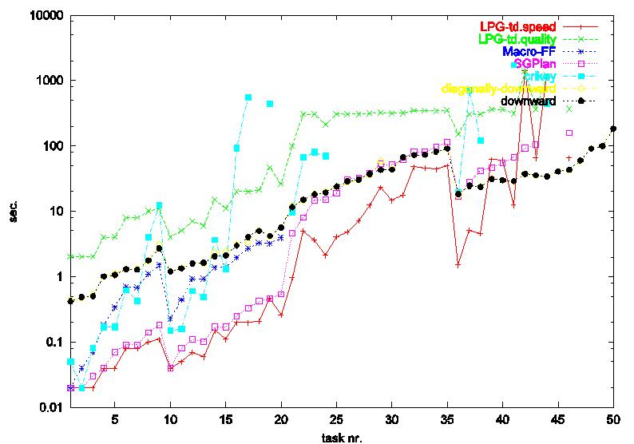
The Scalability Bottleneck
Before: 6-10 action plans in minutes
We have figured out how to scale plan synthesis
In the last dozen years: 100 action plans in seconds
Realistic encodings
of Munich airport!
Realistic encodings
of (some of) the Munich airport!
The primary revolution in planning has been search control methods for scaling plan synthesis

Slide 7
PSP
Highest net-benefit
Cheapest plan
Optimization Metrics
Shortest plan
Any (feasible) Plan
Traditional Planning
Metric
Metric-
Temporal
PO
Classical
Temporal
Non-det
Stochastic
System Dynamics

Slide 8
Agenda
In Proposal:
Partial Satisfaction Planning – A Quick History
PSP and Utility Dependencies [IPC 2006; IJCAI 2007; ICAPS 2007]
Study of Compilation Methods [AIJ 2009]
Completed Proposed Work:
Time-dependent goals [ICAPS 2012, best student paper award]

Slide 9
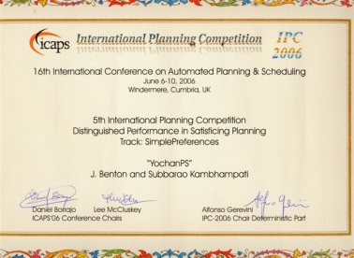

An Abbreviated Timeline of PSP
BB
Distinguished performance
award
1964 – Herbert Simon – “On the Concept of Organizational Goals”
1967 – Herbert Simon – “Motivational and Emotional Controls of Cognition”
1990 – Feldman & Sproull – “Decision Theory: The Hungry Monkey”
1993 – Haddawy & Hanks – “Utility Models … for Planners”
2003 – David Smith – “Mystery Talk” at Planning Summer School
2004 – David Smith – Choosing Objectives for Over-subscription Planning
2004 – van den Briel et al. – Effective Methods for PSP
$${Yochan}^{PS}$$
AB
2005 – Benton, et. al – Metric preferences
2006 – PDDL3/International Planning Competition – Many Planners/Other Language
2007 – Benton, et al. / Do, Benton, et al. – Goal Utility Dependencies & reasoning with them
2008 – Yoon, Benton & Kambhampati – Stage search for PSP
2009 – Benton, Do & Kambhampati – analysis of SapaPS & compiling PDDL3 to PSP / cost planning
2010 – Benton & Baier, Kambhampati – AAAI Tutorial on PSP / Preference Planning
2010 – Talamadupula, Benton, et al. – Using PSP in Open World Planning
2012 – Burns, Benton, et al. – Anticipatory On-line Planning
2012 – Benton, et al. – Temporal Planning with Time-Dependent Continuous Costs
Best student paper award

Slide 10
Agenda
In Proposal:
Partial Satisfaction Planning – A Quick History
PSP and Utility Dependencies [IPC 2006; IJCAI 2007; ICAPS 2007]
Study of Compilation Methods [AIJ 2009]
Completed Proposed Work:
Time-dependent goals [ICAPS 2012, best student paper award]

Slide 11

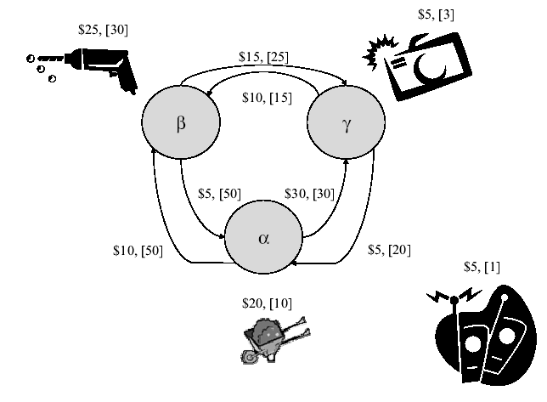
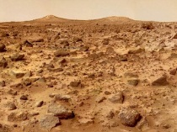

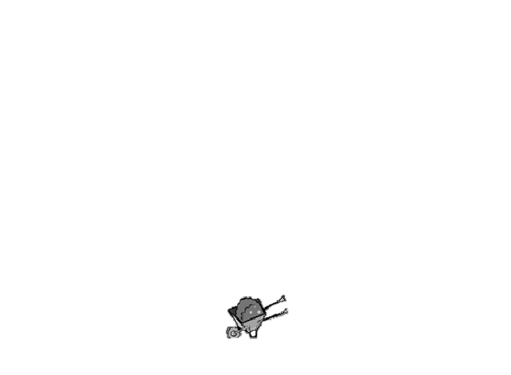
Net Benefit
[Smith, 2004; van den Briel et. al. 2004]
As an extension from
planning:
β
β
β
Cannot achieve all goals
due to cost/mutexes
β
γ
γ
α
γ
α
α
Soft-goals with reward:
  r(Have(Soil)) = 25, r(Have(Rock)) = 50, r(Have(Image)) = 30
Actions with costs:
  c(Move(α,β)) = 10, c(Sample(Rock,β)) = 20
Objective function: find plan P that
  Maximize r(P) – c(P)

Slide 12
General Additive Independence Model
[Do, Benton, van den Briel & Kambhampati IJCAI 2007; Benton, van den Briel & Kambhampati ICAPS 2007]
Goal Cost Dependencies come from the plan
Goal Utility Dependencies come from the user
Utility over sets of dependent goals
g1 reward: 15
g2 reward: 15
g1 ^ g2 reward: 20
[Bacchus & Grove 1995]

Slide 13
The PSP Dilemma
β
2³=8
β
β
β
γ
γ
α
γ
α
α
  Impractical to find plans for all 2^{n} goal combinations
2⁶=64

Slide 14
Handling Goal Utility Dependencies
Look at as optimization problem
  Encode planning problem as an Integer Program (IP)
  Extends objective function of Herb Simon, 1967
  Resulting Planner uses van den Briel’s G1SC encoding
Look at as heuristic search problem
  Modify a heuristic search planner
  Extends state-of-the-art heuristic search methods
  Changes search methodology
  Includes a suite of heuristics using Integer Programming and
  Linear Programming

Slide 15
Heuristic Goal Selection
[Benton, Do & Kambhampati AIJ 2009; Do, Benton, van den Briel & Kambhampati, IJCAI 2007]
Step 1: Estimate the lowest cost relaxed plan P⁺ achieving all goals
Step 2: Build cost-dependencies between goals in P⁺
Step 3: Find the optimize relaxed plan P⁺ using goal utilities

Slide 16



Heuristic Goal Selection Process: No Utility Dependencies
[Do & Kambhampati JAIR 2002; Benton, Do, Kambhampati AIJ 2009]
P₀
action cost
A₀
P₁
A₁
P₂
avail(soil, α)
20
avail(soil, α)
avail(soil, α)
20
20
avail(rock, β)
sample(soil, α)
avail(rock, β)
sample(soil, α)
avail(rock, β)
10
10
10
avail(image,γ)
drive(α, β)
avail(image, γ)
drive(α, β)
avail(image, γ)
30
30
at(α)
drive(α, γ)
at(α)
drive(α, γ)
at(α)
25
20
sample(image,γ)
20
have(soil)
35
have(soil)
sample(rock, β)
55
have(image)
45
25
have(rock)
10
drive(β, γ)
10
at(β)
15
at(β)
drive(β, α)
β
35
30
drive(γ, α)
25
at(γ)
40
at(γ)
α
γ
drive(γ, β)
Heuristic from SapaPS

Slide 17

Heuristic Goal Selection Process: No Utility Dependencies
[Benton, Do & Kambhampati AIJ 2009]
avail(soil, α)
20
20
avail(rock, β)
sample(soil, α)
avail(rock, β)
10
10
avail(image,γ)
drive(α, β)
avail(image, γ)
30
at(α)
drive(α, γ)
25
20
sample(image,γ)
20
25
have(soil)
35
have(soil)
sample(rock, β)
55
have(image)
30
45
have(rock)
50
10
at(β)
β
30
at(γ)
25 – 20 = 5
30 – 55 = -25
50 – 45 = 5
α
γ
h = -15
Heuristic from SapaPS

Slide 18
Heuristic Goal Selection Process: No Utility Dependencies
[Benton, Do & Kambhampati AIJ 2009]
avail(soil, α)
20
20
avail(rock, β)
sample(soil, α)
avail(rock, β)
10
10
avail(image,γ)
drive(α, β)
at(α)
20
20
25
have(soil)
35
have(soil)
sample(rock, β)
45
have(rock)
50
10
at(β)
β
25 – 20 = 5
50 – 45 = 5
α
γ
h = 10
Heuristic from SapaPS

Slide 19



Goal selection with Dependencies: SPUDS
[Do, Benton, van den Briel & Kambhampati, IJCAI 2007]
Sapa^{Ps} Utility DependencieS
Step 1: Estimate the lowest cost relaxed plan P⁺ achieving all goals
Step 2: Build cost-dependencies between goals in P⁺
Step 3: Find the optimize relaxed plan P⁺ using goal utilities
Encodes our
the previous
pruning
approach as
an IP, and
including
goal utility
dependencies
avail(soil, α)
20
20
avail(rock, β)
sample(soil, α)
avail(rock, β)
10
10
avail(image,γ)
drive(α, β)
avail(image, γ)
30
at(α)
drive(α, γ)
25
20
sample(image,γ)
20
25
$$h_{relax}^{GAI}$$
have(soil)
35
have(soil)
sample(rock, β)
55
have(image)
30
45
50
10
have(rock)
at(β)
β
30
25 – 20 = 5
30 – 55 = -25
50 – 45 = 5
γ
at(γ)
h = -15
α
Heuristic
Use IP Formulation to maximize net benefit.
Encode relaxed plan & GUD.

Slide 20



BBOP-LP:
$$h_{LP}^{GAI}$$
[Benton, van den Briel & Kambhampati ICAPS 2007]
loc1
loc2
DTG_{Truck1}
Load(p1,t1,l1)
Unload(p1,t1,l1)
Network flow
Multi-valued (captures mutexes)
Relaxes action order
Solves LP-relaxation
Generates admissible heuristic
Each state keeps same model
  Updates only initial flow per state
1
Drive(l1,l2)
Drive(l2,l1)
2
Load(p1,t1,l1)
Unload(p1,t1,l1)
DTG_{Package1}
Load(p1,t1,l1)
1
Unload(p1,t1,l1)
Load(p1,t1,l2)
2
Unload(p1,t1,l2)
T

Slide 21
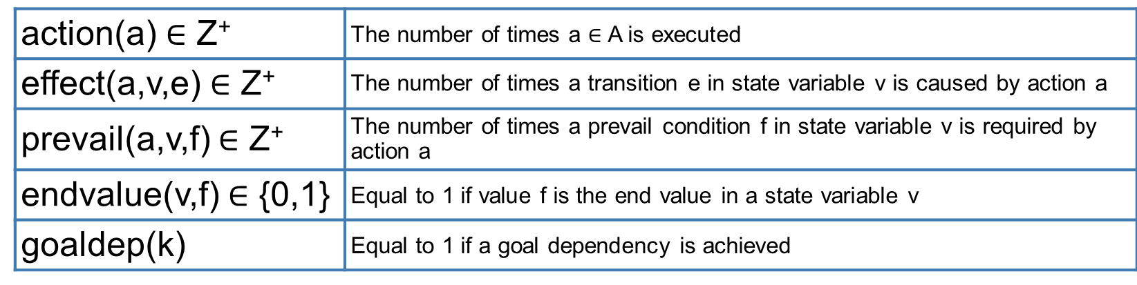
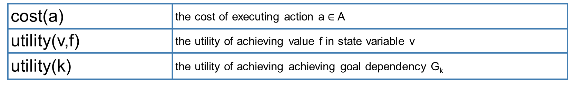
Heuristic as an Integer Program
[Benton, van den Briel & Kambhampati ICAPS 2007]
Constraints of this Heuristic
1. If an action executes, then all of its effects and prevail conditions must also.
action(a) = Σ_{effects of a in v} effect(a,v,e) + Σ_{prevails of a in v} prevail(a,v,f)
2. If a fact is deleted, then it must be added to re-achieve a value.
1{if f ∈ s₀[v]} + Σ_{effects that add f} effect(a,v,e) = Σ_{effects that delete f} effect(a,v,e) + endvalue(v,f)
3. If a prevail condition is required, then it must be achieved.
1{if f ∈ s₀[v]} + Σ_{effects that add f} effect(a,v,e) ≥ prevail(a,v,f) / M
4. A goal utility dependency is achieved iff its goals are achieved.
goaldep(k) ≥ Σ_{f in dependency k} endvalue(v,f) – |G_{k}| – 1
goaldep(k) ≤ endvalue(v,f) ∀ f in dependency k
Variables
Parameters

Slide 22



Relaxed Plan Lookahead
[Benton, van den Briel & Kambhampati ICAPS 2007]
α
Lookahead
Actions
Move(α,γ)
Move(α,β)
Sample(Soil,α)
β
α,Soil
γ
Move(α,β)
[similar to Vidal 2004]
Move(α,γ)
Lookahead
Actions
β ,Soil
γ, Soil
Move(β,α)
Lookahead
Actions
Move(β,γ)
α,Soil
Sample(Rock,β)
γ, Soil
β ,Soil,Rock
Lookahead
Actions
…
Move(β,α)
Move(β,γ)
β
α,Soil
γ, Soil
…
…
α
γ
…

Slide 23
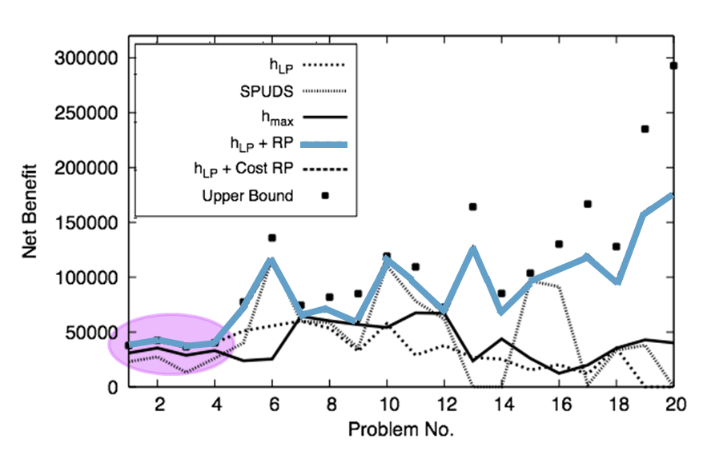
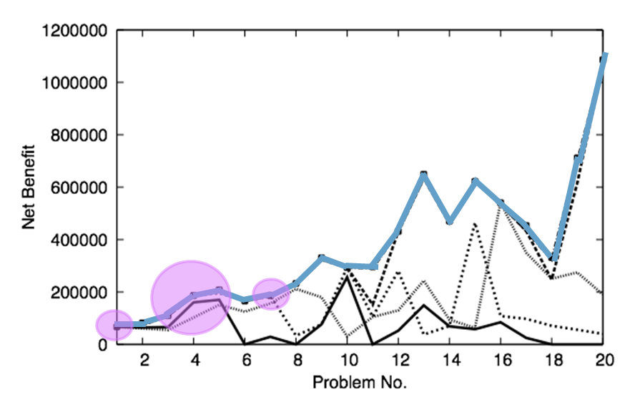
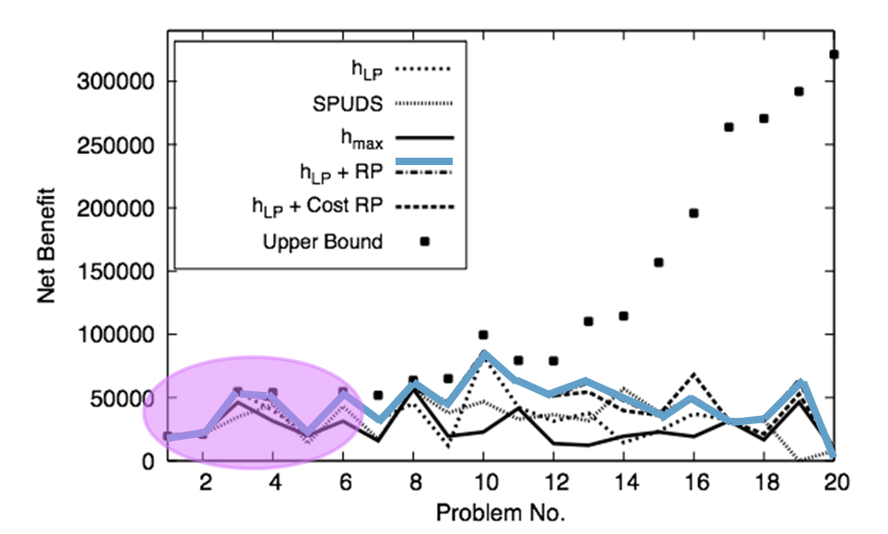

Results:
$$h_{LP}^{GAI}$$
[Benton, van den Briel & Kambhampati ICAPS 2007]
Rovers
Satellite
Found Optimal
in 15
Zenotravel
(higher is better)

Slide 24
Stage
PSP
[Yoon, Benton, Kambhampati ICAPS 2008]
Adopts Stage algorithm
  Originally used for optimization problems
  Combines a search strategy with restarts
  Restart points come from value function learned via previous search
    First used hand-crafted features
    We use automatically derived features
[Boyan & Moore 2000]
O-Search:
  A* Search
  Use tree to learn new value function V
S-Search:
  Hill-climbing search
  Using V, find a state S for restarting
  O-Search
Rovers

Slide 25
Agenda
In Proposal:
Partial Satisfaction Planning – A Quick History
PSP and Utility Dependencies [IPC 2006; IJCAI 2007; ICAPS 2007]
Study of Compilation Methods [AIJ 2009]
Completed Proposed Work:
Time-dependent goals [ICAPS 2012, best student paper award]

Slide 26
Compilation
Directly Use
AI Planning Methods
[Benton, Do & Kambhampati 2009]
[Benton, Do & Kambhampati 2006,2009]
[Keyder & Geffner 2007, 2009]
PDDL3-SP
PSP
Net Benefit
Cost-based
Planning
Planning Competition
“simple preferences” language
Integer
Programming
[van den Briel, et al. 2004]
[Russell & Holden 2010]
Weighted
MaxSAT
[van den Briel, et al. 2004]
Bounded-length optimal
Markov Decision Process
Bounded-length optimal
Also: Full PDDL3 to metric planning for symbolic breadth-first search [Edelkamp 2006]

Slide 27
PDDL3-SP to PSP / Cost-based Planning
Soft Goals
[Benton, Do & Kambhampati 2006,2009]
(:goal (preference P0A (stored goods1 level1)))
(:metric
(+ (× 5 (is-violated P0A) )))
(:goal (preference P0A (stored goods1 level1)))
(:metric
(+ (× 5 (is-violated P0A) )))
Minimizes violation cost
(:action p0a-0
:parameters ()
:cost 0.0
:precondition (and (stored goods1 level1))
:effect (and (hasPref-p0a)))
(:action p0a-1
:parameters ()
:cost 5.0
:precondition (and
(not (stored goods1 level1)))
:effect (and (hasPref-p0a)))
(:goal (hasPref-p0a))
(:action p0a
:parameters ()
:precondition (and (stored goods1 level1))
:effect (and (hasPref-p0a)))
(:goal ((hasPref-p0a) 5.0))
Maximizes net benefit
1-to-1 mapping
between optimal solutions that achieve
“has preference” goal once
Actions that delete goal also delete “has preference”

Slide 28
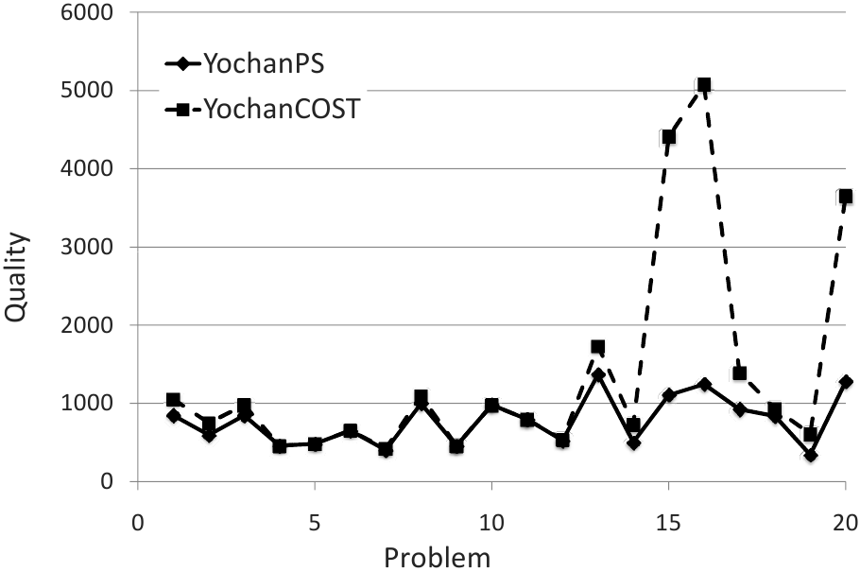
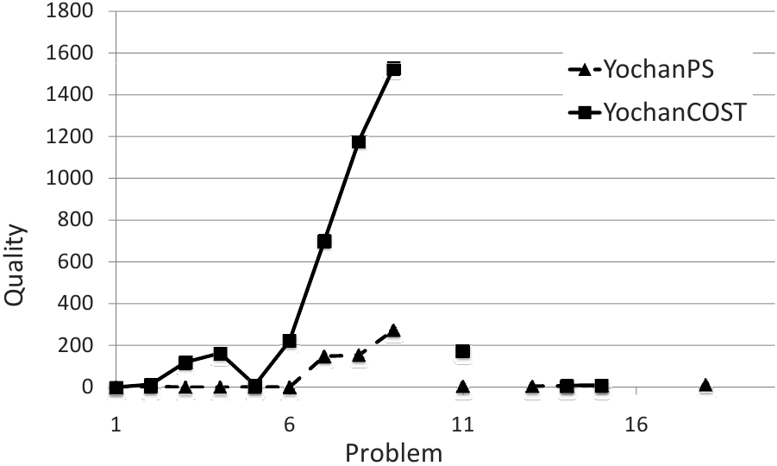
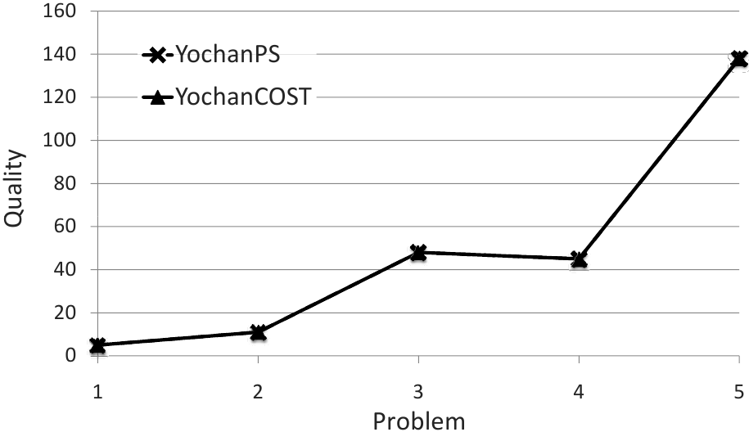
Results
Rovers
Trucks
Storage
(lower is better)

Slide 29
Agenda
In Proposal:
Partial Satisfaction Planning – A Quick History
PSP and Utility Dependencies [IPC 2006; IJCAI 2007; ICAPS 2007]
Study of Compilation Methods [AIJ 2009]
Completed Proposed Work:
Time-dependent goals [ICAPS 2012, best student paper award]

Slide 30
Temporal Planning
[Benton, Coles and Coles ICAPS 2012; best paper]
Continuous
Cost
Deadlines
PSP
Discrete
Cost
Deadlines
Optimization Metrics
Shortest
Makespan
Any
Feasible
Temporally
Simple
Temporally
Expressive
System Dynamics

Slide 31
Continuous Case
[Benton, Coles and Coles ICAPS 2012; best paper]
The Dilemma of the Perishable Food
6 days
Cost
β
Deliver Blueberries
0
7 days
soft
deadline
max cost
deadline
5 days
3 days
Deliver Apples
γ
Goal Achievement Time
α
7 days
Deliver Oranges
Apples last ~20 days
Oranges last ~15 days
Blueberries last ~10 days

Slide 32
Makespan != Plan Utility
[Benton, Coles and Coles ICAPS 2012; best paper]
The Dilemma of the Perishable Food
6 days
Cost
β
Deliver Blueberries
0
7 days
max cost
deadline
5 days
3 days
Deliver Apples
7 days
γ
α
Deliver Oranges
plan
makespan
time-on-shelf
Apples last ~20 days
Oranges last ~15 days
Blueberries last ~10 days
α→β→γ
15
13 + 0 + 0 = 13
β→γ→α
16
4 + 6 + 4 = 14

Slide 33
Solving for the Continuous Case
[Benton, Coles and Coles ICAPS 2012; best paper]
Handling continuous costs
  Directly model continuous costs
  Compile into discretized cost functions
  (PDDL3 preferences)

Slide 34
Handling Continuous Costs
[Benton, Coles and Coles ICAPS 2012; best paper]
Model passing time as a PDDL+ process
Use “Collect Cost” Action for Goal
cost(g)
f(t,g)
Cost
Conditional effects
precondition
tg < d : 0
0
at(apples, α)
d
d + c
d < tg < d + c : f(t,g)
Time
tg ≥ d + c : cost(g)
New goal
collected_at(apples, α)
effect
collected_at(apples, α)

Slide 35
“Anytime” Search Procedure
[Benton, Coles and Coles ICAPS 2012; best paper]
Enforced hill-climbing search for an incumbent solution P
Restart using best-first branch-and-bound:
  Prune using cost(P)
    Use admissible heuristic for pruning

Slide 36
Compile to Discretized Cost
[Benton, Coles and Coles ICAPS 2012; best paper]
cost(g)
f(t,g)
Cost
0
d
d + c
Time

Slide 37
Discretized Compilation
[Benton, Coles and Coles ICAPS 2012; best paper]
Cost
f1(t,g)
f2(t,g)
cost(g)
cost(g)
0
0
d1
d2
Time
Cost
f3(t,g)
cost(g)
0
d3
Time

Slide 38
Final Discretized Compilation
[Benton, Coles and Coles ICAPS 2012; best paper]
cost(g)
fd(t,g)
Cost
0
d1
d2
d1 + c
d3=
Time
fd(t,g) = f1(t,g) + f2(t,g) + f3(t,g)
What’s the best granularity?

Slide 39
The Discretization (Dis)advantage
[Benton, Coles and Coles ICAPS 2012; best paper]
we can prune this one
if this one is found first
cost(g)
fd(t,g)
Cost
0
d1
d2
d1 + c
d3=
Time
With the admissible heuristic we can do this
early enough to reduce the search effort!

Slide 40
The Discretization (Dis)advantage
[Benton, Coles and Coles ICAPS 2012; best paper]
But you’ll miss this better plan
cost(g)
f(t,g)
Cost
The cost function!
0
d1
d2
d1 + c
d3=
Time

Slide 41

Continuous vs. Discretization
[Benton, Coles and Coles ICAPS 2012; best paper]
The Contenders
Continuous Advantage
  More accurate solutions
  Represents actual cost functions
Discretized Advantage
  “Faster” search
  Looks for bigger jumps in quality

Slide 42

Continuous + Discrete-Mimicking Pruning
[Benton, Coles and Coles ICAPS 2012; best paper]
Tiered Search
Continuous Representation
  More accurate solutions
  Represents actual cost functions
Mimicking Discrete Pruning
  “Faster” search
  Looks for bigger jumps in quality

Slide 43
Tiered Approach
[Benton, Coles and Coles ICAPS 2012; best paper]
solution value
cost(g)
Cost: 128 (sol)
f(t,g)
Cost
0
d
d + c
Time

Slide 44
Tiered Approach
[Benton, Coles and Coles ICAPS 2012; best paper]
heuristically prune
solution value
cost(g)
Cost(s₁): 128 (sol)
Prune >= sol – s₁/2
f(t,g)
Cost
0
d
d + c
Time
Sequential pruning bounds where we
heuristically prune
from the cost of the best plan so far

Slide 45
Tiered Approach
[Benton, Coles and Coles ICAPS 2012; best paper]
heuristically prune
solution value
cost(g)
Cost(s₁): 128 (sol)
Prune >= sol – s₁/4
f(t,g)
Cost
0
d
d + c
Time
Sequential pruning bounds where we
heuristically prune
from the cost of the best plan so far

Slide 46
Tiered Approach
[Benton, Coles and Coles ICAPS 2012; best paper]
heuristically prune
solution value
cost(g)
Cost(s₁): 128 (sol)
Prune >= sol – s₁/8
f(t,g)
Cost
0
d
d + c
Time
Sequential pruning bounds where we
heuristically prune
from the cost of the best plan so far

Slide 47
Tiered Approach
[Benton, Coles and Coles ICAPS 2012; best paper]
heuristically prune
solution value
cost(g)
Cost(s₁): 128 (sol)
Prune >= sol – s₁/16
f(t,g)
Cost
0
d
d + c
Time
Sequential pruning bounds where we
heuristically prune
from the cost of the best plan so far

Slide 48
Tiered Approach
[Benton, Coles and Coles ICAPS 2012; best paper]
solution value
cost(g)
Cost(s₁): 128 (sol)
Prune >= sol
f(t,g)
Cost
0
d
d + c
Time
Sequential pruning bounds where we
heuristically prune
from the cost of the best plan so far

Slide 49
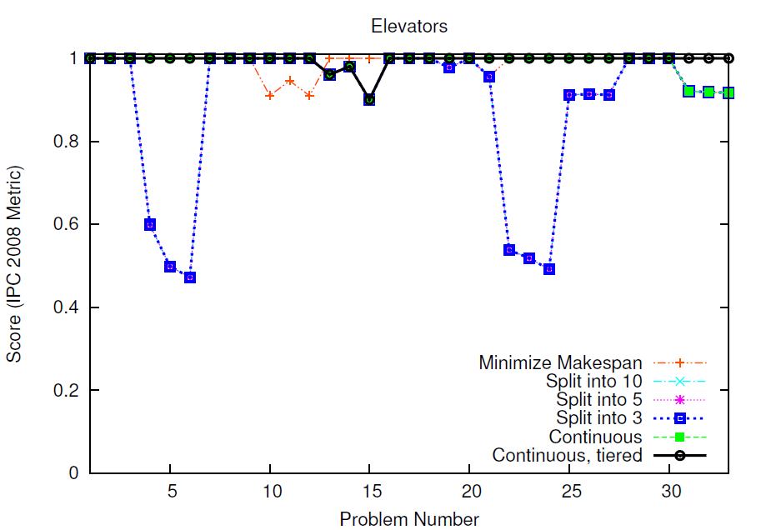
Time-dependent Cost Results
[Benton, Coles and Coles ICAPS 2012; best paper]

Slide 50
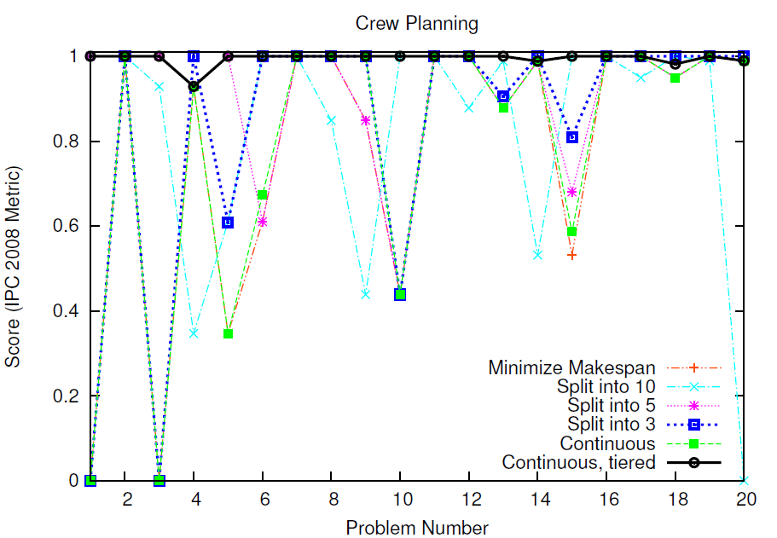
Time-dependent Cost Results
[Benton, Coles and Coles ICAPS 2012; best paper]

Slide 51
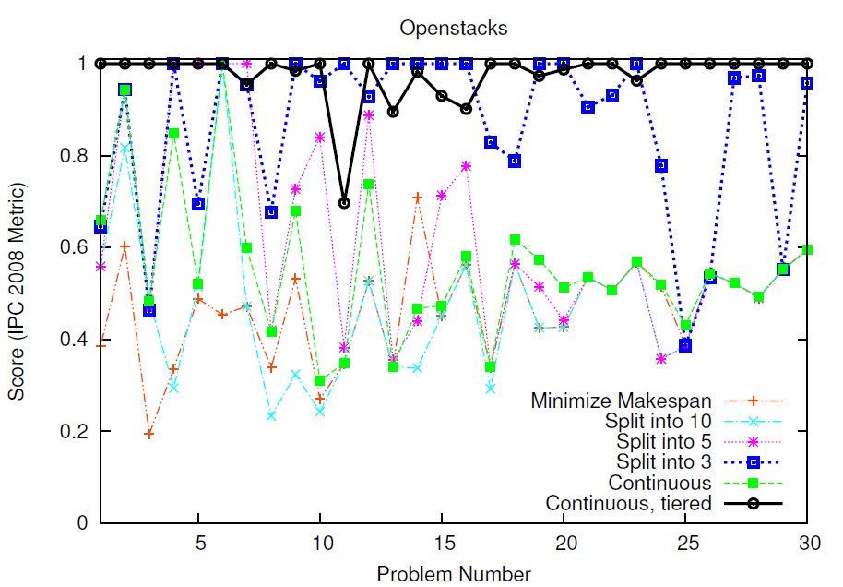
Time-dependent Cost Results
[Benton, Coles and Coles ICAPS 2012; best paper]

Slide 52
Summary
Partial Satisfaction Planning
  Ubiquitous
  Foregrounds Quality
  Present in many applications
Challenges: Modeling & Solving
  Extended state-of-the-art methods to handle:
  - PSP problems with goal utility
  dependencies
  - PSP problems involving soft deadlines

Slide 53
Other Work
In looking at PSP:
  Anytime Search Minimizing Time Between Solutions
  [Thayer, Benton & Helmert SoCS 2012; best student paper]
  Online Anticipatory Planning
  [Burns, Benton, Ruml, Do & Yoon ICAPS 2012]
  Planning for Human-Robot Teaming
  [Talamadupula, Benton, et al. TIST 2010]
  G-value plateaus: A Challenge for Planning
  [Benton, et al. ICAPS 2010]
  Cost-based Satisficing Search Considered Harmful
  [Cushing, Benton & Kambhampati SoCS 2010]

Slide 54
Ongoing Work in PSP
More complex time-dependent costs
  (e.g., non-monotonic costs, time windows, goal achievement-based cost functions)
Multi-objective (e.g., multiple resource) plan quality measures

Slide 55
References
K. Talamadupula, J. Benton, P. Schermerhorn, M. Scheutz, S, Kambhampati. Integrating a Closed World Planner with an Open-World Robot. In AAAI 2010.
D. Smith. Choosing Objectives in Over-subscription Planning. In ICAPS 2004.
D. Smith. “Mystery Talk”. PLANET Planning Summer School 2003.
S. Yoon, J. Benton, S. Kambhampati. An Online Learning Method for Improving Over-subscription Planning. In ICAPS 2008.
M. van den Briel, R. Sanchez, M. Do, S. Kambhampati. Effective Approaches for Partial Satisfaction (Over-subscription) Planning. In AAAI 2004.
J. Benton, M. Do, S. Kambhampati. Over-subscription Planning with Metric Goals. In IJCAI 2005.
J. Benton, M. Do, S. Kambhampati. Anytime Heuristic Search for Partial Satisfaction Planning. In Artificial Intelligence Journal, 173:562-592, April 2009.
J. Benton, M. van den Briel, S. Kambhampati. A Hybrid Linear Programming and Relaxed Plan Heuristic for Partial Satisfaction Planning. In ICAPS 2007.
J. Benton, J. Baier, S. Kambhampati. Tutorial on Preferences and Partial Satisfaction in Planning. AAAI 2010.
J. Benton, A. J. Coles, A. I. Coles. Temporal Planning with Preferences and Time-Dependent Continuous Costs. ICAPS 2012.
M. Do, J. Benton, M. van den Briel, S. Kambhampati. Planning with Goal Utility Dependencies. In IJCAI 2007
J. Boyan and A. Moore. Learning Evaluation Functions to Improve Optimization by Local Search. In Journal of Machine Learning Research, 1:77-112, 2000.

Slide 56
References
R. Sanchez, S. Kambhampati. Planning Graph Heuristics for Selecting Objectives in Over-subscription Planning Problems. In ICAPS 2005.
M. Do, Terry Zimmerman, S. Kambhampati. Tutorial on Over-subscription Planning and Scheduling. AAAI 2007.
W. Ruml, M. Do, M. Fromhertz. On-line Planning and Scheduling for High-speed Manufacturing. In ICAPS 2005.
E. Keyder, H. Geffner. Soft Goals Can Be Compiled Away. Journal of Artificial Intelligence, 36:547-556, September 2009.
R. Russell, S. Holden. Handling Goal Utility Dependencies in a Satisfiability Framework. In ICAPS 2010.
S. Edelkamp, P. Kissmann. Optimal Symbolic Planning with Action Costs and Preferences. In IJCAI 2009.
M. van den Briel, T. Vossen, S. Kambhampati. Reviving Integer Programming Approaches for AI Planning: A Branch-and-Cut Framework. In ICAPS 2005.
V. Vidal. A Lookahead Strategy for Heuristic Search Planning. In ICAPS 2004.
F. Bacchus, A. Grove. Graphical Models for Preference and Utility. In UAI 1995.
M. Do, S. Kambhampati. Planning Graph-based Heuristics for Cost-sensitive Temporal Planning. In AIPS 2002.
H. Simon. On the Concept of Organizational Goal. In Administrative Science Quarterly. 9:1-22, June 1964.
H. Simon. Motivational and Emotional Controls of Cognition. In Psychological Review. 74:29-39, January 1964.

Slide 57
Partial Satisfaction Planning
Thanks!

