Slide 1
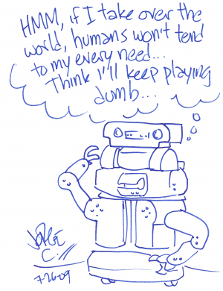
PLANNING CHALLENGES IN
HUMAN-ROBOT TEAMING
KARTIK TALAMADUPULA
Committee Members
Dr. Subbarao Kambhampati, Chair
Dr. Chitta Baral
Dr. Huan Liu
Dr. Matthias Scheutz
Dr. David E. Smith
Source: Robot Comics

Slide 2
Planning for Human-Robot Teaming
Human-Robot Teaming (HRT) is becoming an important problem
Requires a lot of different technologies
  Perception (Vision), Actuation, Dialogue, Planning …
Most current robots are glorified remote-operated sensors
Autonomous Planning is an important capability
  Supporting flexible HRT with constant changes
The broad aims of this thesis are to
  Engineer an effective integration of planning techniques into a Human-Robot Teaming system
  Analyze the design tradeoffs involved in doing so
Notes:
STAID SLIDE.
I got involved in this work trying to use existing planning technology to support the teaming behavior.

Slide 3
Contributions
Engineering Approach
    Planners have not been used extensively in HRT scenarios
    Introduce planner into an architecture for HRT
    Use/extend automated planning methods
      QUANTIFIED GOALS in an open world
      REPLANNING for a changing, open world
      Handling MODEL CHANGE during planning
      PLAN RECOGNITION to enhance planning
Analysis of Solution Methods
Notes:
First contrib. was to just make the planner WORK, while controlling a robot in real-time.
And so for each one of these 4, I will explain the implemented solution first.
And then I will take a step back and look at a more principled way of doing things.
In some cases, it has been done – e.g., replanning. In some other cases, it remains work to be done.

Slide 4
Contributions
Engineering Approach
    Planners have not been used extensively in HRT scenarios
    Introduce planner into an architecture for HRT
    Use/extend automated planning methods
      QUANTIFIED GOALS in an open world
      REPLANNING for a changing, open world
      Handling MODEL CHANGE during planning
      PLAN RECOGNITION to enhance planning
Analysis of Solution Methods
Notes:
First contrib. was to just make the planner WORK, while controlling a robot in real-time.
And so for each one of these 4, I will explain the implemented solution first.
And then I will take a step back and look at a more principled way of doing things.
In some cases, it has been done – e.g., replanning. In some other cases, it remains work to be done.

Slide 5
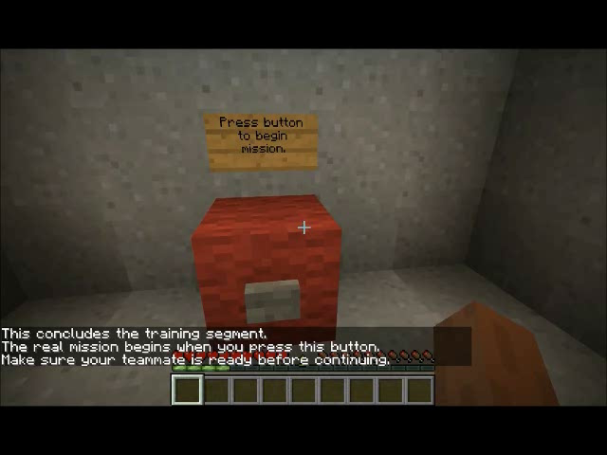
USAR Human Factors Case Study
Joint work with C. Bartlett, N. Cooke, Y. Zhang, S. Kambhampati

Slide 6
Planning Challenges in Human-Robot Teaming
OPEN WORLD GOALS
    Provide a way to specify quantified goals on unknown objects
    Consider a more principled way of handling uncertainty in facts
REPLANNING
    Handle state and goal updates from a changing world while executing
    Present a unified theory of replanning, to analyze tradeoffs
MODEL UPDATES
    Accept changes to planner’s domain model via natural language
PLAN RECOGNITION
    Use belief models of other agents to enhance planning
Notes:
Second contributions slide.

Slide 7
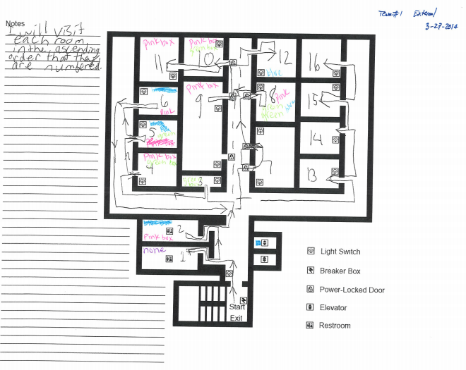
Urban Search and Report (USAR)
Joint work with C. Bartlett, N. Cooke, Y. Zhang, S. Kambhampati
Notes:
I am going to give you a quick intro to the scenario at hand. This is going to be a running example through this discussion. This is a map of a building where search & recon/report must be performed. You have an agent that goes in to perform the recon, in communication with another remote agent (human).
Notice that since the building is damaged, things on the ground may not be exactly as they seem in the map.
So we first did human-human experiments, to figure how human teams would handle this scenario. The following is a video trace …

Slide 8
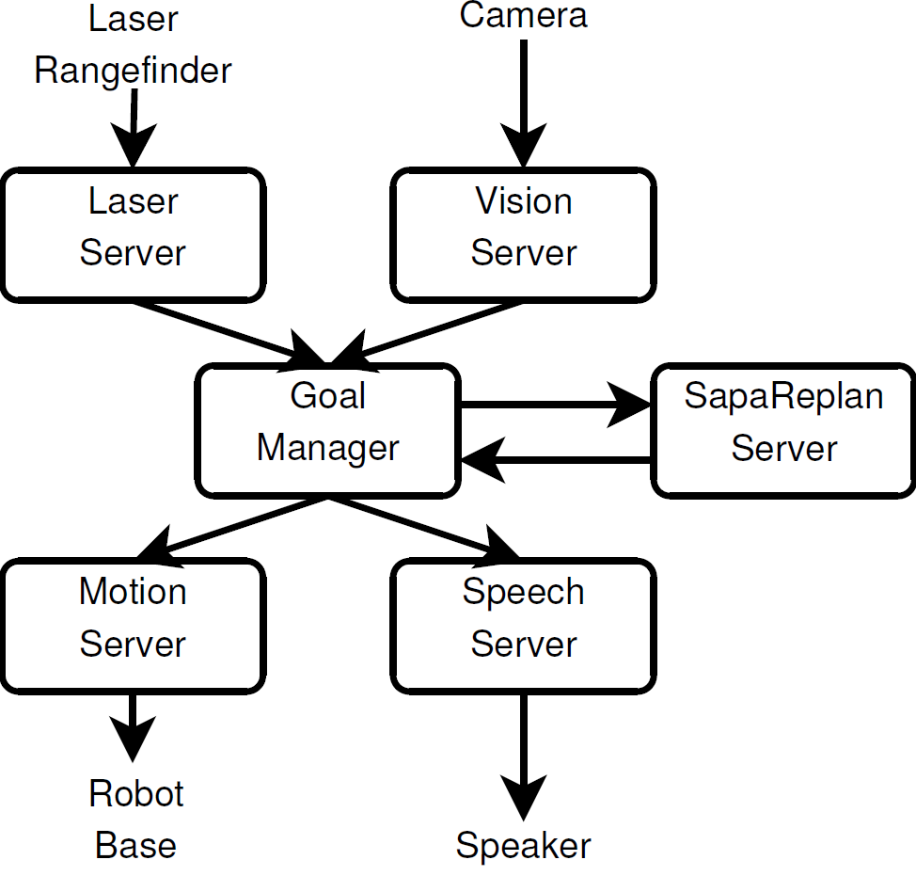
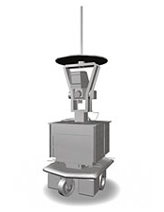

An Integrated System for USAR
Updated
Information
Updates
Actions
Goal Manager
Plan
Monitor
Plan
Planner
World State and Goals
Model and Belief Updates
Notes:
My main work has been in situating / engineering the planner into this integrated system.
A lot of my time was spent here; along the way, I did some additional NOVEL analysis of the problems that I had to solve.

Slide 9
Planner’s Role
PLANNER
World Updates
Quantified
Goals
on
Unknown
Objects
New Plan
to
Execute
Model
Updates
Beliefs
and
Intentions
GOAL MANAGER
Notes:
So the things that I had to solve (GOALS I SET FOR MYSELF IN THIS THESIS) to enable this kind of integration of the planner into HRT are the following.
While there are lots of engg. issues, I WANT TO FOCUS ON THE ONES THAT I HAD TO SOLVE (TO DO THIS INTEGRATION) IN MY TALK/THESIS.
WORLD KEEPS CHANGING
THERE ARE UNKNOWN OBJECTS, AND THERE ARE GOALS ABOUT THOSE OBJECTS
THE ACTION MODEL KEEPS CHANGING
THERE ARE OTHER AGENTS, WHOSE BELIEFS WE NEED TO TAKE INTO ACCOUNT

Slide 10
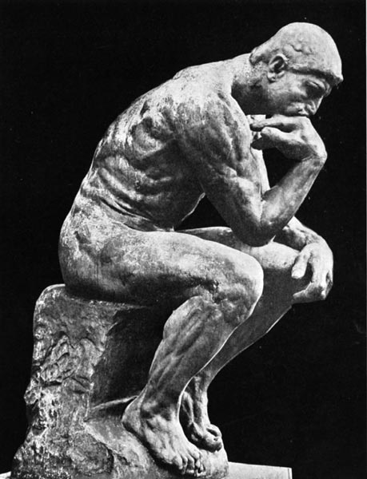
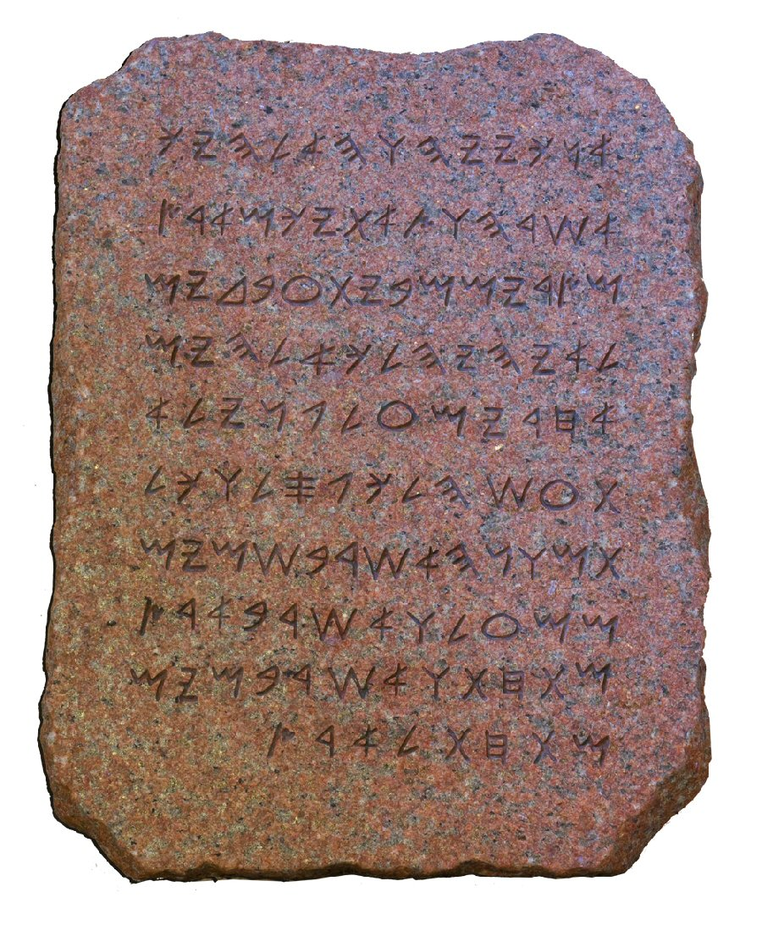

The TRADITIONAL Planner
An Island Unto Itself
Full
Problem
Specification
PLANNER
Fully Specified
Action Model
Fully Specified
Goals
Completely Known (Initial) World State
Plan (Handed off for Execution)
Notes:
Planning can be used for all of these problems. However, classical planning barricades itself in an artificial world.
Enormous speedups in the past decade … but of what use? All these restrictive assumptions ---
Problem specification is handed down from the heavens.
Planner assumes fully specified everything – action model, goals, state.
Plan is handed off for execution and planner forgets about it.
ONE SHOT PLANNING.

Slide 11

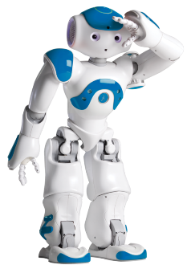
The Embedded Planner
An Interactive, Iterative System
Full
Problem
Specification
Problem Updates
[TIST10]
0000000000000000000000000000000000000000000000000000000000000000000000000
Open World Goals
[IROS09, AAAI10, TIST10]
Assimilate Sensor Information
Action Model Information
[HRI12]
PLANNER
Sapa Replan
Handle Human Instructions
[ACS13, IROS14]
Fully Specified
Action Model
Goal Manager
Communicate with Human in the Loop
Fully Specified
Goals
Planning for
Human-Robot Teaming
Completely Known (Initial) World State
Replan for the Robot
[AAAI10, DMAP13]
Coordinate with Humans
[IROS14]
Notes:
The story I am going to give you is of two interactive, iterative AI applications – HRT, and crowdsourcing – and the challenges that must be handled to provide embedded AI planning support for them.
The embedded planner cannot assume a number of things:
Full knowledge: Out the window, comes in piecemeal
One shot planning: Not possible, knowledge trickling in ← need to engage agents
Assimilate new information
There is an interactive loop going: planning as an interactive, iterative process

Slide 12
Fielded Prototype
Planning Artifact: Sapa Replan
  Extension of Sapa metric temporal planner
Partial Satisfaction Planning
  Builds on Sapa^{PS} planner
Replanning
  Uses an execution monitor to support scenarios with real-time execution
[Benton et al., AIJ07]
[Talamadupula, Benton, et al., TIST10]

Slide 13
Planning Challenges in Human-Robot Teaming
OPEN WORLD GOALS
    Provide a way to specify quantified goals on unknown objects
    Consider a more principled way of handling uncertainty in facts
REPLANNING
    Handle state and goal updates from a changing world while executing
    Present a unified theory of replanning, to analyze tradeoffs
MODEL UPDATES
    Accept changes to planner’s domain model via natural language
PLAN RECOGNITION
    Use belief models of other agents to enhance planning
Notes:
Second contributions slide.

Slide 14
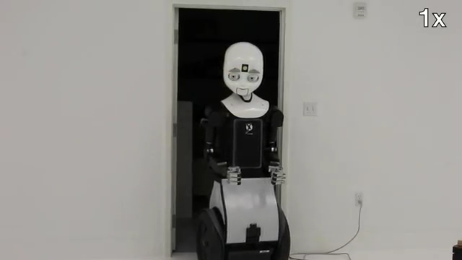
Open World Goals
When to start
sensing?
  Indicator to start
  sensing
What to look for?
  Object type
  Object properties
When to stop sensing?
  When does the planner know the world is closed?
Why should the robot sense?
  Does the object fulfill a goal?
  What is the reward? Is it a bonus?
[Talamadupula, Benton et al., ACM TIST 2010]

Slide 15
Open World Quantified Goals (OWQGs)
When to sense
What to sense
When to stop
Why sense
“Wounded persons may be in rooms. Report the locations of as many wounded people as possible.”
(:open (forall ?r – room
(sense ?p – person
(looked_for ?p ?r)
(and (has_property ?p wounded)
(in ?p ?r))
(:goal
(and (reported ?p wounded ?r)
[100] - soft))))
Quantified Object(s) [1]
Sensed Object [2]
Closure Condition [3]
Quantified Facts [2]
Quantified Goal [4]
[Talamadupula, Benton et al., ACM TIST 2010]
Notes:
Remember the four questions from before.
The quantified objects which indicate an opportunity (in this case, a zone)
The object that must be sensed (in this case, a person)
The closure condition, which indicates that the goal is now “closed” (having looked for a person in a zone)
Facts that are true about the object that we are sensing for (that the person is wounded, and is in the zone ?z); and
The goal itself, which in this case is reporting that the wounded person is in zone ?z, and carries some reward (100) with it.

Slide 16
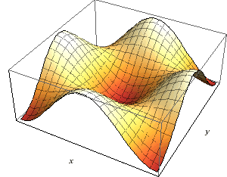
Solution Approach
Tricking the Robot for Profit
OWQG is provided to the planner
Planner uses an optimistic determinization
  Given an OWQG, assume the presence of object
    Create a runtime object (may exist only in planner)
    E.g.: For every room, assume wounded person
Replan
    Make a new plan that uses runtime object to achieve the open world goal; (assumed) profit from reward
Execute
    Up to the sensing action (closure condition)
    Delete runtime object
    Real object either exists, or doesn’t

Slide 17
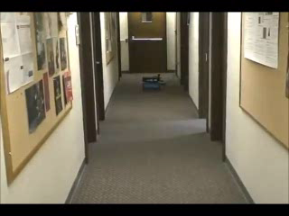
Replanning for Changing Worlds
New Information
    Sensors
    Human teammate
New Goals
    Orders: Humans
    Requests
Requirement
    New plan that works in new world (state)
    Achieves the changed goals
[Talamadupula et al. AAAI10]

Slide 18
How to Replan
The Engineering Solution
Problem changes from [I, G] to [I`, G`]
Solution:
  Stop execution of old plan π
  Assimilate state changes I → I`
  Assimilate goal changes G → G`
  Give the new instance [I`, G`] to planner
  Execute the new plan π`
(Re)Planning System: Sapa Replan

Slide 19
Sapa Replan: Execution Monitor
Implement rational choice over possible courses of action
  Two possible choices
    Continue currently executing plan
    Deliberate (replan)
Objective Selection
  Two possibilities
    Update goal description: Replan
    Update goal description: Replan + Restart search
  Net Benefit
    Partial Satisfaction Planning
[ASU-TR08, IROS09, TIST10, AAAI10, SPARK11]

Slide 20
Specifying Changes
Use an update syntax
Example
U = <O, E, G_{n}, T>
O: Set of objects (constants)
E: Set of new events (predicates)
G_{n}: Set of new goals
T: Current time point
1 (:update
2 :objects
3 room3 - room
4 :events
5 (at 125.0 (not (at room2)))
6 (at room3)
7 (visited room3)
8 :goal (visited room4) [500] - hard
9 :now 207.0)
[Talamadupula et al. AAAI10]

Slide 21
Replanning + Open World Goals
USAR Example
Original Plan
(move-hallway hall_start hall1)
(move-hallway hall1 hall2)
(move-hallway hall2 hall3)
(move-hallway hall3 hall_end)
(deliver medkit1)
(:open (forall ?r – room
(sense ?p – person
(looked_for ?p ?r)
(and (has_property ?p wounded)
(in ?p ?r))
(:goal
(and (reported ?p wounded ?r)
[100] - soft))))
New Plan
(move-hallway hall2 hall3)
(enter room1 hall3)
(sense-for !person1 room1)
(report !person1 room1)
(exit room1 hall3)
(move-hallway hall3 hall_end)
(deliver medkit1)
(:update
:objects
room1 - room
:events
(at 90.0 (not (at hall1)))
(at hall2)
(connected hall3 room1)
:goal
:now 103.0)

Slide 22
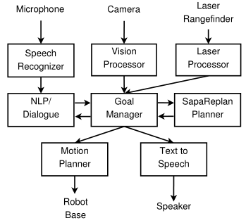
Model Updates
(via natural language)
“To go into a room when you are at a closed door, push it one meter.”
    Precondition: “you are at a closed door”
    Action definition: “push it one meter”
    Effect: “go into a room”
NLP Module
    Reference resolution
    Parsing
    Background knowledge
    Action submission (to planner)
[Cantrell, Talamadupula et al., HRI 2012]
[In collaboration with hrilab, Tufts University]

Slide 23
Example: Action Addition
New Action: “push”
(:durative-action push
:parameters (?door - doorway ?cur_loc - hallway ?to_loc - zone)
:duration (= ?duration (dur_push))
:condition (and (at start (at ?cur_loc))
(at start (door_connected ?door ?cur_loc ?to_loc))
(over all (door_connected ?door ?cur_loc ?to_loc)))
:effect (and (at start (not (at ?cur_loc)))
(at end (open ?doorway))
(at end (at ?to_loc))))
“To go into a room when you are at a closed door, push it one meter.”
From natural language
Architecture
Background knowledge

Slide 24
Why Support Model Updates?
One ground truth model of the world
    Neither human nor robot have this
    Human may know more though …
Impossible to specify everything up-front
    But during execution …
    Addition
      Human sees a closed door, but knows robot can push it
    Deletion
      Taking a picture might ignite vapors
    Modification
      No power, so robot must needs light for taking a picture
Notes:
THIS IS THE HARD THING ABOUT MODELS – CANNOT SPECIFY THEM BEFOREHAND.

Slide 25





Model Revision
Model represented in PDDL
PDDL domain model
    : set of constants (objects)
    : set of predicates
    : set of functions
    : set of actions (operators)
Revision should support modification of any of these on the fly

Slide 26
How to Update a Model
(The Engineering Solution)
Pause execution of the current plan
Provide a way of updating an existing model
  (Currently restricted to only actions)
  Planner API for architecture can access and edit various action constituents
      Cost
      Duration
      Variables (Parameters)
      Preconditions
      Effects
Replan with new model, generate new plan
  Discard old plan
Execute new plan

Slide 27
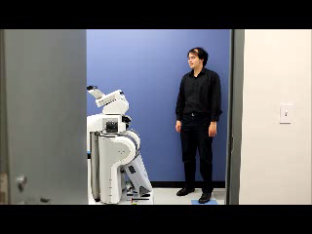
Plan & Intent Recognition
[In collaboration with hrilab, Tufts University]
[Talamadupula, Briggs et al., IROS14]

Slide 28
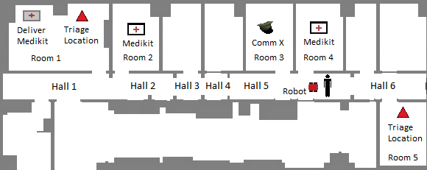
Proposed Approach
Map the robot’s beliefs and knowledge about CommX into a new planning instance
Generate a plan for this instance – prediction of CommX’s plan
Extract relevant information from the predicted plan
  Which medkit will CommX pick up?
Use the extracted information to deconflict robot’s plan

Slide 29
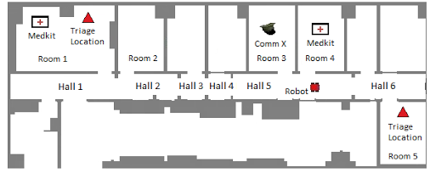
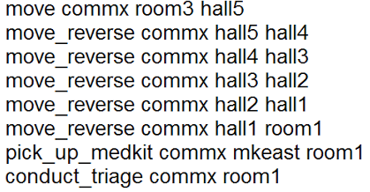
Solution
Comm X’s Goal
PREDICTED
PLAN FOR
COMMX

Slide 30
Contributions
Engineering Approach
    Planners have not been used extensively in HRT scenarios
    Introduce planner into an architecture for HRT
    Use/extend automated planning methods
      QUANTIFIED GOALS in an open world
      REPLANNING for a changing, open world
      Handling MODEL CHANGE during planning
      PLAN RECOGNITION to enhance planning
Analysis of Solution Methods
Notes:
First contrib. was to just make the planner WORK, while controlling a robot in real-time.
And so for each one of these 4, I will explain the implemented solution first.
And then I will take a step back and look at a more principled way of doing things.
In some cases, it has been done – e.g., replanning. In some other cases, it remains work to be done.

Slide 31
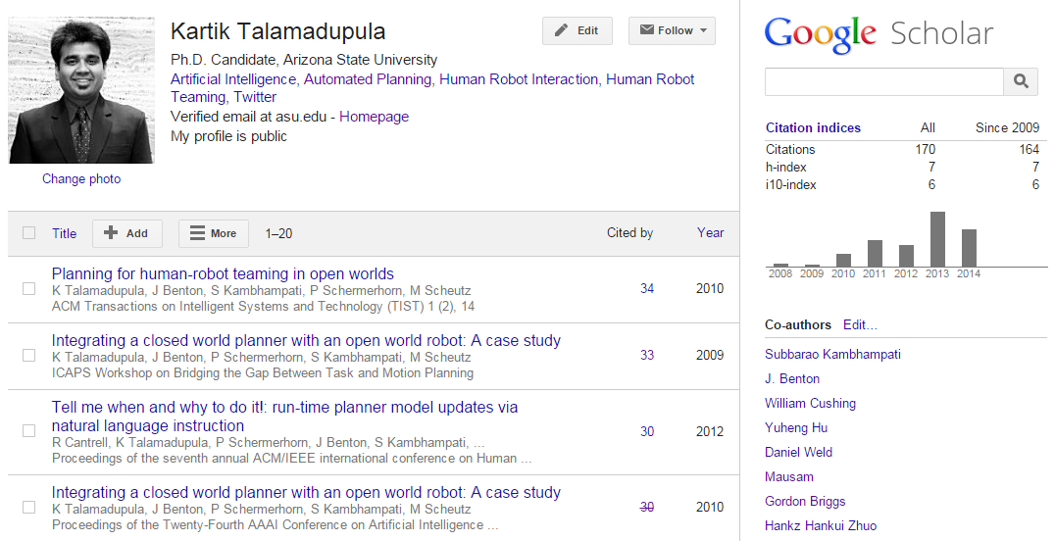
Relevant Publications
Coordination in Human-Robot Teams Using Mental Modeling and Plan Recognition.
Talamadupula, K.; Briggs, G.; Chakraborti, T.; Scheutz, M.; and Kambhampati, S.
Proceedings of the IEEE/RSJ International Conference on Intelligent Robots and Systems (IROS), 2014.
The Metrics Matter!: On the Incompatibility of Different Flavors of Replanning.
Talamadupula, K.; Smith, D. E.; and Kambhampati, S.
arXiv preprint arXiv:1405.2883, 2014.
Architectural Mechanisms for Handling Human Instructions in Open-World Mixed-Initiative Team Tasks.
Talamadupula, K.; Briggs, G.; Scheutz, M.; and Kambhampati, S.
Proceedings of the Second Annual Conference on Advances in Cognitive Systems (ACS), 2013.
On the Many Interacting Flavors of Planning for Robotics.
Talamadupula, K.; Scheutz, M.; Briggs, G.; and Kambhampati, S.
ICAPS 2013 Workshop on Planning and Robotics (PlanRob)
A Theory of Intra-Agent Replanning.
Talamadupula, K.; Smith, D.; Cushing, W.; and Kambhampati, S.
ICAPS 2013 Workshop on Distributed and Multi-Agent Planning (DMAP)
Tell me when and why to do it!: Run-time Planner Model Updates via Natural Language Instruction.
Cantrell, R.; Talamadupula, K.; Schermerhorn, P.; Benton, J.; Kambhampati, S.; and Scheutz, M.
Proceedings of the Seventh Annual ACM/IEEE International Conference on Human-Robot Interaction (HRI), 471--478, 2012.
Planning for Agents with Changing Goals.
Talamadupula, K.; Schermerhorn, P.; Benton, J.; Kambhampati, S.; and Scheutz, M.
ICAPS 2011 Systems Demos and Exhibits
Placed 3rd for Best Demo
Planning for Human-Robot Teaming.
Talamadupula, K.; Kambhampati, S.; Schermerhorn, P.; Benton, J.; and Scheutz, M.
ICAPS 2011 Scheduling and Planning Applications Workshop (SPARK), 2011.
Planning for Human-Robot Teaming in Open Worlds.
Talamadupula, K.; Benton, J.; Kambhampati, S.; Schermerhorn, P.; and Scheutz, M.
ACM Transactions on Intelligent Systems and Technology (TIST), 1(2):14. 2010.
Integrating a Closed World Planner with an Open World Robot: A Case Study.
Talamadupula, K.; Benton, J.; Schermerhorn, P.; Kambhampati, S.; and Scheutz, M.
Proceedings of the Twenty Fourth AAAI Conference on Artificial Intelligence (AAAI), 2010.
Integrating a Closed World Planner with an Open World Robot: A Case Study.
Talamadupula, K.; Benton, J.; Schermerhorn, P.; Kambhampati, S.; and Scheutz, M.
ICAPS 2011 Workshop on Bridging the Gap between Task and Motion Planning (BTAMP), 2009.
Finding and exploiting goal opportunities in real-time during plan execution.
Schermerhorn, P.; Benton, J.; Scheutz, M.; Talamadupula, K.; and Kambhampati, S.
Proceedings of the IEEE/RSJ International Conference on Intelligent Robots and Systems (IROS), 3912--3917, 2009.
Notes:
My work on extending the frontiers of planning for HRT has been published at various venues, and cited.
A lot of this work has been done in collaboration with Dr. Matthias Scheutz’s hrilab at Tufts University.
“And I’d like to acknowledge all my collaborators.”
Particularly Dr. David Smith, J. Benton, Paul Schermerhorn and Gordon Briggs.

Slide 32
Related Work
Human-Robot Teaming Symbiotic Autonomy [Rosenthal et al. 2010] Seeking Human Help [Rosenthal & Veloso 2012] Replanning with Dynamic Information [Coltin & Veloso 2013] Generalized Architectures for Distributed Human-Robot Teams [Scerri et al. 2003] [Schurr et al. 2005] Mixed-Initiative Planning [Bagchi et al. 1996] Advisable Planning [Myers 1996] Continuous Planning & Execution [Myers 1998] TRAINS-95 [Ferguson et al. 1996] | (Open World) Goals Local Closed Worlds [Etzioni et al. 1997] Sensing Goals [Scherl & Levesque 1993] [Golden & Weld 1996] Temporal Goals [Baral et al. 2001] [Bacchus & Kabanza 1996] Trajectory Constraints (Preferences) [Gerevini et al. 2009] | Replanning & Execution Monitoring Contingent Planning [Albore et al. 2009] [Meauleau & Smith 2003] CASPER [Knight et al. 2001] IxTeT-eXeC [Lemai & Ingrand 2003] STRIPS [Fikes et al. 1972] Plan Stability & Repair [Fox et al. 2006] [Van Der Krogt & De Weerdt 2006] Minimal Perturbation Planning [Kambhampati 1990] Plan Re-Use [Nebel & Koehler 1995] Plan Validity [Fritz & McIlraith 2007] | Multi-Agent Systems Inter and Intra Agent Commiments [Wagner et al. 1999] Inter-Agent Commitments [Meneguzzi et al. 2013] [Komenda et al. 2012] [Komenda et al. 2008] [Bartold & Durfee 2003] [Wooldridge 2000] Coordination Using Mental Models Joint Human Behavior [Klein et al. 2005] Common Ground [Clark & Brennan 1991] Coordinated Assembly Tasks [Kwon & Suh 2012] Object Hand-overs [Strabala 2013]

Slide 33
PLAN & INTENT RECOGNITION
Modeling human agent key to teaming
  Can augment robot’s planning capabilities
  Information can be used for inter-plan coordination
Required information
  Action/capability model of the human agent
  Goal(s) of the human agent
  Current state of the human agent
Planner simulates human’s mental process
  Produces a predicted plan that can be used by robot for coordination purposes
[Talamadupula, Briggs et al., IROS14]
Notes:
THIS IS THE HARD THING ABOUT MODELS – CANNOT SPECIFY THEM FULLY BEFOREHAND.
Here are examples from our scenario that show examples of situations where actions may be added, deleted … or modified.

Slide 34
Can Belief Models Enhance Planning?
Communication Bandwidth
  Even with good NLP, there are still bandwidth issues between humans and robots
  Humans are not always fully explicit about what they are going to do, or what they want
Natural Teaming
  Agents have good models of each other
  Enables them to
    Anticipate: Actions of other teammates
    Recognize: The intentions of other teammates
Can affect the robot’s planning in turn

Slide 35
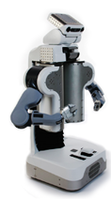
Beliefs, Intentions & Teaming
Agents have beliefs and intentions
  An agent can model its team members’ beliefs and intentions
This information can be used to
predict the plans of team members
[Briggs & Scheutz, SIGDIAL11]

Slide 36
Proposed Approach
Map the robot’s beliefs and knowledge about CommX into a new planning instance
Generate a plan for this instance – prediction of CommX’s plan
Extract relevant information from the predicted plan
  Which medkit will CommX pick up?
Use the extracted information to deconflict robot’s plan
[Talamadupula, Briggs et al., IROS14]

Slide 37
Mapping to Planning
Used for high-level plan synthesis
Can be used to simulate the agent’s plan
  Based on known beliefs and intentions
  Some information about agent’s capabilities
Automated Planning Instance:
  Initial State: All known beliefs of that agent
  Goal Formula: All known goals of that agent
  Action Model: Precondition/Effect description
[Talamadupula, Briggs et al., IROS14]

Slide 38
Mapping to Planning
Beliefs of another agent α
Intentions of another agent α
Mapping to a planning problem
bel _{α} = { φ | bel(α,φ) ∈ bel_{self} }
goals _{α} = { goal(α,φ,P) | goal(α,φ,P) ∈ bel_{self} }
where P is a goal priority
I = { φ | bel(α,φ) ∈ bel_{robot} }
G = { φ | goal(α,φ,P) ∈ bel_{robot} }
O = { o | o ∈ (φ | φ ∈ (I ∪ G) }
[Briggs & Scheutz, SIGDIAL11]
[Talamadupula, Briggs et al., IROS14]
Notes:
P is a goal “priority”

Slide 39
Use Case Scenario
[In collaboration with hrilab, Tufts University]
[Talamadupula, Briggs et al., IROS14]

Slide 40
Use Case Scenario
Comm X’s Goal
CommY: “CommX is going to perform triage at Room 1.”
Robot: “Okay.”
CommY: “I need you to take a medkit to Room 5.”
Robot: “Okay…”
“I am picking up the medkit at Room 4.”
[Talamadupula, Briggs et al., IROS14]

Slide 41
Solution
Comm X’s Goal
PREDICTED
PLAN FOR
COMMX

Slide 42
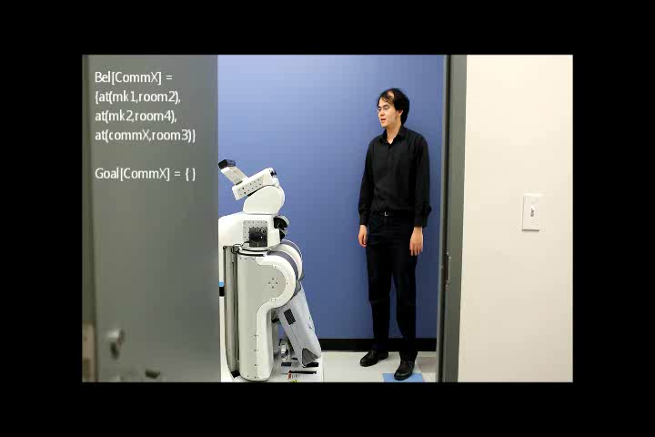
Preliminary Evaluation
[In collaboration with hrilab, Tufts University]
[Talamadupula, Briggs et al., IROS14]

Slide 43
But what if we don’t have full knowledge regarding the team member’s goal(s)?

Slide 44
Intent Recognition
Extend the goal set to a hypothesized goal set
  Contains all possible goals of CommX
Given a sequence of observations of CommX’s actions, recompute the probability distribution over the hypothesized goal set
  Plan recognition as planning [Ramirez & Geffner 2010]
  Compiles plan recognition problem into a classical planning problem
Given more observations, the distribution converges towards the most likely goal
  (assuming correct observations and rational agency)
Incremental Plan Recognition
  Can accept a stream of observations
  Incremental re-recognition: Replanning when compiled to classical planning
[Talamadupula, Briggs et al., IROS14]

Slide 45
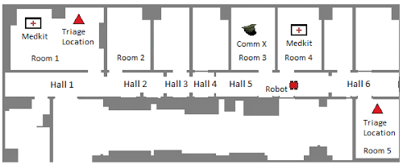

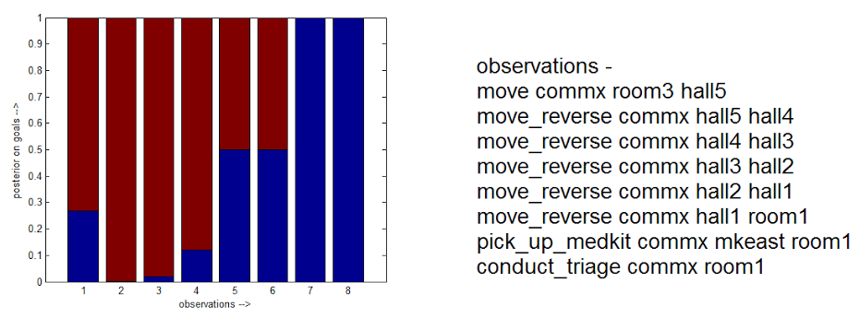
Evaluation: Intent Recognition I
[Talamadupula, Briggs, Chakrabarti et al., IROS14]
BELIEF IN GOAL

Slide 46
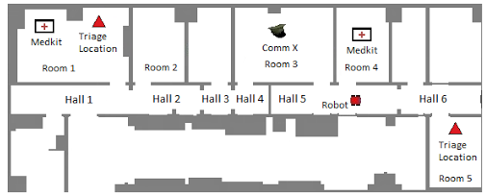
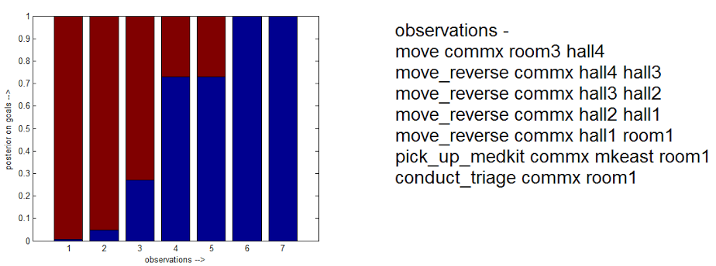
Evaluation: Intent Recognition II
[Talamadupula, Briggs, Chakrabarti et al., IROS14]
BELIEF IN GOAL

Slide 47
Limitations & Extensions
Intentions (and goals) of human fully known
  Use observations to determine most likely goals being pursued
Model of human is fully known (and correct)
  Incomplete models: [Nguyen et al. ICAPS14]
High level observations are given up-front
  Currently given by human (CommY)
  Going from sensors to observations non-trivial
[Talamadupula, Briggs et al., IROS14]

Slide 48
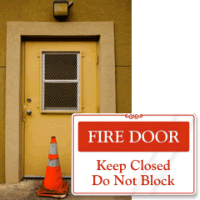
Replanning for Human-Robot Teaming
Motivating Scenario: Automated Warehouses
  Used by Amazon (Kiva Systems) for warehouse management
Human: Packager
  Only human on the entire floor; remotely located
  Issues goals to the robotic agents
Robot(s): Kiva Robots
  Can transport items from shelves to the packager
Goals: Order requests; come in dynamically
  Goals keep changing as orders pile up
  World changes as shelves are exhausted; break downs
[IROS09, AAAI10, TIST10, DMAP13, arXiv14]
Notes:
Met Pete Wurman, CTO of Kiva Systems at ICAPS
Told him about this work, he was interested
This is almost exactly their problem, except they don’t model autonomy on the part of their kiva bots right now

Slide 49
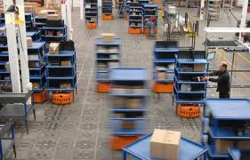

Replanning Example: Warehouses
PACKAGE
SHELF
TOWTRUCK
PACKAGE
(DELIVERED)
TRANSPORT
PACKAGER
(HUMAN)
GRIDSQUARE
GARAGE
[Talamadupula, Smith et al., Submitted 2014]

Slide 50
Warehouses: Perturbations
PACKAGE
PACKAGE
SHELF
SHELF
TOWTRUCK
TOWTRUCK
PACKAGE
(DELIVERED)
PACKAGE
(DELIVERED)
TRANSPORT
TRANSPORT
PACKAGER
(HUMAN)
PACKAGER
(HUMAN)
GRIDSQUARE
GRIDSQUARE
GARAGE
GARAGE

Slide 51
Warehouses: Commitments
Transports holding Packages
Towtrucks towing Transports
Packages delivered to Packager
PACKAGE
PACKAGE
SHELF
SHELF
TOWTRUCK
TOWTRUCK
PACKAGE
(DELIVERED)
PACKAGE
(DELIVERED)
TRANSPORT
TRANSPORT
PACKAGER
(HUMAN)
PACKAGER
(HUMAN)
GRIDSQUARE
GRIDSQUARE
GARAGE
GARAGE

Slide 52
A Generalized Model of Replanning
Notes:
Talk about the “replanning constraints” – basically, need replanning because there is some discrepancy during plan’s execution in the world (sensing event). After monitoring, you process the constraints – these can be of different forms depending on the metric you are trying to optimize.
Could be commitment to other agents, or to humans who have seen the plan; then take all these into account and replan.

Slide 53
Replanning Constraints
M1 REPLANNING AS RESTART (From scratch) | No Constraints
M2 REPLANNING AS REUSE (Similarity) | Depends on the similarity metric between plans ACTION SIMILARITY CAUSAL SIMILARITY
M3 REPLANNING TO KEEP COMMITMENTS | Dependencies between π and other plans Project down into commitments that π` must fulfill Exact nature of commitments depends on π E.g.: Multi-agent commitments (between rovers)
min | π Δ π` |
min | CL(π) Δ CL(π`) |

Slide 54
Replanning: Solution Techniques
M1 REPLANNING AS RESTART (From scratch) | CLASSICAL PLANNING | Solve new instance [I`,G`] for π` using classical planner
M2 REPLANNING AS REUSE (Similarity) | ITERATIVE PLAN REPAIR (Local Search) | Start from π Minimize differences while finding a candidate π` Stop when [I`,G`] satisfied
M3 REPLANNING TO KEEP COMMITMENTS | COMPILATION (Partial Satisfaction Planning) | Commitments are constraints on plan generation process Commitments = Soft Goals G_{s} Add G_{s} to G` → G`` Run PSP planner with [I`,G``]

Slide 55
Research Question
There exist multiple replanning solution techniques, founded in addressing different constraints during the replanning process.
To what extent do the constraints imposed by one type of replanning formulation act as a surrogate in tracking the constraints of another?
Are the different replanning metrics good surrogates of each other?
[Talamadupula, Smith et al., Submitted 2014]

Slide 56
Experimental Setup
Generate randomized problem instances of increasing complexity
Set up replanning constraints for each replanning metric
  Speed: No constraints
  Similarity: Number of differences with previous plan
  Commitment Satisfaction: Enumerate commitment violations
Perturb the initial problem instance; create a perturbed instance for each case (2a, 2b, 2c)
Run problem instances with a PSP or preference based planner

Slide 57
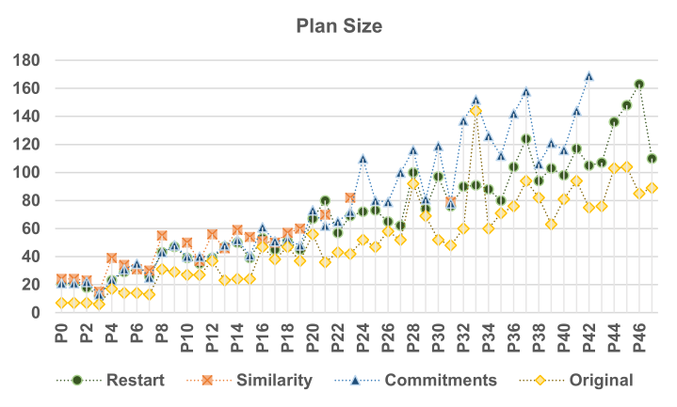
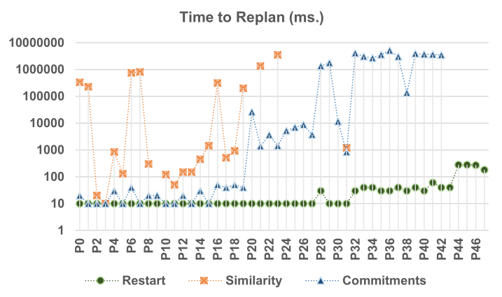
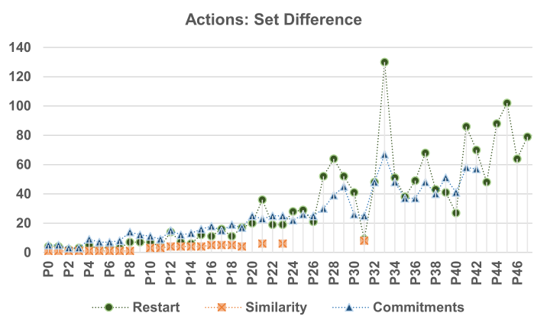
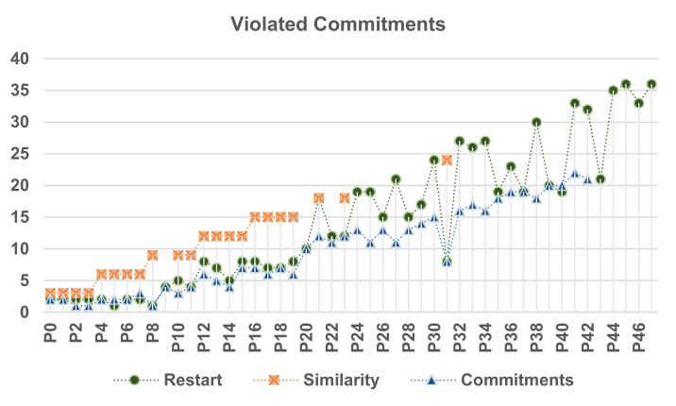
Experimental Results

Slide 58
Limitations & Extensions
Coverage: IPC Benchmark Domains
  Additional experimental conditions
Modeling Execution Failures
  Currently initial state is perturbed
    Approximation of execution failure
    Solution: Perturb state where execution stopped
Compilation to Classical Planning
Replanning Metrics
  Realistic cost and penalty estimates

Slide 59
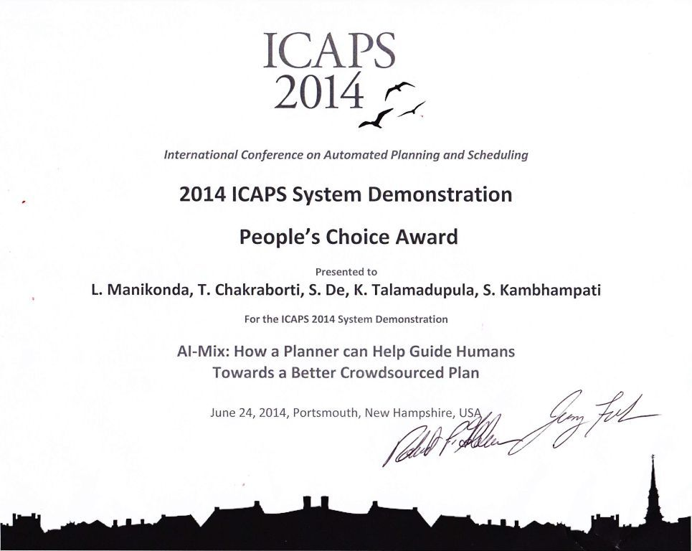
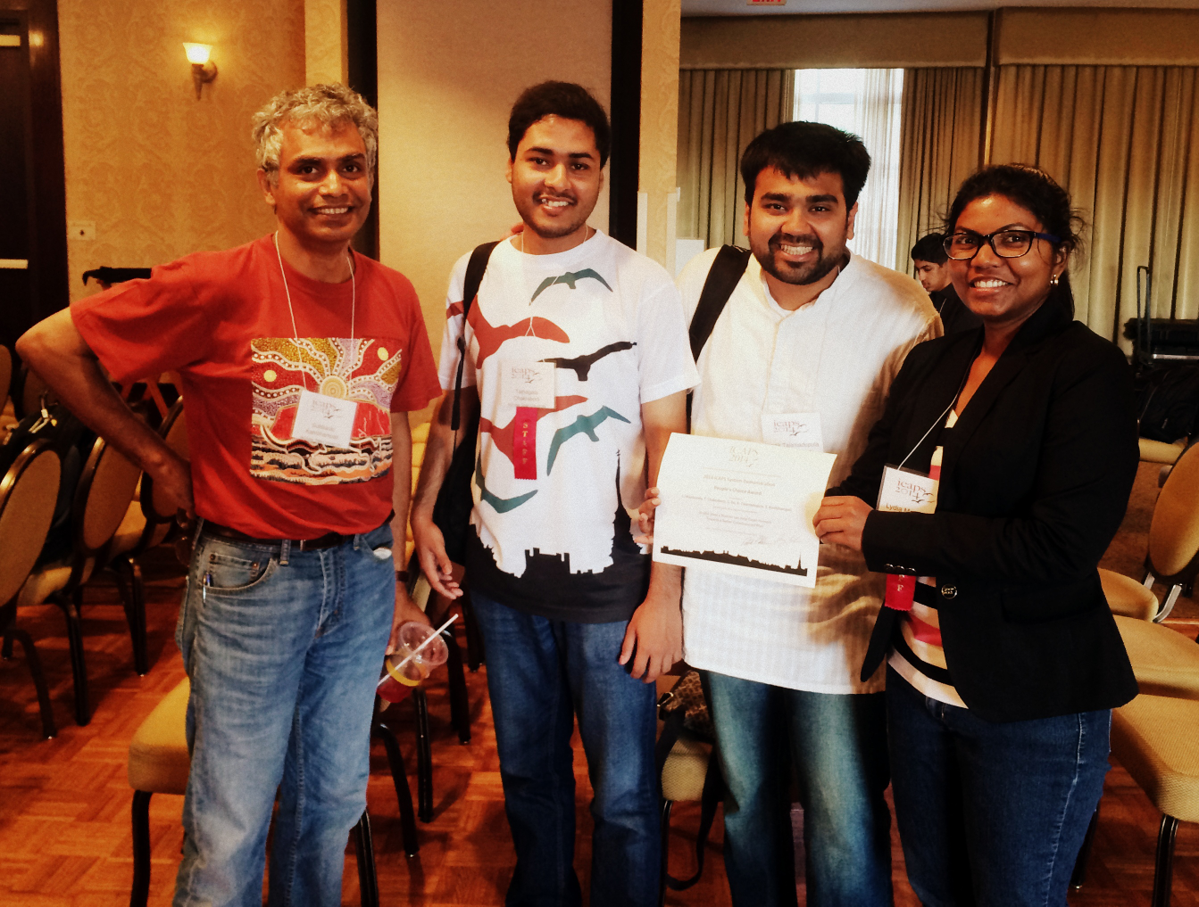

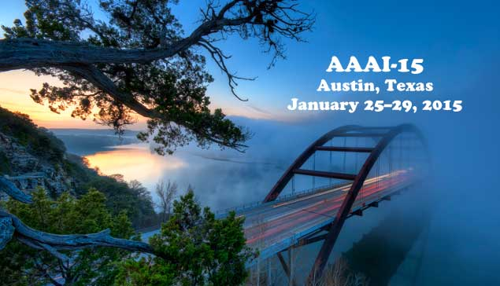
Broader Impact: HIL Planning
Planning for Crowdsourcing
Voted ICAPS 2014 Best Demo by … the Crowd!
COLLABORATIVE
BLACKBOARD
REQUESTER
(Human)
INTERPRETATION
Task specification
Requester goals
Preferences
FORM/MENU
SCHEDULES
PLANNER
Analyze the extracted plan in light of M, and provide critiques
M: Planner’s Model
(Partial)
Human-Computer
Interface
UNSTRUCTURED
STRUCTURED
Crowd’s plan
Sub-goals
New actions
Suggestions
ALERTS
STEERING
CROWD
(Turkers)
[HCOMP13, ICAPS14, IAAI14, HCOMP14]

Slide 60

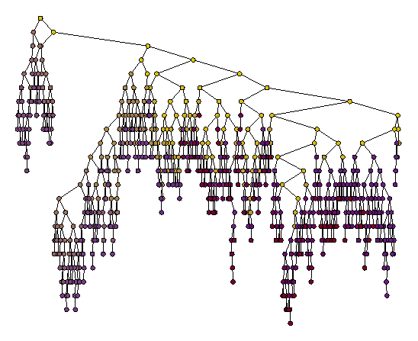


Other Work
Planning for Network Security
Apply automated planners to the Strategic Planning problem
[arXiv:1305.2561]
(Work done as part of an IBM internship)
Foundations of Automated Planning
Required Concurrency (in Temporal Planning domains) [ICAPS07]
Search Space Plateaus [ICAPS10]
Compilation of Replanning Techniques [DMAP13, arXiv14]
Analyzing Tweet Content
Analyzing language content to detect formalness [ICWSM13]
Predicting user engagement with real-world events [Submitted]
Information Retrieval on Twitter
Improving Twitter Search using source & content trustworthiness
[CIKM13, AAAI-LBP13, Submitted]
Hashtag rectification problem
Notes:
USE the phrases “information integration” and “decision support”

Slide 61
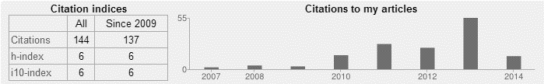
Collaborators
Arizona State University
  Subbarao Kambhampati
  J. Benton (SIFT)
  William Cushing (UC Berkeley)
  Yuheng Hu (IBM Almaden)
  Srijith Ravikumar (Amazon)
  Raju Balakrishnan (Groupon)
  Lydia Manikonda
  Tathagata Chakraborti
  Sumbhav Sethia
  Sushovan De (Google)
  Paul Reesman
  Hankz Hankui Zhuo (Sun-Yat Sen U.)
  Yu Zhang
  Nancy Cooke (ASU Poly)
  Cade Bartlett (ASU Poly)
Tufts University
  Matthias Scheutz
  Gordon Briggs
NASA Ames Research Center
  David E. Smith
Indiana University
  Paul Schermerhorn (SOARTech)
  Rehj Cantrell (Nuance Communications)
IBM Research (TJ Watson)
  Anton V. Riabov
  Octavian Udrea
  Anand Ranganathan
IBM Research (India)
  Shalini Kapoor (IBM Global Services)
  Shachi Sharma (IRL Delhi)
  Biplav Srivastava (IRL Delhi)
University of Washington
  Daniel S. Weld
  Mausam (IIT Delhi)
University of Freiburg
  Patrick Eyerich
  Robert Mattmueller
Notes:
And all of this work was in collaboration with a number of colleagues, both at Arizona State as well as other universities and research institutions around the world – to whom I wish to extend my thanks.

Slide 62
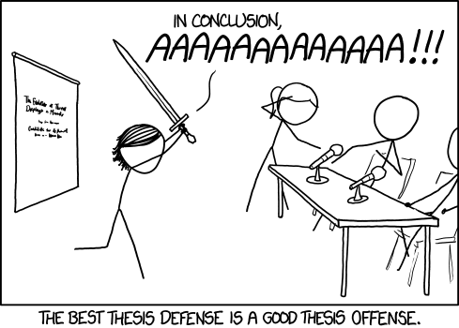
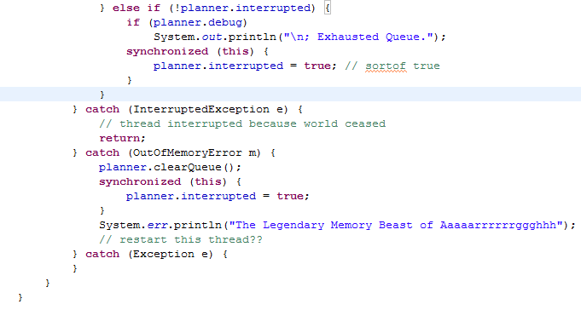
Conclusion

Slide 63
Challenges Addressed
OPEN WORLD GOALS
    Provide a way to specify quantified goals on unknown objects
    Consider a more principled way of handling uncertainty in facts
REPLANNING
    Handle state and goal updates from a changing world while executing
    Present a unified theory of replanning, to analyze tradeoffs
MODEL UPDATES
    Accept changes to planner’s domain model via natural language
PLAN RECOGNITION
    Use belief models of other agents to enhance planning
Notes:
Second contributions slide.

Slide 64
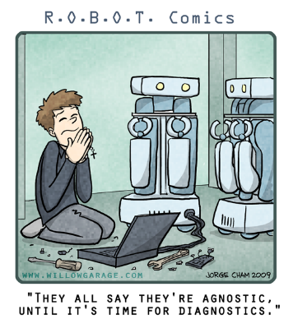
Summary
Planning for Human-Robot Teaming (HRT)
is an important problem
Demonstrated the successful integration of a planner with an architecture for HRT
Detailed techniques used in that integration, and novel extensions and analysis of some of them
    Replanning
    Plan & Intent Recognition
    Open World Quantified Goals
    Model Updates
Broader Implications: Human-in-the-Loop Planning

