Slide 1
TWEETSENSE:
RECOMMENDING HASHTAGS FOR ORPHANED TWEETS BY EXPLOITING SOCIAL SIGNALS IN TWITTER
Manikandan Vijayakumar
Arizona State University
School of Computing, Informatics, and Decision Systems Engineering
Master’s Thesis Defense – July 7th, 2014

Slide 2
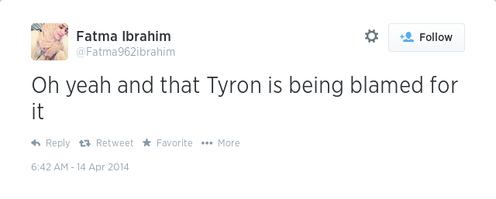
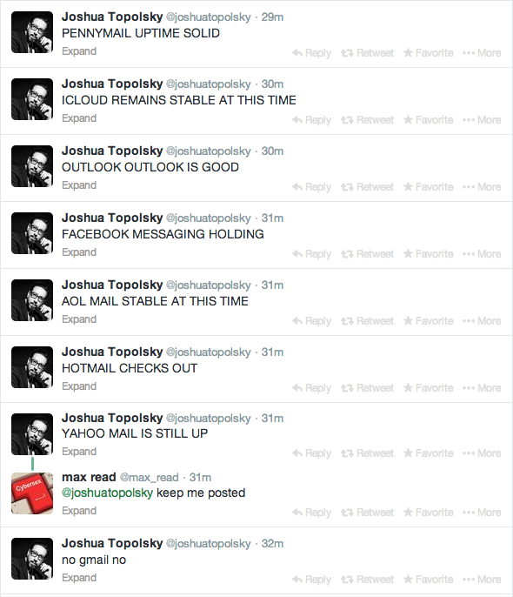
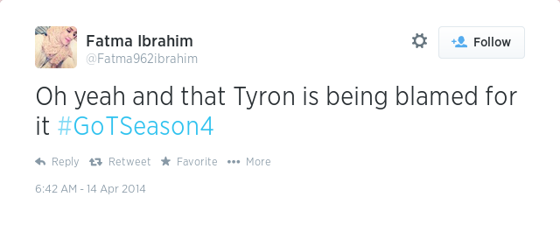
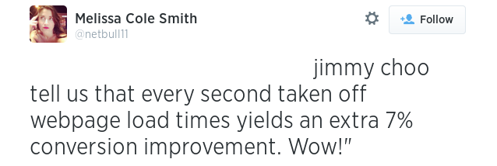
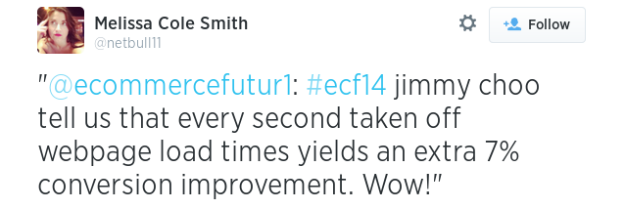
Orphaned Tweets
Orphaned Tweets
Source: Twitter

Slide 3
Overview
Overview

Slide 4



Twitter
Twitter
Twitter is a micro-blogging platform
where users can be
  Social
  Informational or
  Both
Twitter is, in essence, also a
  Web search engine
  Real-Time News media
  Medium to connect with friends
Image Source: Google

Slide 5



Why people use Twitter?
Why people use Twitter?
  According to Research charts, people use Twitter for
    Breaking news
    Content Discovery
    Information Sharing
    News Reporting
    Daily Chatter
    Conversations
Source: Deutsche Bank Markets

Slide 6
But..
But..
    According to Cowen & Co Predictions & Report:
      Twitter had 241 million monthly active users at
      the end of 2013
      Twitter will reach only 270 million monthly active users by the end of 2014
      Twitter will be overtaken by Instagram with 288 million monthly active users
      Users are not happy in Twitter

Slide 7
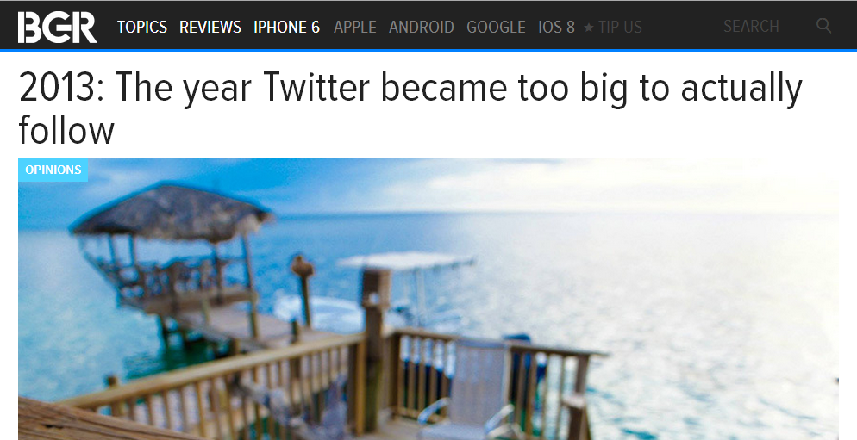
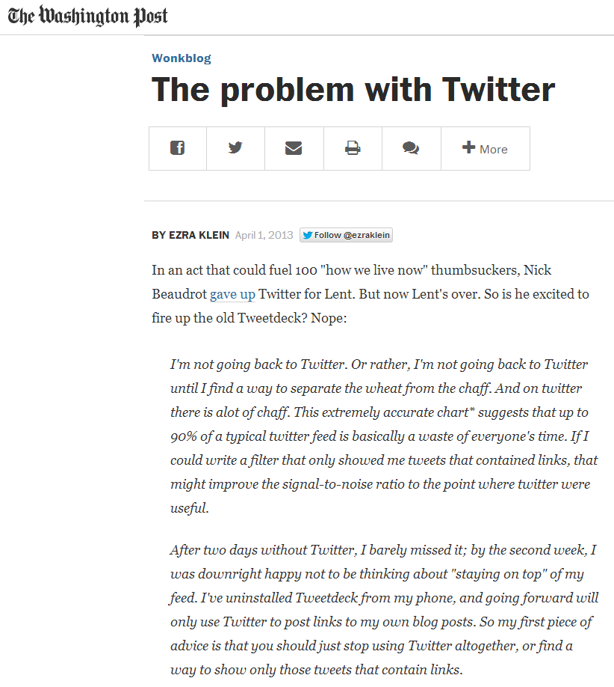
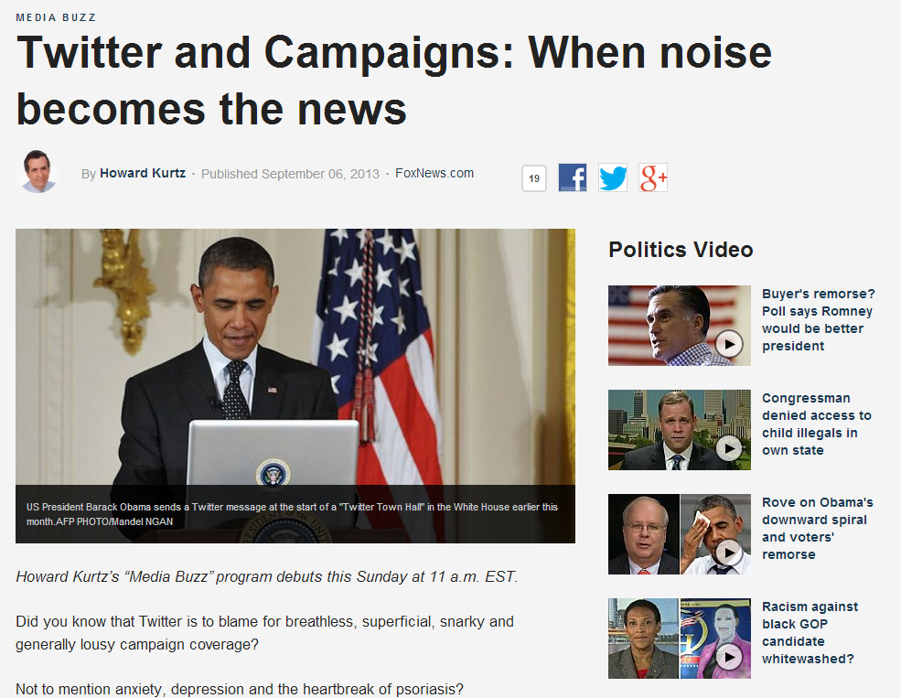
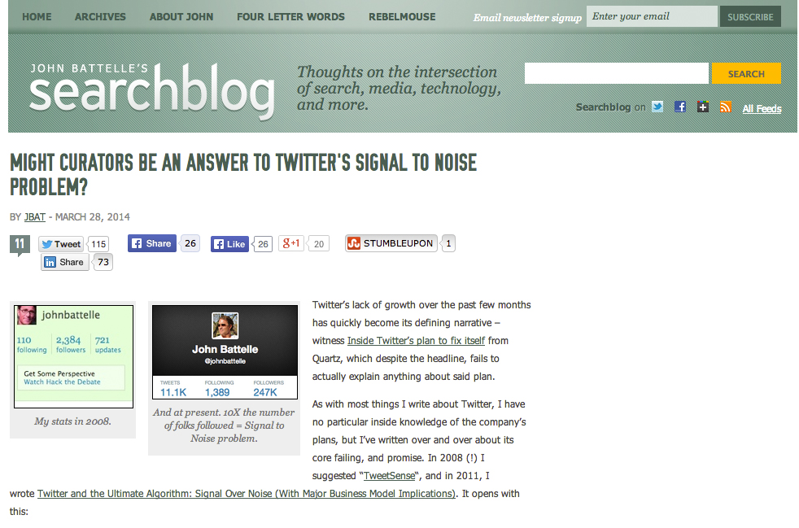
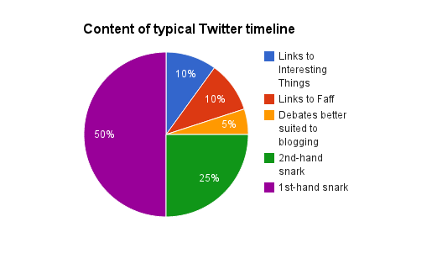
Twitter Noise

Slide 8
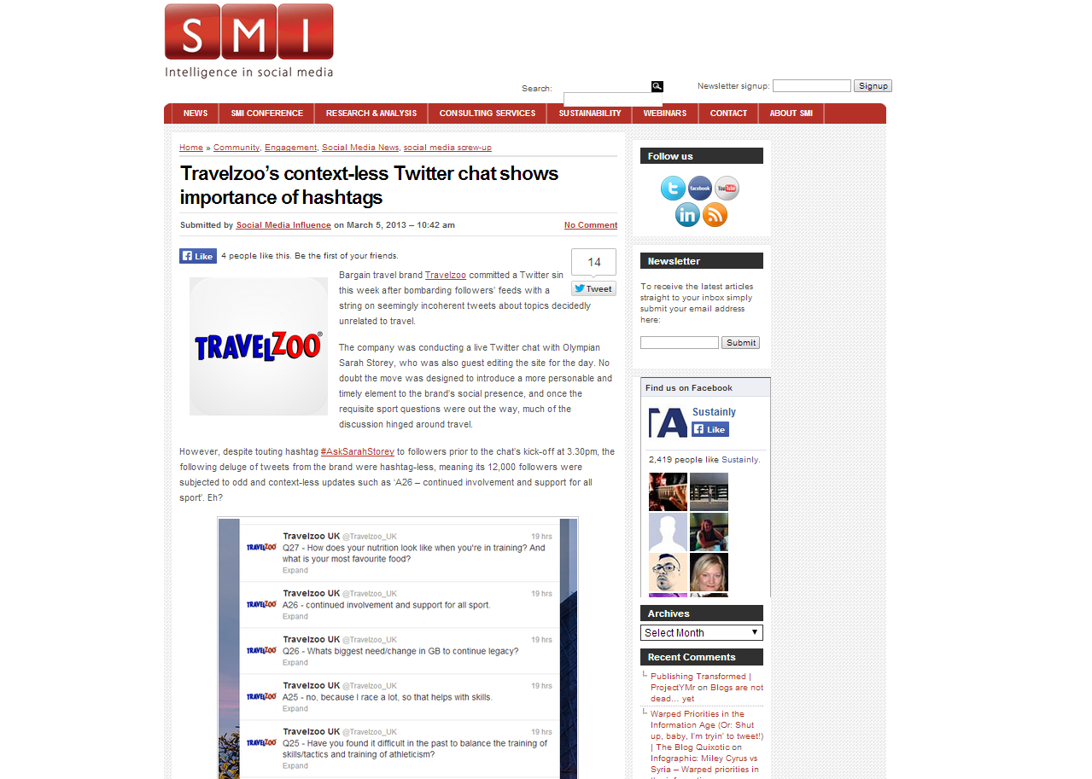
Noise in Twitter
Missing hashtags

Slide 9
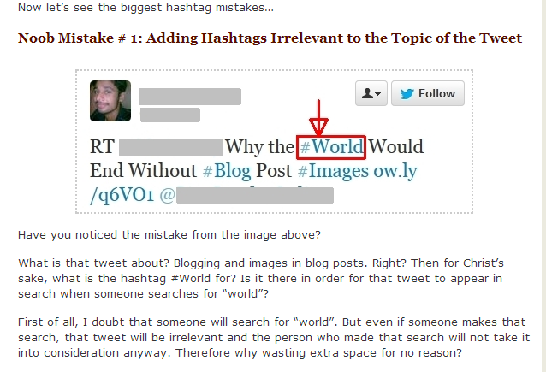
Noise in Twitter
User may use incorrect hashtags

Slide 10
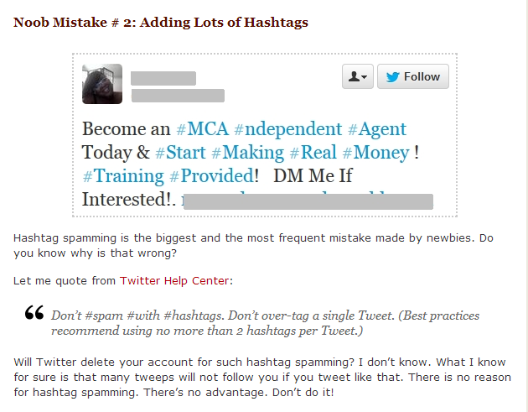
Noise in Twitter
User may use many hashtags

Slide 11
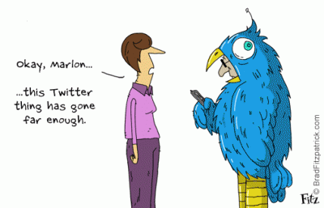
Possible Solutions
Missing Hashtag problem - Hashtags are supposed to help
  Importance of using hashtag
    Hashtags provide context or metadata for arcane tweets
    Hashtags are used to organize the information in the tweets for retrieval
    Helps to find latest trends
    Helps to get more audience

Slide 12
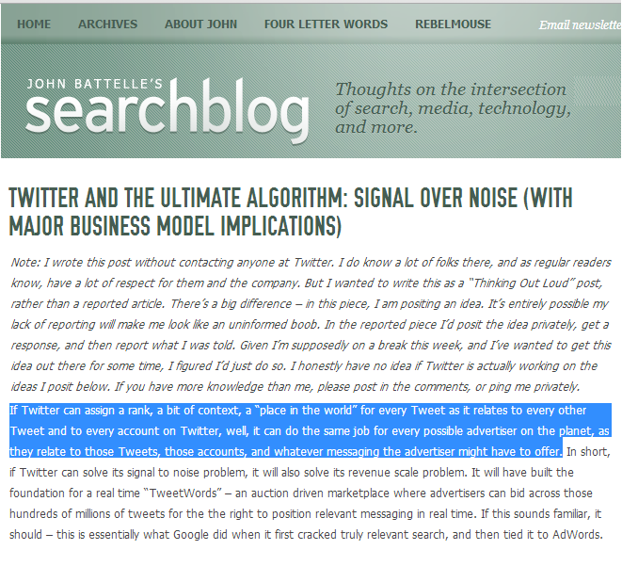
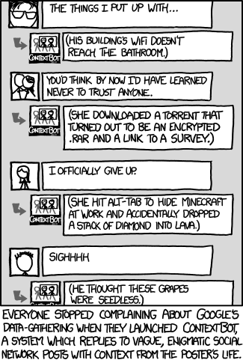

Importance of Context in Tweet

Slide 13
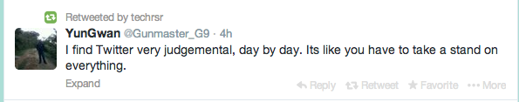


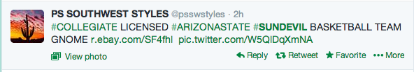

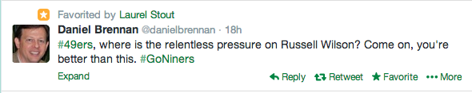

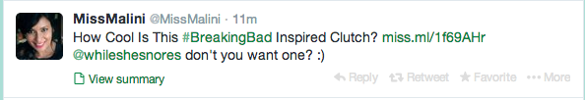


Orphaned Tweets Non-Orphaned Tweets

Slide 14
Problem Solved?
But, Problem Still Exist.
  Not all users use hashtags with their tweets.

Slide 15
Existing Methods
Existing systems addresses this problem by recommending hashtags based on:
  Collaborative ﬁltering- [Kywe et.al. SocInfo,Springer’2012]
  Optimization-based graph method -[Feng et.al,KDD’2012]
  Neighborhood- [Meshary et.al.CNS’2013, April]
  Temporality– [Chen et.al. VLDB’2013, August]
  Crowd wisdom [Fang et.al. WWW’2013, May]
  Topic Models – [Godin et.al. WWW’2013,May]
  On the impact of text similarity functions on hashtag recommendations in microblogging environments”, Eva Zangerle, Wolfgang Gassler, Günther Specht: Social Network Analysis and Mining; Springer, December 2013, Volume 3, Issue 4, pp 889-898

Slide 16
Objective
Objective
      How can we solve the problem of finding missing hashtags for orphaned tweets by providing more accurate suggestions for Twitter users?
        Users tweet history
        Social graph
        Influential friends
        Temporal Information

Slide 17

Impact
  Aggregate Tweets from users who doesn’t use
  hashtags for opinion mining
  Identify Context
  Named entity problems
  Sentiment evaluation on topics
  Reduce noise in Twitter
  Increase active online user and social engagement

Slide 18
Outline
(Chapter 3) Modeling the Problem
TweetSense
(Chapter 4) Ranking Methods
(Chapter 5) Binary Classification
(Chapter 6) Experimental Setup
(Chapter 7) Evaluation
(Chapter 8) Conclusions

Slide 19
Modeling the Problem
Modeling the Problem

Slide 20
Problem Statement
Problem Statement
    Hashtag Rectification Problem
    What is the probability P(h/T,V) of a hashtag h given tweet T of user V?
U
Orphan Tweet
V
Recommends Hashtags
System

Slide 21
Outline
(Chapter 3) Modeling the Problem
TweetSense
(Chapter 4) Ranking Methods
(Chapter 5) Binary Classification
(Chapter 6) Experimental Setup
(Chapter 7) Evaluation
(Chapter 8) Conclusions

Slide 22
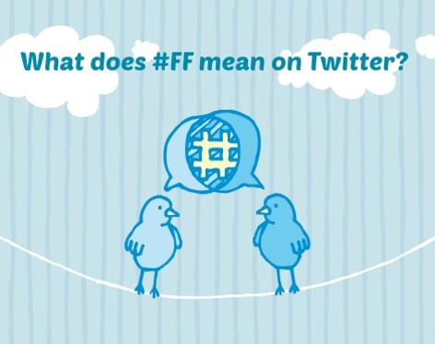
TweetSense

Slide 23
Architecture
Architecture
User
Top K hashtags
#hashtag 1
#hashtag 2
.
.
#hashtag K
Username & Query tweet
Crawler
Retrieve User’s Candidate Hashtags from their Timeline
Ranking Model
Indexer
Learning Algorithm
Twitter Dataset
Training Data
Source: http://en.wikipedia.org/wiki/File:MLR-search-engine-example.png

Slide 24
Hypothesis
A Generative Model for Tweet Hashtags
    When a user uses a hashtag,
      she might reuse a hashtag which she created before
      – present in her user timeline
        she may also reuse hashtags which she sees from her home timeline (created by the friends she follows)
          more likely to reuse the tweets from her most influential friends
          hashtags which are temporally close enough

Slide 25
Build Discriminative model over Generative Model
  To build a statistical model, we need to model
  P(<tweet-hashtag>| <tweet-social features> <tweet-content features>)
  Rather than build a generative model, I go with a discriminative model
  Discriminative model avoids characterizing the correlations between
  the tweet features
  Freedom to develop a rich class of social features.
  I learn the discriminative model using logistic regression

Slide 26
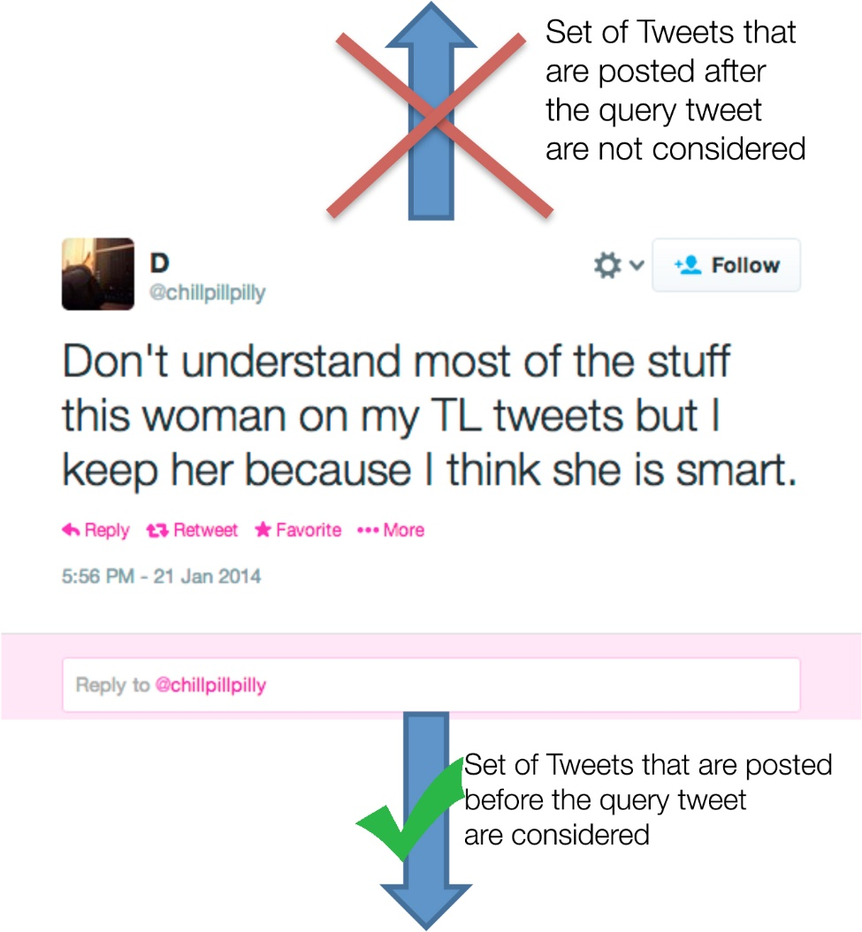
Candidate Tweet Set
Retrieving Candidate Tweet Set
Global Twitter Data
User’s Timeline
U

Slide 27
Feature Selection – Tweet Content Related
        Two inputs to my system: Orphaned tweet and User who posted it.
Tweet content related features
Tweet text Temporal Information Popularity

Slide 28
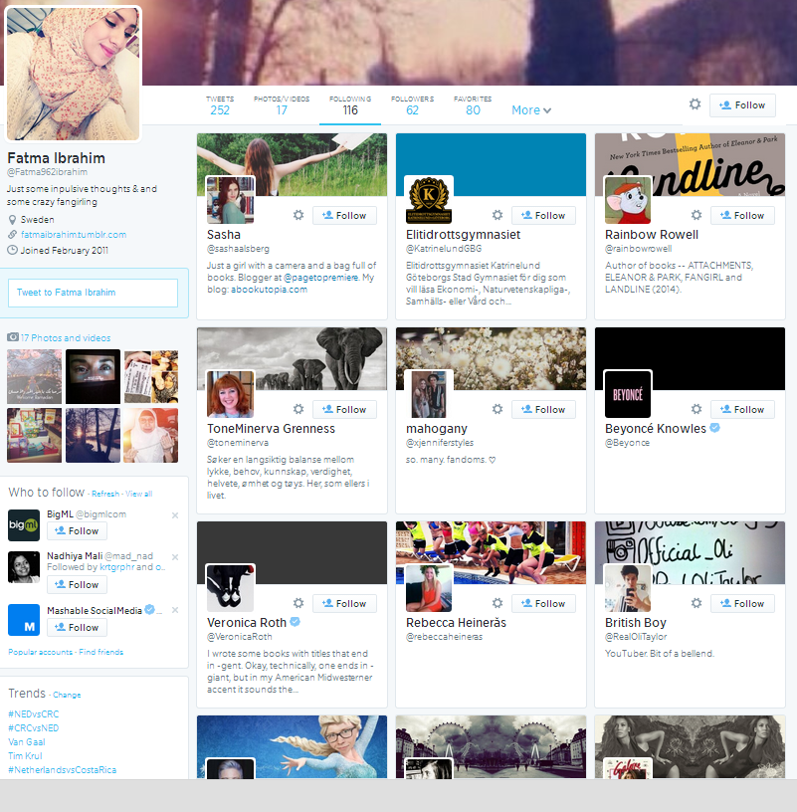
Feature Selection – User Related
User related features
@mentions Favorites Co-occurrence of hashtags Mutual Friends Mutual Followers Follower-Followee Relation
Friends
Features are selected based on my generative model that users reuse hashtags
from her timeline, from the most influential user and that are temporally close enough

Slide 29
Architecture
Architecture
User
Top K hashtags
#hashtag 1
#hashtag 2
.
.
#hashtag K
Username & Query tweet
Crawler
Retrieve User’s Candidate Hashtags from their Timeline
Ranking Model
Indexer
Learning Algorithm
Twitter Dataset
Training Data
Source: http://en.wikipedia.org/wiki/File:MLR-search-engine-example.png

Slide 30
Outline
(Chapter 3) Modeling the Problem
TweetSense
(Chapter 4) Ranking Methods
(Chapter 5) Binary Classification
(Chapter 6) Experimental Setup
(Chapter 7) Results
(Chapter 8) Conclusions

Slide 31
Ranking Methods
Ranking Methods

Slide 32
List of Feature Scores
List of Feature Scores
Tweet text
Temporal Information
Popularity
@mentions
Favorites
Mutual Friends
Mutual Followers
Co-occurrence of hashtags
Follower-Followee Relation
Similarity Score
Recency Score
Social Trend Score
Attention score
Favorite score
Mutual Friend Score
Mutual Follower Score
Common Hashtags Score
Reciprocal Score

Slide 33
Similarity Score
    Cosine Similarity is the most appropriate similarity measure over others (Zangerle et.al.)
    Cosine Similarity between Query tweet Q_{i} and candidate tweet T_{j}

Slide 34
Recency Score
    Exponential decay function to compute the recency score of a hashtag:
    k = 3, which is set for a window of 75 hours
    q_{t} = Input query tweet
    C_{t} = Candidate tweet

Slide 35
Social Trend Score
Social Trend Score
    Popularity of hashtags h within the candidate hashtag set H
    Social Trend score is computed based on the "One person,
    One vote" approach.
    Total counts of frequently used hashtag in H_{j} is computed.
    Max normalization

Slide 36
Attention score
&
Favorites score
Attention score & Favorites score
    Attention score and Favorites Score captures the social signals between the users
    Ranks the user based on recent conversation and favorite activity
    Determine which users are more likely to share topic of common interests

Slide 37
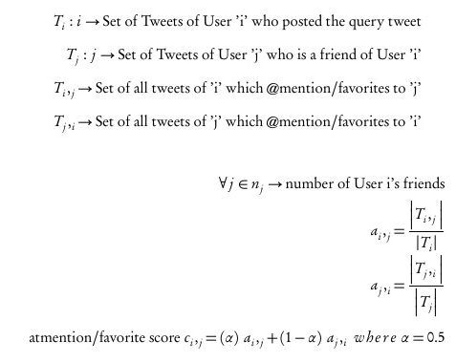
Attention score
&
Favorites score
Equation
Attention score & Favorites score Equation

Slide 38
    Gives similarity between users
      Mutual friends - > people who are friends with both you and the person whose Timeline you’re viewing
      Mutual Followers -> people who follow both you and the person whose Timeline you’re viewing
    Score is computed using well-known Jaccard Coefficient
Mutual Friend Score & Mutual Followers Score

Slide 39
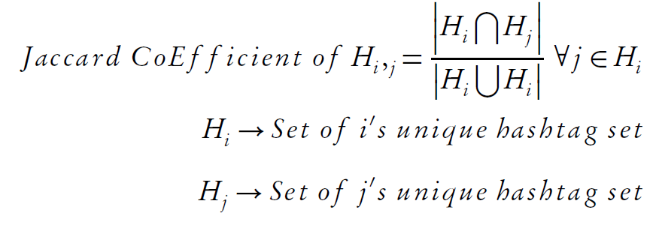
Common Hashtags Score
    Ranks the users based on the co-occurrence of hashtags in their timelines.
    I use the same Jaccard Coefficient

Slide 40
    Twitter is asymmetric
    This score differentiates friends from just topics of interest like news channel, celebrities, etc.,
Reciprocal Score

Slide 41
How to combine the scores?
How to combine the scores?
    Combine all the feature scores to one final score
    to recommend hashtags
    Model this as a classification problem to learn weights
    While each hashtags can be thought of as its own class
    Modeling the problem as a multi-class classification problem has certain challenges as my class labels are in thousands
    So, I model this as binary classification problem

Slide 42
Architecture
Architecture
User
Top K hashtags
#hashtag 1
#hashtag 2
.
.
#hashtag K
Username & Query tweet
Crawler
Retrieve User’s Candidate Hashtags from their Timeline
Ranking Model
Indexer
Learning Algorithm
Twitter Dataset
Training Data
Source: http://en.wikipedia.org/wiki/File:MLR-search-engine-example.png

Slide 43
Outline
(Chapter 3) Modeling the Problem
TweetSense
(Chapter 4) Ranking Methods
(Chapter 5) Binary Classification
(Chapter 6) Experimental Setup
(Chapter 7) Evaluation
(Chapter 8) Conclusions

Slide 44
Binary Classification
Binary Classification

Slide 45
Problem Setup
    Training Dataset: Tweet and Hashtag pair < Ti ,Hj >
      Tweets with known hashtags
    Test Dataset: Tweet without hashtag < Ti ,?>
      Existing hashtags removed from tweets to provide ground truth.
Problem Setup

Slide 46
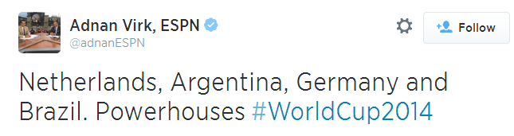
Training Dataset
Training Dataset
    The training dataset is a feature matrix containing the features scores of
    all < CTi ,CHj > pair belonging to each < Ti ,Hj > pair.
    The class label is 1, if CHj = Hj , 0 otherwise.
    Multiple hashtag occurrence are handled as single instance
    <CT1 - CH1,CH2,CH3 > = <CT1,CH1> ,<CT1,CH2>, <CT1,CH3>
<Tweet(T1), Hashtag(H1) Pair>
<Candidate Tweet, Candidate Hashtag>
CT1,CH1
CT2,CH2
.
.
CTi,CHj
 | Similarity Score | Recency Score | SocialTrend Score | Attention Score | Favorite Score | MutualFriend Score | MutualFollowers Score | Common Hashtag Score | Reciprocal Rank | Class Label
CT1,CH1 | 0.095 | 0.0 | 0.00015 | 0.00162 | 0.0805 | 0.11345 | 0.0022 | 0.0117 | 1 | 1
CT2,CH2 | 0.0 | 0.00061 | 0.520 | 0.0236 | 0.0024 | 0.00153 | 0.097 | 0.0031 | 0.5 | 0

Slide 47
Imbalanced Training Dataset
    Occurrence of ground truth hashtag H_{j} in a
    candidate tweet < Ti ,Hj > is very few in number.
      Higher number of negative samples
    In multiple occurrences my training dataset has a class distribution of 95% of negative samples and 5% of positive samples
    Learning the model on an imbalanced dataset causes low precision

Slide 48
SMOTE Over Sampling
SMOTE Over Sampling
    Possible solutions is under sampling and over sampling.
    SMOTE - Synthetic Minority Oversampling Technique to resample to a balanced dataset of 50% of positive samples and negative samples
    SMOTE does over-sampling by creating synthetic examples rather than
    over-sampling with replacement.
    It takes each minority class sample and introduces synthetic examples along the line segments joining any/all of the k minority class nearest neighbors
    This approach effectively forces the decision region of the minority class to become more general.
SMOTE: Synthetic Minority Over-sampling Technique (2002) by Nitesh V. Chawla , Kevin W. Bowyer , Lawrence O. Hall , W. Philip Kegelmeye: Journal of Artificial Intelligence Research

Slide 49
Learning – Logistic Regression
I use Logistic Regression Model over a generative model such as NBC or Bayes networks as my features have lot of correlation. ( shown in evaluation )
Feature Matrix
Class Labels
+ve samples
<Tweet(T1), Hashtag(H1) Pair>
<Candidate Tweet, Candidate Hashtag>
CT1,CH1
CT2,CH2
.
.
CTi,CHj
Logistic Regression Model
λ2
1
0
λ1
λ3
0
<Tweet(T2), Hashtag(H2) Pair>
<Candidate Tweet, Candidate Hashtag>
CT1,CH1
CT2,CH2
.
.
CTi,CHj
λ4
1
1
0
<Tweet(Ti), Hashtag(Hj) Pair>
<Candidate Tweet, Candidate Hashtag>
CT1,CH1
CT2,CH2
.
.
CTi,CHj
λ6
λ5
0
λ7
0
λ9
λ8
1
-ve samples

Slide 50
Test Dataset
    My test dataset is represented in the same format as my training dataset as a feature matrix with the class labels unknown (removed).
Test Dataset
<Tweet(T1), ?>
<Candidate Tweet, Candidate Hashtag>
CT1,CH1
CT2,CH2
.
.
CTi,CHj
 | Similarity Score | Recency Score | SocialTrend Score | Attention Score | Favorite Score | MutualFriend Score | MutualFollowers Score | Common Hashtag Score | Reciprocal Rank | Class Label
CT1,CH1 | 0.034 | 0.7 | 0.0135 | 0.0621 | 0.0205 | 0.11345 | 0.22 | 0.611 | 1 | ?
CT2,CH2 | 0.0 | 0.613 | 0.215 | 0.316 | 0.0224 | 0.0523 | 0.057 | 0.0301 | 0.5 | ?

Slide 51
Classification
Classification
    If the predicted probability is greater than 0.5 then the model labels the hashtag as 1 or 0 otherwise.
    The hashtags labeled as 1 are likely to be the suitable hashtag.
    I rank the top K recommended hashtags based on their probabilities.
Feature Matrix
Class Labels
<Query Tweet(Qi), ? >
<Candidate Tweet, Candidate Hashtag>
CT1,CH1
CT2,CH2
.
.
CTi,CHj
Logistic Regression Model
1
?
?
?
0

Slide 52
Implementation – System Example 1
TweetSense (Top 10) | Baseline-SimGlobal (Top 10) | Baseline-SimTime (Top 10) | Baseline-SimRecCount(Top 10)
#KUWTK 0.989970778 #tfiosmovie 0.985176542 #CatchingFire 0.981380129 #ANTM 0.968851541 #GoTSeason4 0.946418848 #Jofferyisdead 0.944493746 #TFIOS 0.941791929 #Lunch 0.940883835 #MockingjayPart1trailer0.9344869 #JoffreysWedding 0.934201161 | #KUWTK 0.824264068712 #ANTM 0.583979541687 #Glee 0.453373612475 #NowPlaying 0.439078783215 #Scandal 0.435994273991 #XFactor 0.425513196481 #Spotify 0.42500253688 #LALivin 0.424264068712 #PansBack 0.424264068712 #ornah 0.424264068712 | #Scandal 0.82326311013 #ornah 0.819013620132 #LALivin 0.816627941101 #KUWTK 0.814775850946 #Glee 0.778570381907 #SURFBOARD 0.746003141257 #latergram 0.745075687756 #Spotify 0.744375215512 #NowPlaying 0.744375215512 #EFCvAFC 0.730686523119 | #Scandal 0.428809523257 #KUWTK 0.428809523257 #LALivin 0.426536795985 #PansBack 0.426536795985 #ornah 0.426536795985 #Glee 0.381746046493 #goodcompany 0.348682888787 #SURFBOARD 0.348682888787 #JLSQuiz 0.348682888787 #HungryAfricans 0.348682888787

Slide 53
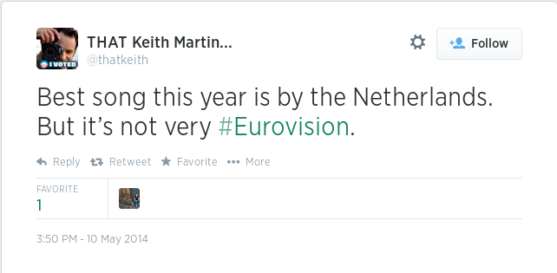
Implementation – System Example 2
TweetSense (Top 5) | Baseline-SimGlobal (Top 5) | Baseline-SimTime (Top 5) | Baseline-SimRecCount (Top 5)
#Eurovision 0.998892319 #EurovisionSongContest2014 0.997934085 #garybarlo 0.989491417 #UKIP 0.988958194 #parents 0.98511502 | #photogeeks 0.6 #FSTVLfeed 0.476912544 #FestivalFriday 0.424264069 #barkerscreeklife 0.420229873 #IPv6 0.4 | #photogeeks 0.907490888 #FSTVLfeed 0.823842681 #FestivalFriday 0.82085025 #Pub49 0.745300825 #monumentvalleygame0.738922 | #photogeeks 0.600706714 #FSTVLfeed 0.429211065 #FestivalFriday 0.424970782 #Pub49 0.353477299 #sma2013 0.348530303

Slide 54
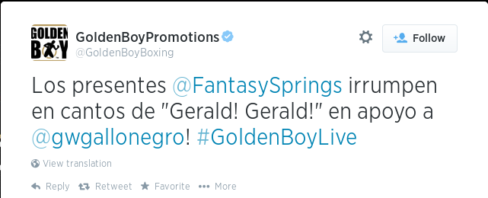
Implementation – System Example 3
TweetSense (Top 5) | Baseline-SimGlobal (Top 5) | Baseline-SimTime (Top 5) | Baseline-SimRecCount (Top 5)
#boxing 0.996480078 #GoldenBoyLive 0.9336961478 #USC 0.913498443 #AngelOsuna 0.911312201 #paparazzi 0.90625792 | #BoxeoBoricua 0.346937709 #ListoParaHacerHistoria 0.2889 #CaneloAngulo 0.272852636 #6pm 0.261133502 #Vallarta 0.252135503 | #TU 0.517962946 #regardless 0.489156945 #legggoo 0.476362923 #Shoutout 0.464033604 #TeamH 0.44947086 | #BoxeoBoricua 0.34687581 #ListoParaHacerHistoria 0.2893 #CaneloAngulo 0.27221214 #6pm 0.42458613 #sonorasRest 0.42458613

Slide 55
Outline
(Chapter 3) Modeling the Problem
TweetSense
(Chapter 4) Ranking Methods
(Chapter 5) Binary Classification
(Chapter 6) Experimental Setup
(Chapter 7) Evaluation
(Chapter 8) Conclusions

Slide 56
Experimental Setup
Experimental Setup

Slide 57
Dataset
    I randomly picked 63 users from a partial random distribution by navigating through the trending hashtags in Twitter.
Dataset
    Characteristic of the Dataset
Characteristics | Value | Percentage
Total number of users | 63 | N/A
Total Tweets Crawled | 7,945,253 | 100%
Tweets with Hashtags | 1,883,086 | 23.70%
Tweets without Hashtags | 6,062,167 | 76.30%
Tweets with exactly one Hashtag | 1,322,237 | 16.64%
Tweets with more than one Hashtag | 560,849 | 7.06%
Total number of tweets with user @mentions | 716,738 | 58.63%
Total number of Favorite Tweets | 4,658,659 | 9.02%
Total number of tweets with Retweets | 1,375,194 | 17.31%

Slide 58
Evaluation Method
    Randomly pick the tweet with only one hashtag – avoids getting credit for recommending generic hashtags
    Deliberately remove the hashtag and its retweets for evaluation
    Pass the tweet as an input to my system TweetSense
    Get the recommended hashtag list
    Compare if the ground truth hashtag in the recommended list

Slide 59
Outline
(Chapter 3) Modeling the Problem
TweetSense
(Chapter 4) Ranking Methods
(Chapter 5) Binary Classification
(Chapter 6) Experimental Setup
(Chapter 7) Evaluation
(Chapter 8) Conclusions

Slide 60
Results
Evaluation

Slide 61
External Evaluation with Baseline for all 3 ranking methods
TweetSense
Baseline
Test users : 45 users & 1599 tweet Samples

Slide 62
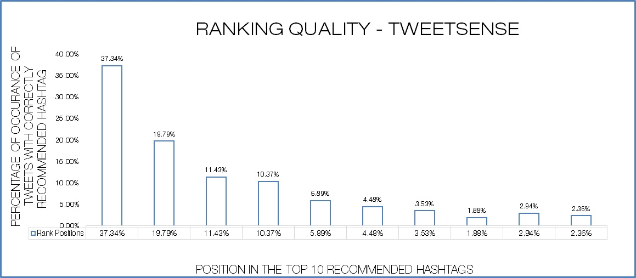
Ranking Quality
RANKING QUALITY - TWEETSENSE

Slide 63
Odds Ratio
–
Feature Comparison
ODDS RATIO - FEATURE COMPARISON
– WITH ALL FEATURES

Slide 64
ODDS RATIO - FEATURE COMPARISON
– WITHOUT MUTUALFRIEND SCORE

Slide 65
ODDS RATIO - FEATURE COMPARISON – WITHOUT MUTUAL FRIEND, FOLLOWERS,RECIPROCAL SCORE

Slide 66
Odds Ratio
–
Feature Comparison
ODDS RATIO - FEATURE COMPARISON – ONLY MUTUAL FRIEND SCORE

Slide 67
Precision @n
-
Only Mutual Friend Feature Score
TweetSense
Baseline
With only
Mutual Friend
Score

Slide 68
Outline
(Chapter 3) Modeling the Problem
TweetSense
(Chapter 4) Ranking Methods
(Chapter 5) Binary Classification
(Chapter 6) Experimental Setup
(Chapter 7) Results
(Chapter 8) Conclusions

Slide 69
Conclusion
Conclusion

Slide 70
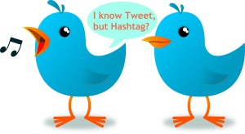
Summary
Proposed a system called TweetSense, which finds additional context for an orphaned tweet by recommending hashtags.
Proposed a better approach on choosing the candidate tweet set by looking at user’s social graph
Exploit the social signals along with the user’s tweet history to recommend personalized hashtags.
I do internal and external evaluation of my system
Showed how my system performs better than the
current state of art system

Slide 71

Future Works
Rectifying incorrect/irrelevant hashtags for tweets by identifying and/or adding the right hashtag for the tweets
“Named hashtag recognition” – Aggregate processing of tweets for sentiment and opinion mining
Use topic models to recommend hashtags based on topic distributions
Do a incremental learning version and make it as a online application.

