Slide 1
An Investigation of Model-Lite planning and Multi-Agent planning
Sarath Sreedharan
Committee Members:
Dr. Subbarao Kambhampati
Dr. Yu Zhang
Dr. Heni Ben Amor

Slide 2
Automated Planning
A branch of AI aimed at generating goal directed agent behavior
Planning algorithms generates plans (sequence of actions/policies) to achieve a given goal
It’s a model-based method that relies on a domain model to identify the actions
Agent Planning Model
Initial state + goal
+
Planner
Plan
Environment
Execute actions
Slide courtesy CSE 574 slides by Prof. Subbarao Kambhampati

Slide 3
Topics investigated
Multi-Agent Planning
Model-Lite Planning Models

Slide 4
Topics investigated
Multi-Agent Planning:
Planning in the presence of multiple agents
Required Cooperation
Multi-Agent Planning
Model-Lite Planning Models

Slide 5
Topics investigated
Multi-Agent Planning:
Planning in the presence of multiple agents
Required Cooperation
Multi-Agent Planning
Model-Lite Planning Models:
Incomplete planning models that are capable of performing planning or related tasks
APDDL
Model-Lite Planning Models

Slide 6
Topics investigated
Multi-Agent Planning:
Planning in the presence of multiple agents
Required Cooperation
Multi-Agent Planning
Model-Lite Planning Models:
Incomplete planning models that are capable of performing planning or related tasks
APDDL
Model-Lite Planning Models

Slide 7
Multi-Agent Planning
Required Cooperation

Slide 8
A Formal Analysis of Required Cooperation in Multi-agent Planning
Collaboration with: Dr. Yu Zhang, Prof. Subbarao Kambhampati
Presented in ICAPS 2016

Slide 9
Multi-Agent Planning Problems
MAP
Notes:
Since our work is titled analysis of multi-agent planning problems, lets start by looking at multi-agent problems, let the blue box present the set of all possible MAP problems. Now let us take a look at a unique M

Slide 10
Multi-Agent Planning Problems
MAP
Multi-agent blocksworld
Notes:
Starting out lets ask ourselves the question what are MAS
Something about logistic domain

Slide 11
Multi-Agent Planning Problems
MAP
Multi-agent blocksworld
Logistic Domain
Notes:
Starting out lets ask ourselves the question what are MAS
Something about logistic domain

Slide 12
Multi-Agent Planning Problems
MAP
RC Problems
Multi-agent blocksworld
Homogeneous agents
Heterogeneous agents
Logistic Domain
Notes:
Pose a question about whether RC includes hetrogeniety

Slide 13
Multi-Agent Planning Problems
MAP
RC Problems
Multi-agent blocksworld
Homogeneous agents
Heterogeneous agents
Burglary problem
Room 2
switch
Room 1
Door
Logistic Domain
Notes:
Starting out lets ask ourselves the question what are MAS
Something about logistic domain

Slide 14
Multi-Agent Planning Problems
MAP
RC Problems
Multi-agent blocksworld
Homogeneous agents
Heterogeneous agents
Burglary problem
Room 2
switch
Room 1
*
Door
Logistic Domain
* Image courtesy gliphly.com
Notes:
Starting out lets ask ourselves the question what are MAS
Something about logistic domain

Slide 15
Multi-Agent Planning Problems
MAP
RC Problems
Multi-agent blocksworld
Type-1
Type-2
Homogeneous agents
Heterogeneous agents
Burglary problem
Room 2
switch
Room 1
Door
Logistic Domain
Notes:
Line through the division
A big map title

Slide 16
Why is this categorization important?
This categorization can inform the design of the planning algorithm
MAP
RC Problems
Multi-agent blocksworld
Type-1
Type-2
Homogeneous agents
Heterogeneous agents
Burglary problem
Room 2
switch
Room 1
Door
Logistic Domain
Notes:
Starting out lets ask ourselves the question what are MAS
Something about logistic domain

Slide 17
Why is this categorization important?
This categorization can inform the design of the planning algorithm
MAP
RC Problems
Multi-agent blocksworld
Type-1
Type-2
A single agent planner + post processing
Homogeneous agents
Heterogeneous agents
Burglary problem
Room 2
switch
Room 1
Door
Logistic Domain
Notes:
Starting out lets ask ourselves the question what are MAS
Something about logistic domain

Slide 18
Why is this categorization important?
This categorization can inform the design of the planning algorithm
MAP
RC Problems
Multi-agent blocksworld
Type-1
Type-2
A single agent planner + post processing
Homogeneous agents
Heterogeneous agents
Burglary problem
Room 2
switch
Room 1
Can be compiled to single agent
Door
Transformer agents
Logistic Domain
Notes:
Starting out lets ask ourselves the question what are MAS
Something about logistic domain

Slide 19
Why is this categorization important?
This categorization should inform the design of MAP benchmarks
MAP
RC Problems
Multi-agent blocksworld
Type-1
Type-2
Homogeneous agents
Heterogeneous agents
Burglary problem
Room 2
switch
Room 1
Door
Logistic Domain
Notes:
Starting out lets ask ourselves the question what are MAS
Something about logistic domain

Slide 20
Why is this categorization important?
This categorization should inform the design of MAP benchmarks
CoDMAP problems only cover a subset of possible RC problems
MAP
RC Problems
Multi-agent blocksworld
Type-1
Type-2
Homogeneous agents
Heterogeneous agents
Burglary problem
Room 2
switch
Room 1
Door
Logistic Domain
Notes:
Starting out lets ask ourselves the question what are MAS
Something about logistic domain

Slide 21
Questions we answered
MAP
RC Problems
Type-1
Type-2
Homogeneous agents
Heterogeneous agents
What conditions cause required cooperation (RC) between agents
Identified three conditions that can cause RC
Eg: Agent heterogeneity
How do these conditions affect planning for MAP?
The above conditions are used to divide RC to subclasses, in which some are easier to solve
Can we provide upper bounds on number of agents required for a MAP problem?
Determined the number of agents that is required for subsets of RC problems
Notes:
Small version of the question?

Slide 22
Outline
MAP
RC Problems
RC Definition
Problem Types
Agent Heterogeneity
Type-1 (Homogenous agents)
Causes of RC
Conditions for single agent Solvability
Upper bound on number of agents
Type-2 (Heterogeneous agents)
Transformer Agents
RCPLAN
Type-1
Type-2
Homogeneous agents
Heterogeneous agents
Notes:
Put the picture
Subsection shld be a b c d

Slide 23
Outline
MAP
RC Problems
RC Definition
Problem Types
Agent Heterogeneity
Type-1 (Homogenous agents)
Causes of RC
Conditions for single agent Solvability
Upper bound on number of agents
Type-2 (Heterogeneous agents)
Transformer Agents
RCPLAN
Type-1
Type-2
Homogeneous agents
Heterogeneous agents
Notes:
Put the picture
Subsection shld be a b c d

Slide 24
SAS⁺
A SAS⁺ problem is given by a tuple $P=〈V,A, I,G 〉$, where:
$V= \{ v_{1}, …, v_{n} \}$ be the set of state variables, and let $D(v_{i})$ be the domain of the variable $v_{i}∈V$
$A= \{ a_{1},…, a_{m}\}$
I and G denote the initial and goal state
A plan $π$ is a sequence of actions $π=〈a_{1},…, a_{l}〉$

Slide 25
MAP problem
A map problem is given by a tuple $Π=〈V, Φ, I, G 〉$, Where:
$Φ= \{φ_{g}\}$
For each agent $φ_{g}$, the set of associated actions is given by ${A(φ}_{g})$
A MAP problem is given by $π_{MAP}$, Where
$$π_{MAP}=〈\left(a_{1},φ\left(a_{1}\right)\right), …,\left(a_{L},φ\left(a_{L}\right)\right))$$
Notes:
Where goal state do not contain any agent references

Slide 26
Required Cooperation
For $P=〈V,φ, I, G 〉$
K-agent Solvable: $\left|φ_{k}\right|=k$ and $〈V,φ_{k}, I, G 〉$ is solvable
Required Cooperation: Not $1$-agent solvable
Notes:
Unfortunately checking if a given problem has RC or is minimally k-agent solvable in PSPACE-complete

Slide 27
Outline
MAP
RC Problems
RC Definition
Problem Types
Agent Heterogeneity
Type-1 (Homogenous agents)
Causes of RC
Conditions for single agent Solvability
Upper bound on number of agents
Type-2 (Heterogeneous agents)
Transformer Agents
RCPLAN
Type-1
Type-2
Homogeneous agents
Heterogeneous agents
Notes:
Put the picture
Subsection shld be a b c d

Slide 28
MAP problems divided into two groups based on types of agent
MAP
RC Problems
Type-1
Type-2
Homogeneous agents
Heterogeneous agents
Agent heterogeneity defined using Action Signatures (AS) and Variable Signatures (VS) of agents
Notes:
As we discussed before to simplify the analysis we divide RC problems in to two types but before we can discuss what each type represents we need to look at two new concepts

Slide 29
Agent Capability and Agent State
Action Signature(AS): Obtained by replacing agent names in actions with a global symbol (AG_{Ex})
Variable Signature(VS): Obtained by replacing agent names in agent variables with a global symbol (AG_{Ex})
drive(truck1, city1, city2)
drive(AG_{EX}, city1, city2)
location(truck1, city1)
location(AG_{EX}, city1)
Notes:
We make use of a concept of agent signatures to identify the agent capabilities

Slide 30
Agent Heterogeneity in MAP Problems (DVC)
Domain Heterogeneity (DH): Eg- Fuel variable for truck and plane
Variable Heterogeneity (VH): Eg- altitude variable in plane
Capability Heterogeneity (CH): Eg- fly action in plane
$D\left(V^{′}\right)∖D\left(v\right), V^{′}=\left\{v^{′}\right|v^{′}∈V_{φ}^{′}, VS\left(v^{′}\right)=VS(v)\}$
$VS\left(Φ∖φ\right)∖VS\left(φ\right)≠∅$
$$AS\left(Φ∖φ\right)∖AS\left(φ\right)≠∅$$

Slide 31
Outline
MAP
RC Problems
RC Definition
Problem Types
Agent Heterogeneity
Type-1 (Homogenous agents)
Causes of RC
Conditions for single agent Solvability
Upper bound on number of agents
Type-2 (Heterogeneous agents)
Transformer Agents
RCPLAN
Type-1
Type-2
Homogeneous agents
Heterogeneous agents
Notes:
Put the picture
Subsection shld be a b c d

Slide 32
Type-1 RC
Can be caused by State Space traversability
For example:
Agents with non restorable energy
State space traversabilities analyzed through causal graphs
Notes:
We will be analyzing this type of RC using causal graphs

Slide 33
Causal graphs
v1
v2
For a given MAP problem $P=〈V,φ, I, G 〉$ , consider the causal graph G
Causal graphs are widely used to capture problem structure
An undirected edge exists between v and v’, if an action updates both
A directed edge exists between v and v’, if an action updates v’ with v as prevail condition
v3
v4
v5
v6
v7
v8
Notes:
Two lines v and number

Slide 34
Causal graphs
v1
v2
For a given MAP problem $P=〈V,φ, I, G 〉$ , consider the causal graph G
Individual Causal Graph Signature (ICGS) – obtained by replacing variable agent in G with VS
v3
v4
v5
v6
v7
v8
Notes:
Two lines v and number

Slide 35
Causal graphs
v1
v2
Inner Closure – Is a set of variables for which no other variables are connected to them with undirected edges
Outer Closure – The set of nodes that have directed edges going into nodes in the IC
v3
v4
v5
v6
v7
v8

Slide 36
Causal graphs
v1
v2
Inner Closure – Is a set of variables for which no other variables are connected to them with undirected edges
Outer Closure – The set of nodes that have directed edges going into nodes in the IC
v3
v4
v5
v6
v7
v8

Slide 37
Locally Traversable State Space
IC has locally a traversable state space if and only if there exists a plan that connects any two IC values
Causal graph is traversable if all ICs have locally traversable state space

Slide 38
A Burglary Problem
Consider a problem of stealing a diamond from a room
The act of removing the diamond causes the doors to slam shut
Once closed it can only be opened from the outside
Room 2
switch
Room 1
Door
Notes:
Dnt write full sentences

Slide 39
RC caused by Causal Loops
Room 2
location( EX_{AG} )
Steal, Switch
switch
Room 1
Steal, Place
WalkThrough
location( diamond1 )
doorLocked( door1 )
Steal
Door
location( switch1 )

Slide 40
RC caused by Causal Loops
Causal Loop
Room 2
location( EX_{AG} )
Steal, Switch
switch
Room 1
Steal, Place
WalkThrough
location( diamond1 )
doorLocked( door1 )
Steal
Door
location( switch1 )

Slide 41
When is Cooperation not required in type-1 problems?
Theorem 1
Given a solvable MAP problem with homogenous agents, and for which the ICGS are traversable and contain no causal loops, any single agents can also achieve the goal

Slide 42
An upper bound for RC
location(EX_{AG})
Steal, Place
Steal, Switch
WalkThrough
location(diamond1)
doorLocked(door1)
Steal
location(switch1)

Slide 43
An upper bound for RC
location(EX_{AG})
location(EX_{AG})
Steal, Place
Steal, Switch
location(diamond1)
doorLocked(door1)
Steal
location(switch1)

Slide 44
An upper bound for RC
Lemma 2
For a map problem with homogenous agents having traversable ICGS, If all causal loops contain agent VSs and all edges going in and out of agent VSs are directed, the minimum number of agents required is upper bounded by $Π_{v∈CR\left(Φ\right)}\left|D\left(v\right)\right|$
Add the set of agent VSs in the causal loop to $CR\left(Φ\right)$
Add any agent VS to $CR\left(Φ\right)$, if there is a directed edge going into it from variables in $CR\left(Φ\right)$

Slide 45
Outline
MAP
RC Problems
RC Definition
Problem Types
Agent Heterogeneity
Type-1 (Homogenous agents)
Causes of RC
Conditions for single agent Solvability
Upper bound on number of agents
Type-2 (Heterogeneous agents)
Transformer Agents
RCPLAN
Type-1
Type-2
Homogeneous agents
Heterogeneous agents
Notes:
Put the picture
Subsection shld be a b c d

Slide 46
Type-2 RC
Presence of DVC in a solvable MAP problem
need not always cause RC
is not always the cause of RC
MAP
RC Problems
Type-1
Type-2
Homogeneous agents
Heterogeneous agents
Notes:
Eg: for the second

Slide 47
DVC-RC
An RC problem in which all agents have traversable causal graphs with no causal loops
MAP
RC Problems
DVC-RC
Type-1
Type-2
Homogeneous agents
Heterogeneous agents
Notes:
Eg: for the second

Slide 48
Transformer agents for DVC-RC
A transformer agent $φ^{∗}$ satisfies the following properties
$$∀v∈V_{Φ}, ∃v^{∗}∈V_{φ^{∗}}, D\left(v^{∗}\right)=D\left(v\right)$$
where $V= \{v|v∈V_{Φ} and VS\left(v^{∗}\right)=VS\left(v\right)\}$
$$VS\left(φ^{∗}\right)=VS(Φ)$$
$$AS\left(φ^{∗}\right)=AS(Φ)$$

Slide 49
Connectivity graph
a1
a2
Each node of the graph denotes an agent
Two nodes are connected if their state spaces are connected
a3
a4
State Space Connectivity:
$$∃s∈S_{φ} and ∃s^{′}∈S_{φ^{′}},$$
$$VS\left(s\right)∩VS\left(s^{′}\right)≠φ$$
$$∧$$
$$∀v∈s_{∩}, VS\left(s\right)\left[v\right]=VS\left(s′\right)\left[v\right]$$
$$where s_{∩}=VS\left(s\right)∩VS(s′)$$

Slide 50
Connected DVC-RC
Lemma 3
Given a connected DVC-RC problem, it is solvable by a single transformer agent for any specification of its initial state
truck1
plane1

Slide 51
Connected DVC-RC
Lemma 4
Given a connected DVC RC problem, in which all the goal variables lie in a single connected component in the connectivity graph, the single transformation plan can be expanded to a multi agent plan using $Φ$

Slide 52
Transformer agent plan Expansion
(drive-truck truck-plane pos-1 apt-1)
(Fly-airplane truck-plane apt-1 apt-2)
(unload-plane truck-plane obj-1 apt-1)
(drive-truck truck-1 pos-1 apt-1)
(unload-truck truck1 obj-1)
(load-plane plane-1 obj-1)
(Fly-airplane plane-1 apt-1 apt-2)
(unload-plane plane-1 obj-1 apt-1)
Notes:
Add a figure

Slide 53
Transformer agent plan Expansion
(drive-truck truck-plane pos-1 apt-1)
(Fly-airplane truck-plane apt-1 apt-2)
(unload-plane truck-plane obj-1 apt-1)
(drive-truck truck-1 pos-1 apt-1)
(unload-truck truck1 obj-1)
(load-plane plane-1 obj-1)
(Fly-airplane plane-1 apt-1 apt-2)
(unload-plane plane-1 obj-1 apt-1)
Notes:
Add a figure

Slide 54
RCPLAN
MAP problem
Proposed a transformer agent planner(RCPLAN) to solve DVC-RC MAP problems
RCPLAN expected to be faster as it only needs to consider actions of a single agent
Hence, less grounded actions
Compile to MAP to Transformer agent problem
Fast Downward
Transformer agent plan
Plan expander
Zenotravel domain with 6 agents
RCPLAN – 9152
vs
MAP-LAPKT - 54912
MAP plan
Notes:
TAPLANNER

Slide 55
MAP
We compared RCPLAN against MAP-LAPKT on
11 out of 12 CoDMAP domains
larger problems from three of the CoDMAP domains
RC Problems
DVC-RC
Type-1
DVC-RC
Type-2
Homogeneous agents
Heterogeneous agents
CoDMAP Problems (11 domains)
Large Problems (3 domains)
 | RCPLAN | MAP_LAPKT
Coverage | 219 (98.6%) | 214(96.4%)
Agile Score | 214.37 | 186.73
SAT Score | 187.31 | 204.08
 | RCPLAN | MAP_LAPKT
Coverage | 51 (98.1%) | 41(78.8%)
Agile Score | 44.54 | 34.90
SAT Score | 49.38 | 38.81
Agile Score = $\frac{1}{1+\log_{10}\left(\frac{T}{T^{∗}}\right)}$
Sat Score = $\frac{Q}{Q^{∗}}$

Slide 56
Conclusion
MAP
RC Problems
Type-1
DVC-RC
Type-2
Homogeneous agents
Heterogeneous agents
Introduced the notion of Required Cooperation (RC)
Provided formal characterization of situation where Cooperation is required
Provided an upper bound on the minimum number of agents required for RC problems
Formulated a new compilation based method for simplifying multi agent planning problems
Results show that most problems being considered in multi agent competitions like CoDMAP cover only a subset of MAP problems
Notes:
picture

Slide 57
Multi-Agent Planning Problems
MAP
RC Problems
Multi-agent blocksworld
Type-1
Type-2
Homogeneous agents
Heterogeneous agents
Burglary problem
Room 2
switch
Room 1
Door
Logistic Domain
Notes:
Line through the division
A big map title

Slide 58
Model-Lite Planning Models
APDDL

Slide 59
Planning Domains
Planning domain captures the agent capabilities and environment dynamics
<S, I, G, A, f, c>
S – set of states
I – Initial states
G – Goal states
A – Set of actions
f(a,s) – Transition function
c(a|s) – action cost
Most planning algorithms expects access to a completely specified planning domain
Notes:
Planning is a model based method
Planning algorithms make use of pre defined action model to identify actions that can help achieve a goal
Domains usually captures both agent capability and the environment dynamics
* Algo expect model to be complete model

Slide 60
Model-lite planning models: Incomplete models that can be used for planning or planning related activities
Image courtesy [7]

Slide 61
PISA/C-PISA

Slide 62
C-PISA: Exploiting Case-Based Knowledge for PISA
Collaboration with: Dr. Tuan Nguyen, Prof. Subbarao Kambhampati
Under Revision for Artificial Intelligence Journal
PISA/C-PISA

Slide 63
PDDL and model incompleteness
A planning domain is usually captured using a planning language
PDDL - Planning Domain Definition Language
Eg: Pickup action of blocksworld domain
(:action pick-up :parameters (?x - block) :precondition (and
(clear ?x)
(ontable ?x) (handempty)
) :effect (and (not (ontable ?x)) (not (clear ?x)) (not (handempty)) (holding ?x)))
(:action pick-up :parameters (?x - block) :precondition (and
(clear ?x)
(?)
) :effect (and (not (ontable ?x)) (not (clear ?x)) (?) ))

Slide 64
Annotated PDDL (APDDL)
(:action pick-up :parameters (?x - block) :precondition (and
(ontable ?x) )
:effect(and
(not (clear ?x)) (not (handempty)))
)
Includes annotations
M₁
(:action pick-up :parameters (?x - block) :precondition (and
(ontable ?x) )
:poss-precondition(and
(clear ?x)
(handempty)) :effect(and
(not (clear ?x)) (not (handempty)))
:poss-effect(and
(not (ontable ?x))
(holding ?x)
))
(:action pick-up :parameters (?x - block) :precondition (and
(ontable ?x)
(clear ?x)
(handempty)))
:effect(and
(not (clear ?x)) (not (handempty))
(not (ontable ?x))
(holding ?x)))
APDDL represents a set of possible domain completions
M_{n}

Slide 65
PISA and Robust Planning
Robustness of a given plan P and an APDDL model M
P
M*
M₁
M₂
M₃
M₄
M_{n-3}
M_{n-2}
M_{n-1}
M_{n}
Robustness of a plan for M = $\frac{No of domains where problem is executable}{Total no of domains}$

Slide 66
PISA and Robust Planning
Robustness of a given plan P and an APDDL model M
P
M*
M₁
M₂
M₃
M₄
M_{n-3}
M_{n-2}
M_{n-1}
M_{n}
How to measure robustness efficiently?
Robustness of a plan for M = $\frac{No of domains where problem is executable}{Total no of domains}$

Slide 67
Robustness as Model Counting
Model Counting –identify the number of models satisfying a given propositional formula
Each plan represented by a set of annotation constraints
For example, in the plan $π=〈a_{1}, a_{2},…, a_{i}, .. , a_{n}〉$
Let predicate $p∈pre(a_{i})$ and let $p=F for C_{p}^{i}$ then we can say that
$⋁_{ \left\{C_{p}^{\left\{i\right\}}≤k< i, p∈\tilde{add}\left(a_{k}\right)\right\}} p_{a_{k}^{}}^{add}$
PISA uses stochastic local search to identify incrementally robust plans
Fraction of models where these constraints are satisfied = robustness of the plan

Slide 68
Refining a given APDDL model
Are there other sources of domain information PISA can use?
Cases – a collection of successful plan traces
Plan traces can help eliminate incorrect models
(:action pick-up :parameters (?x - block) . . .
:effect(and
. . .
)
:poss-effect(and
(holding ?x)
))
(:action put-down :parameters (?x - block)
:precondition (and
(ontable ?x) ) . . .)
Plan trace:
….
Pick-up b1
Put-down b1
….
This means that all models, where (holding ?x) is not in effects can be eliminated
+

Slide 69
C-PISA
Robustness of a given plan P, a set of cases and an APDDL model M
Search and robustness estimation remains the same as before, except for the additional case constraints
P + cases
M*
M₁
M₂
M₃
M₄
M_{n-3}
M_{n-2}
M_{n-1}
M_{n}
Robustness of a plan = $\frac{\# of domains where problem and cases are executable}{\# of domains where cases are executable}$

Slide 70
C-PISA
Robustness of a given plan P, a set of cases and an APDDL model M
P + cases
M*
M₁
M₂
M₃
M₄
M_{n-3}
M_{n-2}
M_{n-1}
M_{n}
Provides a way of eliminating a major drawback of APDDL
- Creating domain annotations
In C-PISA
- Annotation given by all possible predicates

Slide 71
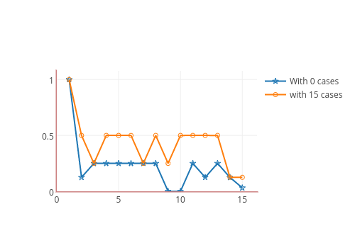
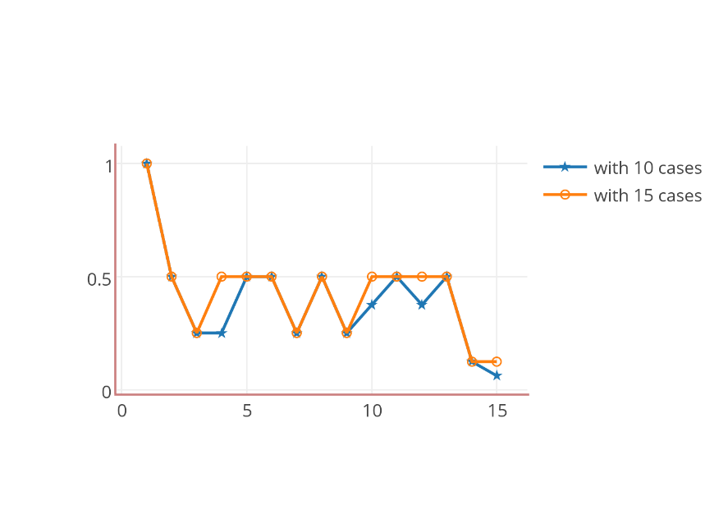
Comparing C-PISA to PISA
Zenotravel

Slide 72
Comparing CPISA to RIM
RIM [IJCAI 2013] - a case-based approach to refining incomplete models
RIM identifies a single model that satisfies the highest number of case constraints
RIM and C-PISA compared on Zenotravel domain
Both systems were provided the same incomplete model and cases
Input model to C-PISA annotated with all possible predicates for each action

Slide 73
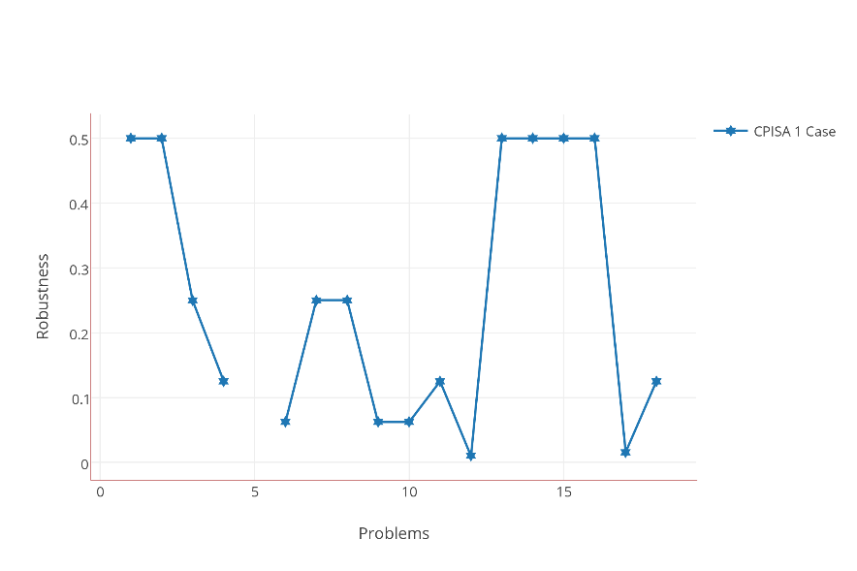
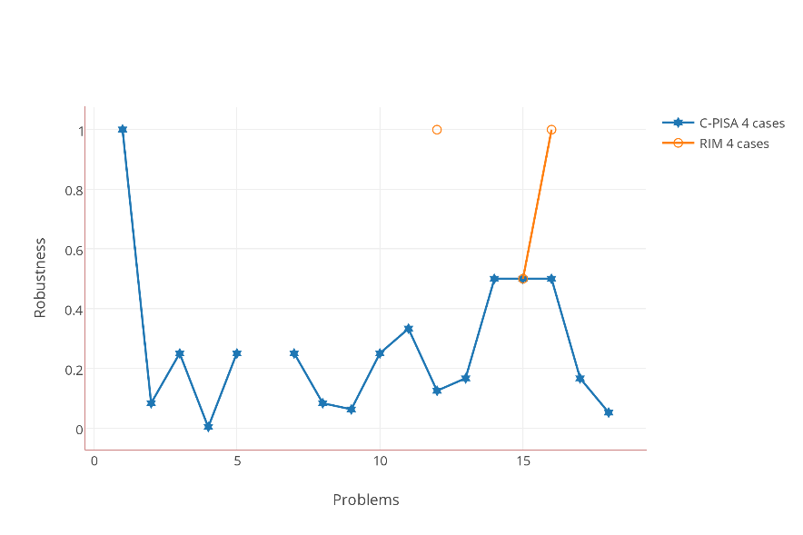
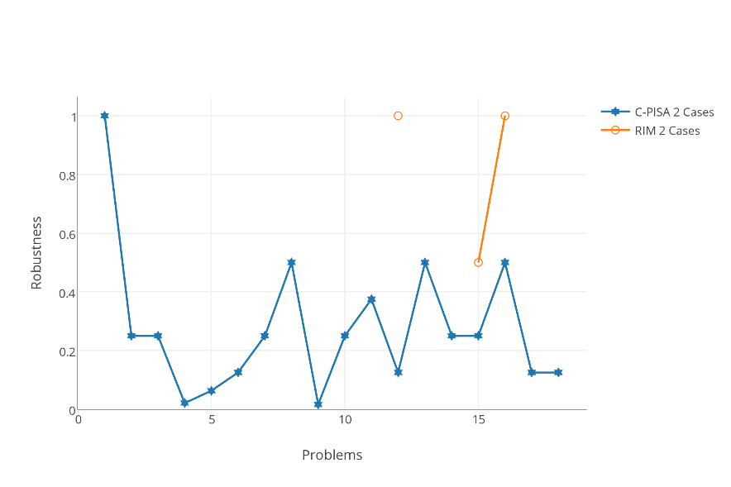
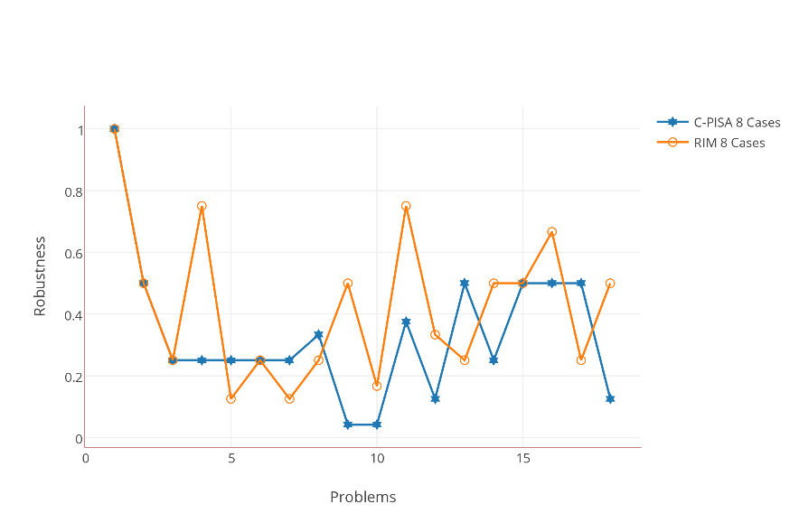
Comparing CPISA to RIM

Slide 74
Future Works
In addition to robust planning, other related problems include
Incremental plan robustification
Robust plan generation with fixed plan costs
Generating plans with desired level of robustness
Robust planning can be modified to incorporate safety constraints
Incorporating pre-specified constraints (eg: certain predicates should not be modified)
Learning constraints from safe and unsafe plans

Slide 75
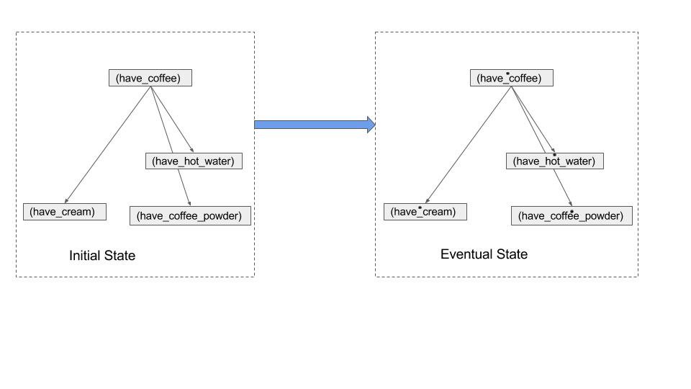
My other works
Capability Models:
Collaboration with: Dr. Yu Zhang, Prof. Subbarao Kambhampati
A model-lite planning model to capture human capabilities
Presented at AAMAS 2015

Slide 76
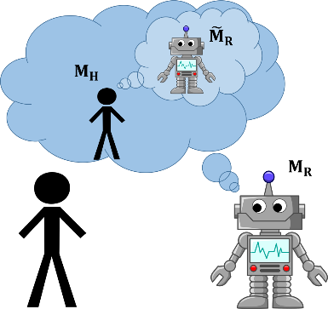
My other works
Explicable plans for peer-to-peer teams:
Collaboration with: Anagha Kulkarni, Dr. Yu Zhang, Tathagata Chakraborti, Prof. Subbarao Kambhampati
Adapting the idea of plan explicability to peer-to-peer human-robot teams
Introduced the idea of semantic task labels to generate good team behavior
Composite Plan:
a₁^{R}
a₂^{H}
a₃^{R}
a₄^{H}
a₅^{R}
…
Robot Task 1
Human Task 1
Presented at IROS 2016

Slide 77
Multi-Agent Planning
Model-Lite Planning Models
?
?
?

Slide 78
References
[1] Backstrom, C., and Nebel, B. 1996. Complexity results for sas+ planning. Computational Intelligence 11:625–655
[2] Brafman, R. I., and Domshlak, C. 2013. On the complexity of planning for agent teams and its implications for single agent planning. AIJ 198(0):52 – 71. Brafman, R. I. 2006.
[3] Factored planning: How, when, and when not. In AAAI, 809–814.
[4] Cushing, W.; Kambhampati, S.; Mausam; and Weld, D. S. 2007a. When is temporal planning really temporal? In IJCAI, 1852–1859.
[5] Muise, C.; Lipovetzky, N.; and Ramirez, M. 2015. Maplapkt: Omnipotent multi-agent planning via compilation to classical planning. (CoDMAP-15) 14.
[6] Stolba, M.; Komenda, A.; and Kovacs, D. L. 2015. Competition of distributed and multiagent planners (CoDMAP). http://agents.fel.cvut.cz/ codmap/results-summer

