Slide 1
Planning with Incomplete User Preferences and Domain Models
Tuan Anh Nguyen
Graduate Committee Members:
Subbarao Kambhampati (Chair)
Chitta Baral
Minh B. Do
Joohyung Lee
David E. Smith

Slide 2
Motivation
Automated Planning Research:
Actions
Preconditions
Effects
Deterministic
Non-deterministic
Stochastic
Initial situation
Goal conditions
What a user wants about plans
Find a (best) plan!
In practice…
Action models are not available upfront
Cost of modeling
Error-prone
Users usually don’t exactly know what they want
Always want to see more than one plan
Planning with incomplete user preferences and domain models

Slide 3
Preferences in Planning – Traditional View
Classical Model: “Closed world” assumption about user preferences.
All preferences assumed to be fully specified/available
Two possibilities
If no preferences specified —then user is assumed to be indifferent. Any single feasible plan considered acceptable.
If preferences/objectives are specified, find a plan that is optimal w.r.t. specified objectives.
Either way, solution is a single plan
Full Knowledge
of Preferences
3

Slide 4
Preferences in Planning—Real World
Full Knowledge
of Preferences is
lacking
Real World: Preferences not fully known
Unknown preferences
For all we know, user may care about every thing --- the flight carrier, the arrival and departure times, the type of flight, the airport, time of travel and cost of travel…
Partially known
We know that users cares only about travel time and cost. But we don’t know how she combines them…
4
Notes:
Having said that a single plan is sufficient when full knowledge of preferences is available, the question is whether it is still the case when preferences are not completely known.
In other words, what is the solution concept for planning with incomplete user preferences, and how to find solutions according to the concept.

Slide 5
Domain Models in Planning – Traditional View
Classical Model: “Closed world” assumption about action descriptions.
Fully specified preconditions and effects
Known exact probabilities of outcomes
Full Knowledge
of domain models
pick-up
:parameters (?b – ball ?r – room)
:precondition
(and (at ?b ?r) (at-robot ?r) (free-gripper))
:effect
(and (carry ?b) (not (at ?b ?r)) (not (free-gripper)))
5
Notes:
- The work on LCW (on world states) may give ideas on how to make these two slides

Slide 6
Domain Models in Planning – (More) Practical View
Completely modeling the domain dynamics
Time consuming
Error-prone
Sometimes impossible
What does it mean by planning with incompletely specified domain models?
Plan could fail! Prefer plans that are more likely to succeed…
How to define such a solution concept?
6
Notes:
However, it is more practical to keep in mind that...
What needed is techniques for planning even when domain models are incompletely specified.

Slide 7
Problems and Challenges
Incompleteness representation
Solution concepts
Planning techniques
7
Notes:
We identify three problems when considering planning with preference and domain incompleteness
Representation of the incompleteness. Note: there are other ways to represent incompleteness (we will talk about some of them later when I discuss some related work)
Solution concepts: given the types of incompleteness, what is a solution for the problem? Again, different ways to define solutions are possible.
Techniques

Slide 8
Dissertation overview
“Model-lite” Planning
Preference incompleteness
Domain incompleteness
Representation
Solution concept
Solving techniques
Representation
Solution concept
Solving techniques
Notes:
Mention the publication here; and which part is the proposed work.

Slide 9
Dissertation overview
“Model-lite” Planning
Preference incompleteness
Domain incompleteness
Representation: two levels of incompleteness
User preferences exist, but totally unknown
Partially specified
Complete set of plan attributes
Parameterized value function, unknown trade-off values
Representation
Actions with possible preconditions / effects
Optionally with weights for being the real ones
Solution concept: “robust” plans
Solving techniques: synthesizing robust plans
Solution concept: plan sets
Solving techniques: synthesizing high quality plan sets
Notes:
Also note that knowing that user preferences exist but totally unknown is different from assuming that users have no preferences on plans.
Also note that “plan sets” is not the only concept for solution when preferences are incomplete. We will discuss notions used by other work later.

Slide 10
Dissertation Overview
“Model-lite” Planning
Preference incompleteness
Representation: two levels of incompleteness
User preferences exist, but totally unknown
Partially specified
Full set of plan attributes
Parameterized value function, unknown trade-off values
Solution concept: plan sets with quality
Solving techniques: synthesizing quality plan sets
Distance measures w.r.t. base-level features of plans (actions, states, causal links)
CSP-based and local-search based planners
IPF/ICP measure
Sampling, ICP and Hybrid approaches
Notes:
Also mention that our experiments show that ignoring partial knowledge on user preferences results in bad quality plan sets.

Slide 11
Dissertation overview
“Model-lite” Planning
Preference incompleteness
Domain incompleteness
Publication
Domain independent approaches for finding diverse plans. IJCAI (2007)
Planning with partial preference models. IJCAI (2009)
Generating diverse plans to handle unknown and partially known user preferences. AIJ 190 (2012)
(with Biplav Srivastava, Subbarao
Kambhampati, Minh Do, Alfonso
Gerevini and Ivan Serina)
Publication
Assessing and Generating Robust Plans with Partial Domain Models. ICAPS-WS (2010)
Synthesizing Robust Plans under Incomplete Domain Models. AAAI-WS(2011), NIPS (2013)
A Heuristic Approach to Planning with Incomplete STRIPS Action Models. ICAPS (2014)
(with Subbarao Kambhampati,
Minh Do)
Representation: two levels of incompleteness
User preferences exist, but totally unknown
Partially specified
Full set of plan attributes
Parameterized value function, unknown trade-off values
Representation
Actions with possible preconditions / effects
Optionally with weights for being the real ones
Solution concept: “robust” plans
Solving techniques: synthesizing robust plans
Solution concept: plan sets
Solving techniques: synthesizing high quality plan sets
Notes:
Mention the publication here; and which part is the proposed work.

Slide 12
Planning with Incomplete Domain Models

Slide 13
Review: STRIPS
Predicate set R: clear(x – object), on-table(x – object), on(x – object, y – object), holding(x – object), hand-empty
Operators O:
Name (signature): pick-up(x – object)
Preconditions: hand-empty, clear(x)
Effects: ~hand-empty, holding(x), ~clear(x)
A single complete model!

Slide 14
Planning Problem with STRIPS
Set of typed objects $\{o_{1},…,o_{k}\}$
Together with predicate set $P$, we have a set of grounded propositions $F$
Together with operators $O$, we have a set of grounded actions $A$
Initial state: $I∈F$
Goals: $G⊆F$

Slide 15
Planning Problem with STRIPS (2)
Find: a plan $π$ achieves $G$ starting from $I$: $γ\left(π,I\right)⊇G.$
Transition function:
$γ\left(〈a〉,s\right)=s∪Add\left(a\right)∖Del(a)$ for applying $a∈A$ in $s⊆F$ s.t. $Pre\left(a\right)⊆s$.
Applying $π=〈a_{1},…,a_{n}〉$ at state $s$: $γ\left(π,s\right)=γ(〈a_{n}〉,γ(〈a_{2},…,a_{n−1}〉,s))$

Slide 16
Incomplete Domain Models
Predicate set $R$: clear(x – object), on-table(x – object), on(x – object, y – object), holding(x – object), hand-empty, light(x – object), dirty(x – object)
Operators $O$
Name (signature): pick-up(x – object)
Preconditions: hand-empty, clear(x)
Possible preconditions: light(x)
Effects: ~hand-empty, holding(x), ~clear(x)
Possible effects: dirty(x)
Incomplete domain $\tilde{D}=〈R,O〉$
At “schema” level with typed variables (no objects)
With K “annotations”, we have $2^{K}$ possible complete models, one of which is the true model.
Incompleteness in deterministic domains
Stochastic domains

Slide 17
Planning Problem with Incomplete domain
Set of typed objects $\{o_{1},…,o_{k}\}$
Together with predicate set $P$, we have a set of grounded propositions $F$
Together with operators $O$, we have a set of grounded actions $A$
Initial state: $I∈F$
Goals: $G⊆F$
Find: a plan $π$ “achieves” $G$ starting from $I$
An ill-defined solution concept!
Need a definition for “goal achievement”

Slide 18
Transition Function
Under $\tilde{D}$, applying $π$ in s results in a set of possible states:
$$γ\left(π,s\right)=\bigcup_{D_{i}∈≪\tilde{D}≫}{γ^{D_{i}}(π,s)}$$
The probability of ending up in $s^{′}∈γ(π,s)$ is equal to
$$\sum_{D_{i}∈≪\tilde{D}≫, { s}^{′}=γ^{D_{i}}(π,s)}{Pr(D_{i})}$$
where $Pr⁡(D_{i})$ is the probability of $D_{i}$ being the true model.

Slide 19
Transition Function
Under $\tilde{D}$, applying $π$ in s results in a set of possible states:
$$γ\left(π,s\right)=\bigcup_{D_{i}∈≪\tilde{D}≫}{γ^{D_{i}}(π,s)}$$
$$γ^{D_{i}}(π,s)=\left\{\begin{aligned}s, π=〈〉 \\ &{ γ}^{D_{i}}\left(〈a〉,γ^{D_{i}}\left(π^{′},s\right)\right), π=π^{′}∘〈a〉\end{aligned}\right.$$
$$γ^{D}\left(〈a〉,s\right)?$$

Slide 20
Transition Function
STRIPS Execution (SE):
Generous Execution (GE):
$γ^{D}(〈a〉,s)$:
$$γ_{SE}^{D}(〈a〉,s)=\left\{\begin{aligned} s∖Del^{D}\left(a\right)∪Add^{D}\left(a\right), if Pre^{D}\left(a\right)⊆s \\ s_{⊥}= \{⊥\} , otherwise\end{aligned}\right.$$
$$⊥ ∉F$$
$$Pre^{D}\left(a\right) ⊈s_{⊥}, G⊈s_{⊥}$$
$$γ_{GE}^{D}(〈a〉,s)=\left\{\begin{aligned} s∖Del^{D}\left(a\right)∪Add^{D}\left(a\right), if Pre^{D}\left(a\right)⊆s \\ s, otherwise\end{aligned}\right.$$

Slide 21
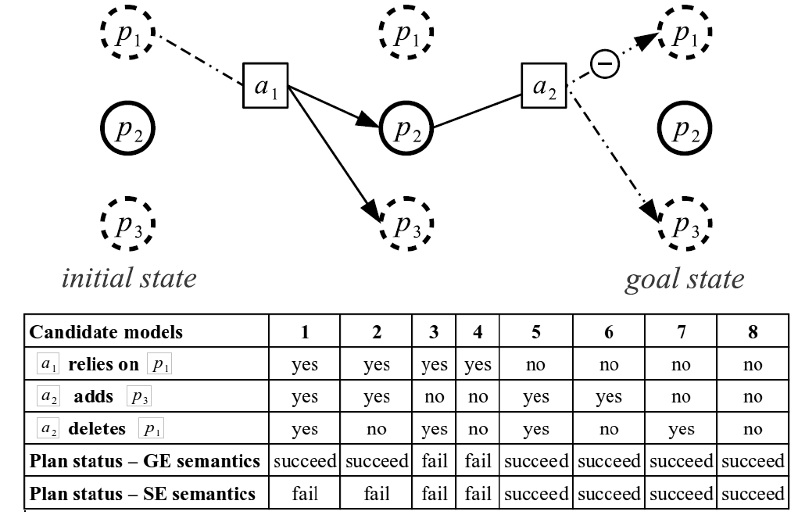
Proposition set $F=\{p_{1},p_{2},p_{3}\}$
Initial state $I=\{p_{2}\}$
Goal $G=\{p_{3}\}$

Slide 22
A Measure for Plan Robustness
Naturally, we prefer plan that succeeds in as many complete models as possible
$$R\left(π\right)=\frac{|Π|}{2^{K}}$$
$$R_{SE}\left(π\right) ≤R_{GE}(π)$$
$$R_{GE}\left(π\right)=6/8$$
$$R_{GE}\left(π\right)=4/8$$

Slide 23
A bit more general…
Predicate set $R$: clear(x – object), on-table(x – object), on(x – object, y – object), holding(x – object), hand-empty, light(x – object), dirty(x – object)
Operators $O$
Name (signature): pick-up(x – object)
Preconditions: hand-empty, clear(x)
Possible preconditions: light(x) with a weight of 0.8
Effects: ~hand-empty, holding(x), ~clear(x)
Possible effects: dirty(x) with an unspecified weight
Treat weights as probabilities with random variables
Robustness measure:
$$R\left(π\right)≝\sum_{D_{i} ∈ 〈〈\tilde{D}〉〉:γ^{D_{i}}\left(π,I \right)⊨G}{Pr⁡(D_{i})}$$

Slide 24
Content
A measure for plan quality
Robustness of plan $R\left(π\right)∈[0,1]$
Plan robustness assessment
Reduced to weighted model counting
Complexity
Synthesizing robust plans
Compilation approach
Heuristic search approach

Slide 25
Plan Robustness Assessment
Computation:
Given $\tilde{D}$, $\tilde{P}=〈F,A,I,G〉$, a plan $π$
Construct a set of correctness constraints $Σ(π)$ for the execution of $π:$
State transitions caused by actions are correct.
The goal $G$ is satisfied in the last state.
Then: $R(π)$ is computed from the weighted model count of $Σ(π)$

Slide 26
$$π$$
$$I$$
$$G$$
$$\bigvee_{C_{p}^{i}≤k≤i−1, p∈\tilde{Add}(a_{k})}{p_{a_{k}}^{add}}$$
$$p_{a_{i}}^{pre}⇒\bigvee_{C_{p}^{i}≤k≤i−1, p∈\tilde{Add}(a_{k})}{p_{a_{k}}^{add}}$$
$$Σ(π)$$
$$p_{a_{m}}^{del}⇒\bigvee_{C_{p}^{i}≤k≤i−1, p∈\tilde{Add}(a_{k})}{p_{a_{k}}^{add}}$$
$$p_{a_{i}}^{pre}⇒(p_{a_{m}}^{del}⇒\bigvee_{C_{p}^{i}≤k≤i−1, p∈\tilde{Add}(a_{k})}{p_{a_{k}}^{add}})$$

Slide 27
Plan Robustness Assessment
Complexity
The problem of computing $R(π)$ for a plan $π$ to a problem $〈\tilde{D},I,G〉$ is #P-complete.
Membership:
Have a Counting TM non-deterministically guess a complete model, and check the correctness of the plan.
The number of accepting branches output: the number of complete models under which the plan succeeds.
Completeness:
There exists a counting reduction from the problem of counting satisfying assignments for Monotone-2-SAT problem to Robustness-Assessment (RA) problem
Notes:
May be include the detailed proof here..

Slide 28
Content
A measure for plan quality
Robustness of plan $R\left(π\right)∈[0,1]$
Plan robustness assessment
Reduced to weighted model counting
Complexity
Synthesizing robust plans
Compilation approach
Heuristic search approach

Slide 29
Compilation Approach
The realization of possible preconditions / effects is determined by unknown variables $p_{a}^{pre}$, $p_{a}^{add}$, $p_{a}^{del}$
Thus, can be compiled away using “conditional effects”
If $p_{a}^{pre}=true$ then $p$ is a precondition of $a$.
Domain incompleteness ➔ State incompleteness
Conformant probabilistic planning problem!

Slide 30
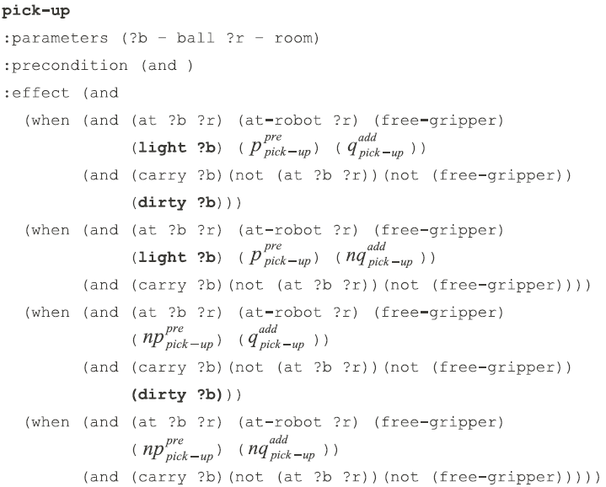
Compilation Example
Compiled “pick-up”

Slide 31
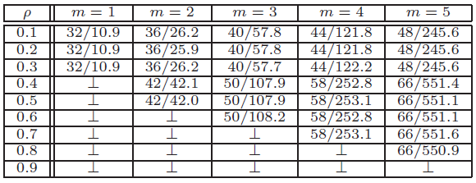
Compilation: Experimental Results
Using Probabilistic-FF planner (Domshlak & Hoffmann, 2006)
Synthesizing Robust Plans under Incomplete Domain Models
(NIPS 2013)
Normally fails with large problem instances
Incomplete Logistics domain

Slide 32
Content
A measure for plan quality
Robustness of plan $R\left(π\right)∈[0,1]$
Plan robustness assessment
Reduced to weighted model counting
Complexity
Synthesizing robust plans
Compilation approach
Heuristic search approach

Slide 33
Approximate Transition Function
Not explicitly maintain set of resulting states
Successor state:
$${\tilde{γ}}_{SE}\left(〈a〉,s\right)=s∪Add\left(a\right)∪\tilde{Add}\left(a\right)∖Del\left(a\right), if Pre\left(a\right)⊆s$$
Possible delete effects might not take effects!
Recursive definition for ${\tilde{γ}}_{SE}(π,s)$
$$γ\left(π,s\right)=\bigcup_{D_{i}∈≪\tilde{D}≫}{γ^{D_{i}}(π,s)}$$
Completeness: Any solution in the complete STRIPS action model exists in the solution space of the problem with incomplete domain.
Soundness: For any plan returned under incomplete STRIPS domain semantics, there is one complete STRIPS model under which the plan succeeds.

Slide 34
Anytime Approach for Generating Robust Plans
Initialize: $δ=0$
Repeat
Find plan $π$ s.t. $R\left(π\right)>δ$ (Stochastic)
If plan found: $δ=R(π)$
Until time bound reaches
Return $π$ and $R(π)$ if plan found

Slide 35
Use of Upper Bound
Reduce exact weighted model counting
$$I$$
$$π$$
$$s$$
If $(G⊆s)$ and $U\left(π\right)>δ$
then $wmc(π)$
$$U\left(π\right)≥wmc(π)$$
(Upper bound for $R(π)$)

Slide 36
Find $π$ s.t. $R\left(π\right)>δ$
How to…
Sample a next action at each state
Probabilistically depends on $h_{i}$
In constructing the neighborhood:
Half of the times using helpful actions
Second half: all applicable actions
$$h_{1}$$
$$h_{2}$$
$$h_{k}$$

Slide 37
Use of Lower Bound
How to…
Compute $h\left(s,δ\right)=|\tilde{π}|$
$$π_{k}$$
$$s$$
$$\tilde{π}$$
$$s_{G}$$
$$I$$
Find: $\tilde{π}$ s.t. $wmc\left(π_{k}∘\tilde{π}\right)>δ$
Avoid invoking $wmc\left(∘\right)$ during the construction of $\tilde{π}$!
Find: $\tilde{π}$ s.t. $L\left(π_{k}∘\tilde{π}\right)>δ$
$$L\left(π\right)≤wmc(π)$$
(Lower bound for $R(π)$)

Slide 38
Lower bound for $R(π)$
$$\bigvee_{C_{p}^{i}≤k≤i−1, p∈\tilde{Add}(a_{k})}{p_{a_{k}}^{add}}$$
$$p_{a_{i}}^{pre}⇒\bigvee_{C_{p}^{i}≤k≤i−1, p∈\tilde{Add}(a_{k})}{p_{a_{k}}^{add}}$$
$$Σ(π)$$
$$p_{a_{m}}^{del}⇒\bigvee_{C_{p}^{i}≤k≤i−1, p∈\tilde{Add}(a_{k})}{p_{a_{k}}^{add}}$$
$$p_{a_{i}}^{pre}⇒(p_{a_{m}}^{del}⇒\bigvee_{C_{p}^{i}≤k≤i−1, p∈\tilde{Add}(a_{k})}{p_{a_{k}}^{add}})$$

Slide 39
Lower bound for $R(π)$
$$\bigvee_{C_{p}^{i}≤k≤i−1, p∈\tilde{Add}(a_{k})}{p_{a_{k}}^{add}}$$
$${¬p}_{a_{i}}^{pre} ∨\bigvee_{C_{p}^{i}≤k≤i−1, p∈\tilde{Add}(a_{k})}{p_{a_{k}}^{add}}$$
$$Σ(π)$$
$${¬p}_{a_{m}}^{del} ∨\bigvee_{C_{p}^{i}≤k≤i−1, p∈\tilde{Add}(a_{k})}{p_{a_{k}}^{add}}$$
$${¬p}_{a_{i}}^{pre}∨{¬p}_{a_{m}}^{del} ∨\bigvee_{C_{p}^{i}≤k≤i−1, p∈\tilde{Add}(a_{k})}{p_{a_{k}}^{add}}$$
$$w\left(¬p\right)=1−w(p)$$
$Σ(π)$ as a set of clauses with positive literals.

Slide 40
Lower bound for $R(π)$
Given positive clauses $c$, $c^{′}$ : $\operatorname{Pr}\left(c \right|c^{′})≥Pr(c)$
Given $Σ\left(π\right)=\{c_{1},c_{2},…,c_{n}\}$ :
$$wmc\left(Σ\left(π\right)\right)=\operatorname{Pr}\left(c_{1}∧c_{2}∧…∧c_{n}\right)$$
$$=\operatorname{Pr}\left(c_{1}\right)\operatorname{Pr}\left(c_{2} | c_{1}\right)…\operatorname{Pr}\left(c_{n} | c_{n−1},…,c_{1}\right)$$
$$≥ \prod_{c_{i}∈Σ(π)}{Pr(c_{i})}$$
(Equality holds when all clauses are independent)
$$L\left(π\right)= \prod_{c_{i}∈Σ(π)}{Pr⁡(c_{i})} ≤R(π)$$

Slide 41
Upper bound for $R(π)$
$Σ\left(π\right)=\{c_{1},…,c_{n}\}$
An (trivial) upper bound:
$U\left(π\right)≥\min_{c_{i}∈Σ(π)}{Pr⁡(c_{i})}$
A much tighter bound:
Clauses contains variables corresponding to one specific predicate
Thus, $Σ(π)$ is highly decomposable into “connected components”
$$¬p$$
$$p$$
$$p$$
$$I$$
$$a_{k}$$
$$a_{i}$$
$$G$$
$$\bigvee_{C_{p}^{i}≤k≤i−1, p∈\tilde{Add}(a_{k})}{p_{a_{k}}^{add}}$$
$$U\left(π\right)=\prod_{j}{\min_{c∈Σ_{j}}{Pr⁡(c)}}$$
$$\{x_{1},x_{2}\} \{x_{2}, x_{3}\} \{x_{4},x_{5}\}$$

Slide 42
Find: $\tilde{π}$ s.t. $L\left(π_{k}∘\tilde{π}\right)>δ$
$$π_{k}$$
$$s$$
$$\tilde{π}$$
$$s_{G}$$
$$I$$
Build relaxed planning graph
Ignoring known & possible delete effects
Propagate clauses for propositions and actions
Extract relaxed plan

Slide 43
Relaxed Planning Graph Propositional Layer $L_{1}$
$$L_{1}=s_{k+1}={\tilde{γ}}_{SE}(π_{k},I)$$
Establishment constraints (if needed) and protection constraints for $p_{j}$ at state $s_{k+1}$
$$Σ_{p_{j}}(1)$$
$$¬p_{j}$$
$$p_{j}$$
$$I$$
$$a_{1}$$
$$a_{k}$$
$$π_{k}$$

Slide 44
Relaxed Planning Graph Action Layer $A_{t}$
$$A_{t}=\{a \left| a∈A, Pre\left(a\right)⊆L_{t}\}∪ \{noop_{p} \right| p∈L_{t}\}$$
$$Σ_{p_{i}}(t)$$
$$Σ_{a_{m}}\left(t\right)=Σ_{p_{i}}\left(t\right)∧(p_{j a_{m}}^{pre}⇒Σ_{p_{j}}(t))$$
$$p_{i}$$
$$Σ_{p_{j}}(t)$$
$$a_{m}$$
$$p_{j}$$
$$p_{j a_{m}}^{pre}$$
$$L_{t}$$
$$A_{t}$$

Slide 45
Relaxed Planning Graph Action Layer $A_{t}$
$$A_{t}=\{a \left| a∈A, Pre\left(a\right)⊆L_{t}\}∪ \{noop_{p} \right| p∈L_{t}\}$$
$$Σ_{p_{i}}(t)$$
$$Σ_{p_{i}}(t)$$
$$p_{i}$$
$$noop_{p_{i}}$$
$$Σ_{p_{j}}(t)$$
$$Σ_{p_{j}}(t)$$
$$p_{j}$$
$$noop_{p_{j}}$$
$$L_{t}$$
$$A_{t}$$

Slide 46
Relaxed Planning Graph Propositional Layer $L_{t+1}$
$$L_{t+1}=\{p |a∈A_{t}, p∈Add\left(a\right)∪\tilde{Add}\left(a\right)\}$$
$$Σ_{a_{m}}(t)$$
$$a_{m}$$
$$Σ_{p_{m}}(t+1)$$
$$p_{i}$$
$$Σ_{p_{i}}^{}\left(t+1\right)=argmax_{Σ} l(Σ∧Σ_{k})$$
$$Σ_{a_{l}}(t)$$
$$a_{l}$$
$$Σ∈\{Σ_{a_{m}}\left(t\right), p_{i a_{l}}^{pre}⇒Σ_{a_{l}}(t)\}$$
$$A_{t}$$
$$L_{t+1}$$

Slide 47
Relaxed Plan Extraction Overview
$$Σ_{p_{i}}^{}\left(t+1\right)=argmax_{Σ} l(Σ∧Σ_{k})$$
Best supporting action for $g$ at layer T
$$p_{8}$$
$$a_{3}$$
$$a_{5}$$
$$p_{2}$$
$$p_{4}$$
$$p_{6}$$
$$g$$
$$a_{1}$$
$$L_{1}$$
$$A_{1}$$
$$L_{2}$$
$$L_{T−1}$$
$$A_{T−1}$$
$$L_{T}$$
$\tilde{π}$ in total order
Succeed when:
All know preconditions are supported
$l\left(Σ_{k}∧Σ_{π^{′}}\right)>δ$

Slide 48
Relaxed Plan Extraction When to insert actions?
A supporting action $a_{best}$ is inserted only if needed
Depending on:
Relation between: subgoal and “relaxed plan state”
Robustness of the current $\tilde{π}$ and $\tilde{π}∪\{a_{best}\}$
$$s_{→a}$$
+
$$a$$
$$s_{→a}^{+}$$

Slide 49
Relaxed Plan Extraction Subgoal v.s RP state
$$p$$
$$s_{→a}$$
$$s_{→a}$$
$$s_{→a}$$
$$p$$
$$a$$
$$a$$
$$a$$
+
+
$$p$$
+
$$s_{→a}^{+}$$
$$s_{→a}^{+}$$
$$s_{→a}^{+}$$
$$p$$
$$s_{→a}$$
$$s_{→a}$$
$$s_{→a}$$
$$p$$
$$a$$
$$a$$
$$a$$
+
+
$$p$$
+
$$s_{→a}^{+}$$
$$s_{→a}^{+}$$
$$s_{→a}^{+}$$

Slide 50
Relaxed Plan Extraction
$p∈Pre\left(a\right), p∉s_{→a}$: insert $a_{best}$ into $\tilde{π}$
This type of subgoal makes the relaxed plan “incomplete”
No actions in $π_{k}$ and $\tilde{π}$ supporting this subgoal
$$p$$
$$s_{→a}$$
$$a$$
+
$$s_{→a}^{+}$$

Slide 51
Relaxed Plan Extraction
For these subgoals, supporting actions inserted if the insertion increases the robustness of the current relaxed plan.
$$l\left(Σ_{π}∧Σ_{\tilde{π}∪\left\{a_{best}\right\}}\right)>l(Σ_{π}∧Σ_{\tilde{π}})$$
$$p$$
$$s_{→a}$$
$$s_{→a}$$
$$s_{→a}$$
$$p$$
$$p$$
$$a$$
$$a$$
$$a$$
+
+
+
$$s_{→a}^{+}$$
$$s_{→a}^{+}$$
$$s_{→a}^{+}$$

Slide 52
Relaxed Plan Extraction
For these subgoals, no supporting actions needed!
$$s_{→a}$$
$$s_{→a}$$
$$a$$
$$a$$
$$p$$
$$p$$
+
+
$$s_{→a}^{+}$$
$$s_{→a}^{+}$$

Slide 53
Find $π$ s.t. $R\left(π\right)>δ$: Search Algorithm
Stochastic local search with failed bounded restarts (Coles et al., 2007)
$$h\left(s,δ\right)=100$$
$h(s,δ)$: how far it is approximately from s to a goal state so that the resulting plan has approximate robustness > $δ$.
$$δ∈(0,1]$$
$$failcount=0$$
$$a_{10}$$
$$a_{12}$$
Better state found.
$$h\left(s^{′},δ\right)=55$$
$$failcount=0$$
Depth bound reached. Failed.
$$probecount=0$$
$$probecount=2$$
$$probecount=1$$
If $probecount=probebound$
then increment $failcount$
$$a_{20}$$
$$h\left(s^{′′},δ\right)=0$$
Goal reached
If $failcount=failbound$
then double depth bound
$$δ=R(π)$$
$$failbound=32, 64,128,…$$

Slide 54
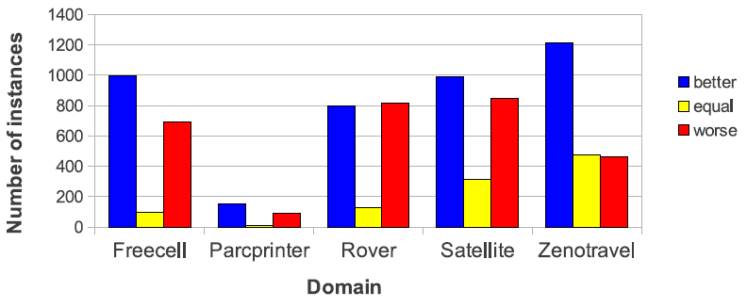
Experimental Results
Domains:
Zenotravel, Freecell, Satellite, Rover (215 domains x 10 problems = 2150 instances)
Parc Printer (300 instances)
Number of instances for which PISA produces better, equal and worse robust plans compared to DeFault.

Slide 55
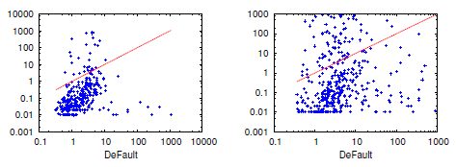
Experimental Results
Total time in seconds (log scale) to generate plans with the same robustness by PISA and DeFault.

Slide 56
Dissertation overview
“Model-lite” Planning
Preference incompleteness
Domain incompleteness
Representation: two levels of incompleteness
User preferences exist, but totally unknown
Partially specified
Full set of plan attributes
Parameterized value function, unknown trade-off values
Representation
Actions with possible preconditions / effects
Optionally with weights for being the real ones
Solution concept: “robust” plans
Solving techniques: synthesizing robust plans
Solution concept: plan sets
Solving techniques: synthesizing high quality plan sets
Notes:
Also note that knowing that user preferences exist but totally unknown is different from assuming that users have no preferences on plans.
Also note that “plan sets” is not the only concept for solution when preferences are incomplete. We will discuss notions used by other work later.

Slide 57
Dissertation overview
“Model-lite” Planning
Preference incompleteness
Domain incompleteness
Publication
Domain independent approaches for finding diverse plans. IJCAI (2007)
Planning with partial preference models. IJCAI (2009)
Generating diverse plans to handle unknown and partially known user preferences. AIJ 190 (2012)
(with Biplav Srivastava, Subbarao
Kambhampati, Minh Do, Alfonso
Gerevini and Ivan Serina)
Publication
Assessing and Generating Robust Plans with Partial Domain Models. ICAPS-WS (2010)
Synthesizing Robust Plans under Incomplete Domain Models. AAAI-WS (2011), NIPS (2013)
A Heuristic Approach to Planning with Incomplete STRIPS Action Models. ICAPS (2014)
(with Subbarao Kambhampati,
Minh Do)
Representation: two levels of incompleteness
User preferences exist, but totally unknown
Partially specified
Full set of plan attributes
Parameterized value function, unknown trade-off values
Representation
Actions with possible preconditions / effects
Optionally with weights for being the real ones
Solution concept: “robust” plans
Solving techniques: synthesizing robust plans
Solution concept: plan sets
Solving techniques: synthesizing high quality plan sets
Notes:
Mention the publication here; and which part is the proposed work.

Slide 58
Thank you! Q & A

