Slide 1


When is Temporal Planning Really Temporal?
William Cushing
Ph.D. Thesis Defense
Committee:
Subbarao Kambhampati
Chitta Baral
Hasan Davulcu
David E. Smith
Daniel S. Weld
Special Thanks:
Mausam
Kartik Talamadupula
J. Benton

Slide 2
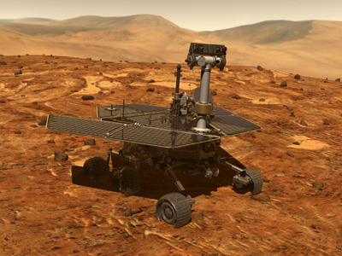
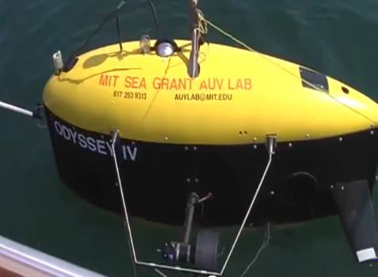
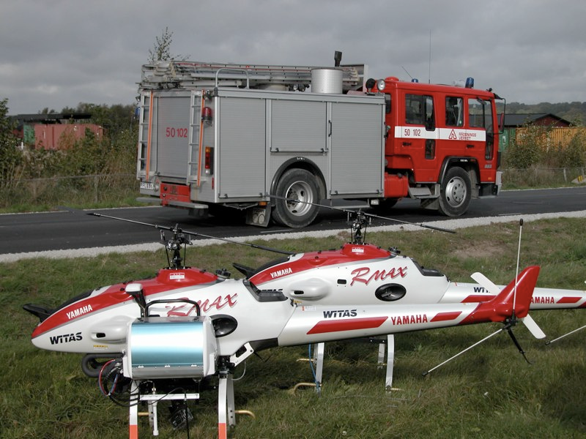
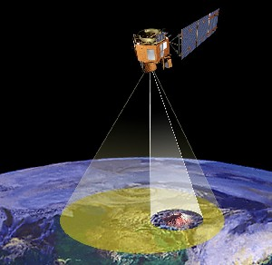
Applications Exist
Motivation
MAPGEN
Kongming
+$1,8mil/year (Chien, ICAPS 2010)
by improved temporal planning
TALplanner
ASPEN/CASPER
Innovative Applications of Artificial Intelligence (IAAI)
Notes:
Naturally, domain-dependent.
MIT Sea Grant AUV Lab: Brian Williams
Mars Rovers: Kanna Rajan
UAVs (RMAX) for emergency logistics: Patrick Doherty
Earth observing satellite (EO-1: ASPEN, CASPER, R4, R5): Steve Chien
67 human steps versus 1 prioritized goal to get an image.
“Initially, we were spending about $7,500 per image to acquire them. Now the cost is less than $600 a scene,”
says Cramer.

Slide 3

Applications are Hard
AI Background
Robotics
  Sensing
    Vision
    Lasers
    GPS
  Actuation
    Swim
    Drill
    Carry
  Safety
    Human
    Self
  Reflexes
  Skills
Agency/AI
  Awareness
    Cognition
    Memory
  Intelligence
    Planning
    Diagnosis
    Learning
  Action
    Execution
    Monitoring
    Communication
  Constrained Autonomy
    Predictability
    Accountability
    Liability
    Explain-ability
Divide to Conquer
(Annual Conference of the) Association for the Advancement of Artificial Intelligence (AAAI)
Notes:
Planning is only one small piece of the puzzle.
Division of Responsibilities.

Slide 4
Simplify To Succeed
Thesis Scope
Philosophy:
Practical iff Engineered
  Unrealistic => Feasible
  Realistic => Infeasible
Simplest Sufficient = Best
  Ockham/KISS/…
Profit / Time
Quality
Profit
Fast
Uncertainty
Cheap
Knightian
Bayesian
When is Time really necessary?
Boolean
STRIPS
How can Classical Planning Technique be made Temporal?
Time
Durations
Deadlines
How should we write Temporal Planning Problems to assist leveraging?
Compounds
What are Least Temporal kinds of Temporal Planning?
Artificial Intelligence: A Modern Approach. Stuart J. Russell, Peter Norvig. 2003.
Notes:
Elaboration Tolerance
Model-View-Controller
Encapsulation

Slide 5
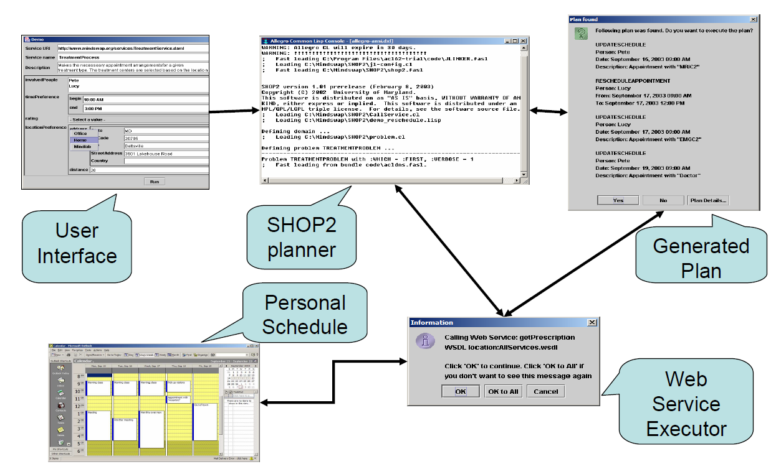
D
Motivation
Notes:
University of Maryland, SHOP2 (HTN Planner): Dana Nau.
Interfacing HTN Planning with Scheduling in order to arrive at Temporal HTN Planning is exceedingly natural.
(Qualitative Scheduling ~ HTN…)

Slide 6
Agenda
Classical Planning Background
Trouble in Temporal Planning
The Mission
Overview of Results and Challenges
  Chapter 2: Definitions
  Chapter 3: Theory
  Chapter 4: Language Analysis
  Chapter 5: Algorithm Analysis
Summary

Slide 7
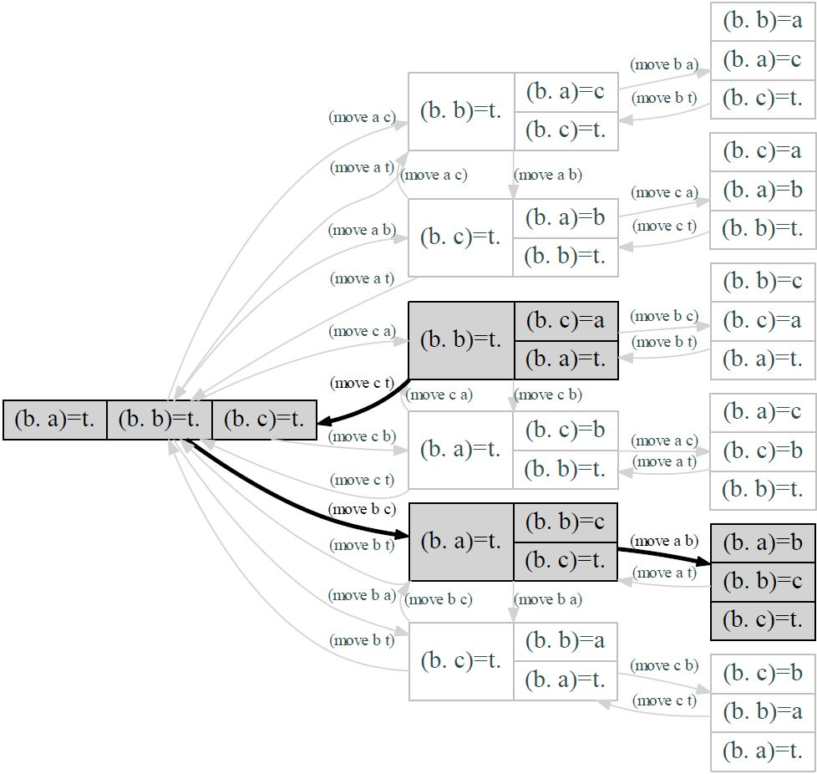
Classical Planning Background
Abstract Maze = Graph
Blocksworld
3 Blocks
Fluents
  (below ?x ?y)
Actions
  (move ?x ?y)
Init
  (below b table)
  (below c a)
  (below a table)
Goal
  (below a b)
  (below b c)
Solution
  (move c table)
  (move b c)
  (move a b)
A Computer Model of Skill Acquisition.
G.J. Sussman. 1975.
A Formal Basis for the Heuristic Determination of Minimum Cost Paths.
Peter E. Hart, Nils J. Nilsson, and Bertram Raphael. 1968. Note: A*.

Slide 8
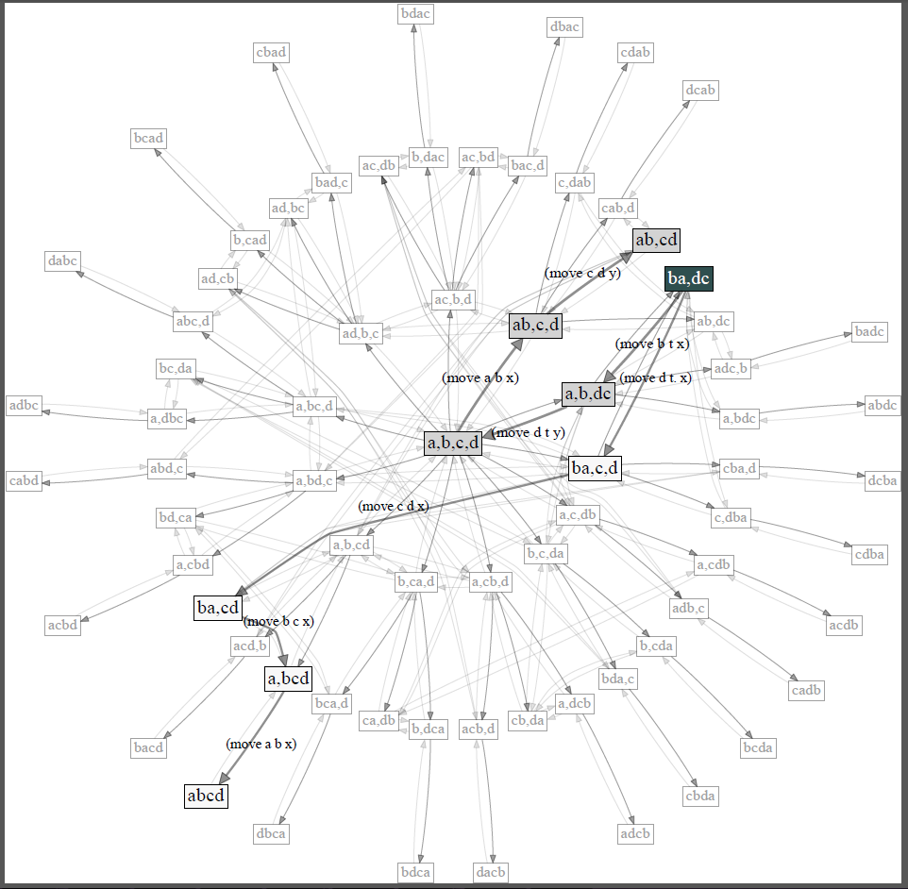
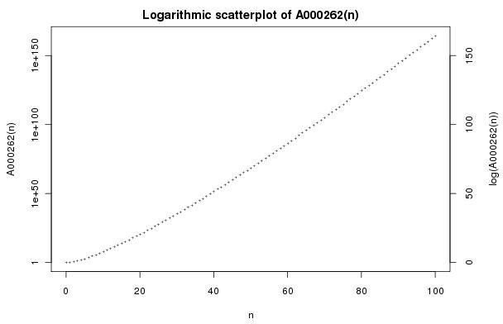
Combinatorial Explosion
Classical Planning Background
3 blocks
13 states
4 blocks
73 states
  19 blocks
13,564,373,693,588,558,173 states
http://oeis.org/A000262
Universe in #atoms (approx.)
Earth in #atoms (approx.)
The On-Line Encyclopedia of Integer Sequences™ (OEIS™)

Slide 9
Cheat To Win
Classical Planning Background
Think outside the Maze
Lifting
  Propositional: Maze -> STRIPS
  Relational: STRIPS -> UCPOP
  Temporal: UCPOP -> ZENO
Equivalence Reductions
  Symmetries
  Duplication
Dominance Reductions
  Worse than Best Known
  Not Better by Enough
Abstractions
  Problem Decomposition
  Precondition Abstraction
  Bisimulation
Planning Graphs
Landmarks
Macros
Portfolios
Temporal Planning Graphs?
Smith, Weld (1999).
Do, Kambhampati (2002-03).
Fox, Long (2002-03).
Coles, … (2008-12).
Dials, Knobs, Levers, Switches, Bells and Whistles:
Fast Downward > 10²⁰ Classical Planners
International Conference on Automated Planning and Scheduling (ICAPS)
Notes:
Fast Downward has many parameters that can be set in more or less infinite ways;
10^20 is a reasonable estimate of the number that are distinct enough
Progress?

Slide 10
Agenda
What are Least Temporal kinds of Temporal Planning?
Comparison to 2007 work
Classical Planning Background
The Trouble with Temporal Planning
Overview of Results and Challenges
  Chapter 2: Definitions
  Chapter 3: Theory
  Chapter 4: Language Analysis
  Chapter 5: Algorithm Analysis
Future Work and Conclusions
Quality
Uncertainty
STRIPS
Time

Slide 11
Agenda
Classical Planning Background
Trouble in Temporal Planning
The Mission
Overview of Results and Challenges
  Chapter 2: Definitions
  Chapter 3: Theory
  Chapter 4: Language Analysis
  Chapter 5: Algorithm Analysis
Summary

Slide 12

The Issue
Temporal Planning Background
Many Flavors of (Temporal) Planning
  Processes, Concurrency, Deadlines, Events, …
  No Standard: Pick your favorites
  Empirical Comparison?
PDDL+IPC
  Goal: Meaningful Empirical Evaluation
  Worked for Classical Planning
Almost Worked for Temporal Planning
  Still at least two kinds (2007):
    Veiled Classical Planners
    Required Concurrency
PDDL --- The Planning Domain Definition Language --- Version 1.2. Drew McDermott, Malik Ghallab, Adele Howe, Craig Knoblock, Ashwin Ram, Manuela Veloso, Daniel S. Weld and David Wilkins. 1998.
PDDL2.1: An Extension to PDDL for Expressing Temporal Planning Domains. Maria Fox and Derek Long. 2003.

Slide 13
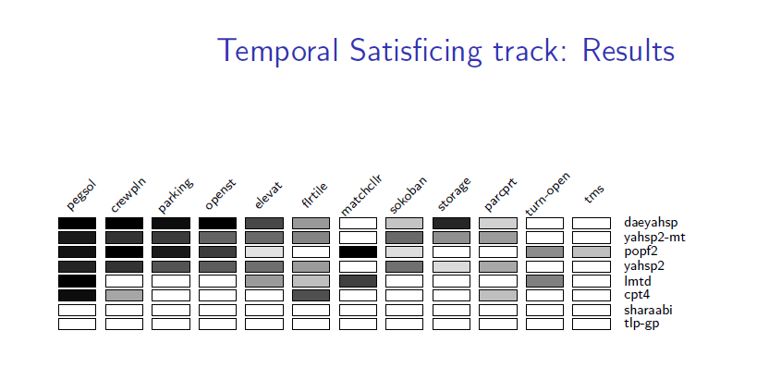
The Results
Impact
Temporal IPC Spirit: Required Concurrency
Pre-2011 Actual: Sugared Classical Problems
Impact, 2011 IPC: Required Concurrency!
Required Concurrency
Temporally Expressive
http://ipc.icaps-conference.org/

Slide 14
Confusion in Temporal Planning
Theory
Practice
Continuous change ☹
Undecidable
2EXPSPACE-complete
Real Systems
  mapgen, europa, circa, kongming, colin
Research Prototypes
  lpg, mips, sgplan, dae-yahsp2
Truth?

Slide 15
Progress???
Temporal Planning Background
Maybe?
  Interesting Theoretical Grounds
Weak Experimental Data
  Not easily fixed
  Problem isn’t the experiment
(Meta-)Problem:
  Distinct Definitions of Temporal Planning
  Logically Distinct
  Computationally Distinct

Slide 16
Agenda
Classical Planning Background
Trouble in Temporal Planning
The Mission
Overview of Results and Challenges
  Chapter 2: Definitions
  Chapter 3: Theory
  Chapter 4: Language Analysis
  Chapter 5: Algorithm Analysis
Summary

Slide 17
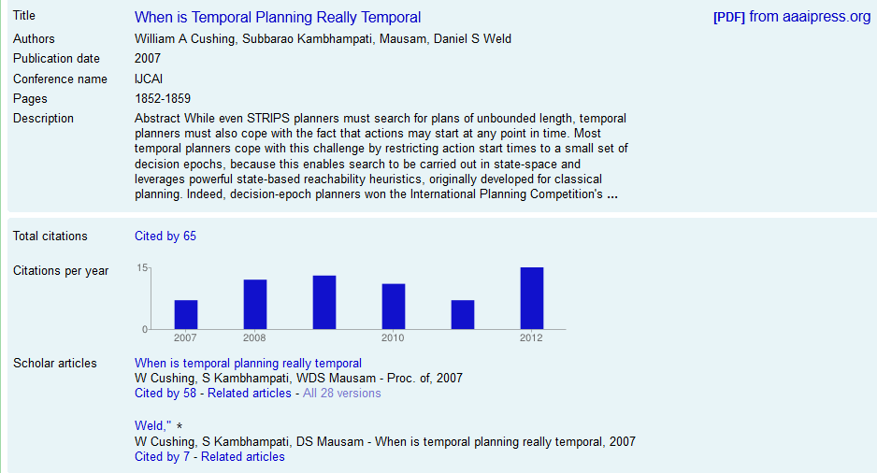
The Mission: “Really Do 2007”
Impact

Slide 18
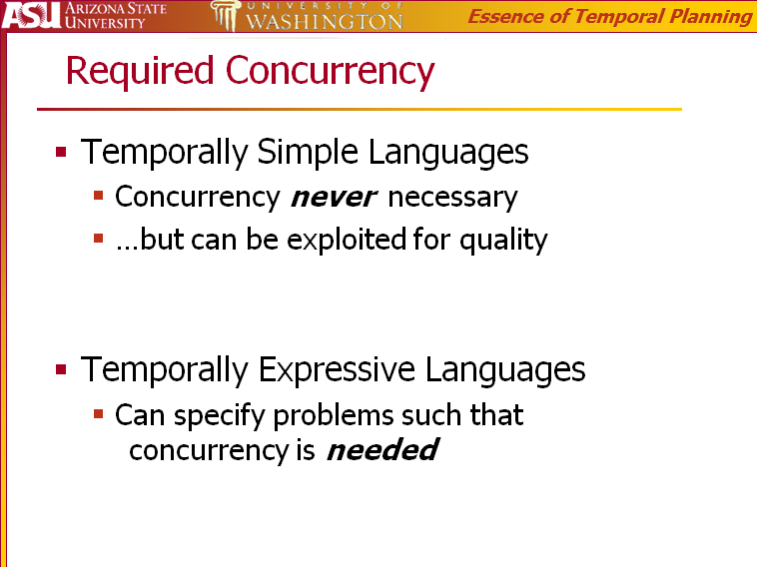
Thesis
Comparison
2007
2012
Sequential
  Concurrency Forbidden
  Primitive Actions
Conservative
  Concurrency Optional
  +Schedules
Interleaved
  Concurrency Requirable
  +Compound Actions
(Everything else)

Slide 19
Definitions: Required Concurrency
Comparison
2007
2012
Reschedulable into:
  temporally disjoint
  set of
  durative action dispatches.
  (Lack: Inherently Sequential)
Syntax: Temporal Gap
Reorderable into:
  classically-sorted
  sequence of
  durative effect dispatches.
  (Lack: Causally Sequential)
Syntax: Causally Compound
A
bgn-A
fin-A
*
bgn-B
fin-B
B
*
bgn-C
fin-C
*
C
bgn-D
fin-D
D
*

Slide 20
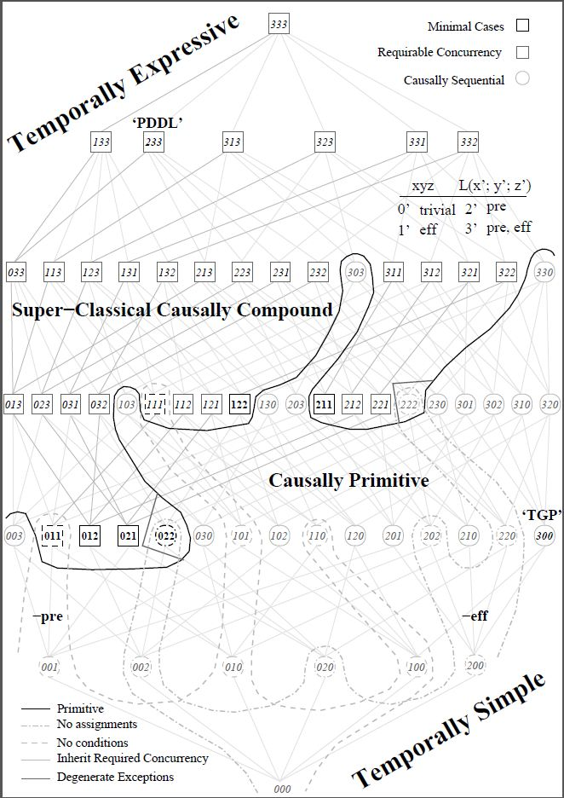
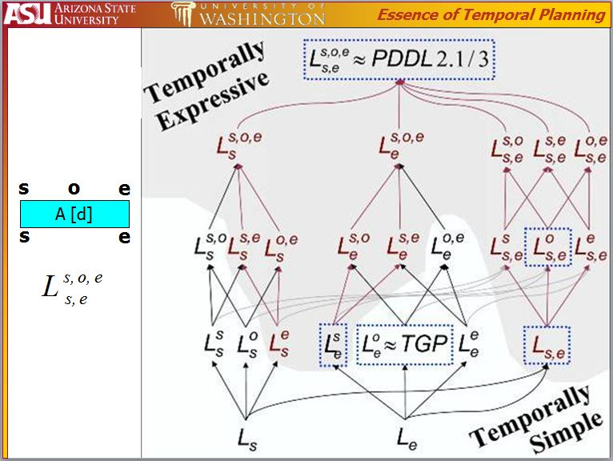
RC Characterization Theorem
Comparison
2007

Slide 21
Technical Level Changes
Comparison
Syntax:
  +Deadlines
  +Durative Effects
  -Instantaneous Effects/Events
Same Intuitive Semantics (Set of Intervals)
Formal Semantics:
  -Timed Sequence of Sets of Events alternating with Sets of Processes
  +Timed Sequence of Effects
Theory:
  +Definitions, Proofs
  +Intuitive Semantics Hold
  +Reordering
  +Compilations/Reductions to Graph Theory
  +FFC complete, systematic, and defined
  +DEP nonsystematic
  +TEMPO systematic
  -DEP+

Slide 22
Agenda
Classical Planning Background
Trouble in Temporal Planning
The Mission
Overview of Results and Challenges
  Chapter 2: Definitions
  Chapter 3: Theory
  Chapter 4: Language Analysis
  Chapter 5: Algorithm Analysis
Summary

Slide 23
Thesis
Overview
Everything More General
(“true concurrency”, continuous change)
ZENO, Kongming, ASPEN
Interleaved Temporal Planning
TLplan, SAPA, POPF
Aim: Understand Temporal Planning
  Relative to Classical Planning
Concurrency
  Sequential: Forbid
  Conservative: Strictly Optional
  Interleaved: Possibly Required
Justification:
  Increasing computational generality
  Captures state-of-the-art
Conservative Temporal Planning
TGP, CPT, DAE-YAHSP2
Sequential Planning
STRIPS, FF, FD

Slide 24
How Should:
Overview: Chapter 2
Time be represented
  Finite, Integer, Rational, Real…
Plans/Schedules be represented
  Points, Intervals, Sequences, Sets, Gantt Charts, …
Concurrency be defined
  Occlusion/Atomic, Commutativity, Synchronous, …
Formal Execution be defined
  Transition Systems, Temporal Logic, Hybrid Automata, Petri Nets, …
(‘Intuitive’) Behavior be defined
  f(t) = v, …
Solutions be defined
  Goal-satisfaction (no uncertainty)
  Deadlock, Livelock, Fairness (anti-Zeno conditions), Robustness, …
Algebra
Calculus
Time and Time Again: The Many Ways to Represent Time. James F. Allen. 1991.
Notes:
Many tricky questions
Time: also hyperreals (nonstandard analysis), {R,W} * Real
Schedules: sequences of sets of (pddl), sets of sequences of (optop), flexible partial orders (executive picks), …
Concurrency: also communicating processes, nondeterminism, prioritization, stochastic (exponential fallback)
Executions: also Petri Nets
Behavior: also f(s,t), f[s,t], f(s,t], …; also uncertainty (beliefs instead of states)
Solutions: also expectations, etc., i.e., for MDPs
http://users.cecs.anu.edu.au/~jks/bw.html

Slide 25
We should (always) identify and prove:
Overview: Chapter 3
Reduction to simpler setting (transition systems)
  Full reduction: target is sound and complete
Rescheduling
  SP: Trivial
  CTP: First-Fit (Left-Shifting, Right-Shifting)
  ITP: Simple Temporal Networks (Slackless)
Reordering
  SP: Standard
  CTP: Same as SP, harder proof
  ITP: +decomposition constraints
if and only if
Are 10:00 and 10:10 different?
Does order matter?
Temporal Planning with Mutual Exclusion Reasoning. David E. Smith and Daniel S. Weld. 1999. TGP.
Multiple Relaxations in Temporal Planning. Keith Halsey, Derek Long, and Maria Fox. 2004. CRIKEY.
Computational Aspects of Reordering Plans. Christer Bäckström. 1998.
Systematic Nonlinear Planning. David A. McAllester and David Rosenblitt. 1991. SNLP.
Notes:
3 key intuitions for any form of temporal planning
Rescheduling: TGP and CRIKEY
Temporal Planning with Mutual Exclusion Reasoning. David E. Smith and Daniel S. Weld. 1999. (TGP)
Multiple Relaxations in Temporal Planning. Keith Halsey, Derek Long, and Maria Fox. 2004. (CRIKEY)
Reordering:
Computational Aspects of Reordering Plans. Christer Backstrom. 1998.
Systematic Nonlinear Planning. David A. McAllester and David Rosenblitt. 1991. (SNLP)

Slide 26
Redo Language Analysis
Overview: Chapter 4
Define Required Concurrency
  Argue for Hard but Not Impossible
  Future work not futile
Setup space of languages
Prove syntactic characterization:
  Causally Compound
Collapse simple side
  ‘CTP representative:’
  First-Fit suffices
Collapse complex side
  ITP representative:
  Subintervals reduce to RC
ITP
CTP
An Investigation into the Expressive Power of PDDL2.1.
Maria Fox, Derek Long, and Keith Halsey. 2003.
Notes:
Define RC, argue that this definition means that implementations will be handicapped.
Ideally: not forever.
Show a piece of the puzzle that is the full background theory on compiling away syntax.

Slide 27
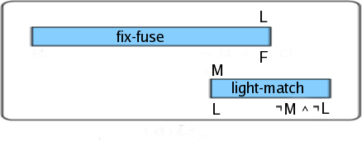
Redo Algorithm Analysis
Overview: Chapter 5
Results
  FFC, Conservative - deadlines:
  complete, systematic
FFC, Conservative:
  pseudo-complete, systematic
(FFC, ITP: incomplete, systematic)
DE, Conservative:
  complete (nonsystematic)
DE, Interleaved:
  incomplete, nonsystematic
TEMPO, Interleaved:
  complete, systematic
(TEMPO, Conservative: complete, systematic)
Define:
  +First-Fit Classical (FFC)
  Decision Epoch (DE)
  Temporally Lifted (TEMPO)
Prove/Disprove:
  completeness
  +systematicity
  SP given
  CTP/ITP novel
Local Search
Incomplete!
SAPA: A Multi-objective Metric Temporal Planner.
Minh Binh Do and Subbarao Kambhampati. 2003.
Planning with Resources and Concurrency: A Forward Chaining Approach.
Fahiem Bacchus and Michael Ady. 2001.

Slide 28
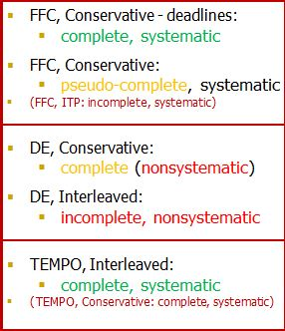
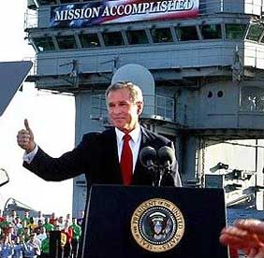
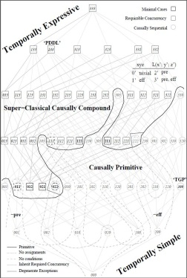
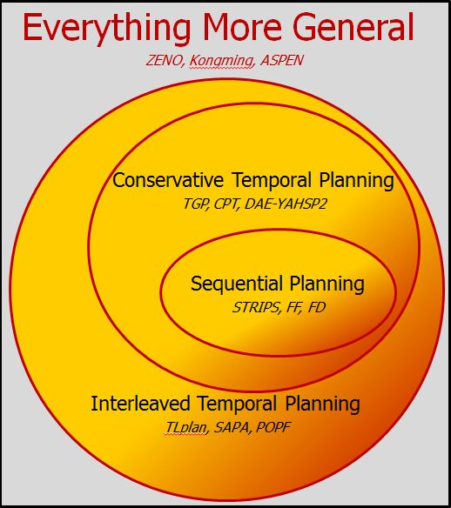
Review:
Overview
Mission Accomplished
Identified
Lessons/Intuitions
  Reduction (multi-objective, unit-time reduced)
  Rescheduling (left-shifted, slackless)
  Reordering (deordered)
Semantics (Definitions, Axioms, …)
  Conservative Temporal Planning
    Locks
  Interleaved Temporal Planning
    Promises
Computational Features
  Causally Required Concurrency
  Causally Compound
Proved
Circumscribed
  Forward-chaining
  Least Temporal
  …
  Future Work: Expand Scope
Comprehensive Theory
  Languages
  Algorithms
  Future Work: Domains
ITP
CTP
Are 10:00 and 10:10 different?
Algebra
Calculus
Does order matter?

Slide 29
Agenda
Classical Planning Background
Trouble in Temporal Planning
The Mission
Overview of Results and Challenges
  Chapter 2: Definitions
  Chapter 3: Theory
  Chapter 4: Language Analysis
  Chapter 5: Algorithm Analysis
Summary

Slide 30
What is Time?
Chapter 2: Definitions
Theory
Natural (LTL)
Integer (VHPOP)
Rational (TGP)
Real (ZENO)
Hyperreal (OPTOP)
Real + Real’ (COLIN)
Locally Finite Tree (CTL)
Symbolic Algebra (Allen)
  Two versions
…
Practice
Bounded
  uint32, int32
  float
  double
  fixed-point (TALplanner)
  …
`Unbounded’
  BigDecimal
  Rational (Scheme)
  Algebraic (Mathworks)
  …
Time and Time Again: The Many Ways to Represent Time. James F. Allen. 1991.
A temporal logic-based planning and execution monitoring framework for unmanned aircraft systems.
Patrick Doherty, Jonas Kvarnström, and Fredrik Heintz. 2009.

Slide 31
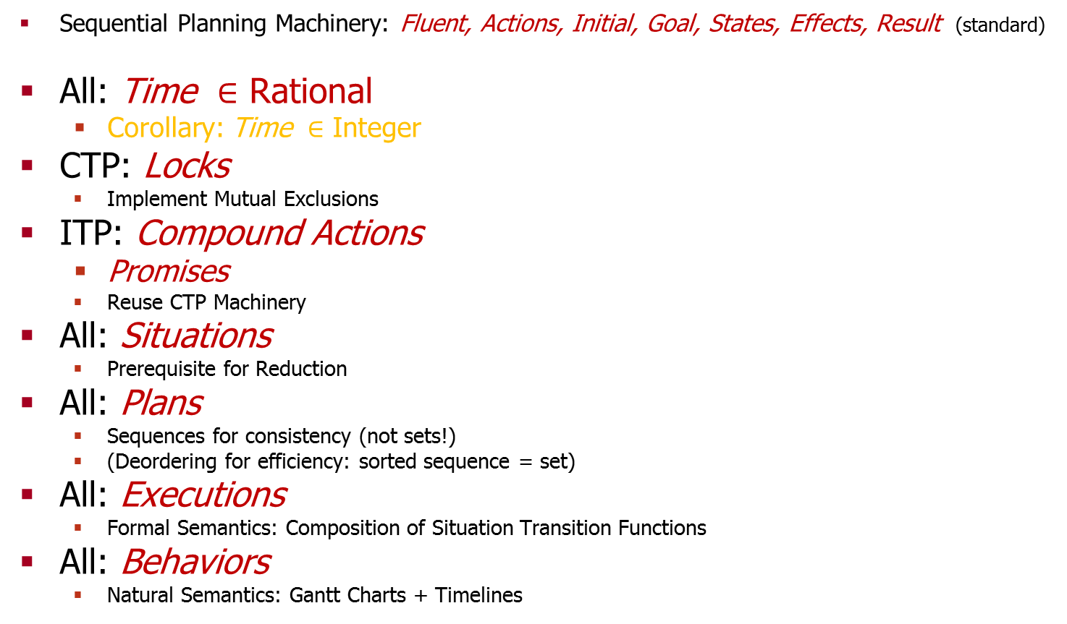
Mini-Overview: Machinery
Chapter 2: Definitions
Sequential Planning Machinery: Fluent, Actions, Initial, Goal, States, Effects, Result (standard)
All: Time $∈$ Rational
  Corollary: Time $∈$ Integer
CTP: Locks
  Implement Mutual Exclusions
ITP: Compound Actions
  Promises
  Reuse CTP Machinery
All: Situations
  Prerequisite for Reduction
All: Plans
  Sequences for consistency (not sets!)
  (Deordering for efficiency: sorted sequence = set)
All: Executions
  Formal Semantics: Composition of Situation Transition Functions
All: Behaviors
  Natural Semantics: Gantt Charts + Timelines

Slide 32

CTP Machinery: Locks
Chapter 2: Definitions
A write-lock is an interval
  along a fluent’s timeline
  disjoint from all other locks
A read-lock is an interval
  along a fluent’s timeline
  concurrent with at most other read-locks
Effects:
  Depend on certain fluents
  Write to certain fluents
  Acquire write-locks on the fluents written to
  Acquire read-locks on the rest
    (fluents depended on but not written to)

Slide 33
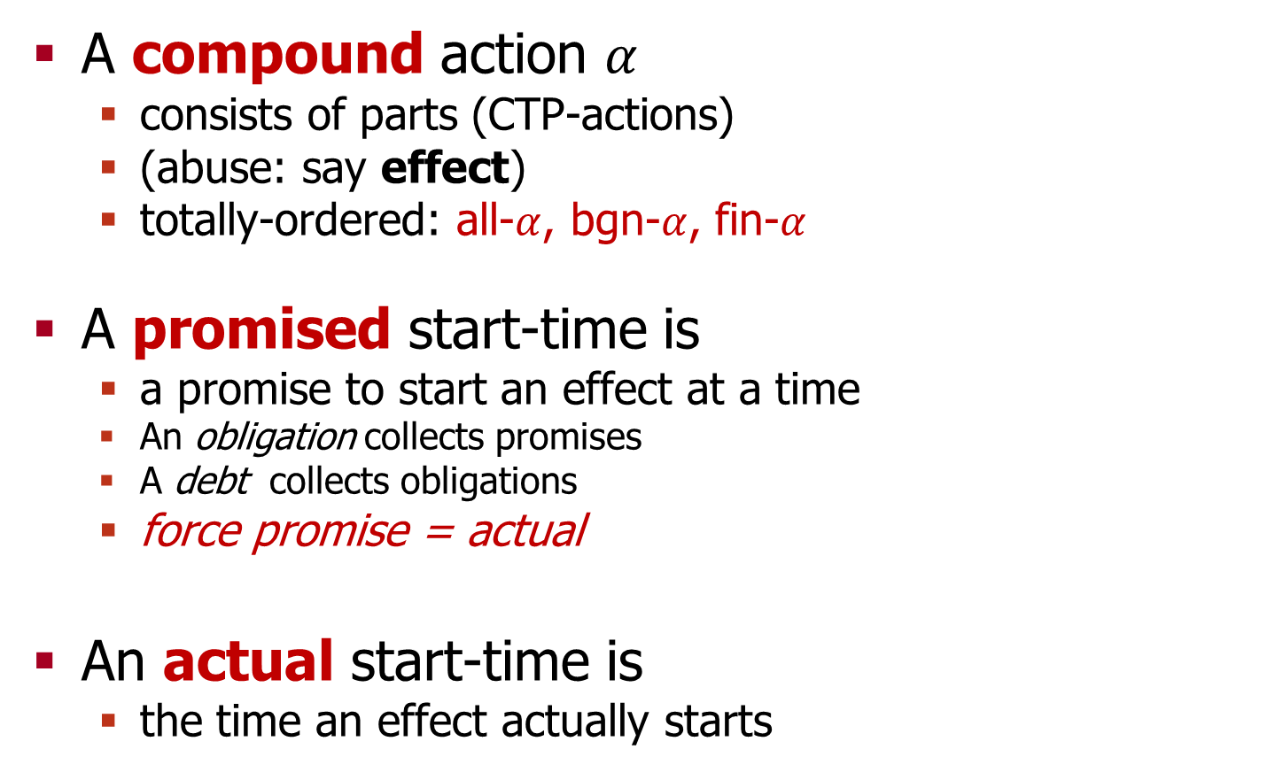
ITP Machinery: Compound Actions
Chapter 2: Definitions
A compound action $α$
  consists of parts (CTP-actions)
  (abuse: say effect)
  totally-ordered: all-$α$, bgn-$α$, fin-$α$
A promised start-time is
  a promise to start an effect at a time
  An obligation collects promises
  A debt collects obligations
  force promise = actual
An actual start-time is
  the time an effect actually starts
all-A
bgn-A
A
fin-A

Slide 34
Formal Semantics (1/3): Situations
Chapter 2: Definitions
A SP-situation:
A CTP-situation:
An ITP-situation:
match-exists=T
light=F
fuse-fixed=F
match-exists=T,-inf,0,W
light=F,-inf,0,W
fuse-fixed=F,-inf,0,W
match-exists=T,-inf,0,W
light=F,-inf,0,W
fuse-fixed=F,-inf,0,W
light-match={}
fix-fuse={}

Slide 35
Formal Semantics (2/3): Plans
Chapter 2: Definitions
An action-sequence:
  Its diagram:
An action-schedule:
  Its diagram:
An effect-schedule:
  (similar diagram)
A
B
C
D
A
B
C
D
A,1
B,0
C,7
D,7
Deordering fixes spurious ordering of C and D
A
B
Deordering justifies merging all-A with bgn-A
C
D
bgn-A,1
bgn-B,0
bgn-C,7
bgn-D,7
fin-A,9
fin-B,8
fin-D,16
fin-C,24

Slide 36
Formal Semantics (3/3): Executions
Chapter 2: Definitions
An execution is a situation-sequence
  formed by applying transition functions
  S₀, S₁, S₂, …, S_{n}
  ITP: dispatch-times must be actual
The Good: STRIPS-like
The Bad: STRIPS-like
  Temporal??

Slide 37
Natural Semantics: Behaviors
Chapter 2: Definitions
A behavior collects fluent timelines
A fluent timeline assigns
  per time point
  values to fluents
  f(t) = v
Prop.: Behavior-Equivalence implies Result-Equivalence
  …implies Solution-Equivalence
  Meta-meaning: Formal meaning is (logically) isomorphic to natural meaning
Translation: Temporal
Notes:
computationally isomorphic?
This concludes Chapter 2

Slide 38
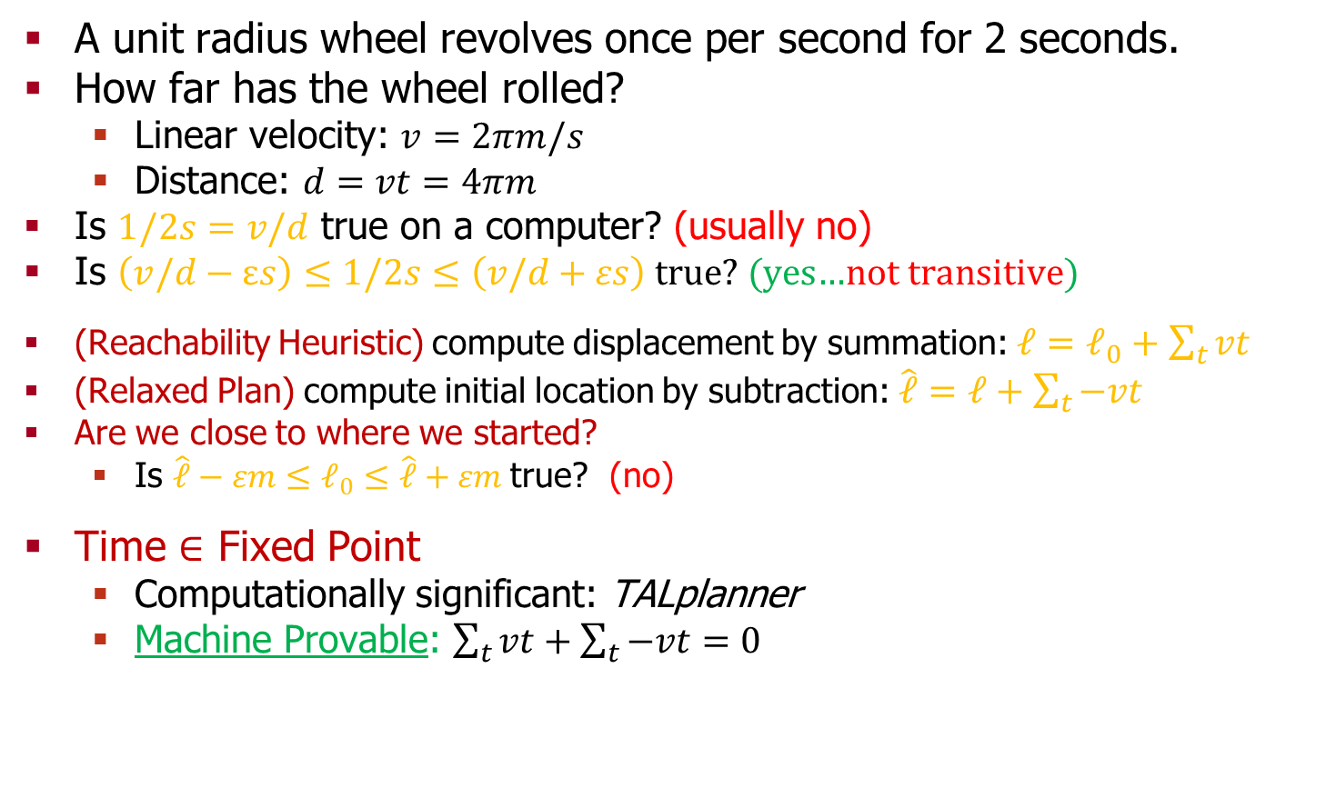
What is Time? How should Time be defined?
Chapter 2: Definitions
A unit radius wheel revolves once per second for 2 seconds.
How far has the wheel rolled?
  Linear velocity: $v=2πm/s$
  Distance: $d=vt=4πm$
  Is $1/2s=v/d$ true on a computer? (usually no)
Is $\left(v/d−εs\right)≤1/2s≤\left(v/d+εs\right)$ true? (yes…not transitive)
(Reachability Heuristic) compute displacement by summation: $ℓ=ℓ_{0}+\sum_{t}{vt}$
(Relaxed Plan) compute initial location by subtraction: $\hat{ℓ}=ℓ+\sum_{t}{−vt}$
Are we close to where we started?
  Is $\hat{ℓ}−εm≤ℓ_{0}≤\hat{ℓ}+εm$true? (no)
Time $∈$ Fixed Point
  Computationally significant: TALplanner
  Machine Provable: $\sum_{t}{vt+\sum_{t}{−vt=0}}$
Time and Time Again: The Many Ways to Represent Time. James F. Allen. 1991.
A temporal logic-based planning and execution monitoring framework for unmanned aircraft systems.
Patrick Doherty, Jonas Kvarnström, and Fredrik Heintz. 2009.

Slide 39

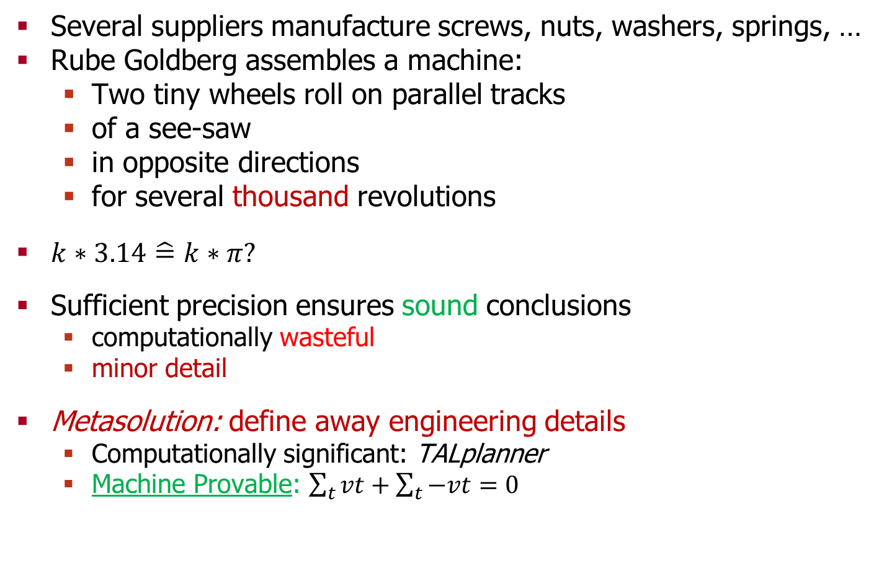

Time $∈$ Fixed Point
Chapter 2: Definitions
Several suppliers manufacture screws, nuts, washers, springs, …
Rube Goldberg assembles a machine:
  Two tiny wheels roll on parallel tracks
  of a see-saw
  in opposite directions
  for several thousand revolutions
$k∗3.14\hat{=}k∗π?$
Sufficient precision ensures sound conclusions
  computationally wasteful
  minor detail
Metasolution: define away engineering details
  Computationally significant: TALplanner
  Machine Provable: $\sum_{t}{vt+\sum_{t}{−vt=0}}$
A temporal logic-based planning and execution monitoring framework for unmanned aircraft systems.
Patrick Doherty, Jonas Kvarnström, and Fredrik Heintz. 2009.

Slide 40
Agenda
Classical Planning Background
Trouble in Temporal Planning
The Mission
Overview of Results and Challenges
  Chapter 2: Definitions
  Chapter 3: Theory
  Chapter 4: Language Analysis
  Chapter 5: Algorithm Analysis
Summary

Slide 41
Reductions and Equivalences
Chapter 3: Theory
An equivalence relation ~ is
  Reflexive, Symmetric, Transitive
A partial order < is
  (Irreflexive), Asymmetric, Transitive
An equivalence reduction is ~ s.t.
  If X ~ Y then
    Y solves iff X solves
A dominance reduction is (~,<) s.t.
  If X ~ Y and X < Y then
    Y solves implies X solves
A compilation is
a reduction
between languages
Notes:
same-shirt-color = equivalent
(brush teeth, comb hair) before leaving to work

Slide 42
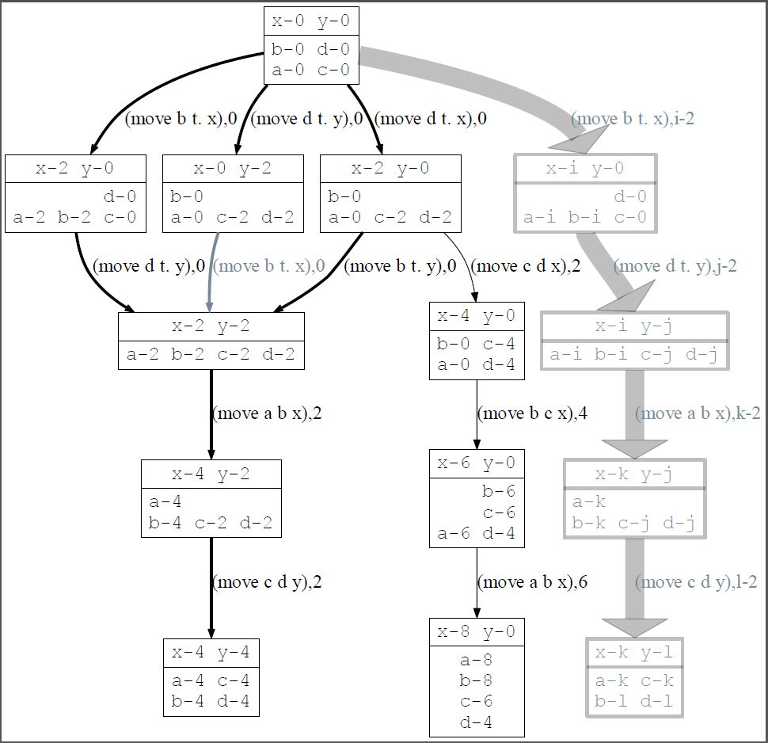
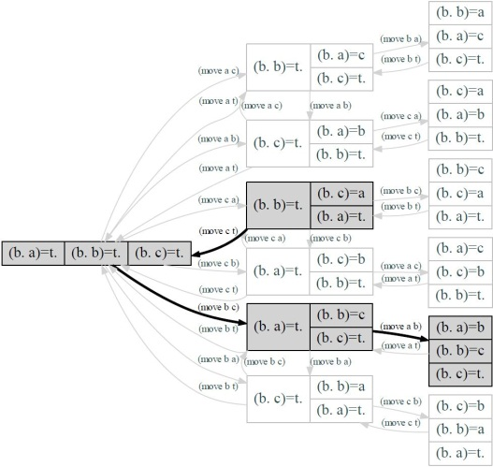
CTP: Rescheduling, Reduction
Chapter 3: Theory
First-Fit/Left-Shifted: start every action at EST
Rescheduling Theorem:
First-Fit is a dominance reduction of CTP
Reduction Theorem:
CTP compiles to state-space…
  …for the multi-objective path problem
  Classical planners easily adapted
  High quality hard
A
B
C
a,b
b
a
b,a
Notes:
Soonest is Best

Slide 43
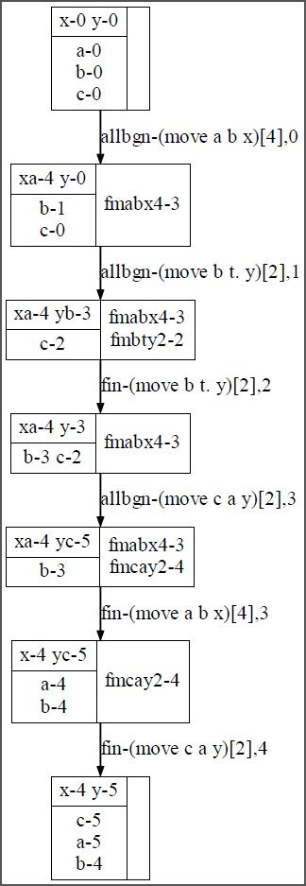
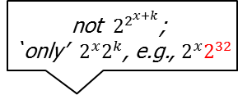
ITP: Rescheduling, Reduction
Chapter 3: Theory
Corresponding Simple Temporal Network (STN):
  negatively weighted directed graph modeling, per plan:
    (Precedence) causal constraints
    (Duration) temporal constraints
Slackless: every action starts as soon as possible
  Lemma: slackless = optimally solve the corresponding STN
Rescheduling Theorem:
Slackless is a dominance reduction of ITP
Reduction Theorem:
ITP compiles into a finite transition system
  because (Rescheduling Corollary:) g.c.d. of durations is a unit time
all-A
bgn-A
A
fin-A
all-B
bgn-B
B
fin-B
bgn-A,
bgn-B
bgn-B
bgn-A
bgn-B,
bgn-A
not ${ 2}^{2^{x+k}}$;
`only’ $2^{x}2^{k}$, e.g., $2^{x}2^{32}$
Notes:
Greedy scheduling is not enough: `soonest’ is not best
(because STPs are not acyclic, unlike partial orders, which are acyclic)
(Todo?: Fix dissertation, polynomial bounding is at the level of going through sequential planning)
The 2^32 isn’t so much the problem.
The problem is that the techniques classical planners employ to deal with the 2^x are based in propositional reasoning.
Such techniques do not trivially extend to the 2^32.
That is, adding intelligent understanding of arithmetic is surely a significant extension of STRIPS,
even if constrained to reasoning about time alone (monotonic, etc.).

Slide 44

CTP, ITP: Reordering
Chapter 3: Theory
bgn-lm
fin-lm
bgn-ff
fin-ff
Mutex: either writes to a dependency of the other
Deordered-equivalence: induce the same mutex-order
    regard parts as pairwise mutex
Behavior: f(t) = v, for all f
  Proposition: Behavior-equivalence implies result-equivalence
  Corollary: Behavior is an equivalence reduction
Reordering Theorem:
Deordered-equivalence implies behavior-equivalence
  (Reordering preserves behavior iff deordering)
  Deordered pruning: linear memory, search order independent
Corollary:
Deordered is an equivalence reduction of CTP and ITP

Slide 45
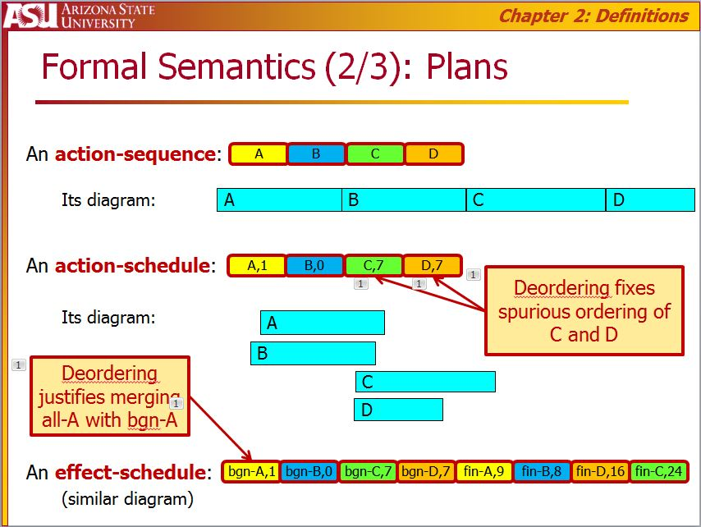
Deordering Significance
Chapter 3: Theory
Proposition:
Concurrent implies nonmutex

Slide 46
Agenda
Classical Planning Background
Trouble in Temporal Planning
The Mission
Overview of Results and Challenges
  Chapter 2: Definitions
  Chapter 3: Theory
  Chapter 4: Language Analysis
  Chapter 5: Algorithm Analysis
Summary

Slide 47


Causally Required Concurrency
Chapter 4: Languages
Causally sequential plan = deordered-equivalent to a
  classically-sorted effect-schedule
Otherwise: causally concurrent plan
Causally required concurrency:
  Solutions are causally concurrent
Causally sequential problem:
  Executable plans are causally sequential
Temporally Expressive Language:
  Permit problems causally requiring concurrency
Temporally Simple Language:
  Permit only causally sequential problems
Temporally Simplest Language:
  Forbid concurrency
bgn-A
fin-A
bgn-B
fin-B
bgn-C
fin-C
bgn-D
fin-D
bgn-lm
fin-lm
bgn-ff
fin-ff

Slide 48

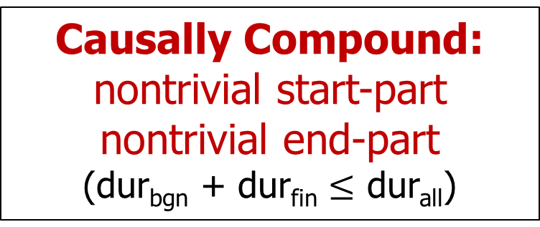

Syntax Restrictions
Chapter 4: Languages
Causally Compound: nontrivial start-part nontrivial end-part
(dur_{bgn} + dur_{fin} $≤$ dur_{all})
X
Y
3: {?Precondition, -Delete, +Add}
1; 2; 2
2: {?}
1: {-, +}
0: {}
3: {?,-,+}
3: {?,-,+}
$$4×4×4=64$$
2: {?}
1: {-, +}
2: {?}
1: {-, +}
0: {}
0: {}

Slide 49

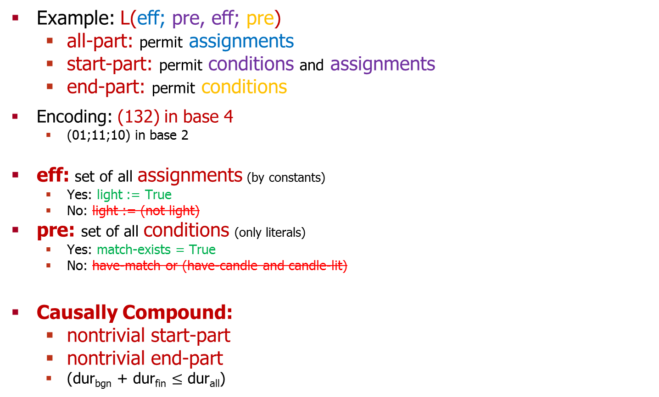
Syntax Restrictions
Chapter 4: Languages
Example: L(eff; pre, eff; pre)
  all-part: permit assignments
  start-part: permit conditions and assignments
  end-part: permit conditions
Encoding: (132) in base 4
  (01;11;10) in base 2
eff: set of all assignments (by constants)
  Yes: light := True
  No: light := (not light)
pre: set of all conditions (only literals)
  Yes: match-exists = True
  No: have-match or (have-candle and candle-lit)
Causally Compound:
  nontrivial start-part
  nontrivial end-part
  (dur_{bgn} + dur_{fin} $≤$ dur_{all})
L(gamma; alpha; beta): for all actions x,
(all) eff_{all-x} a composition of subset of gamma
(start) eff_{bgn-x} a composition of subset of alpha
(end) eff_{fin-x} a composition of subset of beta
primitive assignment (with $f \text{and} c∈{\text{Values}}_{f}$):
$$\{\left\{f=x\right\}↦\left\{f=c\right\}∣x∈{\text{Values}}_{f}\}$$
primitive condition (with $f \text{and} c∈{\text{Values}}_{f}$):
$\{\left\{f=c\right\}↦\{\}\}$
primitive transition (with $f \text{and} \text{u}\text{,}\text{v} ∈{\text{Values}}_{f}$):
$$\{\left\{f=u\right\}↦\left\{f=v\right\}\}$$
eff_{all-lm}({}^{States({})}) = {} ^{States({})}
eff_{bgn-lm}({match-exists=True, light=False} ^{States({match-exists, light})}) =
{match-exists=False, light=True} ^{States({match-exists, light})}
eff_{fin-lm}({light=True} ^{States({light})}) = {light=False} ^{States({light})}

Slide 50
Minimal Compound
Chapter 4: Languages
L( ; eff; pre)
  (012)
L( ; pre; eff )
  (021)
L(pre; eff; eff )
  (122)
  Sub-Classical:
  L( ; eff; eff) (011)
L( eff; pre; pre)
  (211)
  Sub-Classical:
  L( ; pre; pre) (022)
  also degenerate

Slide 51
Proof of Characterization of RC
Chapter 4: Languages
X
X
X
X
Y
Y
Y
Y
Compound implies Temporally Expressive
Proposition:
  Primitive implies Temporally Simple
    Iteratively move critical regions to front
Theorem:
  Compound ‘iff’ Required Concurrency
Causally primitive implies critical region:
non-empty common intersection of temporal extents

Slide 52
Compilability
Chapter 4: Languages
Theorem:
First-Fit is a dominance reduction on every temporally simple language
  Action-sequences + First-Fit suffices
    effectively by definition
  sound, complete, systematic, optimal, …
  CTP is `representative in spirit’
Theorem:
‘Every’ temporally expressive language compiles into Interleaved Temporal Planning
  ITP is representative…
  …up to the limits of the background compilation theory
    so: no continuous change
Notes:
Causally primitive implies FFC will work…does plain temporally simple work?

Slide 53
Agenda
Classical Planning Background
Trouble in Temporal Planning
The Mission
Overview of Results and Challenges
  Chapter 2: Definitions
  Chapter 3: Theory
  Chapter 4: Language Analysis
  Chapter 5: Algorithm Analysis
Summary

Slide 54

First-Fit Classical (Forward-Chaining) Planner
Chapter 5: Algorithms
Results
  systematic
  CTP $−$ deadlines
  complete
CTP (with deadlines)
  pseudo-complete
  i.e., suboptimal
(ITP: incomplete; b/c: RC)
Abstraction
Symmetry
Reduction
Heuristics
Pruning rules
Pick Candidate (min search evaluation function)
Check Goal Satisfaction (schedule to check deadlines)
  Report Solution (if necessary, schedule)
Choose (backtrack)
  Add Action to Plan
Whenever (including: heuristics, etc.)
  Greedily Schedule
Portfolios
Lifting
Search
Landmarks
Grounding
Learning
Domain Knowledge
Engineering
Local Search Techniques for Temporal Planning in LPG.
Alfonso Gerevini, Ivan Serina, Alessandro Saetti, and Sergio Spinoni. 2003.
Notes:
Local Search Techniques for Temporal Planning in LPG.
Alfonso Gerevini, Ivan Serina, Alessandro Saetti, and Sergio Spinoni. 2003.
Results are essentially straightforward corollaries of chapter 3;
the subtlety is to ensure that by pruning when violating the dominance condition, one doesn’t lose good plans.
duplicate state elimination fails that test.

Slide 55
Decision Epoch Planner
Chapter 5: Algorithms
Results
  CTP
  complete
  nonsystematic
ITP
  incomplete
  nonsystematic
Abstraction
Symmetry
Reduction
Heuristics
Pruning rules
Pick Candidate (min search evaluation function)
Check Goal Satisfaction
  Report Solution
Choose (backtrack)
  Dispatch Action Now
  Advance Now to Event
Portfolios
Search
Lifting
Landmarks
Grounding
Learning
Domain Knowledge
Engineering
Planning with Resources and Concurrency: A Forward Chaining Approach.
Fahiem Bacchus and Michael Ady. 2001.
55
Notes:
Planning with Resources and Concurrency: A Forward Chaining Approach.
Fahiem Bacchus and Michael Ady. 2001.

Slide 56
Temporally Lifted (Forward-Chaining) Planner
Chapter 5: Algorithms
Results
ITP
  complete
  systematic
  (CTP: complete, systematic)
Abstraction
Symmetry
Reduction
Heuristics
Pruning rules
Pick Candidate (min search evaluation function)
Check Goal Satisfaction (schedule to check deadlines)
  Report Solution (if necessary, schedule)
Choose (backtrack)
  Add Effect to Plan
Whenever (including: heuristics, etc.)
  Induce, Schedule
Portfolios
Lifting
Search
Landmarks
Grounding
Learning
Domain Knowledge
Engineering
Forward-Chaining Partial-Order Planning.
Amanda Jane Coles, Andrew Coles, Maria Fox, and Derek Long. 2010.
Notes:
Forward-Chaining Partial-Order Planning.
Amanda Jane Coles and Andrew Coles and Maria Fox and Derek Long. 2010.
http://www.aaai.org/ocs/index.php/ICAPS/ICAPS10/paper/view/1421.

Slide 57


TEMPO for Match-Fuse
Chapter 5: Algorithms
2007
total-order
durations
Unschedulability
2012
partial-order
durations
Deordering
fix
light
light
fuse
fix
match
fuse
match
light
fuse
match
fix
fix
light
light
light
match
fuse
fuse
fuse
…

Slide 58
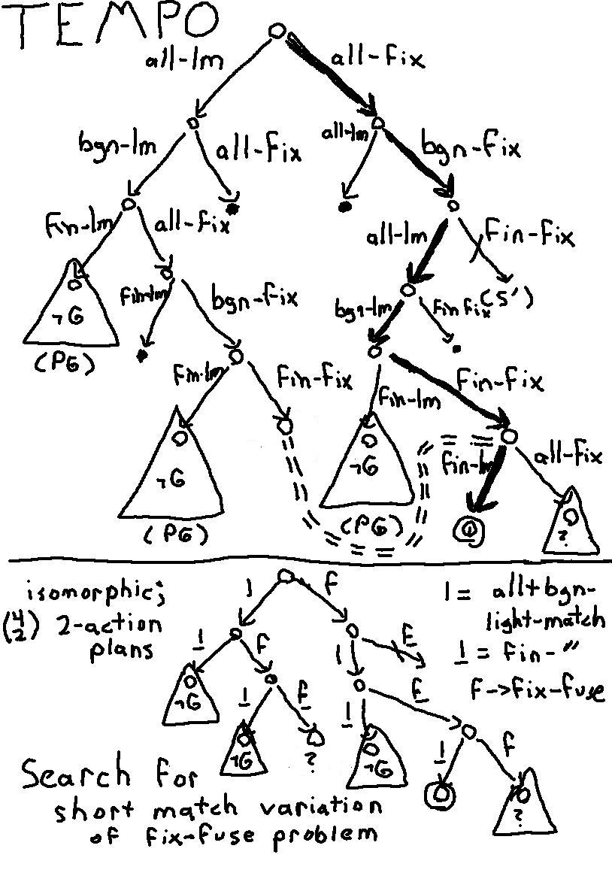
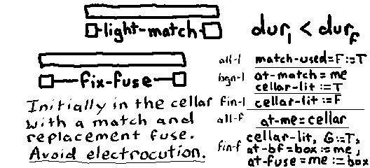
Temporally Lifted
Chapter 5: Algorithms
bgn-lm
fin-lm
bgn-ff
fin-ff
Merge all-part and start-part

Slide 59
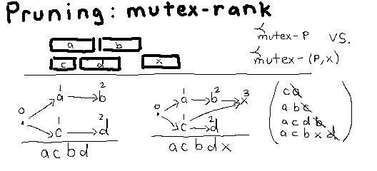
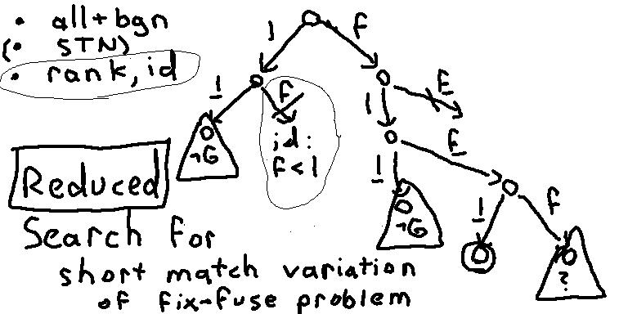
Deordered Reduction
Chapter 5: Algorithms
Prune decreases in rank
tie-break: increasing id
rank(a) = 1+ max_{b} rank(b)
Checking equality of
labeled partial-orders
is legitimately simple,
computationally

Slide 60
Agenda
Classical Planning Background
Trouble in Temporal Planning
The Mission
Overview of Results and Challenges
  Chapter 2: Definitions
  Chapter 3: Theory
  Chapter 4: Language Analysis
  Chapter 5: Algorithm Analysis
Summary

Slide 61
Summary: Thesis
Everything More General
(“true concurrency”, continuous change)
ZENO, Kongming, ASPEN
Interleaved Temporal Planning
TLplan, SAPA, POPF
Conservative Temporal Planning
TGP, CPT, DAE-YAHSP2
Sequential Planning
STRIPS, FF, FD

Slide 62
How Should:
Summary: Definitions
Time be represented
  Finite, Integer, Rational, Real…
Plans/Schedules be represented
  Points, Intervals, Sequences, Sets, Gantt Charts, …
Concurrency be defined
  Occlusion/Atomic, Commutativity, Synchronous, …
Formal Execution be defined
  Transition Systems, Temporal Logic, Hybrid Automata, Petri Nets, …
(`Intuitive’) Behavior be defined
  f(t) = v, …
Solutions be defined
  Goal-satisfaction (no uncertainty)
  Deadlock, Livelock, Fairness (anti-Zeno conditions), Robustness, …
Algebra
Calculus
Time and Time Again: The Many Ways to Represent Time. James F. Allen. 1991.
Notes:
Many tricky questions
Time: also hyperreals (nonstandard analysis), {R,W} * Real
Schedules: sequences of sets of (pddl), sets of sequences of (optop), flexible partial orders (executive picks), …
Concurrency: also communicating processes, nondeterminism, prioritization, stochastic (exponential fallback)
Executions: also Petri Nets
Behavior: also f(s,t), f[s,t], f(s,t], …; also uncertainty (beliefs instead of states)
Solutions: also expectations, etc., i.e., for MDPs
http://users.cecs.anu.edu.au/~jks/bw.html

Slide 63
We should (always) identify and prove:
Summary: Theory
Reduction to simpler setting (transition systems)
  Full reduction: target is sound and complete
Rescheduling
  SP: Trivial
  CTP: First-Fit (Left-Shifting, Right-Shifting)
  ITP: Simple Temporal Networks (Slackless)
Reordering
  SP: Standard
  CTP: Same as SP, harder proof
  ITP: +decomposition constraints
if and only if
Are 10:00 and 10:10 different?
Does order matter?
Temporal Planning with Mutual Exclusion Reasoning. David E. Smith and Daniel S. Weld. 1999. TGP.
Multiple Relaxations in Temporal Planning. Keith Halsey, Derek Long, and Maria Fox. 2004. CRIKEY.
Computational Aspects of Reordering Plans. Christer Bäckström. 1998.
Systematic Nonlinear Planning. David A. McAllester and David Rosenblitt. 1991. SNLP.
Notes:
3 key intuitions for any form of temporal planning
Rescheduling: TGP and CRIKEY
Temporal Planning with Mutual Exclusion Reasoning. David E. Smith and Daniel S. Weld. 1999. (TGP)
Multiple Relaxations in Temporal Planning. Keith Halsey, Derek Long, and Maria Fox. 2004. (CRIKEY)
Reordering:
Computational Aspects of Reordering Plans. Christer Backstrom. 1998.
Systematic Nonlinear Planning. David A. McAllester and David Rosenblitt. 1991. (SNLP)

Slide 64
Redo Language Analysis
Summary: Languages
Define Required Concurrency
  Argue for Hard but Not Impossible
  Future work not futile
Setup Space of Languages
Prove syntactic characterization:
  Causally Compound
Collapse simple side
  ‘CTP representative:’
  First-Fit suffices
Collapse complex side
  ITP representative:
  Subintervals reduce to RC
ITP
CTP
An Investigation into the Expressive Power of PDDL2.1.
Maria Fox, Derek Long, and Keith Halsey. 2003.
Notes:
Define RC, argue that this definition means that implementations will be handicapped.
Ideally: not forever.
Show a piece of the puzzle that is the full background theory on compiling away syntax.

Slide 65
Redo Algorithm Analysis
Summary: Algorithms
Results
  FFC, Conservative - deadlines:
  complete, systematic
FFC, Conservative:
  pseudo-complete, systematic
(FFC, ITP: incomplete, systematic)
DE, Conservative:
  complete (nonsystematic)
DE, Interleaved:
  incomplete, nonsystematic
TEMPO, Interleaved:
  complete, systematic
(TEMPO, Conservative: complete, systematic)
Incomplete!
SAPA: A Multi-objective Metric Temporal Planner.
Minh Binh Do and Subbarao Kambhampati. 2003.
Planning with Resources and Concurrency: A Forward Chaining Approach.
Fahiem Bacchus and Michael Ady. 2001.

Slide 66
Thanks!
What are Least Temporal kinds of Temporal Planning?
How can Classical Planning Technique be made Temporal?
How should we write Temporal Planning Problems to assist leveraging?
Extensions
Evaluating Temporal Planning Domains.
William Cushing, Daniel Weld, Subbarao Kambhampati, Mausam and Kartik Talamadupula. 2007. ICAPS.
The Perils of Discrete Resource Models.
William Cushing and David E. Smith. 2007.
Workshop on IPC: Past, Present & Future. ICAPS.
The ANML Language.
David E. Smith, Jeremy Frank and William Cushing.
2008. Poster Program, ICAPS.
Selected Other Papers
State Agnostic Planning Graphs: Deterministic, Non-Deterministic, and Probabilistic Planning.
Daniel Bryce, William Cushing and Subbarao Kambhampati. 2011. Artificial Intelligence 175:848-889.
Cost-based search considered harmful. 2010. SOCS.
William Cushing, J. Benton and Subbarao Kambhampati.
Replanning: A new perspective. Poster Program, ICAPS.
William Cushing and Subbarao Kambhampati. 2005.
Planar Graphs are 1-relaxed, 4-choosable.
William Cushing and Hal A. Kierstead. 2010.
European Journal of Combinatorics 31:1385-1397.
Learning Probabilistic Hierarchical Task Networks to Capture User Planning Preferences.
Nan Li, William Cushing, Subbarao Kambhampati and Sungwook Yoon. 2012. ACM, TIST (Accepted 7/12).
Algebra
Calculus
Profit / Time
Quality
Profit
ITP
Fast
Uncertainty
CTP
Cheap
Knightian
Bayesian
Boolean
Are 10:00 and 10:10 different?
STRIPS
Time
Durations
Does order matter?
Deadlines
Compounds

Slide 67
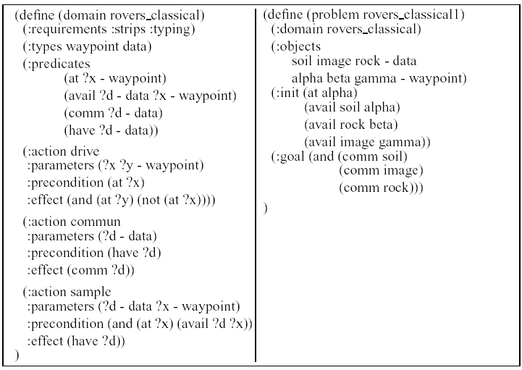
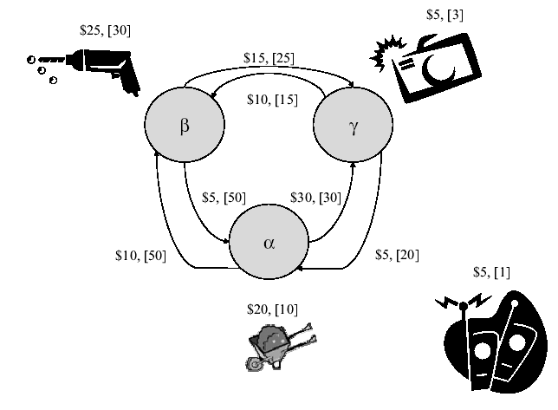
Rover Domain
Classical Planning
Notes:
So this is what a classical planning problem looks like. The small diagram here gives a nice, factored, depiction of the particular problem; there are 3 waypoints, alpha, beta, gamma, each of which has a potentially scientifically significant find. At alpha there is some soil deserving closer attention, at beta there are some interesting rocks to be drilled, and gamma offers a nice vantage point for landscape photography. So at a sufficient level of abstraction this particular problem is just an instance of the traveling salesman problem on a 3 vertex directed graph.
However, the actual formal semantics are rather more expressive than the diagram lets on, and indeed, this domain is actually a lot more challenging in general than TSP.
---
The graph is not even close to the state-space representation.
It shows costs and durations, which are only sortof part of classical planning.
Rover in 3 places. Each sample in 4 propositional states or 3 fluent states.
3*4^3 = 192 groundable states; 3*3^3 = 81 reachable states
864 applicable operators (many loops); 312 non-loop out-edges
270 reachable non-loop out-edges
Qualitative reasoning at a sufficiently high level can break it down to 19 non-dominated plans, at most 6 of which are relevant to any particular problem.

Slide 68
Rovers Plan
Classical Planning
Communicate all samples, finish at beta
s₀ = { (at alpha) (avail soil alpha) (avail rock beta) (avail image gamma) }
  (at alpha)(s₀) = true
  (at beta)(s₀) = false
Solution (10 steps)
  (sample soil alpha) (commun soil)
    adds (have soil) and (comm soil)
  (drive alpha beta)
  (sample rock beta) (commun rock)
  (drive beta gamma)
  (sample image gamma) (commun image)
  (drive gamma alpha)
  (drive alpha beta)
    Not the same edge
    3⁴=81 reachable states; 3*(3*33-9)=270 non-loop edges
s_{n} = { (at beta) (comm soil) (comm rock) (comm image) … }
Notes:
Let’s look at a slightly different problem, by insisting that the rover finish at beta. Perhaps this is because, tomorrow, we wish to begin activities at beta.
In any case, we can represent the initial state here as s₀. This is the set of the true propositions at the beginning of the planning problem – the implicitly represented rover is at waypoint alpha, and the three potential samples are all available for sampling.
One possible solution is then the following 10-step sequential plan.
We begin by immediately conducting the soil-sample and communicating our findings back to Earth. Well, I should say we begin by ordering the rover to do so.
Then the rover drives from waypoint alpha to waypoint beta, and immediately conducts the science experiment on our behalf.
The rover goes on to take the desired photographs at waypoint gamma, at least, supposing all goes according to plan, and then finishes up by navigating over to waypoint beta.
In so doing notice that it crosses the same edge in the diagram – but this is not the same edge in the graph used to formally define semantics.
That graph is much larger – its vertices are all states such as s₀ and s_{n} here.
That is, sets of propositions, so in this case, naïve counts might assert anywhere from 2^12 to 2^18 states.
But in fact many of these propositions are mutually exclusive and/or static, for example, whether or not a sample is available at a location is static – the rover has no actions to create or destroy these propositions.
As these are then constants, we can immediately improve the simplest estimate of size from 2^18 down to 2^9, because there are 9 possible ways to instantiate the “availability” predicate, all of which have constant value.
Subsequently one can notice that in order to have communicated a sample one must first of all have collected the sample. So instead of there being 4 possibilities per sample there are only 3 reachable possibilities.
In a vaguely similar fashion, the propositions encoding the location of the rover do not truly stand for 2^3 possibilities, but instead, only 3 possibilities, as they are all pairwise mutually exclusive.
So in summary there are 4 objects each with 3 local states, for a global set of possibilities no larger than 81. In fact all 81 such possibilities are reachable from the initial state. So in this effectively 81 vertex graph there are 270 `interesting’ edges, each corresponding to a possible state transition induced by executing one of these instantiated actions.
In that graph, these two instances of driving from alpha to beta are not the same edge, but rather merely share the same label. They differ because they are not causing precisely the same transition between global possibilities.
---
… lot bigger than it may appear
(drive, drive, sample1/comm1) * 9 = 27
+ 3*(comm2) + 3*(comm3) = 33
*(avail1,have1,commun1) – 9*(sample1/comm1) = 90
*(at: alpha,beta,gamma) = 270
((3*3*3 + 1*2*3*3/3)*3-1*3*3) * 3 = 270

Slide 69
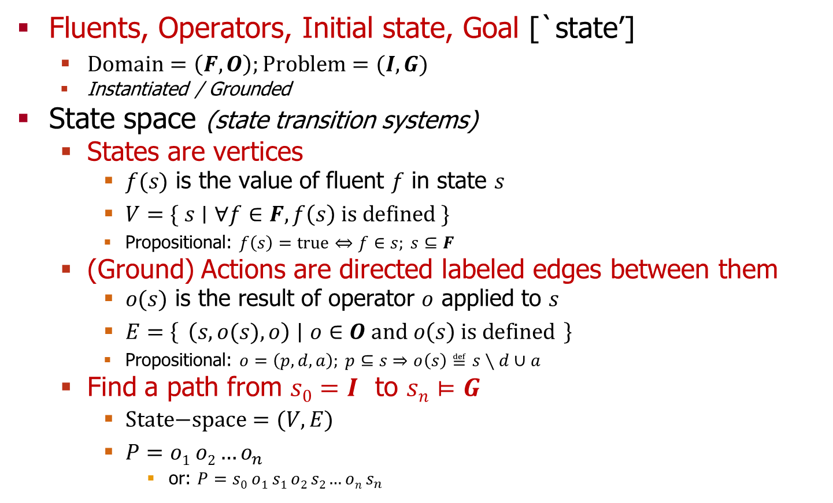
Fundamental Definitions
Classical Planning
Fluents, Operators, Initial state, Goal [`state’]
  $\text{Domain}=\left(F,O\right);Problem=(I,G)$
  Instantiated / Grounded
State space (state transition systems)
  States are vertices
    $f(s)$ is the value of fluent $f$ in state $s$
    $V=\{ s∣∀f∈F, f\left(s\right) \text{is} \text{defined} \}$
    Propositional: $f\left(s\right)=\text{true}⇔f∈s; s⊆F$
  (Ground) Actions are directed labeled edges between them
    $o(s)$ is the result of operator $o$ applied to $s$
    $E=\left\{ \left(s,o(s),o\right) ∣ o∈O \text{and} o\left(s\right) \text{is} \text{defined} \right\}$
    Propositional: $o=\left(p,d,a\right); p⊆s⇒o\left(s\right)≝s∖d∪a$
  Find a path from $s0=I$ to $sn⊨G$
    $\text{State}\text{−}\text{space}=(V,E)$
    $P=o1 o2…o_{n}$
      or: $P=s0 o1 s1 o2 s2…on s_{n}$
Notes:
So, in general, we have the following formal view of what classical planning problems are.
The key items of interest concerning a planning domain are its fluents and operators.
Concerning classical planning problems we are concerned with the initial state and goal formula.
Concerning solutions, ie plans, solutions are held to be sequences of the operators of the domain that happen to transform the initial state into a situation satisfying the goal formula.
That is, one way to formalize the computational problem is to say that the problem is a shortest path problem in a particular graph. That graph, known as state-space, is a directed labeled graph whose vertices are complete assignments to the fluents of the domain, and whose edges are defined by the descriptions of the instantiated actions.
For example, with STRIPS actions one determines the set of edges using the canonical equation shown here in tiny font --- check the preconditions, remove the delete effects, and insert the add effects.
But in general we just say that instantiated actions define arbitrary partial transition functions between states, and that the edges of state space correspond to the individual mappings within all such transition functions of the domain.
Note that I’ve given edges as triples; the last is the label of the edge, in case we need to distinguish between multiple edges between the same pair of states. For example in a version of the rovers domain with multiple rovers, supposing for some reason that both rovers had identical data, then either one of them could communicate the data back and the state transition would be the same --- but the various costs one might choose to model might be different for the two ways of effecting the same result.
So, finally, solutions can be given just as a sequence of the edge labels, although in some situations it is preferable to think of them as an alternating sequence of states and operators. One can also think in terms of just state sequences, though doing so is potentially ambiguous.
So, this, as the title claims, is the fundamental way of defining what classical planning is. Of course it lends itself to immediate implementation of a classical planner --- just run ones favorite single-source shortest/cheapest path algorithm, say Djikstra’s, on the graph here defined. The research revolves on the assumption that such an approach will fail in practice --- that is, that even merely writing the graph down explicitly would take so astronomically long that we must find another way.
So what are some approaches?
---
Given all the background assumptions of classical planning (such as a static environment, full observability, deterministic actions, …) then it suffices to consider just the relatively simple setting of state transition systems in order to define formal semantics.
In this setting, one takes states as complete assignments to all the fluents of the domain and operators as partial transition functions over states. I’ll try to say operator when I mean a fully instantiated action, and action if there are free parameters left.
We can model this as a graph, taking states as vertices and actions as directed edges, so that the planning problem reduces to `mere’ path-finding.
But there are also lots of other ways to reason about state transition systems.

Slide 70
(Simple) Temporal Rovers Domain
Temporal Planning
(:action drive
:parameters (?r – rover ?x ?y - waypoint)
:duration 15
:precondition (loc ?r ?x)
:effect (and (not (loc ?r ?x)) (loc ?r ?y)))
)
TGP
Durative Actions
(:action sample
:parameters (?r – rover ?x – waypoint ?d - data)
:duration 5
:precondition (and (loc ?r ?x) (loc ?d ?x) (sample_poss ?r ?d))
:effect (and (have ?r ?d) (not (loc ?r ?x)) (loc ?r ?x))
)
(:action commun
:parameters (?r – rover ?x – waypoint ?d - data)
:duration 2
:precondition (and (loc ?r ?x) (have ?r ?d) (commun_poss ?r ?x))
:effect (and (comm ?d) (not (loc ?r ?x)) (loc ?r ?x))
)
Notes:
The way Temporal GraphPlan answered the question is to say that temporal planning problems are just like classical planning problems except we add a field to each action to say how long it takes. Oh, and we permit actions to execute concurrently, of course.
In blue here is a fun technical detail of generalizing the Rovers domain to multiple rovers. Let’s just skip right along and see what this syntax is supposed to mean.
---
So this is an example of a temporal planning problem, in the sense that Temporal GraphPlan, aka TGP, considered. We take our typical domain and annotate all the actions with how long they take. The new objective is to find plans of small makespan, ie duration, rather than smallest or cheapest plans. That is, we make up some definition of concurrency that makes sense for classical actions, and then set about considering such concurrency in order to find short duration plans.
In blue is a trick for making actions mutually exclusive that would not otherwise be mutually exclusive, specifically the intent is to make sure that the domain is sequential with respect to a single rover. So the potential concurrency then is just between multiple rovers, which have precious little impact upon one another. For this version of the domain the formal problem is a compactly encoded multi-agent traveling salesman problem.
Well, actually, because of the restriction I’ve put on communicating, the problem is a disjunctive variation on Steiner Forests --- first we have to drive to where we can take the desired sample, then, we have to drive to somewhere where communication is possible.

Slide 71
(Simple) Temporal Rovers Plan
Temporal Planning
0: (drive spirit beta gamma)[15]
0: (drive opportunity alpha beta)[15]
15: (drive spirit gamma alpha)[15]
15: (sample opportunity beta rock)[5]
20: (drive opportunity beta gamma)[15]
30: (sample spirit alpha soil)[5]
35: (commun opportunity gamma rock)[2]
35: (drive spirit alpha beta)[15]
37: (sample opportunity gamma image)[5]
42: (commun opportunity gamma image)[2]
44: (drive opportunity gamma alpha)[15]
50: (drive spirit beta gamma)[15]
59: (drive opportunity alpha beta)[15]
65: (commun spirit gamma soil)[2]
67: (drive spirit gamma alpha)[15]
74: done opportunity
82: (drive spirit alpha beta)[15]
97: done spirit
Notes:
Let’s say there are two rovers, Spirit and Opportunity. In the real world these two would never interact one another in any meaningful sense. But let us pretend they landed close together.
This problem is quite similar to the classical version of the problem, except that we have two rovers instead of one, the rovers can act independently of one another, communication is only possible at location gamma, and, finally, rovers have different capabilities.
In times gone by perhaps the two had identical capabilities, but let’s say that in their old age they now have perfectly complementary capabilties: Spirit can handle all and only soil studies, while Opportunity can handle all and only rocks and pictures.
(x clicks) Spirit’s sub-plan is then like so. Spirit ends up traversing the cycle twice!
(x clicks) Meanwhile, Opportunity handles the other two kinds of samples, and, ends up at beta, because for whatever reason let’s say that the goal is to have them start the next day in the same place.

Slide 72
(Simple) Temporal Rovers States
Temporal Planning
s₀ =
  (loc spirit beta) -> 0
  (loc opportunity alpha) -> 0
  (loc soil alpha), (sample_poss spirit soil), etc. -> 0
s₁ = (loc spirit gamma) ->
  (t? (loc spirit beta)) + 15 = 15, …
s₂ = (loc spirit alpha) ->
  (t? (loc spirit gamma)) + 15 = 30 …
(sample spirit alpha soil)
  (t? (loc spirit alpha)) = 30
  (t? (loc soil alpha)) = 0
  (t? (sample_poss spirit soil)) = 0
  (t? (loc spirit alpha)) = 30
  s = max(30, 0, 0, 30) = 30
  e = s + (d? self) = 35
  -> e
s₃ =
  (have spirit soil) -> 35
  (loc spirit alpha) -> 35
    was 30
  …
Notes:
Let’s look at a slightly different problem, by insisting that the rover finish at beta. Perhaps this is because, tomorrow, we wish to begin activities at beta.
In any case, we can represent the initial state here as s₀. This is the set of the true propositions at the beginning of the planning problem – the implicitly represented rover is at waypoint alpha, and the three potential samples are all available for sampling.
One possible solution is then the following 10-step sequential plan.
We begin by immediately conducting the soil-sample and communicating our findings back to Earth. Well, I should say we begin by ordering the rover to do so.
Then the rover drives from waypoint alpha to waypoint beta, and immediately conducts the science experiment on our behalf.
The rover goes on to take the desired photographs at waypoint gamma, at least, supposing all goes according to plan, and then finishes up by navigating over to waypoint beta.
In so doing notice that it crosses the same edge in the diagram – but this is not the same edge in the graph used to formally define semantics.
That graph is much larger – its vertices are all states such as s₀ and s_{n} here.
That is, sets of propositions, so in this case, naïve counts might assert anywhere from 2^12 to 2^18 states.
But in fact many of these propositions are mutually exclusive and/or static, for example, whether or not a sample is available at a location is static – the rover has no actions to create or destroy these propositions.
As these are then constants, we can immediately improve the simplest estimate of size from 2^18 down to 2^9, because there are 9 possible ways to instantiate the “availability” predicate, all of which have constant value.
Subsequently one can notice that in order to have communicated a sample one must first of all have collected the sample. So instead of there being 4 possibilities per sample there are only 3 reachable possibilities.
In a vaguely similar fashion, the propositions encoding the location of the rover do not truly stand for 2^3 possibilities, but instead, only 3 possibilities, as they are all pairwise mutually exclusive.
So in summary there are 4 objects each with 3 local states, for a global set of possibilities no larger than 81. In fact all 81 such possibilities are reachable from the initial state. So in this effectively 81 vertex graph there are 270 `interesting’ edges, each corresponding to a possible state transition induced by executing one of these instantiated actions.
In that graph, these two instances of driving from alpha to beta are not the same edge, but rather merely share the same label. They differ because they are not causing precisely the same transition between global possibilities.
---
… lot bigger than it may appear
(drive, drive, sample1/comm1) * 9 = 27
+ 3*(comm2) + 3*(comm3) = 33
*(avail1,have1,commun1) – 9*(sample1/comm1) = 90
*(at: alpha,beta,gamma) = 270
((3*3*3 + 1*2*3*3/3)*3-1*3*3) * 3 = 270

Slide 73
Rovers: Navigate in PDDL2.1 Level 3
(:durative-action navigate
:parameters (?x - rover ?y - waypoint ?z - waypoint)
:duration (= ?duration 5)
:condition (and
(at start (at ?x ?y))
(at start (>= (energy ?x) 8))
(over all (can_traverse ?x ?y ?z))
(at start (available ?x))
(over all (visible ?y ?z)) )
:effect (and
(at start (decrease (energy ?x) 8))
(at start (not (at ?x ?y)))
(at end (at ?x ?z)) ))

Slide 74
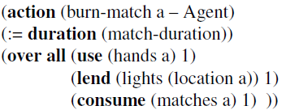

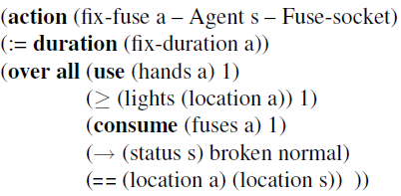
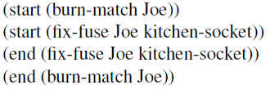
Causally Required Action Concurrency
TEMPO Completeness

Slide 75
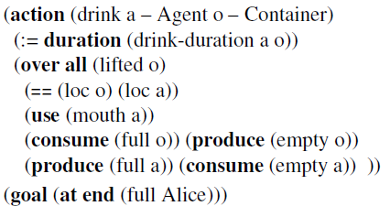

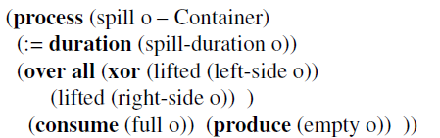
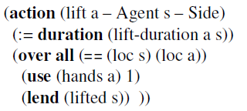
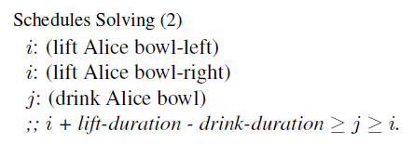
Discrete Soup Bowl Model

Slide 76
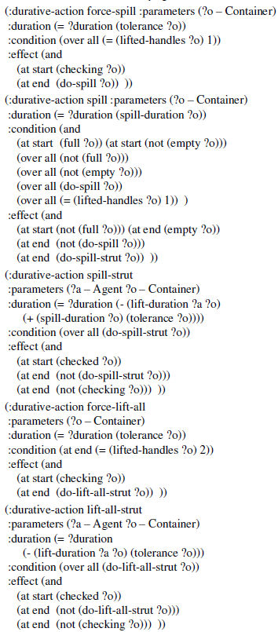
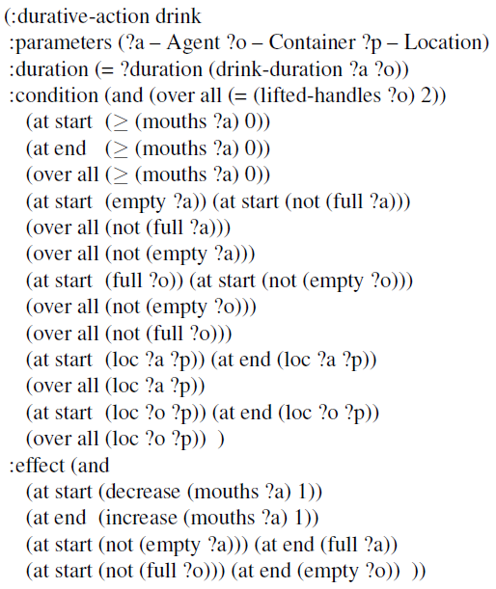
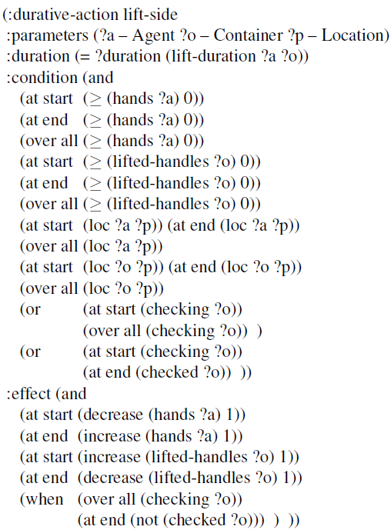
PDDL2.1/3 Model

Slide 77
Sequential Planning Definitions
Planning Problem = (Fluents, Actions, Initial, Goal)
  Planning Domain = (Fluents, Actions)
Fluents: maps fluent (names) to sets of legal values
  Fluents(bright) = Boolean
State: maps fluents to current values
  S(bright) = False
  States(X) = all partial states on fluents in X
Initial: a state
Goal: Boolean function on states
  Goal(S) = (S(bright) = True)
Actions: maps action (names) to descriptions
  eff: any function
    from States(Depends),
    to States(Writes)
  eff_{a}({bright=x, at-switch=True}) = {bright=(not x)}

Slide 78
Sequential Planning Definitions
State Transitions: Overwrite Writes_{a} with
  the partial state X=eff_{a}(Y) from calculating the effect on
  its dependencies: Y=S Restrict Depends_{a}.
  S’_{a}(S) = (S Restrict (Complement Writes_{a})) Union eff_{a}(S Restrict Depends_{a})
  S’_{a}({bright=False, at-switch=True, …})
    = {at-switch=True, …} Union eff_{a}({bright=False, at-switch=True})
    = {bright=True, at-switch-True, …}
  S’_{a}({bright=x, at-switch=False, …}) = undefined
Plans+Solutions:
  action-sequences transitioning Initial to Goal-satisfying state
  (a,b,c) solves P precisely when
    Goal_{P}(F) = True with F = S’_{c} * S’_{b} * S’_{a}(Initial_{P})

Slide 79
Conservative Temporal Definitions
Actions: maps action (names) to descriptions
  eff: any function from States(Depends) to States(Writes)
  dur: a positive Rational number
    actually, a fixed point number
Lock = (Acquired, Released, Readable)
  Aquired, Released: The right-half-open interval that is locked.
  Readable: The type of lock (read-lock or write-lock).
Vault: maps fluents to locks
Situation: (State, Vault)
Goal: permit (only) deadlines
  negation-free boolean expression on temporal literals f=v@[t, infinity)

Slide 80
Conservative Temporal Definitions
Vault Transitions: update (V restrict Depends_{a}) by
  acquiring read-locks (Depends_{a}\Writes_{a}), which are shareable, and
  acquiring write-locks (Writes_{a}), which are exclusive.
    reading read-locked: (Acquired, max(Released, AFT), True)
    reading write-locked: (Released, AFT, True)
    writing: (Released, AFT, False).
  V’_{a,t}(V) =
    V Restrict (Complement Depends_{a}) Union
    Read-locks_{a,t}(V Restrict (Depends_{a}\Writes_{a})) Union
    Write-locks_{a,t}(V Restrict Writes_{a})
Plans: action-schedules
  action-schedule: sequence of dispatches of actions
  ((a,3), (b,1), (c,72))
Situation Transition Function:
  F’_{a,t}(S, V) = (S’_{a}(S), V’_{a,t}(V))
Executions: sequential composition of situation transition functions
  Result(P(a,t), F) = F’_{a,t}(Result(P, F))
Solutions: transition Initial situation into Goal-satisfying situation
  Goal(Result(P, Initial))

Slide 81
Interleaved Temporal Definitions
Compound Actions: consist of
  all-part, start-part, and end-part.
  a: all-a, bgn-a, fin-a
  all-part is a psuedo-part; effectively compounds consist of 2 parts
Parts: CTP-actions
Obligation: maps unfinished parts to their start-times
  O(fin-a) = AST + dur_{all-a} – dur_{fin-a}
Debt: maps each compound action to its obligation, D(a)=O
  Consequence: compound actions are self-mutex
  debt-free: every obligation is empty
Situation = (State, Vault, Debt)
Initial: debt-free situation
Goal: constrained boolean function on situations
  projects to a CTP-goal
  true on at most debt-free situations

Slide 82
Interleaved Temporal Definitions
Debt Transition Functions:
  For all-parts, setup the promises, otherwise
  if actual start-time = promised start-time then
    erase the promise, else fail.
if (i != all and D(a) = t) then
  D’_{i-a,t}(D) = D Restrict (Actions\{a}) U (D(a) \ {(i, t)})
Else if (i = all) then
  D’_{all-a,t}(D) = D Restrict (Actions\{a}) U {(bgn, t), (fin, t + dur_{all-a} - dur_{fin-a})}
Else undefined.
Plans: effect-schedules,
  sequence of effect-dispatches,
  sequence of dispatches of parts of compounds
Situation Transition Functions:
  Actual: Require t >= EST
  B’_{x,t}(S, V, D) = (S’_{x}(S), V’_{x,t}(V), D’_{x,t}(D))
Executions: sequential composition of situation transition functions
  Result(P(x,t), B) = F’_{x,t}(Result(P, B))
Solutions: transition Initial situation into Goal-satisfying situation
  Goal(Result(P, Initial))

Slide 83
Everything More General
ZENO, Kongming, ASPEN
  FFC, Conservative - deadlines:
  complete, systematic
FFC, Conservative:
  pseudo-complete, systematic
(FFC, ITP: incomplete, systematic)
DE, Conservative:
  complete (nonsystematic)
DE, Interleaved:
  incomplete, nonsystematic
TEMPO, Interleaved:
  complete, systematic
(TEMPO, Conservative: complete, systematic)
Interleaved Temporal Planning
TLplan, SAPA, POPF
Conservative Temporal Planning
TGP, CPT, DAE-YAHSP2
Sequential Planning
STRIPS, FF, FD

Slide 84
Intermission
Built Definitions
Proved Theorems
`Solved’ all but ITP
Next: Apply Theory
Language Analysis
  Temporally Simple
  Temporally Expressive
Algorithm Analysis
  FFC
  DE
  TEMPO

