Slide 1


Event Analytics on Social Media: Challenges, Solutions, and Insights
Yuheng Hu
Committee Members
Dr. Subbarao Kambhampati, Chair
Dr. Eric Horvitz
Dr. John Krumm
Dr. Huan Liu
Dr. Hari Sundaram

Slide 2
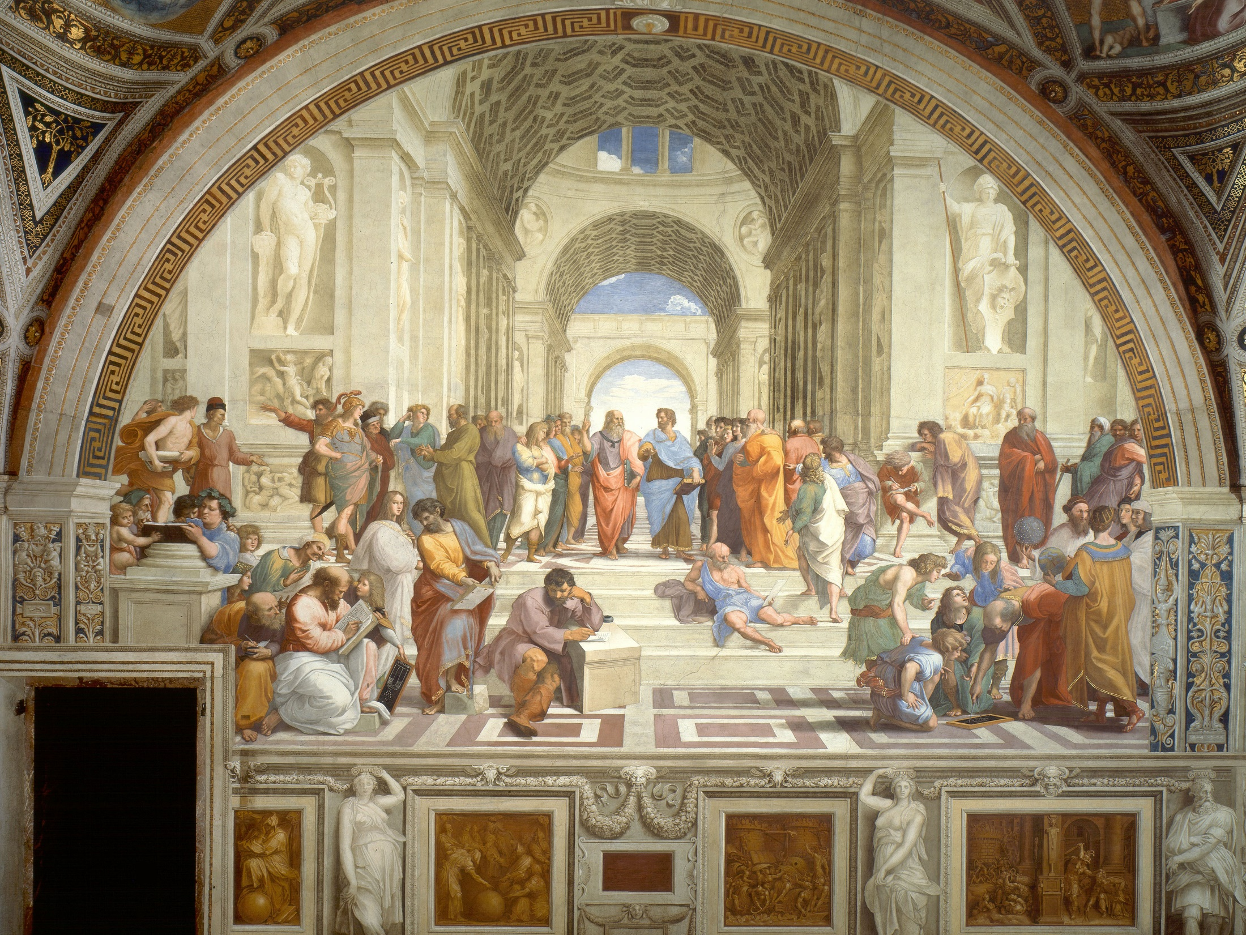
Since the dawn of civilization, people congregated in town squares
to discuss events
Notes:
The overall goal of my thesis work is to support autmated analysis (The School of Athens)

Slide 3

Social media has created a sprawling virtual town square, whose scope is vast, and whose chatter can be captured!
Notes:
opening exciting possibilities for analyzing what people are actually saying..

Slide 4
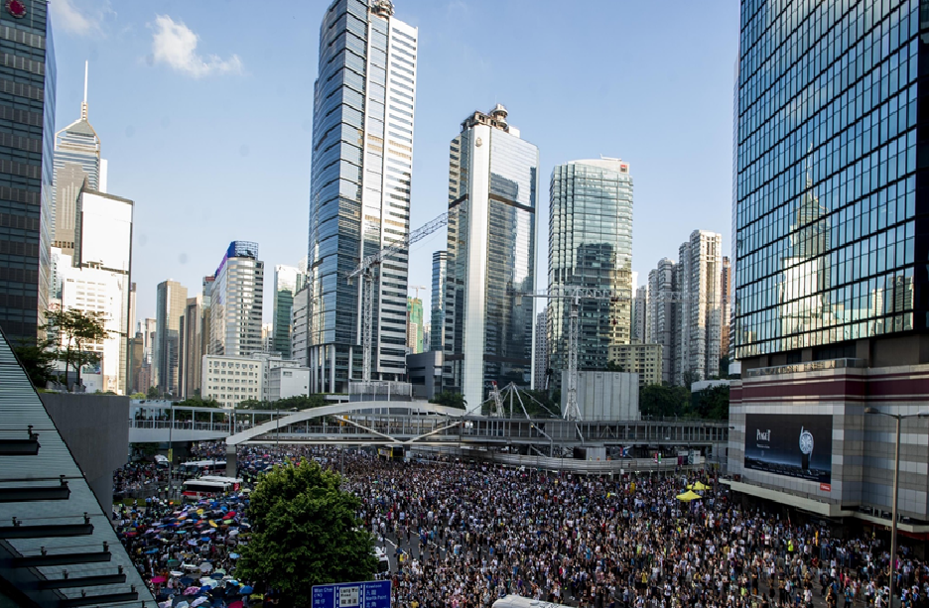
2014 Hong Kong Protest
September 2014 - Ongoing

Slide 5
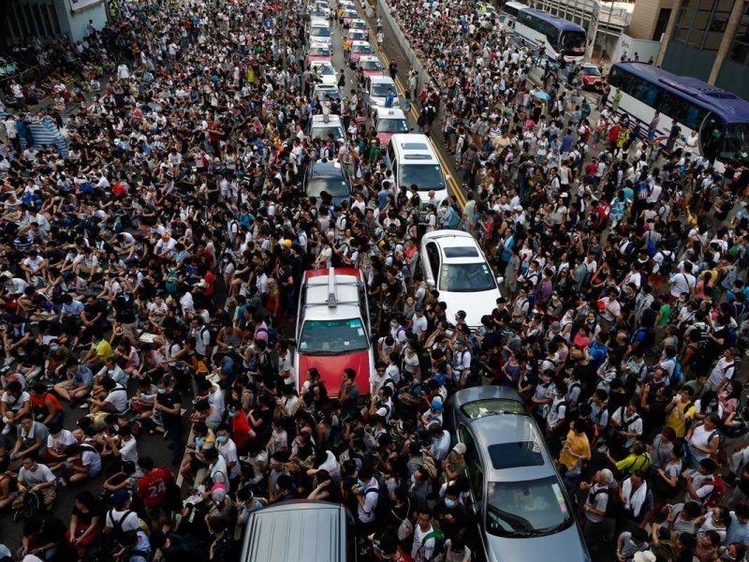
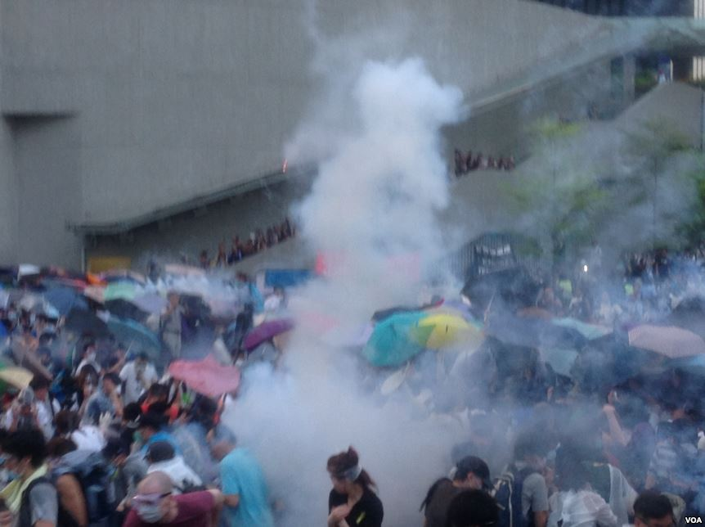
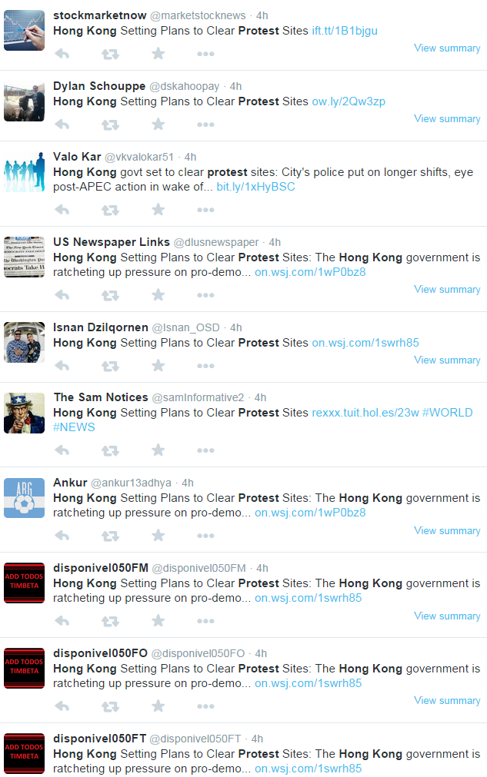
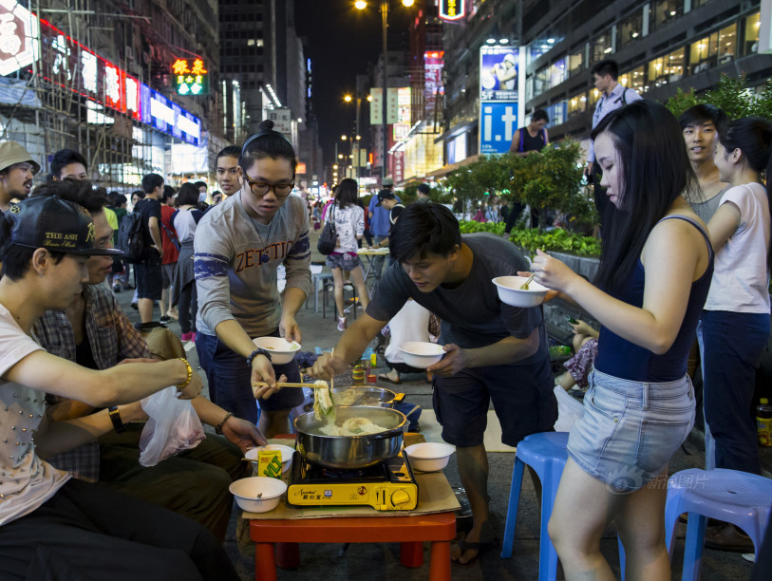
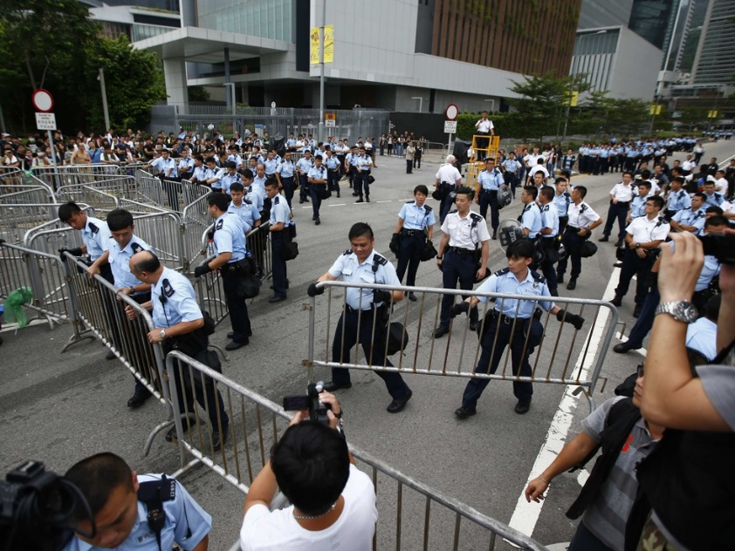
Notes:
2014 hong kong protest started because people in hong kong want to more democracy and trenspency in their leader election. In the course of 3 motnh, over 1 people has been protest in front of the government building and they ococuroeids mnay major city interesections. The event becaome very controvosial because since people block the city interestions. Many publisc transption has been shut doen. Also, police used tear gas to disperse protesteors, which causes questions like whtere police is over reactiong
As you can image, millions of social media responses has emerges…
Given events…

Slide 6
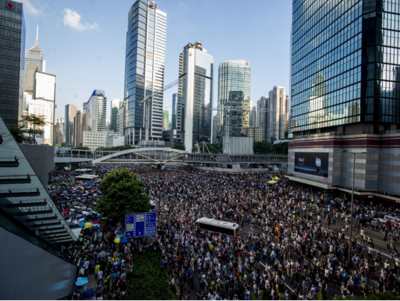

What were the topics of the event and tweets?

Slide 7
What were the crowd’s sentiments on event’s topics

Slide 8
?
How to recognize trending events from Twitter stream

Slide 9
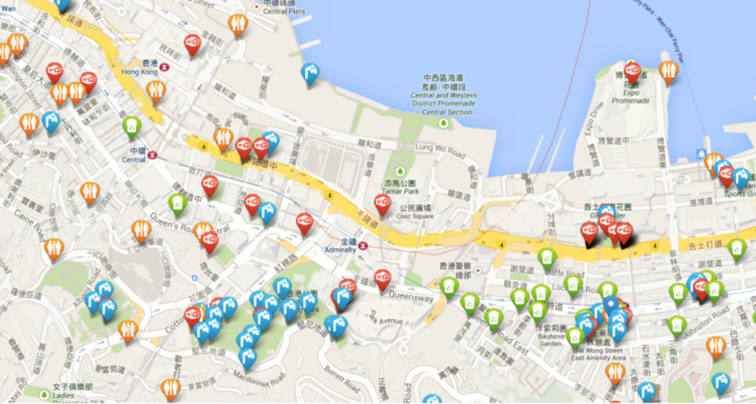
How to gather additional event information

Slide 10
How to find social media responses about the events
How to address these challenges?
How to model relations between event and its responses
How to link social media responses to events
How to infer topics and sentiments of social media responses
How to characterize the crowds’ behavior in response to events
How to distill insights about event based on social media responses

Slide 11
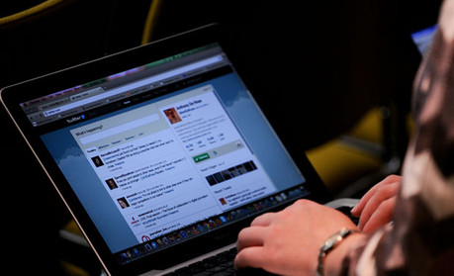
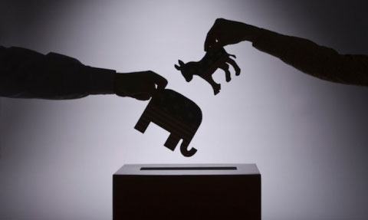
Applications
Computational Journalism
Political Campaign
… and civic engagement, event playback, storytelling, computational advertisement, strategic planning …

Slide 12
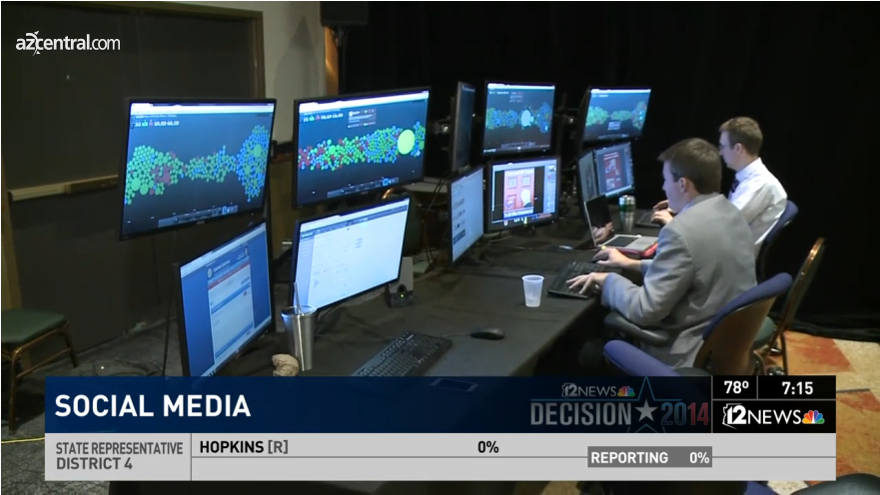
Event masters

Slide 13
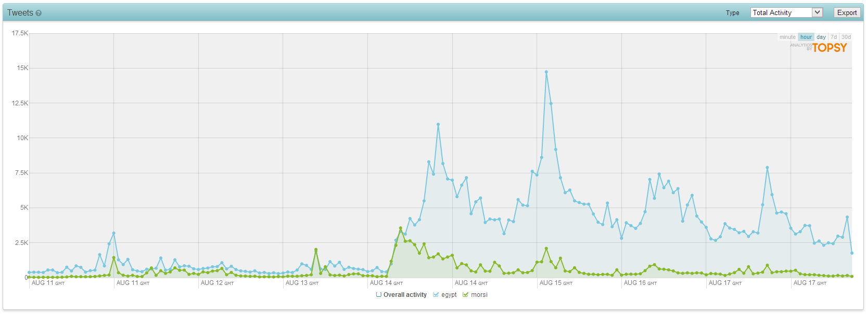
The fact: vast amounts of
social media responses
We need automated solutions!

Slide 14
Event Analytics on Social Media
Most existing event analytics solutions are primitive or ignore connections between events and responses
Given the vast amounts of social media responses and complex nature of events, we need automated tools to conduct in-depth analysis

Slide 15

Technical Contributions
EventRadar
Task 1: Event Characterization
Task 2: Event Recognition
Task 3: Event Enrichment
Learning event topics,
crowds’ sentiment, and responding behavior
Detecting trending events with associated tweets from Twitter
Gathering additional event information using a crowd

Slide 16
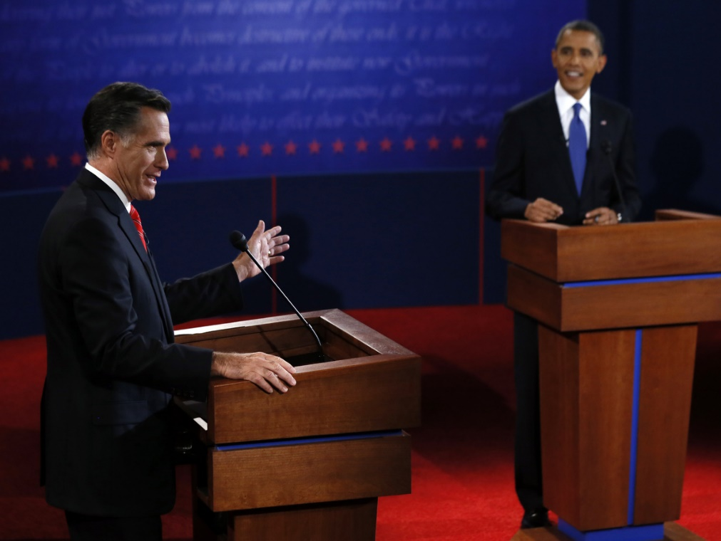
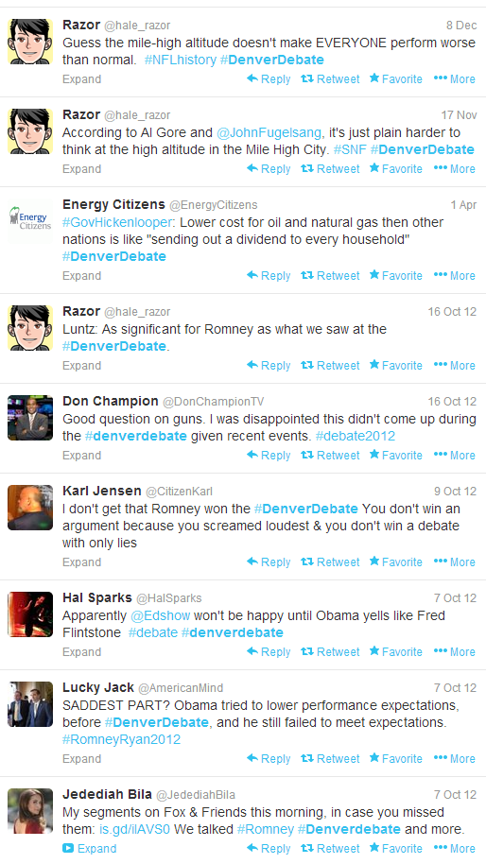
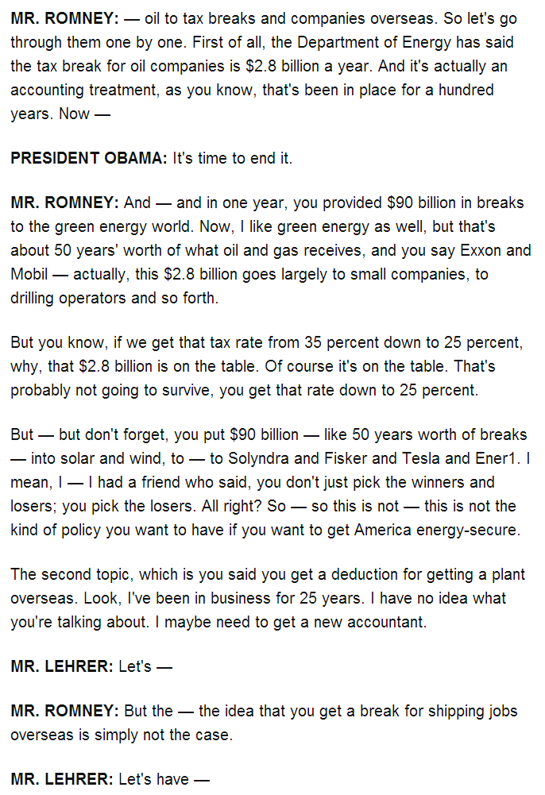
Specific
Specific
Specific
General
Specific
General
Specific
General
General
Inferring event/tweets’ topics, segment and responding behavior
(ICWSM’12, AAAI’12)
Task 1: Event Characterization

Slide 17







Specific
Specific
Specific
General
Specific
General
Specific
General
General
Inferring crowds’ sentiments w.r.t event topics/segments
(IJCAI’13)
Task 1: Event Characterization

Slide 18
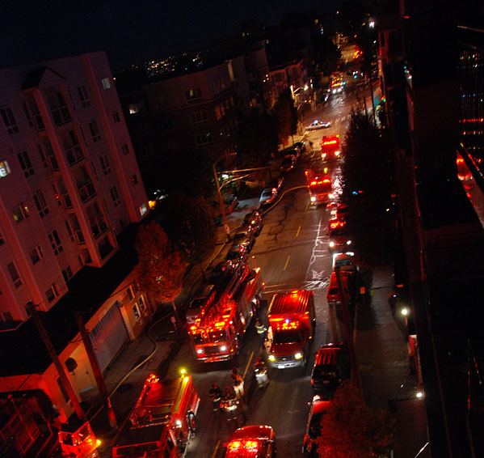
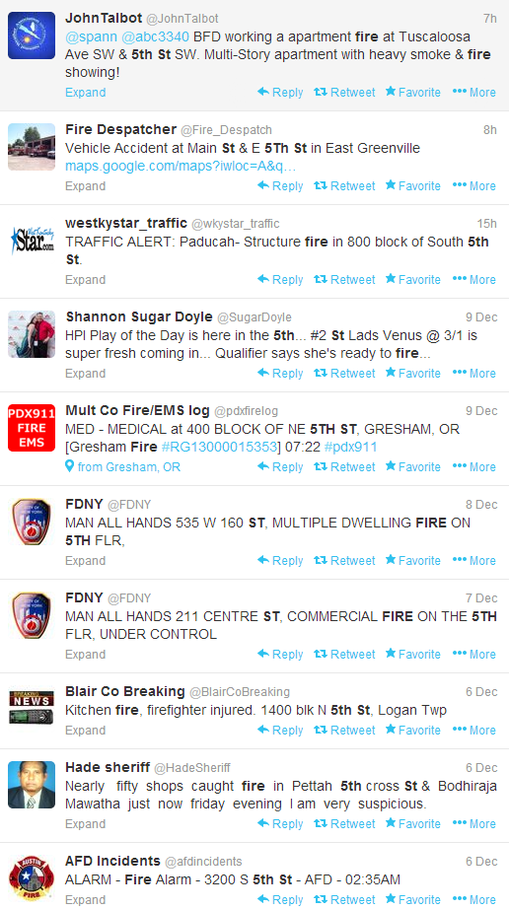
Fire happened at 5 St and Pike, heard sirens, lots smoke
Detecting events from Twitter stream
(CHI’13, best paper nomination)
Task 2: Event Recognition

Slide 19
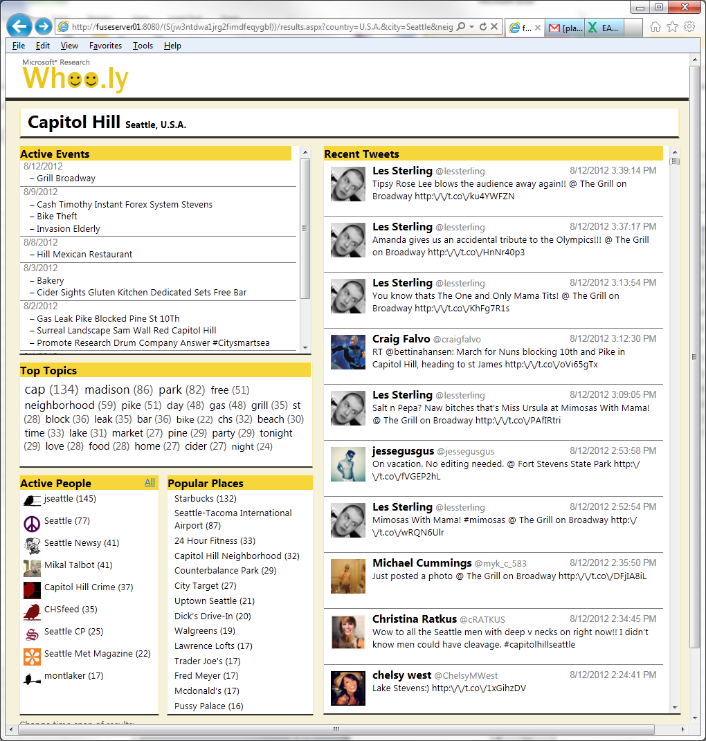
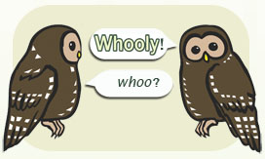
Facilitate information-seeking
for local communities
(CHI’13, best paper nomination)
Notes:
I am also interested acesssible system. In this respesitve, we develop whooly. Build on top of techniqeus of evnetics

Slide 20
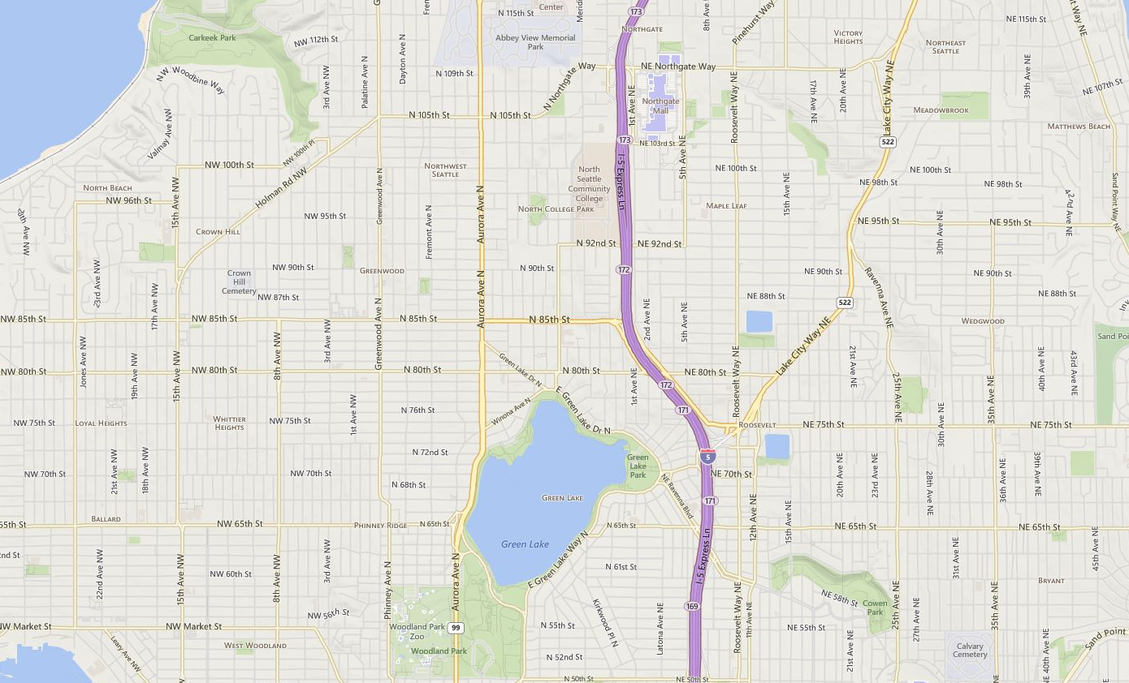

Task: take 5 photos
Location: S2
Reward: $5
Task: take 5 photos
Location: S2
Reward: $5
Task: take 5 photos
Location: S2
Reward: $5
Task: take 5 photos
Location: S3
Reward: $5
Task: take 5 photos
Location: S1
Reward: $5
Task: take 5 photos
Location: S4
Reward: $5
Planning in Support of Crowdsourcing Tasks in the Physical World
Task 3: Event Enrichment

Slide 21
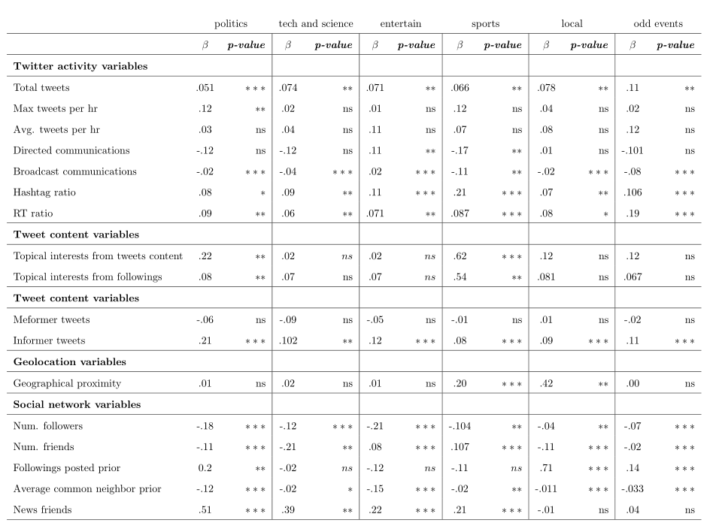
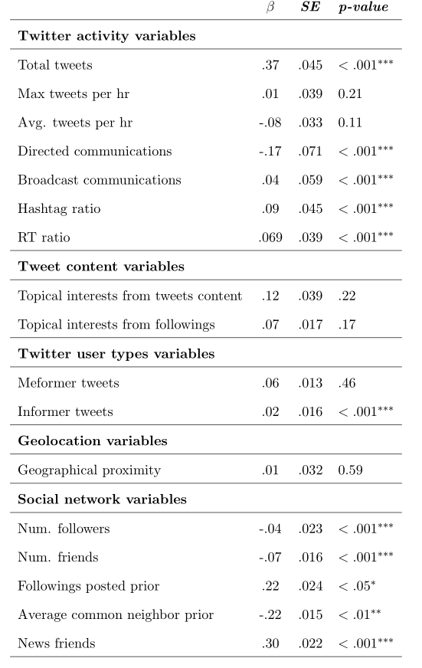
Scientific Contributions
A person post tweets about an event because they are interested in the topics pertaining to that event
A person engaged in the event because her friends are also posting tweets about it
Past activity will only affect the degree of the engagement
…
Understand Factors that Affect People’s Engagement with Events on Twitter

Slide 22
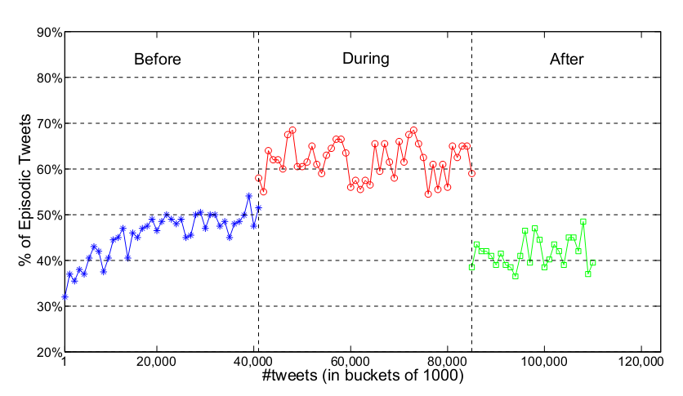
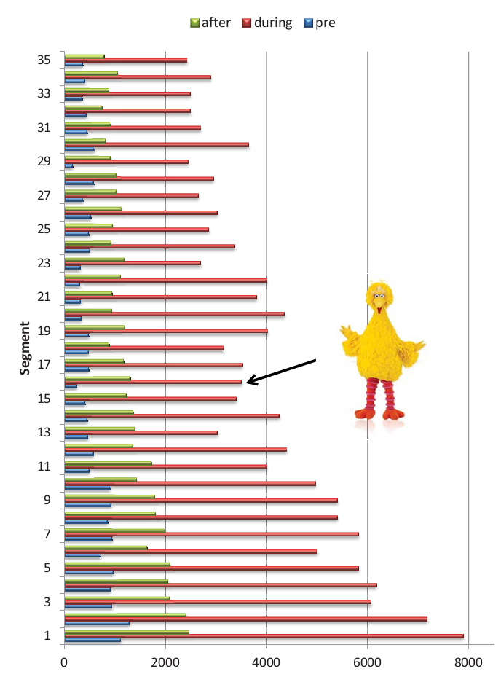
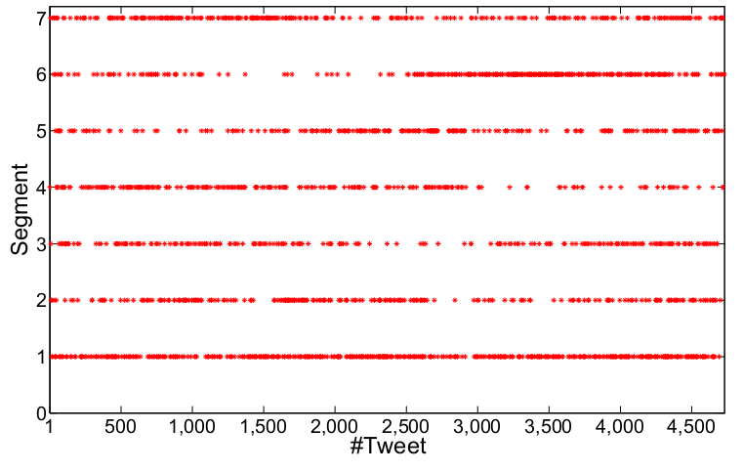
Scientific Contributions
Evolution of the Crowd’s Tweeting Behavior
Specific vs. General tweeting
Understand Patterns of People’s Engagement with Events on Twitter
Evolution of the Crowd’s Tweeting Behavior w.r.t segment

Slide 23
Summary of Contributions
Technical contributions:
We proposed EventRadar, an automated toolbox to handle three core event analysis tasks:
Event Characterization
  ET-LDA[AAAI’12, ICWSM’12, MMW’11], SocSent[IJCAI’13]
Event Recognition
  DeMa, and its application Whoo.ly[CHI’13]
Event Enrichment
  CrowdX system[under review]
  Instagram image understanding [ICWSM’14]
Scientific contributions:
We gained deep insights into:
Factors that affect people’s engagement with real-world events on Twitter
Patterns of people’s engagement with real-world events on Twitter

Slide 24

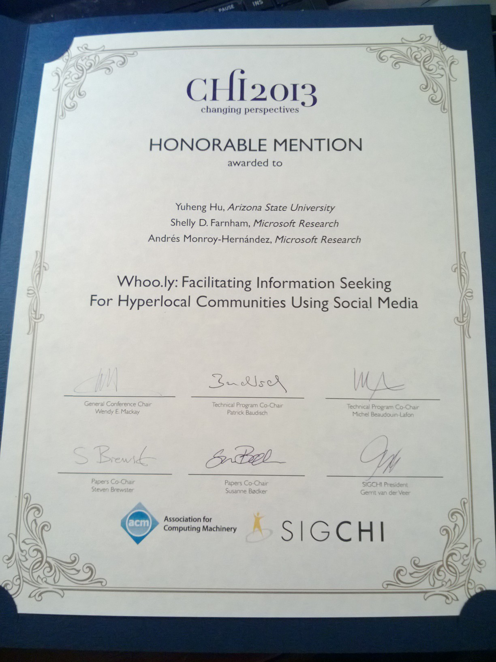
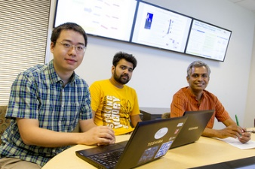
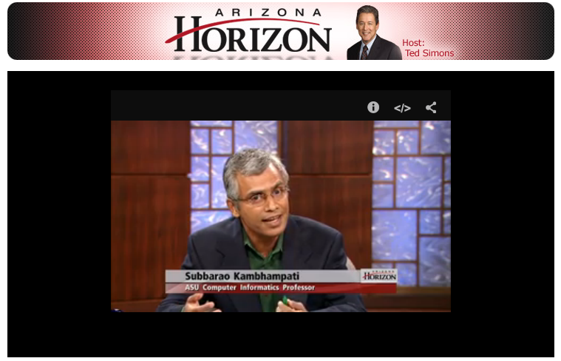








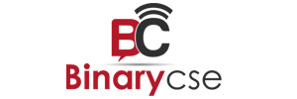

Selected Honors and Media Mentions
ASU Inner Circle
Letter from the President of ASU on my research
CHI 2013 best paper nomination

Slide 25
Outline
Event Analysis using EventRadar
  Event Characterization
    Learning topics, segments and event influences with ET-LDA
    Learning event sentiment with SocSent
  Event Recognition
    Detecting events from Twitter with DeMa
    Whoo.ly, an application of DeMa
  Event Enrichment
    Gathering event information with CrowdX
Insights about Event Engagement
  Factors Affect People’s Engagement with Events on Twitter
  Patterns of People’s Engagement with Events on Twitter

Slide 26
Outline
Event Analysis using EventRadar
  Event Characterization
    Learning topics, segments and event influences with ET-LDA
    Learning event sentiment with SocSent
  Event Recognition
    Detecting events from Twitter with DeMa
    Whoo.ly, an application of DeMa
  Event Enrichment
    Gathering event information with CrowdX
Insights about Event Engagement
  Factors Affect People’s Engagement with Events on Twitter
  Patterns of People’s Engagement with Events on Twitter

Slide 27
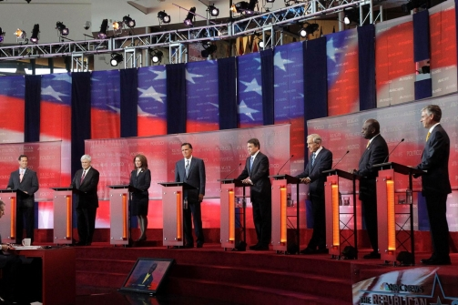
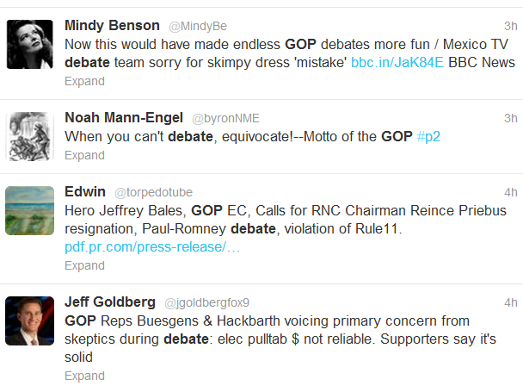
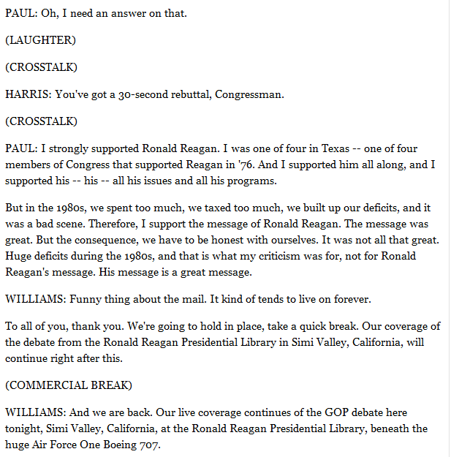
Event Characterization: Learning Topics, Segments and Influences
Republican Primary Debate
Tweets tagged with #ReaganDebate
?
?
?
What were the topics of the event and tweets?
What’s the relation between an event and tweets?
Which part of the event did a tweet refer to?
How to quantify the event’s influence on tweets?

Slide 28
Event Characterization: the Problem
Given an event’s transcript S, and its associated tweets T
Characterize the event in terms of its topics and segments, and its influences (w.r.t the nature and magnitude) on the crowds’ Twitter responding behavior
Requirements:
Extract topics in the event and tweets
Segment the event into topically coherent chunks
Establish the alignment between the event and tweets
Measure the influence of the event on its associated tweets

Slide 29
Event Characterization: the Challenges
  Both topics and segments are latent
Tweets are topically influenced by the content of the event. A tweet’s topics can be general (high-level and constant across the entire event), or speciﬁc (concrete and relate to speciﬁc segments of the event)
An event is formed by discrete sequentially-ordered segments, each of which discusses a particular set of topics

Slide 30

Event Characterization:
Possible Approaches
Applying existing event segmentation tools
e.g., time-windows
For each <tweet, segment> pair, measuring similarities e.g., TF-IDF
Counting related tweets for each segment
Unfortunately, these approaches are not able to discover latent topics/segments, besides they model event and its Twitter responses independently

Slide 31
Our Contribution: ET-LDA
ET-LDA is a hierarchical Bayesian model, which jointly models an event and its Twitter responses via their inter-dependency, i.e., topical influences
Event transcript
……………………………………....................
………………………………
………………………………………………………………
Yuheng Hu, Ajita John, Fei Wang, Subbarao Kambhampati. “ET-LDA: Joint Topic Modeling for Aligning Events and their Twitter Feedback.” In AAAI Conference on Artificial Intelligence (AAAI) 2012
Yuheng Hu, Ajita John, Doree Duncan Seligmann, Fei Wang. “What were the Tweets about? Topical Associations between Public Events and Twitter Feeds.” ICWSM’12
Yuheng Hu, Ajita John, Doree Duncan Seligmann. “Event Analytics via Social Media.” In Proc. ACM Multimedia 2011 Workshop on Social and Behavioral Networked Media Access (SBNMA) , 2011

Slide 32
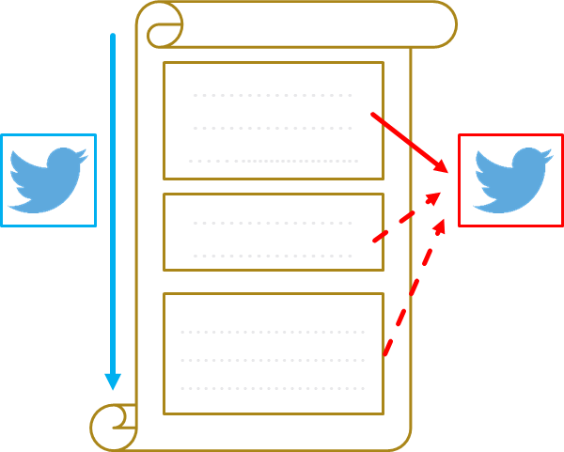
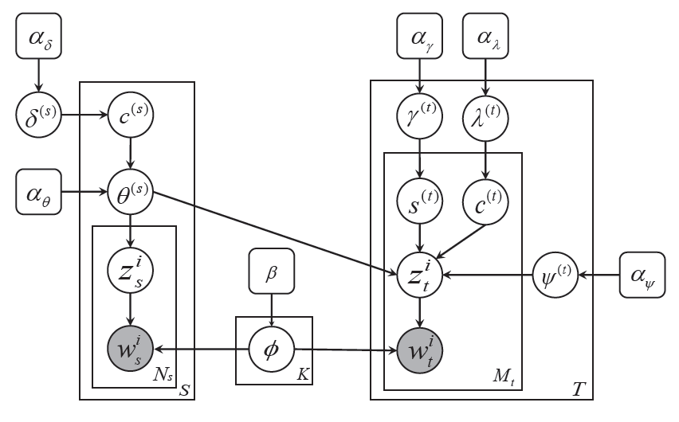
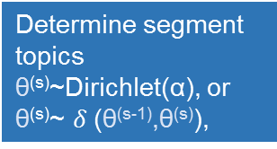
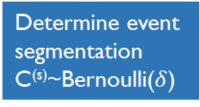
ET-LDA: Graphical Model
Event
Tweets
Determine event
segmentation
C^{(s)}~Bernoulli($δ$)
Determine segment
topics
θ^{(s)}~Dirichlet(α), or
θ^{(s)}~ $δ$(θ^{(s-1)},θ^{(s)}),
Determine which segment a tweet (word) refers to
S^{(t)} ~ Categorical(γ)
Determine tweet type
C^{(t)}~Bernoulli(λ)
Determine word’s topic in event
Z_{s}~multinomial(θ)
Tweets word’s topic
Z_{t}~multinomial(ψ) or
Z_{t}~multinomial(θ)
Notes:
in the event part, we assume that an event is formed by discrete sequentially-ordered segments, each of which discusses a particular set of topics
to do segmentatoin/model the topic evolutions in the event, we apply the Markov assumption on \theta(s),with some probability, it is as same as the distribution of topics of previous paragraph s-1, otherwise, a new distribution of topics \theta(s) is sampled from a dirichlet. This pattern of dependency is produced by associating a binary variable c(s). with each paragraph, indicating whether its topic is the same as that of the previous paragraph or different. If the topic remains the same, these paragraphs are merged to form one segment.
we assume that a tweet consists of
words which can belong to two distinct types of topics: general topics, which are high-level and constant across the entire event, and speciﬁc topics, which are detailed and relate to the segments of the event. As a result, the distribution of general topics is ﬁxed for a tweet. However, the distribution of speciﬁc topics keeps varying with respect to the development of the event.
each word in a tweet is associated with a distribution of topics. It can be either sampled from a mixture of speciﬁc topics \theta(s), or a mixture of general topics \psi(t) over K topics
depending on a binary variable c(t) sampled from a binomial distribution. In the ﬁrst case, \theta(s)
is from a referring segment s of the event, where s is chosen according to a categorical distribution s(t). An important property of the categorical distribution s(t) is to allow choosing any segment in the event. This reﬂects the fact that a person may compose a tweet on topics discussed in a segment that (1) was in the past (2) is currently occurring, or (3) will occur after the tweet is posted (usually when she expects certain topics to be discussed in the event)

Slide 33
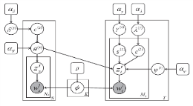
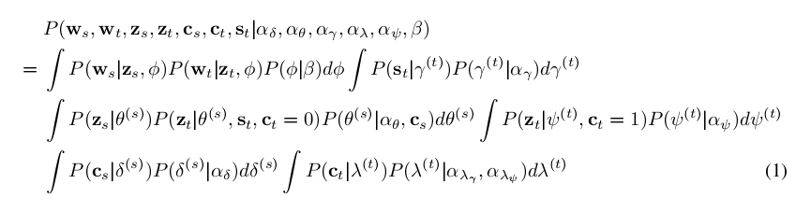

Inference in ET-LDA is HARD
We need to infer P(Z_{s}, Z_{t,} C_{s ,} C_{s,} S_{t} | W_{s}, W_{t} )
Unfortunately, model inference is intractable during coupling of hyperparameters. We need approximate inference algorithms. Here we use collapsed Gibbs sampling
How joint distribution looks like:
Gibbs sampling approximates the posterior distribution by iteratively updating each latent variable given the
remaining variables
Notes:
Show graph model here, learning parameters by gibbs

Slide 34
Evaluation of ET-LDA
 | MESpeech |  | ReaganDebate
 | ET-LDA | LCSeg | ET-LDA | LCSeg
P_{k} | 0.295 | 0.361 | 0.31 | 0.397
Segmentation Results
MESpeech
 | S1 | S2 | S3 | S4 | S5
ET-LDA | 0.49 | 0.51 | 0.56 | 0.58 | 0.63
LDA | 0.48 | 0.49 | 0.54 | 0.51 | 0.57
ReaganDebate
ET-LDA | 0.51 | 0.52 | 0.57 | 0.62 | 0.61
LDA | 0.48 | 0.49 | 0.51 | 0.51 | 0.58
Alignment Results
P_{k} = probability that a randomly chosen pair of words from the event will be incorrectly separated by a hypothesized segment boundary

Slide 35
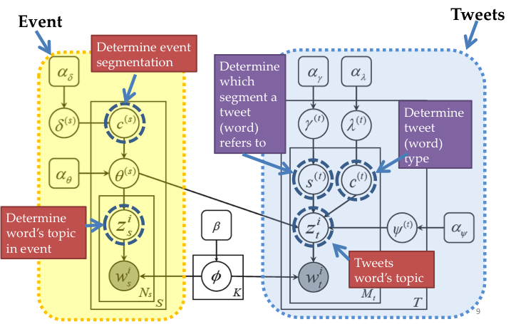
Summary of ET-LDA
Motivated joint event-tweet modeling for event analysis
ET-LDA can concurrently segment an event and classify two types of tweets: general and specific
ET-LDA can align specific tweets with segments
  Demonstrated that ET-LDA significantly outperformed the traditional models

Slide 36
Outline
Event Analysis using EventRadar
  Event Characterization
    Learning topics, segments and event influences with ET-LDA
    Learning event sentiment with SocSent
  Event Recognition
    Detecting events from Twitter with DeMa
    Whoo.ly, an application of DeMa
  Event Enrichment
    Gathering event information with CrowdX
Insights about Event Engagement
  Factors Affect People’s Engagement with Events on Twitter
  Patterns of People’s Engagement with Events on Twitter

Slide 37
Specific
Specific
Specific
General
Specific
General
Specific
General
What were the sentiments elicited by the segments and topics of the event on Twitter?
General
Applications: Event analysis, Stock market, Advertisement

Slide 38
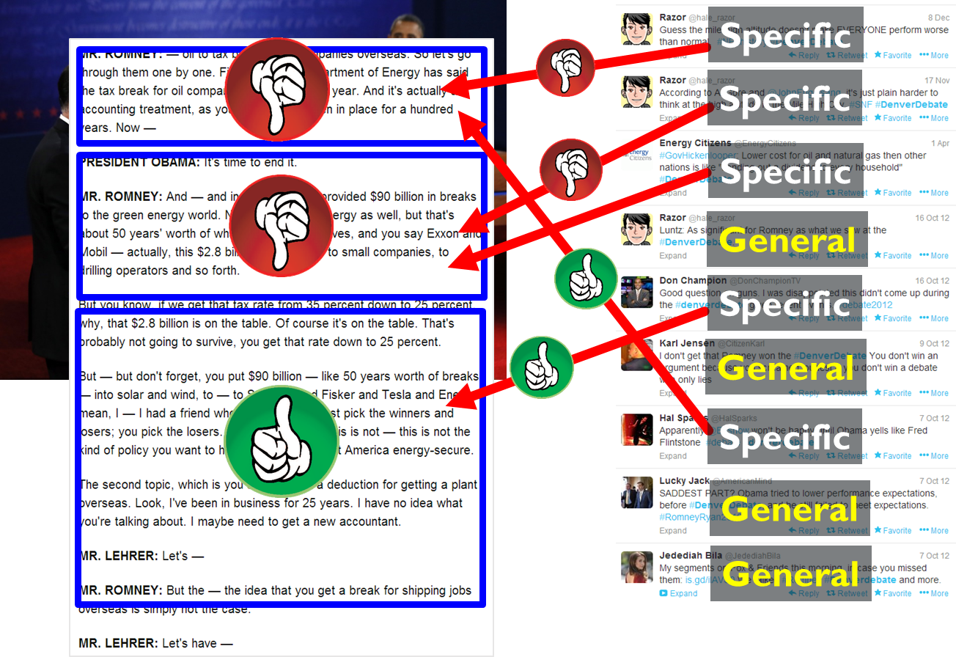
Aggregated Twitter Sentiment Analysis: the Problem
Given an event’s transcript S and its associated tweets T
Find the aggregated sentiments (positive or negative) about segment (s ∈ S) and topics of the event (k ∈ K) elicited on Twitter

Slide 39
Aggregated Twitter Sentiment Analysis: possible solution
  Main steps
  Manually label tweets with their sentiment orientation as training data
  Apply off-the-shelf sentiment classifiers, e.g., MinCut [Pang et al. 2002]
  Relate aggregated Twitter sentiment to segments and topics of the event that occur within ﬁxed time-windows around the tweets’ timestamps
  Is this sufficient?
  Unfortunately, NO..

Slide 40
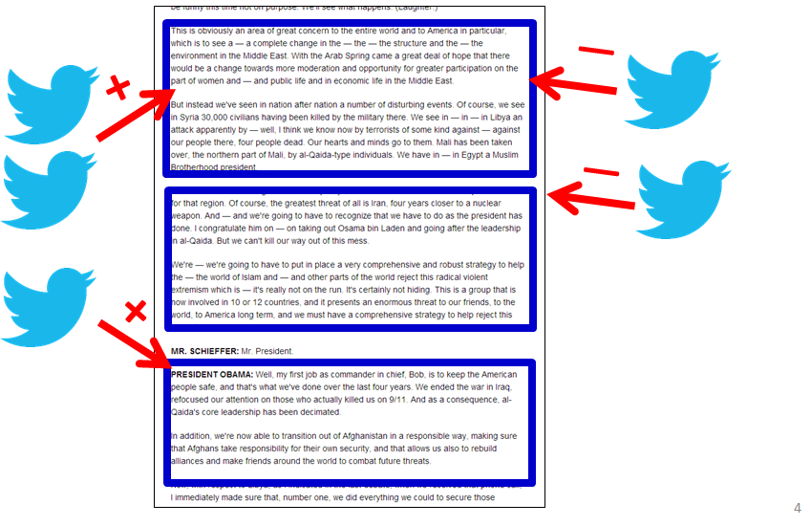
Aggregated Twitter Sentiment Analysis: Challenges
  C1. Difficult to relate Twitter sentiment to segments and topics of the event
    Fixed time-window approach is often not valid as presented in ET-LDA
  C2. Manually annotating sentiments of a vast amount of tweets is error-prone
    Present a bottleneck in learning high quality models
  C3. Twitter sentiment is conveyed with highly domain-speciﬁc contextual cues
    Can cause models to potentially lose performance and become stale
How to overcome these challenges?

Slide 41
Our Contribution: SocSent
Leverage prior knowledge to overcome the challenges
  ET-LDA to align tweets to the event → C1
  Labels for small sets of tweets → C2
  Sentiment lexicon → C3
SocSent incorporates prior knowledge into a matrix factorization framework, that learns factors in latent dimensions – segments, topics and sentiments (positive or negative) – of the event, as elicited on Twitter
Yuheng Hu, Fei Wang, Subbarao Kambhampati. “Listen to the Crowd: Automated Analysis of Events via Aggregated Twitter Sentiment.” In International Joint Conference on Artificial Intelligence (IJCAI) 2013

Slide 42
SocSent: Framework
segment
Regulation
From prior
segment
tweet
tweet
terms
topic
Tweet-event alignment from ET-LDA
segment
Regulation
From prior
sentiment
tweet
sentiment
tweet
factorization
topic
Labels for small tweets
sentiment
T
Regulation
From prior
sentiment
We require that the factors respect the prior knowledge to the extent possible.
term
term
Sentiment lexicon

Slide 43
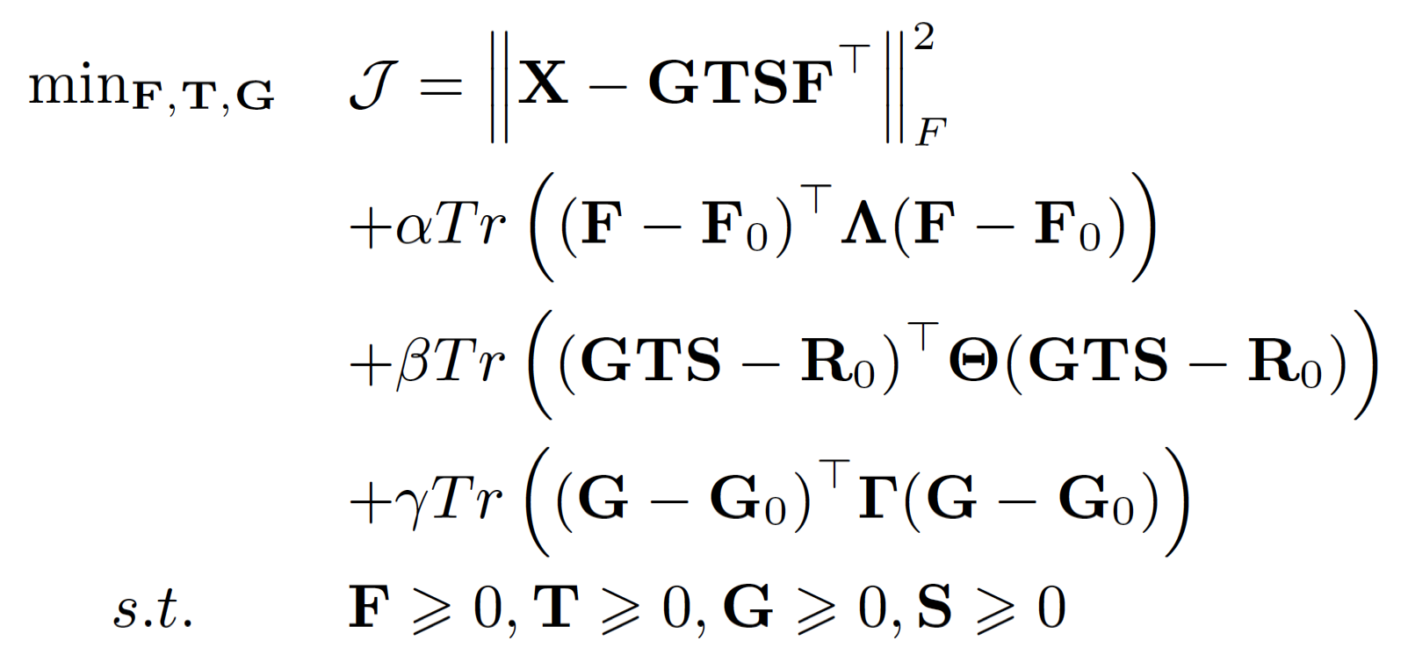
SocSent: Formal Formulation
G
G₀
T
X
R₀
S
F
F₀
R₀ regulates G, T and S together
T X S represents segment-sentiment matrix
G X T X S represents tweets-sentiment matrix
Notes:
in the event part, we assume that an event is formed by discrete sequentially-ordered segments, each of which discusses a particular set of topics
to do segmentatoin/model the topic evolutions in the event, we apply the Markov assumption on \theta(s),with some probability, it is as same as the distribution of topics of previous paragraph s-1, otherwise, a new distribution of topics \theta(s) is sampled from a dirichlet. This pattern of dependency is produced by associating a binary variable c(s). with each paragraph, indicating whether its topic is the same as that of the previous paragraph or different. If the topic remains the same, these paragraphs are merged to form one segment.
we assume that a tweet consists of
words which can belong to two distinct types of topics: general topics, which are high-level and constant across the entire event, and speciﬁc topics, which are detailed and relate to the segments of the event. As a result, the distribution of general topics is ﬁxed for a tweet. However, the distribution of speciﬁc topics keeps varying with respect to the development of the event.
each word in a tweet is associated with a distribution of topics. It can be either sampled from a mixture of speciﬁc topics \theta(s), or a mixture of general topics \psi(t) over K topics
depending on a binary variable c(t) sampled from a binomial distribution. In the ﬁrst case, \theta(s)
is from a referring segment s of the event, where s is chosen according to a categorical distribution s(t). An important property of the categorical distribution s(t) is to allow choosing any segment in the event. This reﬂects the fact that a person may compose a tweet on topics discussed in a segment that (1) was in the past (2) is currently occurring, or (3) will occur after the tweet is posted (usually when she expects certain topics to be discussed in the event)

Slide 44
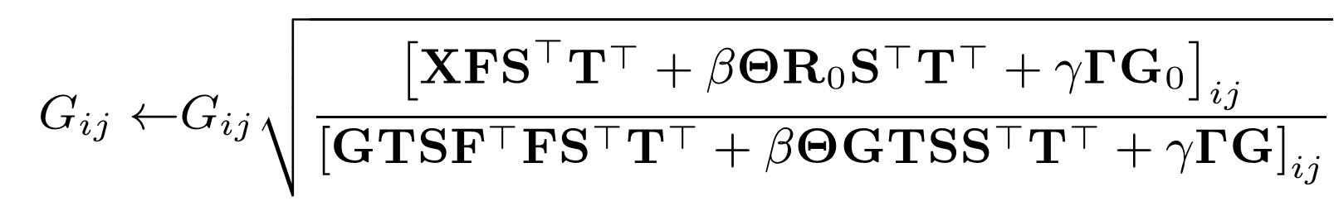
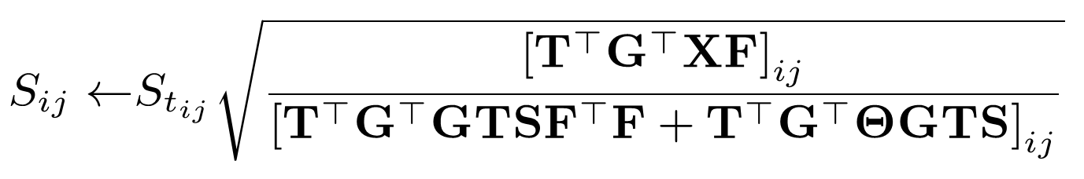
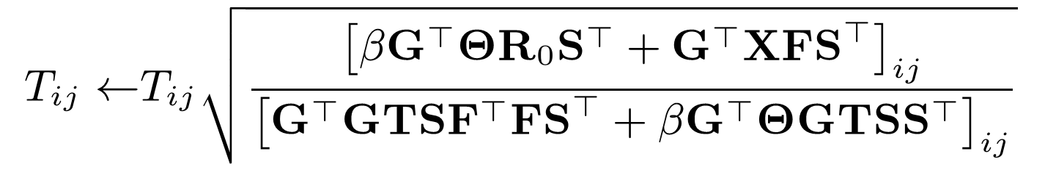
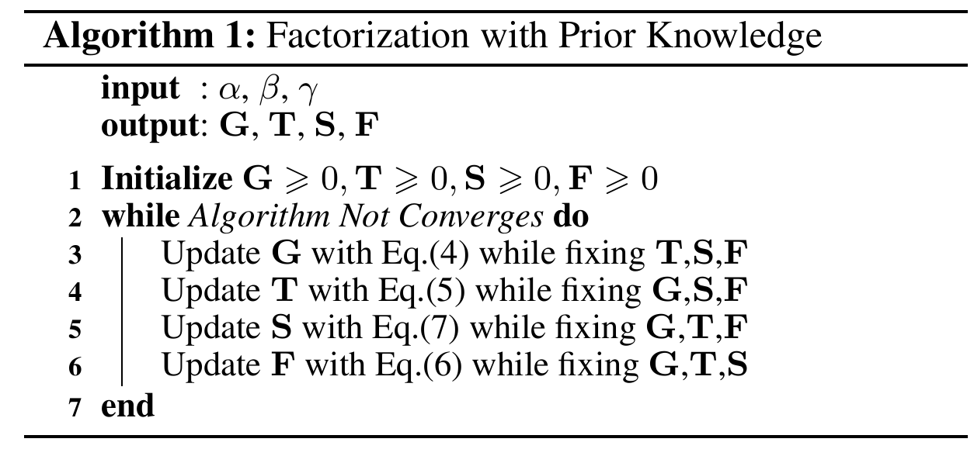
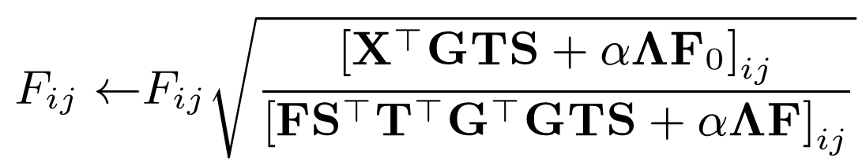
SocSent: Model Inference
Multiplicative update rules
The coupling between G, T, S, F makes it difﬁcult to ﬁnd optimal solutions for all factors simultaneously.
We adopt an alternating optimization scheme [Ding et al., 2006]
Convergence can be proved using Karush–Kuhn–Tucker conditions[Ding et al., 2006]
Notes:
Show graph model here, learning parameters by gibbs

Slide 45
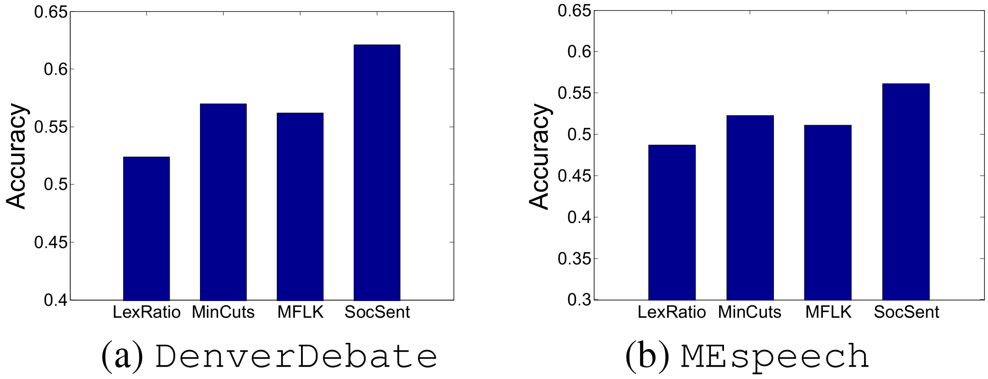
Evaluation of SocSent: Sentiment Classification of Event Segment
SocSent improves other approaches by 7.3% to 18.8%
Baselines:
LexRatio: Counts the ratio of sentiment words from subjectivity lexicon in a tweet to determine its sentiment orientation [Wilson et al., 2009]
MinCuts: Utilizes contextual information via the minimum-cut framework to improve polarity-classification accuracy [Pang and Lee, 2004]
MFLK: Supervised matrix factorization method [Li et al. 2009]
SocSent utilizes the partially available knowledge on tweet-event alignment from ET-LDA to improve the quality of sentiment classification in both events.

Slide 46
Summary of SocSent
Motivated low-rank representation of event-tweet sentiment analysis with prior knowledge acting as a regularizer
Developed SocSent Framework
Demonstrated that SocSent significantly outperformed the traditional models
Notes:
Put question, contact here

Slide 47
Outline
Event Analysis using EventRadar
  Event Characterization
    Learning topics, segments and event influences with ET-LDA
    Learning event sentiment with SocSent
  Event Recognition
    Detecting events from Twitter with DeMa
    Whoo.ly, an application of DeMa
  Event Enrichment
    Gathering event information with CrowdX
Insights about Event Engagement
  Factors Affect People’s Engagement with Events on Twitter
  Patterns of People’s Engagement with Events on Twitter

Slide 48
Event Recognition: the problem
Goals: detecting trending events and their associated tweets from a Twitter stream
State-of-the-art solutions: First story detection [Petrovic et al.], Clustering-based event detector [Becker et al.],Wavelet-based detector [Weng et al]
Drawbacks:
    Unable to locate the time periods when bursts happen
Unable to differentiate whether the detected new event is trivial or not
Domain-specific, can only detect certain types of events such as sports events

Slide 49
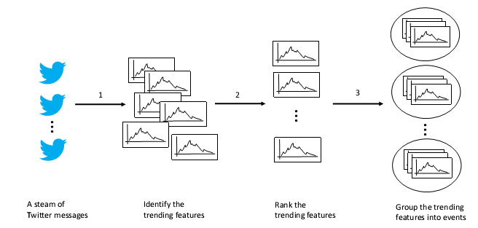
Our Contribution: DeMa

Slide 50
Identifying Trending Feature
Trending event identification
  Find an event where it consists of a set of topically-related trending features, at a given time, where features are terms in each tweets
Definition of Trending
  Trending – a time interval over which the rate of change of momentum is positive
Inspired by work in Finance and Time-series analysis
  EMA (Exponential Moving Average)
  MACD (Moving Average Convergence Divergence)
  MACD histogram

Slide 51

Ranking Trending Feature
EMA, MACD, MACD-histogram can be computed in linear time
But features may be trending up repeatedly
  “morning” can be trending from 8am – 11am everyday
Rank trending features by their novelty

Slide 52
Grouping Trending Feature
Multiple events can be trending within the same time period
We need a way to separate all trending features and group them into event clusters
We use Shared K-Nearest Neighborhood (SNN) clustering (distance defined by JS-divergence of two topical distributions)
A
B
C

Slide 53
Evaluation of DeMa
Methods | Accuracy | Events identified | False positives
DeMa | 0.78 | 684 | 17%
Fastest (Petrovic et al.) | 0.52 | 456 | 35%
OnlineCluter (Becker et al.) | 0.24 | 211 | 85%
Example Detected Events
Events | Terms | Time of trending
Westminster Dog Show | Westminster, dog, show, club | Oct 2nd 2012 10:10am
Gas leaked | Gas, Leak, Pike, 10th, St, Pine, Blocked, Siren | May 23rd 2012 9:55am
Sea Toy Fair | #Toyfairsea, Starwars, Hasbro, Lego | Aug 18th 2012 11:23am

Slide 54
Summary of DeMa
Developed DeMa, an unsurprised event detection algorithm for handling the Event Recognition task.
DeMa is able to find trending events with associated tweets from a Twitter stream
Demonstrated that DeMa significantly outperformed the state-of-the-art algorithm
Notes:
Put question, contact here

Slide 55
Facilitate Information seeking for local communities using Whoo.ly
Application of DeMa
Yuheng Hu, Shelly Farnham, Andrés Monroy-Hernández. Whoo.ly: Facilitating Information Seeking For Hyperlocal Communities Using Social Media. CHI’13 (best paper nomination)
Notes:
Whoo.ly (interested in both, toolbox issues, we first talk interface, design, evaluation of Whooly which uses eventics toolbox

Slide 56

Sirens blaring in your neighborhood

Slide 57

Check the local TV news

Slide 58

Check the local newspaper

Slide 59

Search will probably be fruitless
Notes:
the issue is significant important

Slide 60

Neighbors reporting relevant information on social media

Slide 61


Slide 62

Social media:
noisy
chaotic
hard to understand

Slide 63

Whoo.ly reveals latent neighborhood information

Slide 64


Filter from Twitter:
Events
Topics
People
Places

Slide 65

Mobile version
Notes:
Driven by four core journalistic questions:
what, who, where, when

Slide 66




Trending events
Top topics
Active people
Popular places

Slide 67

Neighborhood Information Seeking Task: Whoo.ly VS. Twitter
Recent events
Local neighborhood reporters
Neighborhood topics
Potential neighborhood friends
                (n=13)

Slide 68


Using Whoo.ly is easier to complete tasks
Interview after finishing tasks
R1: “Really liked it overall, definitely a lot easier to find stuff”
R2: “Twitter isn’t set up for a community. Whool.y functions amazingly for this.”
Whoo.ly is more useful, easy to use, has better overview of neighborhoods, and a sense of connection to communities

Slide 69

Summary
Whoo.ly, a local information gathering tool based on Twitter
Promising feedbacks from local residents
Notes:
Tools like Whoo.ly are beginning to uncover the future of computational civic media that we believe will be an important component of the information ecosystem.

Slide 70
Outline
Event Analysis using EventRadar
  Event Characterization
    Learning topics, segments and event influences with ET-LDA
    Learning event sentiment with SocSent
  Event Recognition
    Detecting events from Twitter with DeMa
    Whoo.ly, an application of DeMa
  Event Enrichment
    Gathering event information with CrowdX
Insights about Event Engagement
  Factors Affect People’s Engagement with Events on Twitter
  Patterns of People’s Engagement with Events on Twitter

Slide 71
How to gather additional event information

Slide 72

Event Enrichment using Crowdsourcing: Possible Solution
However In a real-world scenario:
Possible solution
For each event spot, a request will:
  Find a group of volunteers who are near the spot, e.g., see [Kazemi and Shahabi 2012]
  Assign them the event enrichment task
  Once volunteers complete their tasks, the collected data are sent back to the requester
Workers need to get rewarded
Due to limited budget, on what criteria should potential workers and spots be selected?
Task assignments (work-spot) have uniform utilities
Which worker is to be assigned
to which spot?
Workers may not accept and complete the task
How to quantify such uncertainty?

Slide 73
Our contribution: CrowdX
A utility-theoretic approach which considers workers and event spots jointly and selects worker-spot assignments that simultaneously maximize the overall utility, and achieve low cost within the given budget.
  A model to assess the non-uniform utility of each task assignment
  A model to estimate the expected cost of each worker
  A probabilistic model to quantify the worker’s uncertainty
An efficient algorithm which is guaranteed to provide near-optimal solution for the optimization problem.

Slide 74





CrowdX: Problem Formulation
A ground set of workers:
A ground set of event spots:
Worker-spot assignment:
A subset of all worker-spot assignments:
We want to solve the optimization problem:
Spots
s1
s2
s3
s4
B>0 : Budget
F(): Utility function
C(): Cost function
w1
w2
Workers
w3
w4

Slide 75



Modeling the Utility Function
The utility should have two properties:
Representativeness of the selected spots
  Informative L(W): we only need to dispatch workers to a few spots since what happens at these spots are informative enough to cover the whole event.
  Diverse R(W): an event often has multiple aspects. We can catch as diverse aspects as possible.
Quality of the selected workers
  The quality of the workers’ accomplishments.

Slide 76

Modeling the Cost Function
Since it is uncertain that u will accept and complete the assignment at s, we calculate the expected cost!
Many ways to define the cost c(u, s) such as unit cost, i.e., c(u,s)=1, or c(u,s) = exp(Dist(u,s)), the cost is exponentially proportional to the distance between worker u’s present location and spot s.

Slide 77








Quantifying the Uncertainty
By Bayes rule
Estimate the likelihood
Estimate the likelihood of speed
Based on Log-Normal distribution
Based on user history on CrowdX
Based on user history on CrowdX

Slide 78



Algorithm for CrowdX
NP-Hard
However, we can prove that F() is a submodular function:
L and R are submodular
Q is modular
Sum of submodular/modular functions is also submodular (Lovász 1983)

Slide 79


Scalability and Robustness
CrowdX improves other methods by 43% - 60%

Slide 80

Summary of CrowdX
Developed a crowdsourcing system CrowdX for spatial task
Developed greedy algorithm to solve the optimization problem
Demonstrated that CrowdX significantly outperformed the other models
Notes:
Put question, contact here

Slide 81
Outline
Event Analysis using EventRadar
  Event Characterization
    Learning topics, segments and event influences with ET-LDA
    Learning event sentiment with SocSent
  Event Recognition
    Detecting events from Twitter with DeMa
    Whoo.ly, an application of DeMa
  Event Enrichment
    Gathering event information with CrowdX
Insights about Event Engagement
  Factors Affect People’s Engagement with Events on Twitter
  Patterns of People’s Engagement with Events on Twitter

Slide 82

Thus far, we analyzed events using input social media data. Little is known about the input itself…

Slide 83
Understanding Factors that Affect People’s Engagement with Events on Twitter
Does a person post tweets about an event because they are interested in the topics pertaining to that event?
Are they instead engaged because their friends are also posting tweets about it?
Is their engagement a reflection of the fact that this is a local event happening in their neighborhood?
How and to what extent do the different topics of events affect the degree of a person’s engagement?
Potential applications: event recommendations, civic engagement, etc

Slide 84
Factors to be considered
Inspired by social science, linguistics, and computer-mediated communication, we collect factors that could potentially affect the person’s Twitter engagement in a real-world event from five broad categories:
Twitter activities (#tweets, maximum tweets per hour, etc)
Tweets’ topics (Topical interests from tweets’ content, etc)
Twitter user types (Meformer, Informer, etc)
  Geolocation (Geographical proximity, etc)
Social network structure (#following, #follower, common neighbors, etc)
Dependent Variables
Presence of a person’s Twitter engagement
  Whether or not a person tweet about the event (1 or 0)
Degree of a person’s Twitter engagement
  Number of tweets a person posted

Slide 85
Twitter Data Collection
Event detection from Twitter firehose (20M from June to Sept 2014) using DeMa event detection
Obtain Events’ geolocations manually
  Annotator read tweets and google for location
Obtain Twitter Users’ Geolocation
  Location inference algorithm [Mahmud et al 2014]
  Diurnal pattern verification
  Manual verification
Results
  406 event clusters with geolocations (86% in U.S)

Slide 86
Results
Does a person post tweets about an event because they are interested in the topics pertaining to that event?
  Yes, people like to repeatedly talk about the topics that they are most familiar with/interested in. Therefore, they will show deeper engagement in those specific topics, in contrast to boarder and more general topics.
Are they instead engaged because their friends are also posting tweets about it?
  It is mixed conditioned on the type of event that the user is engaging with, such as local events. We confirm [Zuniga et al 2010] that social ties is a strong predictors of the civic engagement.
Is their engagement a reflection of the fact that this is a local event happening in their neighborhood?
  Mixed, certain kinds of events such as local events and sports events
How and to what extent do the different topics of events affect the degree of a person’s engagement?
  Different genres of events affect the degree of engagement: political, entertainment, and science & technology events depend more on the content of past tweets; engagement with sports and local events tends to correspond more closely with the user’s geolocation.
Notes:
Bonding (5 items, scale alpha=0.75) includes “There are
several people I trust to help solve my problems”

Slide 87

Understanding Patterns of People’s Engagement with Events on Twitter
rapid increase from 33% to 54%
Controversial topic mentioned, the responses were pronounced
most responses were either tangential or about the high-level themes
Insight 1: crowds’ responses tended to be general and steady before the event and after the event, while during the event, they were more specific and episodic.

Slide 88

Tweeting Behavior during Engaged Events
People can also talk about things which are expected to be discussed later
People can talk about things that have been discussed before or being discussed currently
ET-LDA alignment
Insight 2: topical context of the tweets did not always correlate with the timeline of the event – an event segment can be referred to by specific tweets at any time irrespective of whether it has already occurred or is occurring currently or will occur later on

Slide 89
Summary of Contributions
( Toolbox, Insights)
Event analytics on social media is important
Technical contributions: EventRadar, a powerful event analytics system toolbox to handle three event analysis tasks: Event Characterization (via ET-LDA & SocSent), Event Enrichment (via CrowdX), and Event Recognition (via DeMa). We also developed Whoo.ly, an application of DeMa to facilitates information seeking for local communities
Scientific contributions: Insights into factors that affect people’s engagement with real-world events and patterns of people’s tweeting behavior

Slide 90


Other work
Instagram Content and User Behavior Analysis [ICWSM’14]
Helped Organize the First ever Instagram Photo Content
Comprehensive Analysis on Twitter’s Linguistics [ICWSM’13]
Bayesian Model for data cleaning
[BigData’14]
Query Processing on Deep Web Databases
  [ICDE’10,TKDE’11]
Applying AI planning in Crowdsourcing
  [HCOMP’13]

Slide 91

Publications
Yuheng Hu, Lydia Manikonda, Subbarao Kambhampati. “What We Instagram: A First Analysis of Instagram Photo Content and User Types.” ICWSM'14 [Covered in ABCnews, Yahoo News, Marketing blog]
Sushovan De, Yuheng Hu, Yi Chen, and Subbarao Kambhampati, “BayesWipe: A Multimodal System for Data Cleaning and Consistent Query Answering on Structured Data”, IEEE BigData’14
Yuheng Hu, Fei Wang, Subbarao Kambhampati. “Listen to the Crowd: Automated Analysis of Events via Aggregated Twitter Sentiment.” IJCAI’13 [Covered in AZ Horizon], Cite: 6
Kartik Talamadupula, Subbarao Kambhampati, Yuheng Hu, Tuan Nguyen, Hankz Hankui Zhuo. “Herding the Crowd: Automated Planning for Crowdsourced Planning” HCOMP’13 Cite:5
Yuheng Hu, Kartik Talamadupula, Subbarao Kambhampati. “Dude, srsly?: The Surprisingly Formal Nature of Twitter's Language.” ICWSM'13 [Covered in ASU News] Cite: 8
Yuheng Hu, Shelly Farnham, Andrés Monroy-Hernández. “Whoo.ly: Facilitating Information Seeking For Hyperlocal Communities Using Social Media.” CHI’13 (Best Paper Honorable Mention) [Covered in Seattle Times, FastCompany] Cite: 12
Yuheng Hu, Ajita John, Fei Wang, Subbarao Kambhampati. “ET-LDA: Joint Topic Modeling for Aligning Events and their Twitter Feedback.” AAAI’12 Cite: 17
Yuheng Hu, Ajita John, Doree Duncan Seligmann, Fei Wang. “What were the Tweets about? Topical Associations between Public Events and Twitter Feeds.” ICWSM'12 Cite: 28
Yuheng Hu, Ajita John, Doree Duncan Seligmann. “Event Analytics via Social Media.” SBNMA’11 Cite: 2
Vagelis Hristidis, Yuheng Hu, Panagiotis G. Ipeirotis. “Relevance-based Retrieval on Hidden-Web Text Databases without Ranking Support.” TKDE’11 Cite: 5
Vagelis Hristidis, Yuheng Hu, Panagiotis G. Ipeirotis. “Ranked Queries over Sources with Boolean Query Interfaces without Ranking Support.” ICDE’10. Cite: 8

Slide 92


















Acknowledgement
Rao Kambhampati
ASU
Kartik Talamadupula
ASU
Sushovan De
ASU
Tuan Nguyen
ASU
Lydia Manikonda
ASU
Yi Chen
New Jersey Inst. of Tech
Ajita John
Avaya Labs
Doree D. Seligmann
Avaya Labs
Fei Wang
IBM Research
Hankui Zhuo
Sun Yat-set Univ.
Vagelis Hristidis
UC Riverside
Munmun De Choudhury
Georgia Tech
Shelly Farnham
MSR
Eric Horvitz
MSR
John Krumm
MSR
Andres Monroy-Hernandez
MSR
Panos Ipeirotis
New York Univ.
David McDonald
Univ. of Washington

Slide 93
Backups

Slide 94
ET-LDA: Generative Process
Foreach paragraph s in S
  draw a segment choice indicate C^{s}
  if C^{s} = 1 then draw a new topic mixture for s
  else then topic of s is as same as the topic of previous paragraph s-1
  Foreach tweet t in T
  draw a topic changing indicate C^{t}
  if C^{t} = 1 then draw a new topic for t
  else then
  draw a paragraph s
  assign topic mixture of s to t

Slide 95
Prior Knowledge in SocSent
segment
Obtain G₀ sentiment lexicon from ET-LDA inference. Each row represent n_{t} tweets and its columns represent n_{s} segments of the event. the content is the posterior probability of a tweet referring to the segments.
G₀
0.53 | 0.2 | 0.01 | …
0.05 | 0.5 | 0.3 | …
0.4 | 0.23 | 0.21 | …
0.06 | 0.2 | 0.12 | …
tweet
sentiment
F₀
0 | 1
1 | 0
0 | 1
0 | 1
Obtain F₀ sentiment lexicon from MPQA corpus. F₀(i, 1) = 1 if word i is possible, and F₀(i, 2) = 1 for negative sentiment
term
sentiment
R₀
1 | 0
1 | 0
0 | 1
0 | 1
Ask people to label the sentiment for a few tweets (e.g., less than 1000) for the purposes of capturing some domain-speciﬁc connotations
tweets
Notes:
Apply a lexicon normalization technique (Han et al. EMNLP 2011) to overcome irregular English usage and out-of-vocabulary words in Twitter.

Slide 96
Identify Trending Feature:
An Example
  Given a feature F (e.g., “fire”) and its time series S = S(F) = {f₁, f₂, … f_{m}}
fire
tweet volume
11/08 8am
11/08 12pm
Time
11/13 12pm

Slide 97

Identify Trending Feature:
An Example
Present
Past
fire
N₁ = 5 EMA
tweet volume
n₂ = 10 EMA
11/08 8am
11/08 12pm
Time
11/13 12pm

Slide 98

Identify Trending Feature
MACD – Difference between the n₁- and n₂- hour EMA for S(F)
MACD histogram – Difference between F’s MACD and its signal line
Signal line
MACD
Up-trends start
Down-trends start
MACD histogram

Slide 99
Design Process of Whoo.ly
Two rounds design:
Examined local news paper, community blogs, existing hyperlocal sites (e.g. nextdoor).
Examined Twitter data (1.2M tweets from 50K people who claimed Seattle as their hometown)
Findings:
People (8%) talk about their city/neighborhoods on Twitter (7% tweets)
People talked about mostly local events (55%), personal (13%), check-ins (10%)
Data Collection:
GPS data: Very limited (0.6%)
Profile matching + daily patterns: 1) matching profile with keywords like “Seattle”, “Sea”, and 2) so on Verify location with the daily patterns
Shelly Farham, Michal Lahav, Social Media and Neighborhood Well-being 2013

